Slide 1
Candidiasis

Slide 2
Definition:
One of the most common
oppurtunistic infections

Slide 3
Agents:
Candida spp.> 150 species
Frequent pathogens for human:
1-Candida albicans
2-C.glabrata
3-C.krusei
4-C.kefyr
5-C.guilliermondii

Slide 4
6-C.parapsilosis
7-C.tropicalis
8-C.lusitaniae
9-C.dubliniensis (A new species,1998)
10-C.inconspicua (Azole-resistant species)

Slide 5
Ecology:
Normal commensals of humans:
Skin, GI tract, sputum, female genital canal, urine
High incidence of carriage on the skin of health care workers

Slide 6
C.albicans:
Two serotypes:
A and B (Mannan components)

Slide 7
Typing methods:
Recent attempts:
Restriction enzyme profiles
KaryotypingAnd other molecular techniques: PCR
C.albicans, C.langeronii, and C.stellatoidea are synonyms.

Slide 8
Predisposing factors:
1-Physiological:
Age
Pregnancy

Slide 9
2-Hematological:
AIDS
Leukemia
Lymphoma

Slide 10
3-Endocrinological:
Diabetes Mellitus
Hypoparathyroidism
Addison’s disease

Slide 11
4-Iatrogenical
Antibiotics
Oral contraceptives
Steroids
Intravenous catheters :
Chemiotherapy
Organ transplantation

Slide 12
Iatrogenical:
Implantation of prosthetic devices:
Cardiac valves
Artificial heart
Use of heroin
Use of hyperalimentation fluids
Abdominal surgery

Slide 13
5-Impaired epithelial barrier:
Burns
Hydration
Maceration
Dentures
Antibiotics

Slide 14
6-Other factors:
Hypovitaminosis A

Slide 15
Pathogenesis:
Maceration
Myeoperoxidase
Hydrogen peroxide
Superoxide anion

Slide 16
Pathogenesis:
Proteases
Phospholipases
Adherence capabilities
Germ tube

Slide 17
Clinical manifestations:
1-Mucocutaneous
2-Deep organ involvement
1-Mucous membrane infections
2-Cutaneous candidiasis syndromes

Slide 18
Mucous membrane infections
Oral candidiasis
Candida esophagitis
Gastrointestinal candidiasis
Candida vaginitis

Slide 19
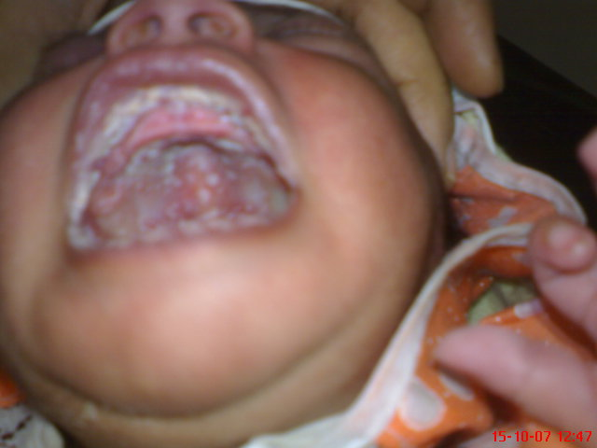
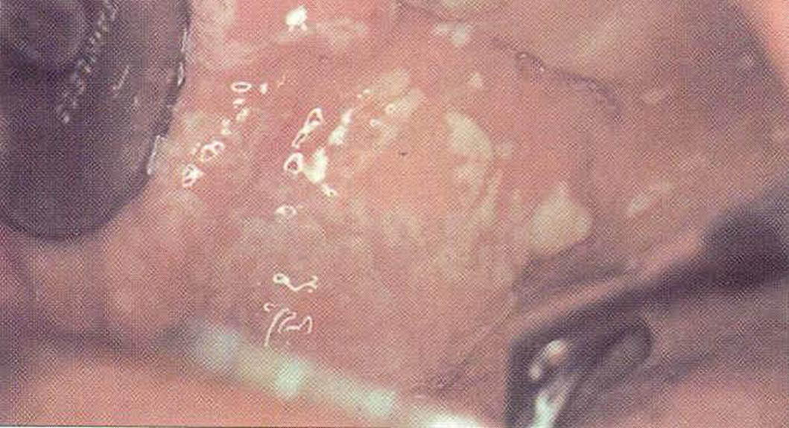
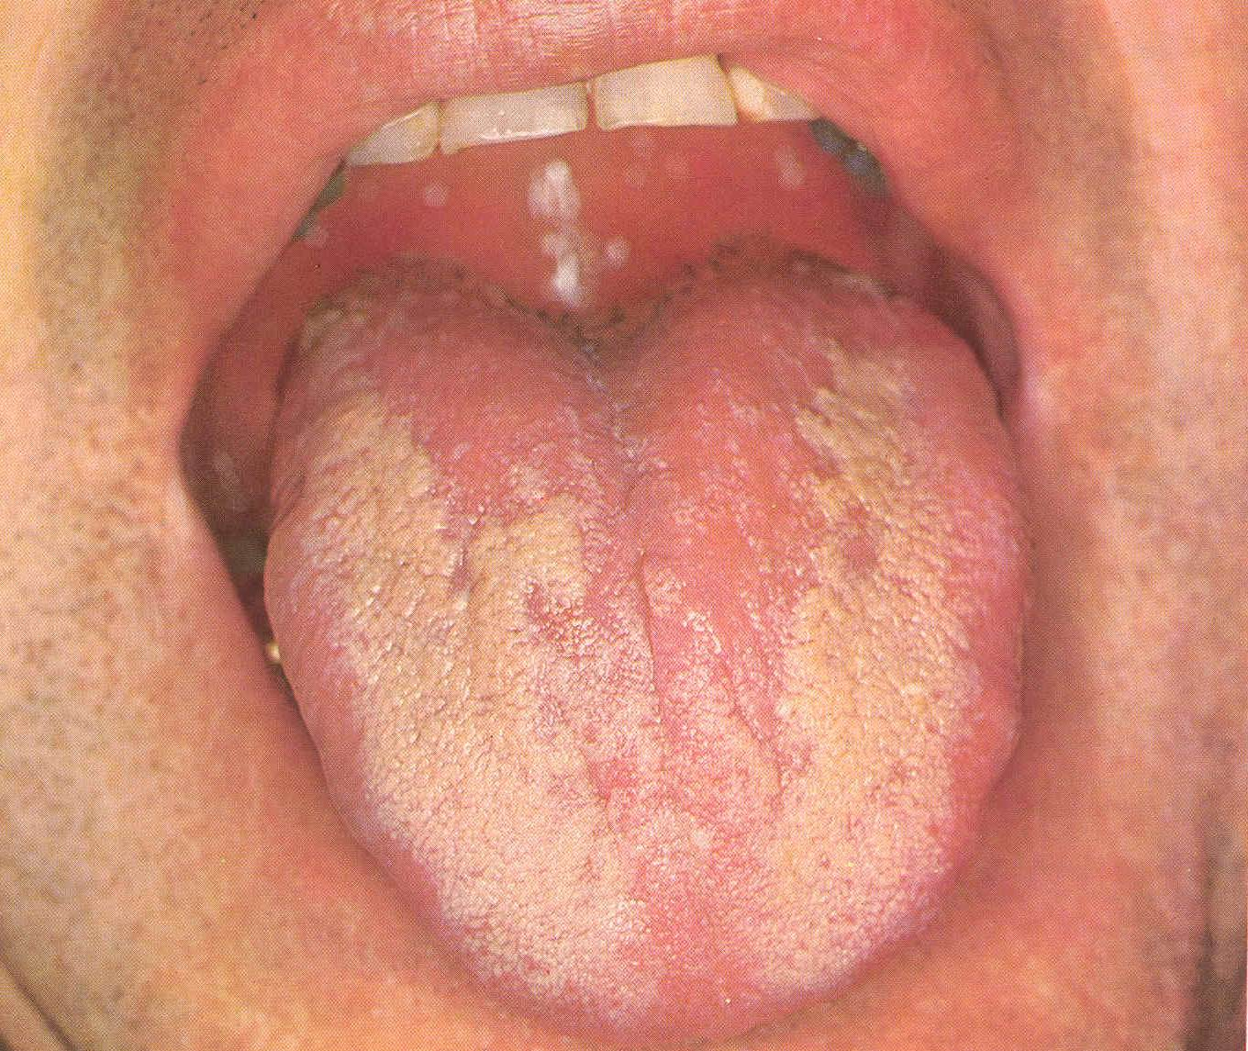
Oral candidiasis
1.Thrush
(Acute pseudomembranous candidiasis)

Slide 20
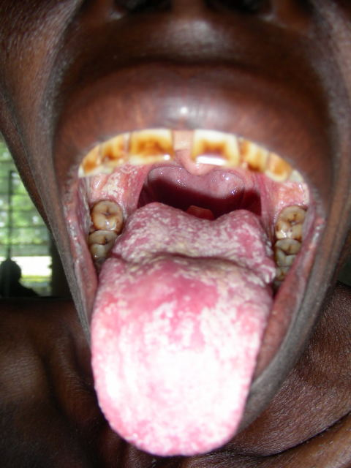
Extensive oral infection with Candida albicans -HIV

Slide 21
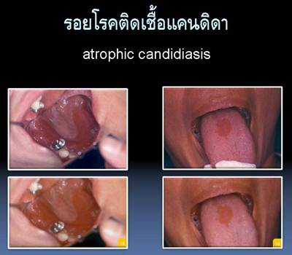
2-Acute atrophic candidiasis

Slide 22
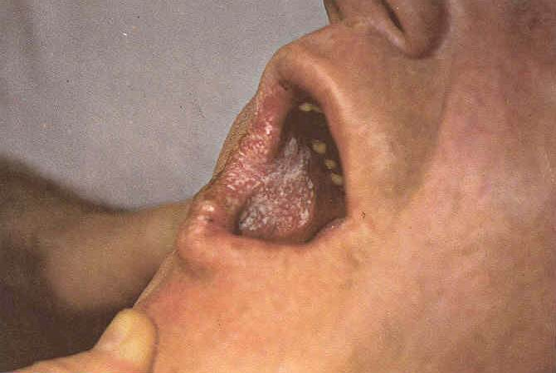
3-Chronic atrophic (Denture stomatitis)

Slide 23
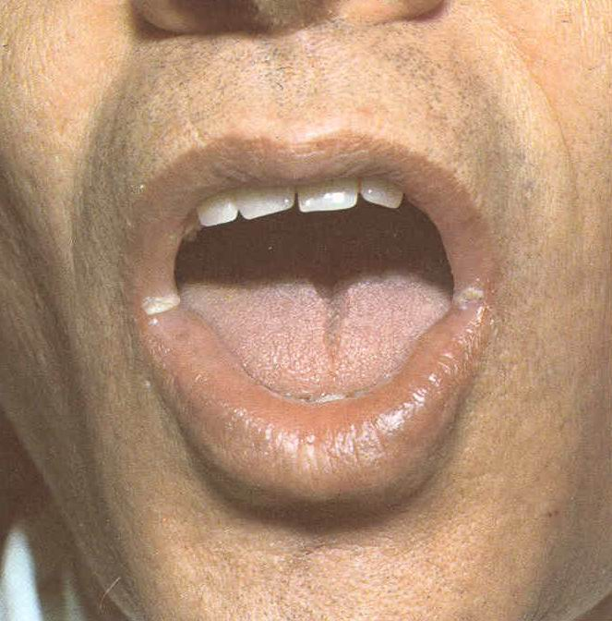
4-Angular cheilitis (Perleche)

Slide 24
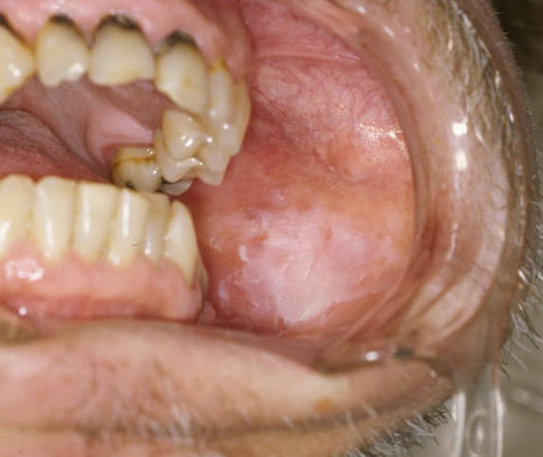
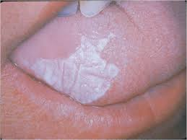
5. Candida leukoplakia
precancerous

Slide 25
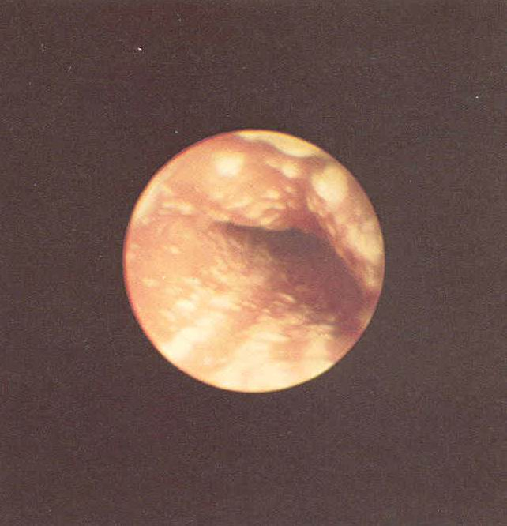
Candida esophagitis
Malignancy of the hematopoietic or lymphatic systems
AIDS

Slide 26
Gastrointestinal candidiasis
Neoplastic patients, autopsy
Stomach
Small bowel
Large bowel

Slide 27
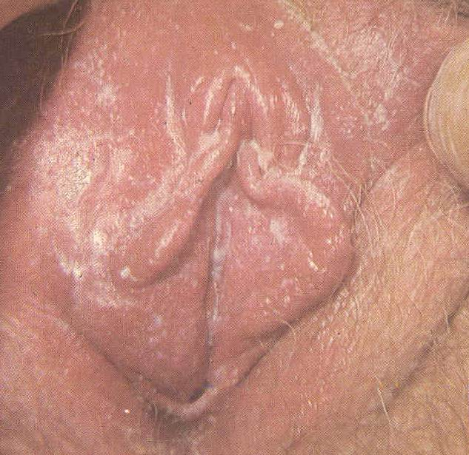
Candida vaginitis

Slide 28
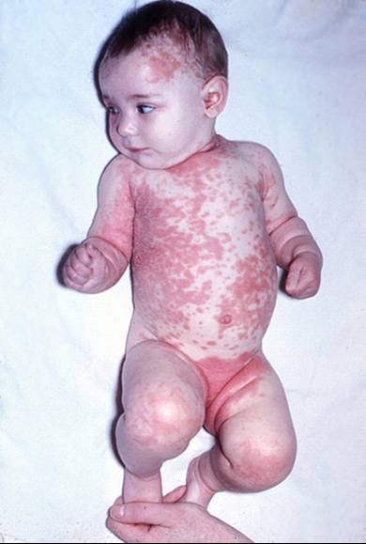
Generalazed cutaneous candidiasis
Generalazed
candidiasis

Slide 29
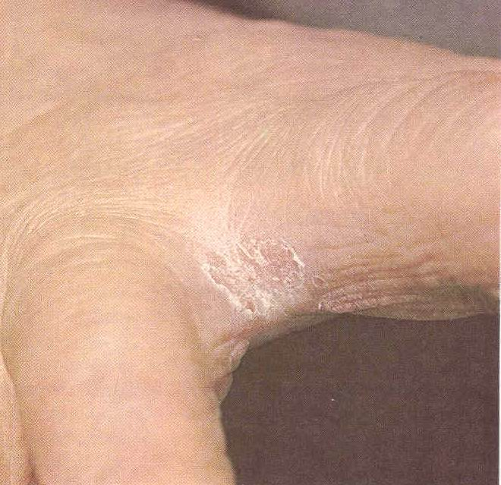
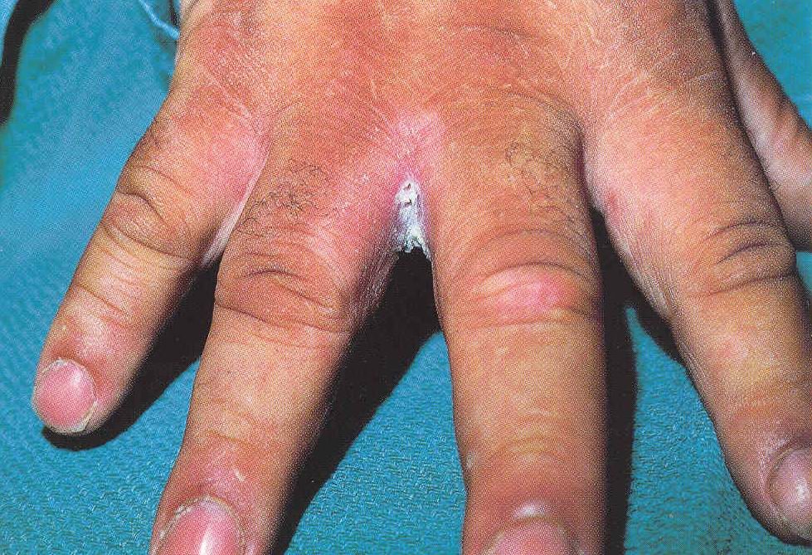
2. Erosio interdigitalis blastomycetica

Slide 30
Interdigital candidiasis of the feet

Slide 31
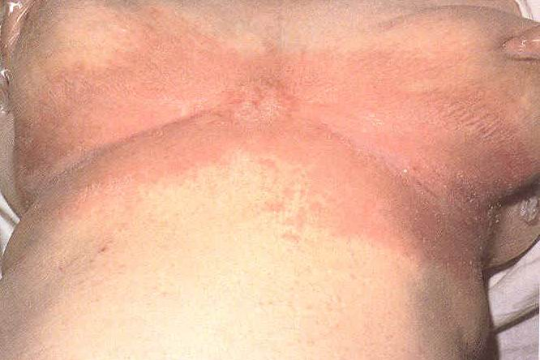
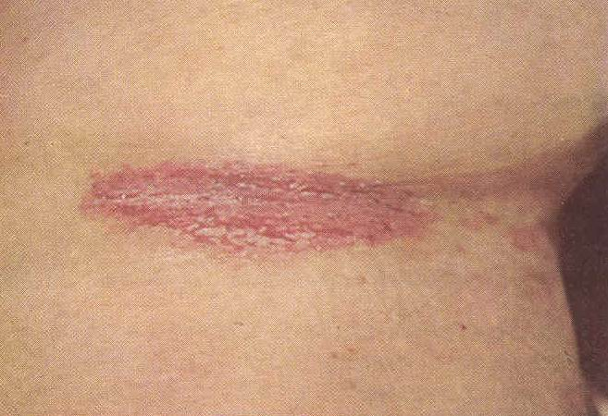
3. Candida Intertrigo (Intertriginous candidiasis): satellite lesions

Slide 32
4. Candida balanitis (diabetes mellitus)

Slide 33
5. Cutaneous lesions of disseminated candidiasis

Slide 34
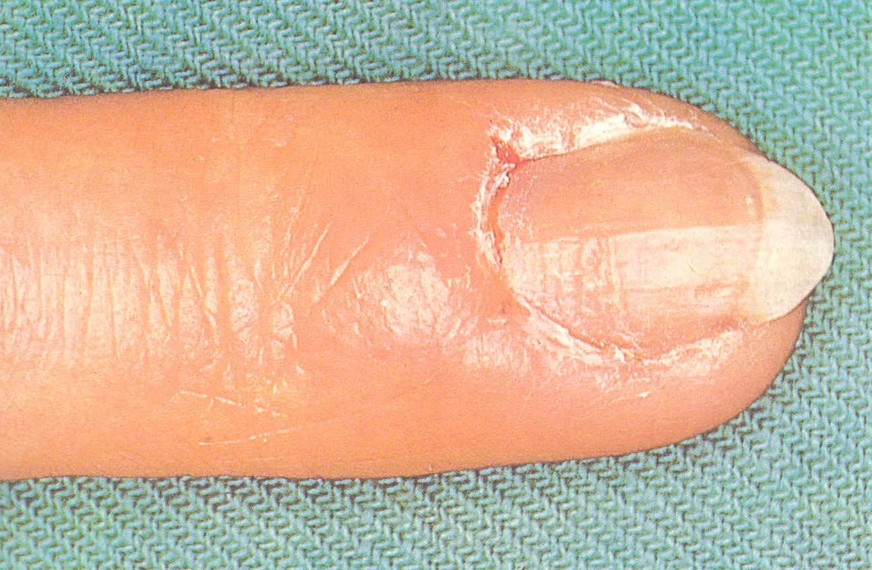
6. Paronychia and onychomycosis
Paronychia

Slide 35
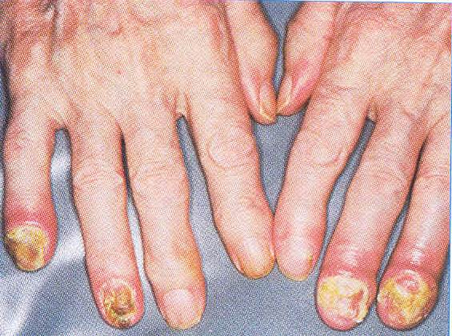
Onycholysis (Onychia)

Slide 36
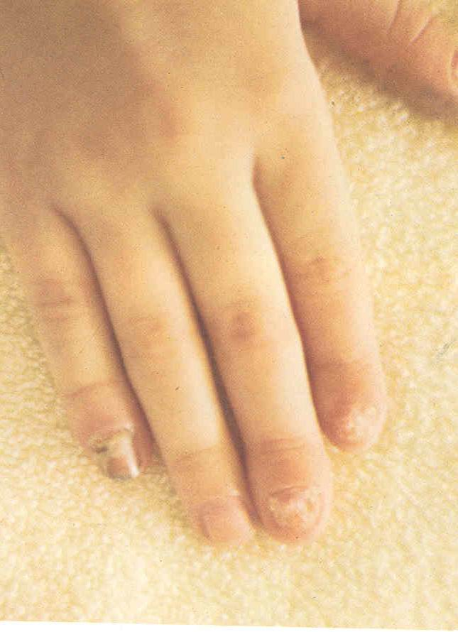
Candida granuloma

Slide 37
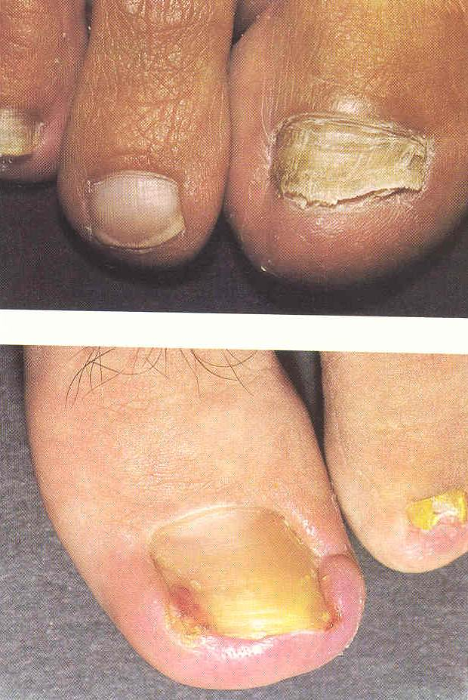
Tinea unguium

Slide 38
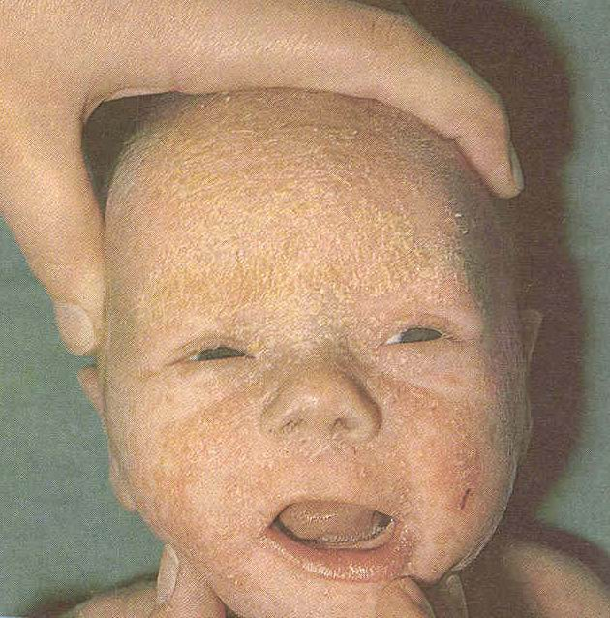
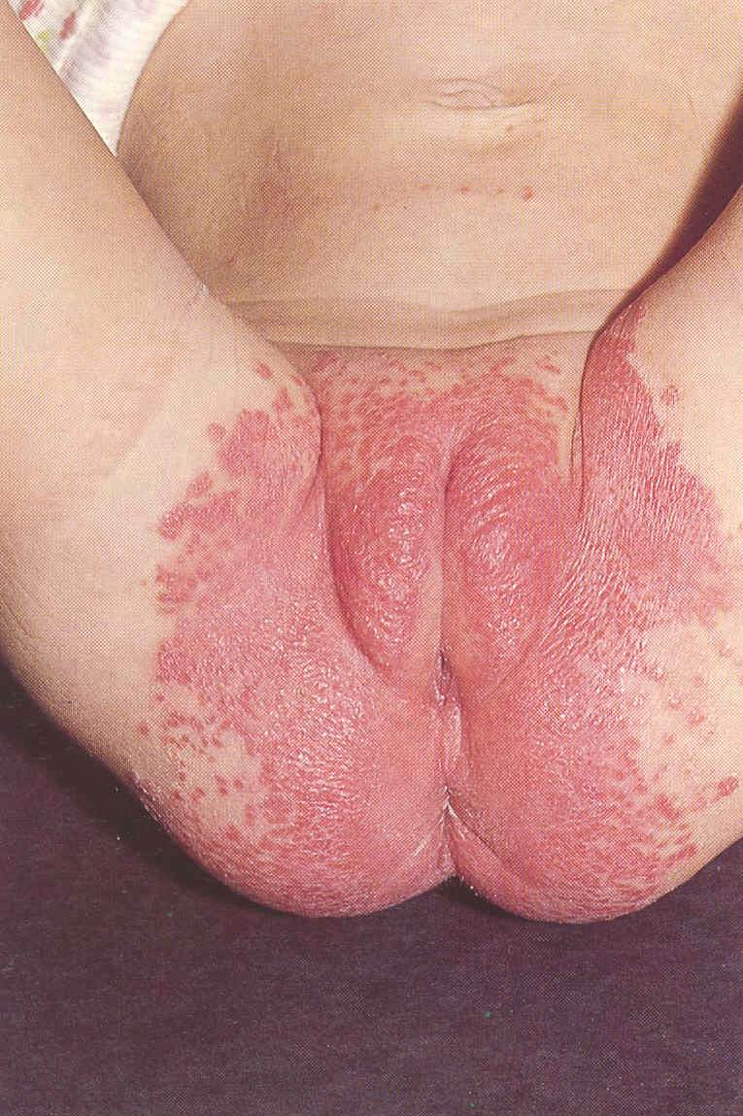
7. Diaper rash (Candida diaper dermatitis)

Slide 39
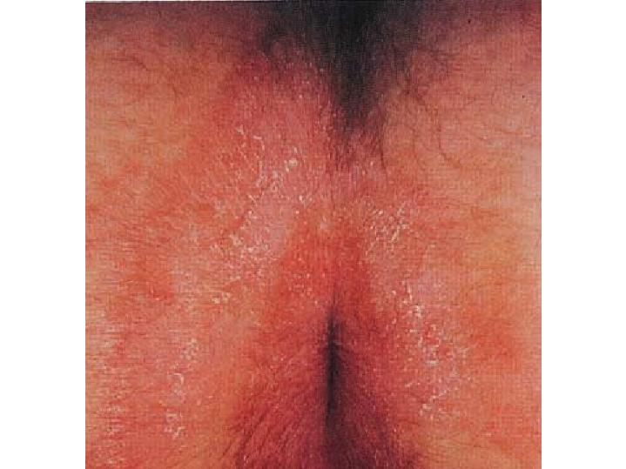
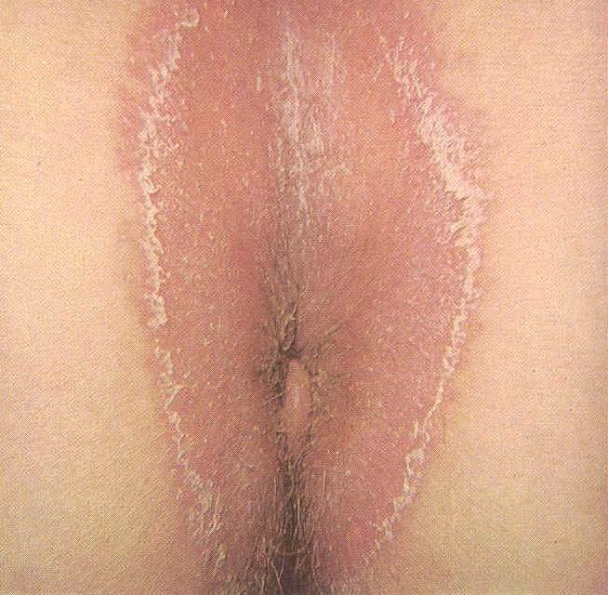
8. Perianal candidiasis

Slide 40
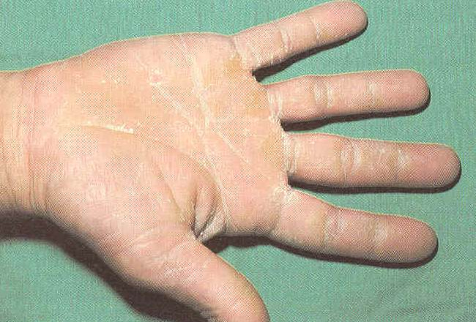
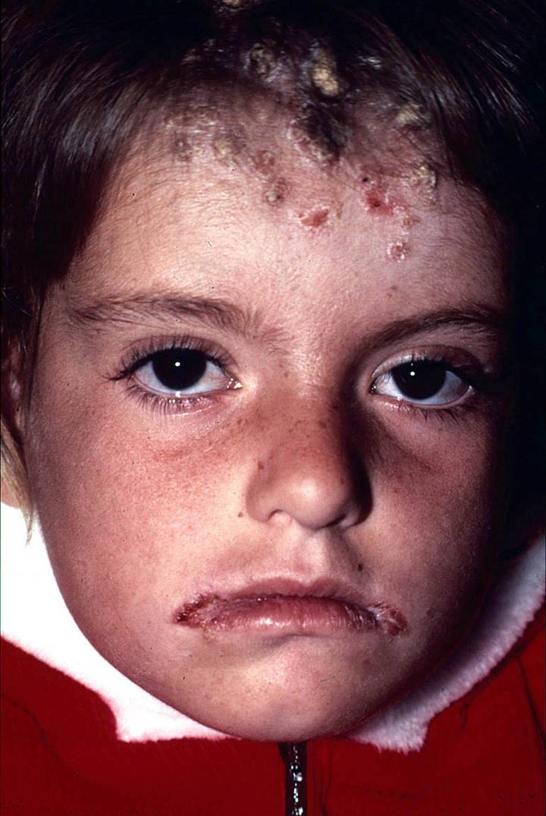
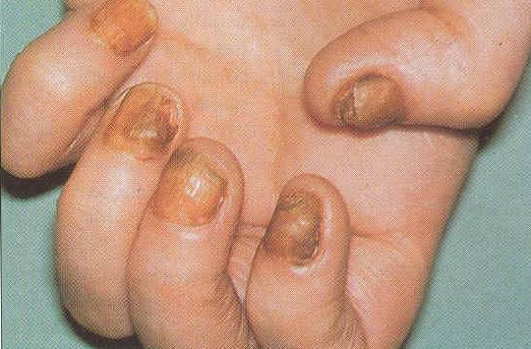
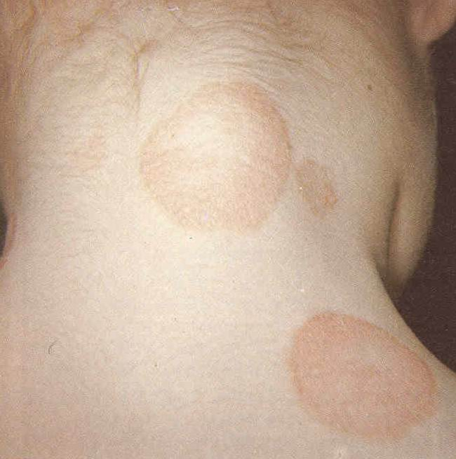
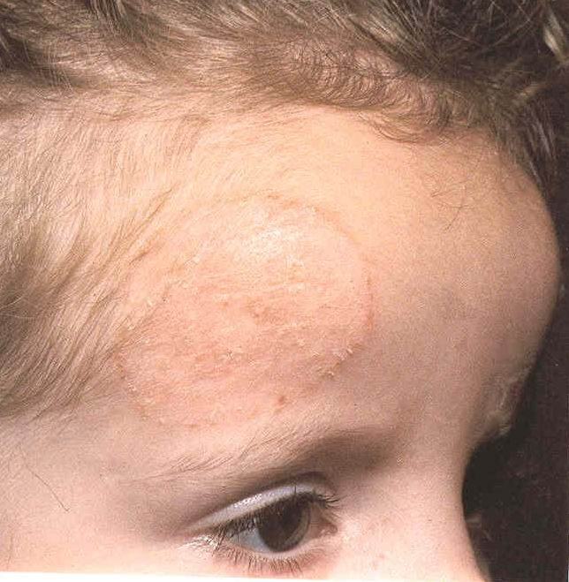
9. Chronic Mucocutaneous Candidiasis (CMCC):

Slide 41
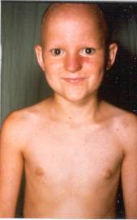
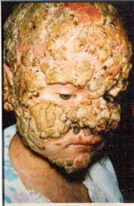
CMCC: Response to Fluconazole

Slide 42
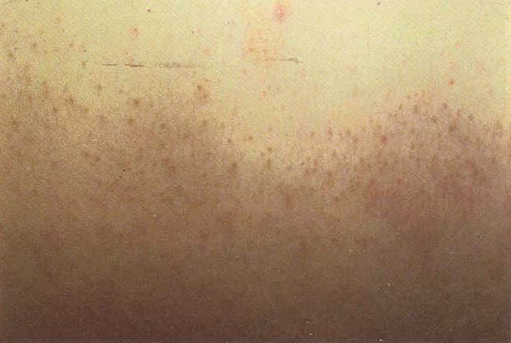
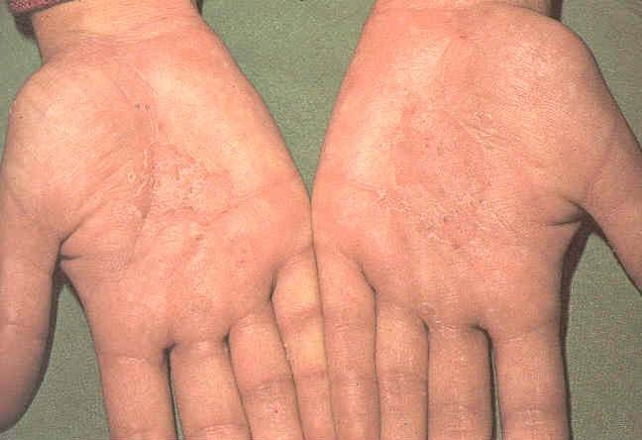
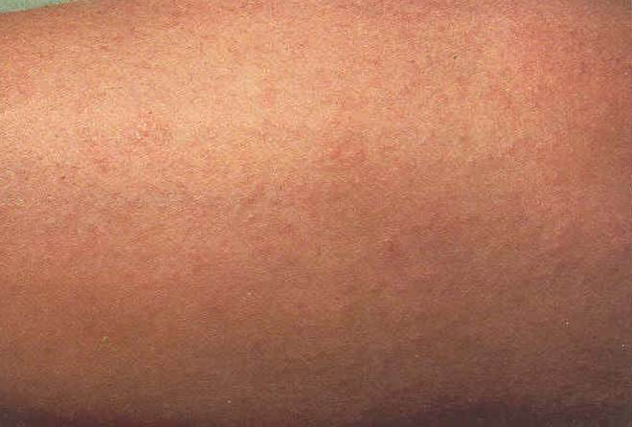
10. Candida folliculitis 11. candidis
Similar to Dermatophytid (ID reaction)

Slide 43
Deep organ involvement
CNS candidiasis
Predisposing factors:
Systemic candidiasis
Lumbar puncture
Trauma
Neurosergery
AIDS

Slide 44
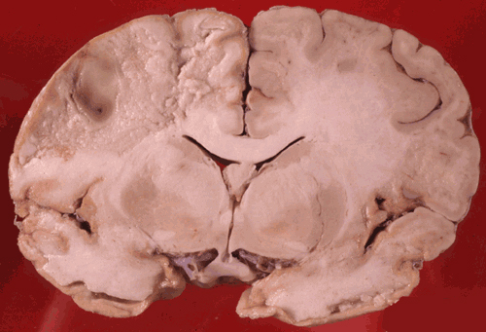
Multiple microabscesses
Small macroabscesses
Meningitis:
Headache, stiffneck, irritability

Slide 45
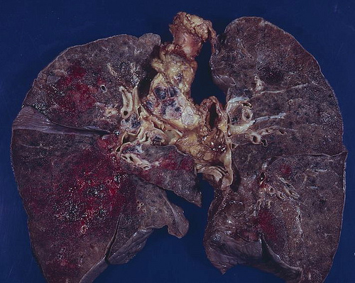
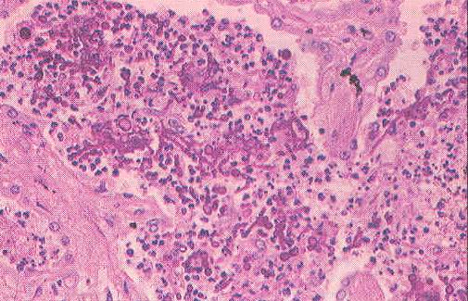
2. Respiratory tract candidiasis: rare- secondery
Hemorrhagic pneumonia due to Candida infection

Slide 46
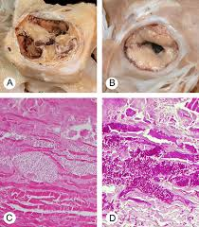
3. Candida endocarditis
Fever
Anaemia
Hepatosplenomegaly
Large emboli to major vessels

Slide 47
4. Urinary tract candidiasis
Predisposing factors:
Candida vaginitis
Antibiotic therapy
Foley catheters
Diabetes mellitus

Slide 48
5. Disseminated candidiasis and candidemia
Neoplastic group:
Acute leukemic population
Postoperative group:
Organ transplantations
Heart surgery
GI canal surgery
Burn patients

Slide 49
Skin lesions of disseminated candidiasis (erythematous papules and pustules)

Slide 50
*Candida septicemia

Slide 51
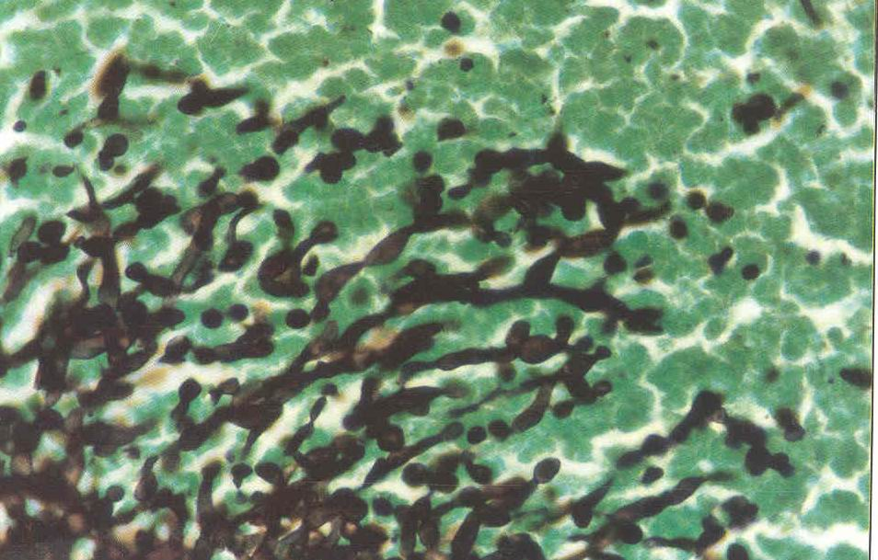
*Candida infection of liver, spleen
Abscesses
Hepatosplenic candidiasis (GMS)

Slide 52
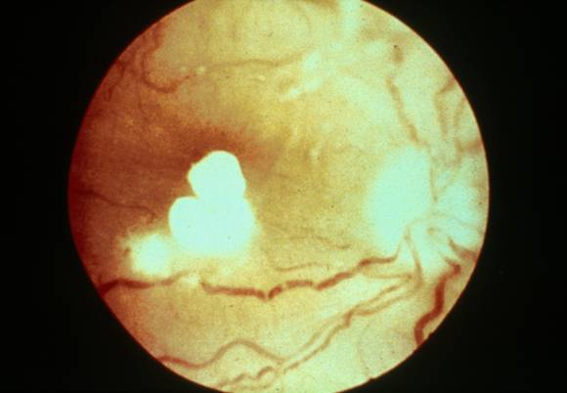
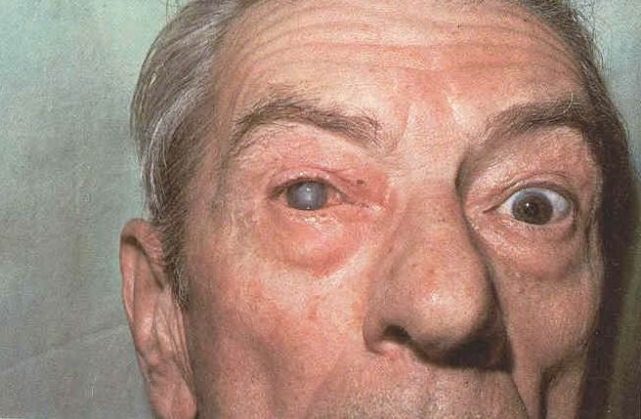
*Ocular candidiasis
Hematogenous. Direct inoculation (surgery)
Candida endophthalmitis-Candidemia
Candida kerato-conjonctivitis

Slide 53
Epidemiology
C.albicans
In USA:The secnd commonest cause of vaginal infections
Females: 75% (second attack: 40-50%)

Slide 54
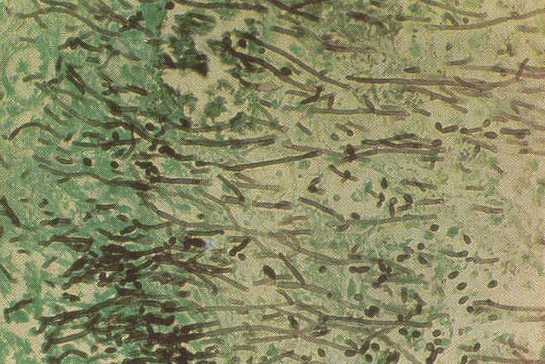
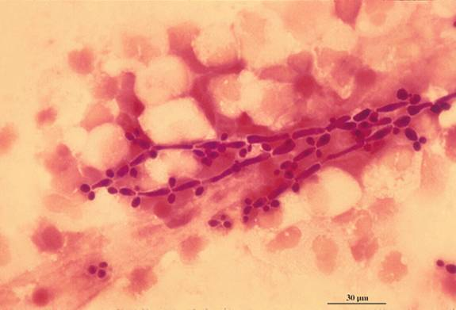
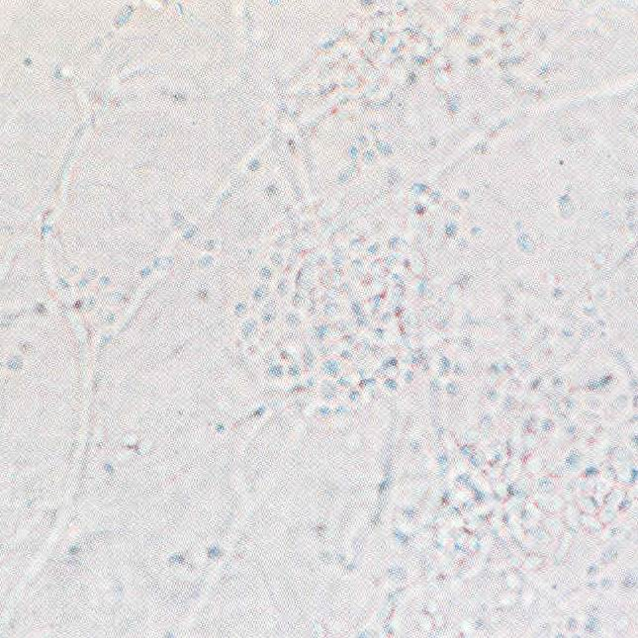
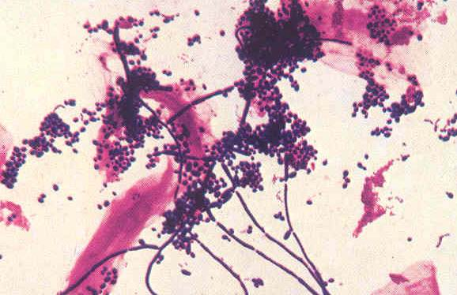
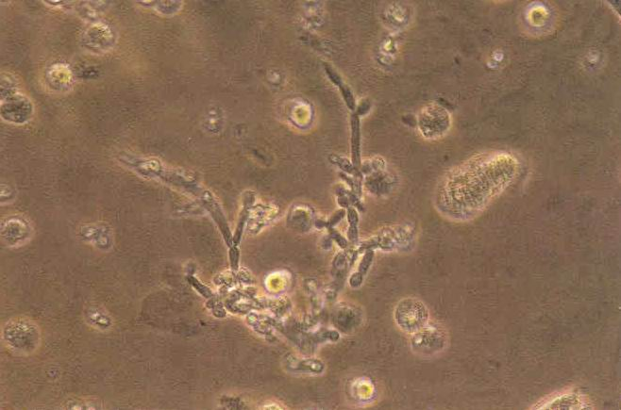
Diagnosis: 1. Direct smear
Candida in KOH
Sputum (Gram stain)
Candida septicemia-urine
Direct smear of urine of kidney
Candida septicemia
(Esophagus, GMS)

Slide 55
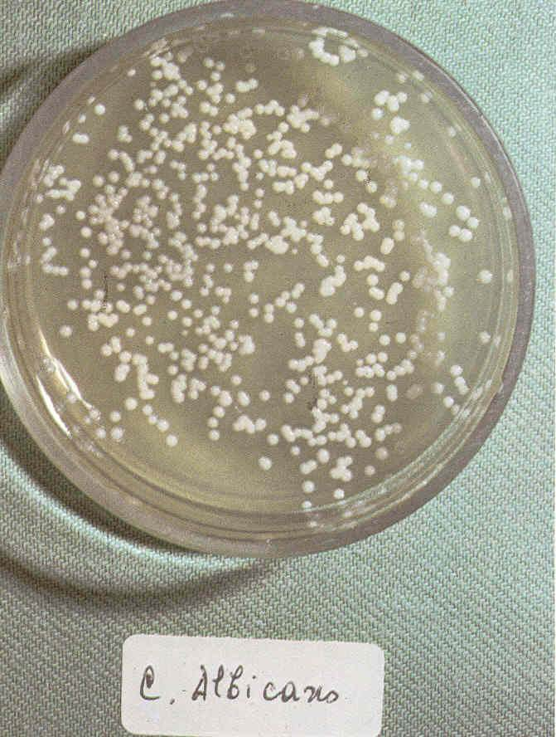
2. Culture:
Skin,…:
SC
SCC (Mycosel or mycobiotic agar)
Deep-seated candidiasis:
Blood:
Biphasic media

Slide 56
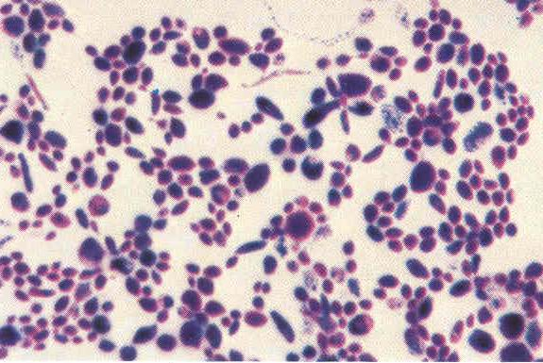
Blastoconidia from culture

Slide 57
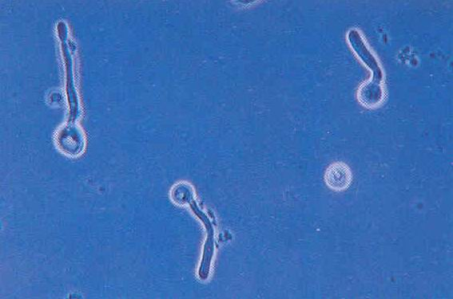
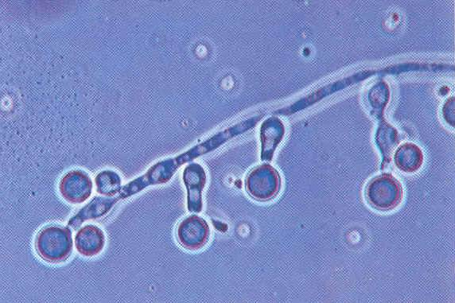
C.albicans and C.dubliniensis
Germ tube test Chlamydospore production

Slide 58
Identification of YESTS
CHROMAGAR
API 20C
Uni-Yeast-Tek

Slide 59
Metabolic tests
Fermentation
Assimilation

Slide 60
Serology:
Antigen detection (mannan):
ELISA
RIA
LA
Serotyping: Iatron serotyping kit

Slide 61
Treatment:
Oral thrush:
Nystatin
Clotrimazole
Fluconazole
Ketoconazole
Itraconazole
CNS candidiasis:
Combination of Amphotericin B and 5-FC

Slide 62
Candida vaginitis:
Short courses of topical or oral (1-7days):
Topical azoles:
Clotrimazole
Miconazole
Tioconazole
Oral azoles:
Ketoconazole
Itraconazole
Floconazole

Slide 63
Prevention:
In AIDS and cancer patients:
Ketoconazole and fluconazole (prevention of oral infections)
***

