Slide 1
Development and Modernisation

Slide 2
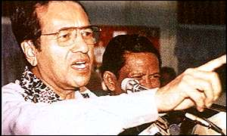
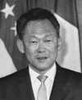
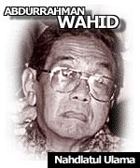
Political Development
Development of democracy and as the indicator of measuring development ?
Why change / development or non-development?
Why democracy as the yardstick?

Slide 3
Political Development School
A descriptive theory…
All societies go through a series of stages
Primitive to modern industrial society
Particularistic to national identification
Ascription to merit or achievement

Slide 4
Binder et al
In the process….
Variables: differentiation, equality & capacity
Crises: identity, legitimacy, participation, penetration & distribution

Slide 5
Remarks
In favour of liberal democracy that democracy as a desirable / natural end product
Cannot explain why these happend

Slide 6
Modernisation School
Societal change is a linear process from traditional / agrarian to modern / industrialist society
Rostow
Organski

Slide 7
Rostow
Traditional society (unable /unwilling to take technological development)
Pre-condition to take-off (economic growth, accept technology and free market, new infrastructure, political structure)
Take-off (blocs / resistance to growth overcome)
Drive to maturity (efficient economy)
Mass consumption (production of goods / welfare state)

Slide 8
Organski
Political development as increasing government efficiency in utilising resources for national goals
Primitive unification (central political authority)
Industrialisation (urbanisation, new elites emerge, build up national identity)
National welfare
Abundance (concentration of resources / power, hollowing state, set up of regional blocs)

Slide 9
Remarks
Ethonocentric
Political development and economic development go side by side
Development in the spheres of social welfare
Emergence of regional / international blocs

Slide 10
Underdevelopment / Dependency School
Underdevelopment as a symptom of capitalist domination, not a stage to development
Why some stay underdevelopment, esp in economic aspect?
Wallerstein
Frank
Amin
Dos Santos

Slide 11
I Wallerstein
World divided into 3 groups: core, peripheral, and semi-peripheral
Core exploits the peripheral, and semi-peripheral is both exploiter and exploited

Slide 12
A G Frank
Underdeveloped societies are the satellite of advanced capitalist societies
Centre-peripheral
Advanced societies never been underdeveloped (from undeveloped to developed)

Slide 13
S. Amin
Centre – peripheral: world bourgeoisie vs world proletariat
Surplus value extracted from peripheral to core

Slide 14
Dos Santos
Dependency as economies conditioned by the development and expansion of another area to which the former is subjected
Export relied on the dominant countries
3 stages of dependency: colonial (monopoly), financial-industrial (investment) & new dependency (markets of capitalist societies)

Slide 15
Resistance
Socialist revolution
Socialist blocs (self-sufficient)
Blocs among Third World
Import substitution and indigenous industries

Slide 16
Asian Modernisation
Strong and stable government leading development
Economic development: capitalist market with state intervention, manufacturing, specialisation of products
Hopefully, political development as products of economic development
Development but any sign of underdevelopment? Neo-imperialism
But not really lead to Western type of liberal democracy

