Slide 1
In the name of gode member of group: yosef saidi rad ali bazrafshan mostafa naghavi mostafa mirboloki

Slide 2
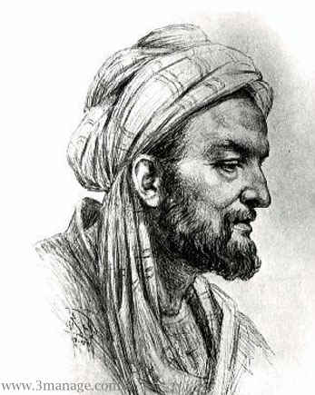
Ebne Sina

Slide 3
Born | 22 August 980 ^{[1]} Afshona, Peshkunskiy, Bukhara,Samanid Empire
Died | 21 June 1037 (aged 57) ^{[1]} Hamadān, Kakuyid Emirate
Residence | Samanid Empire^{[2]} Ziyarid Tabaristan^{[3]} Buyid Persia^{[4]}
Other names | Sharaf al-Mulk Hujjat al-Haq Sheikh al-Rayees Ibn-Sino (Abu Ali Abdulloh Ibn-Sino) Bu Alī Sīnā (بو علی سینا)
Academic background
Influences | Hippocrates Aristotle Galen Neoplatonism al-Kindi al-Farabi Rhazes Al-Biruni al-Masihi Abul Hasan Hankari
Academic work
Era | Islamic Golden Age
Main interests | Medicine Aromatherapy Philosophy and logic Kalām (Islamic theology) Science Poetry
Notable works | The Book of Healing The Canon of Medicine
Influenced | Al-Biruni Omar Khayyám Averroes Shahab al-Din Suhrawardi Tusi Ibn al-Nafis Ibn Tufail Albertus Magnus Maimonides Aquinas William of Ockham Abu 'Ubayd al-Juzjani Enlightenment philosophers

Slide 4
was a Persian polymathwho is regarded as one of the most significant thinkers and writers of the Islamic Golden Age.^{[5]}
Of the 450 works he is known to have written, around 240 have survived, including 150 onphilosophy and 40 on medicine.^{[6]}
His most famous works are The Book of Healing, a philosophical and scientificencyclopedia, and The Canon of Medicine, amedical encyclopedia^{[7][8][9]} which became a standard medical text at many medievaluniversities^{[10]} and remained in use as late as 1650.^{[11]} In 1973, Avicenna's Canon Of Medicine was reprinted in New York.^{[12]}
Besides philosophy and medicine, Avicenna's corpus includes writings on astronomy,alchemy, geography and geology, psychology,Islamic theology, logic, mathematics, physicsand poetry.^{[13]}

