Slide 1


Slide 2
e
Programing languages

Slide 3
comments
Welcome to PROGRAMING LANGUAGES essay....
In this lecture we want to talk about :
history
refinement
initial progress
integration & growth
assessment of language
and division of
programing languages

Slide 4
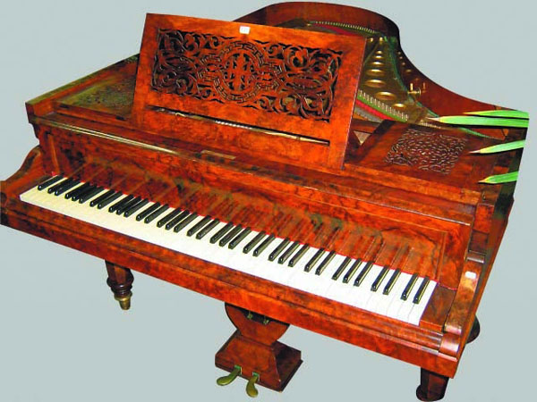
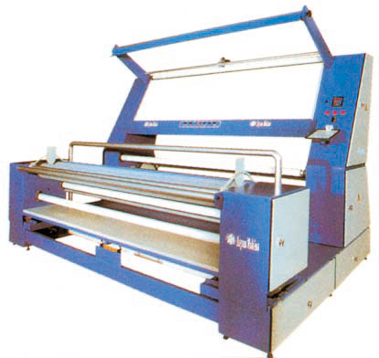
              in 19th century first programing language use for :
              piano textile machines

Slide 5


              Do you know LAMBDA?
              LAMBDA is a way to revelation equation. Its calculus remains influential in language design.

Slide 6
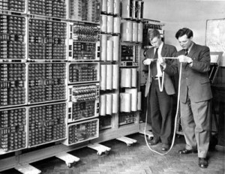
              in 1940 the first digital computers was created by power supply.

Slide 7
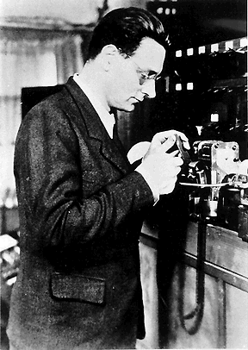
                The first high-level programing language designed for computer Plankalkula. That between 1943 & 1945 were design by the German “Korad zvs”.

Slide 8
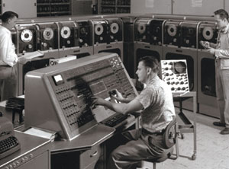
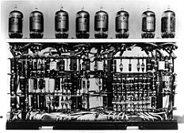
              first machine language programs used :
              Univac 1 & IBM 701

Slide 9
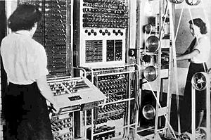
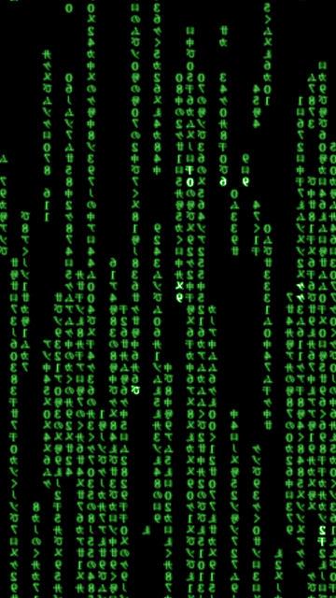
              In 1950 Machine Language replaced by Assembly Language

Slide 10
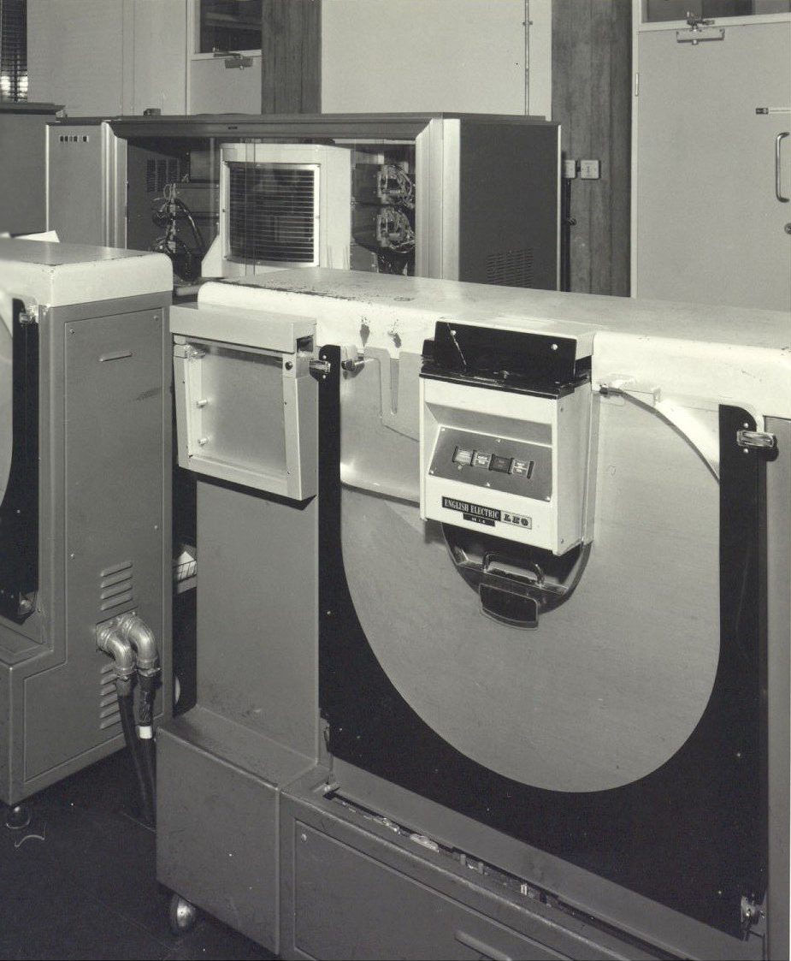
              At the end of the 50th century, language “Algol 60”was introduced and later programing languages are descended from Algol.

Slide 11
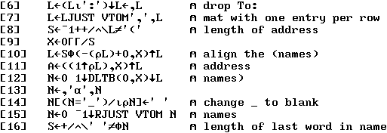
Refinement
APL
Introduced array programing
NPL
Made in late 60th century
Simula
Made in late 60th century. Was the first language that support object- oriented programing.
C
Made between 1969-1973 as a system programing language.
Prolog
design in 1972. its was the first logic programing language.

Slide 12
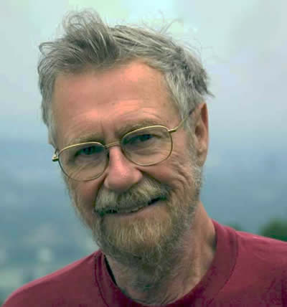
                In 1968 “Edgar Dijkstra” whit a latter to ACM say :
              ( The go to command should be removed from all high-level languages)

Slide 13
              In 1980 C++ object-oriented has been combined by programing system.

Slide 14




Assessment of language
All programing language was good but we cant rank the languages, in generally we can rank languages by :
Counting the number of job advertisements that are called languages.
Number of education books and describing the language that the sale is gone.
Estimate the number of lines that are written in the language.
Counts of language references in the internet search engines.

Slide 15

              Languages commonly arise by combining the elements of languages background are turning new ideas in circuit.

Slide 16

Division
Programing techniques :
subroutine
structured
modular
object-oriented
2. close to machine language:
under side level
intermediate level
high level
3. Translation :
interpreted
compiler
4. Programing interface:
text-based
based on the graphic (visual)

