Slide 1
بسم الله الرحمن الرحیم

Slide 2
LESSON 6

Slide 3
PLACE

Slide 4
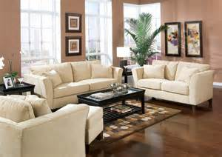
Living room

Slide 5
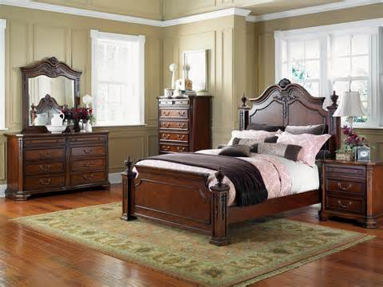
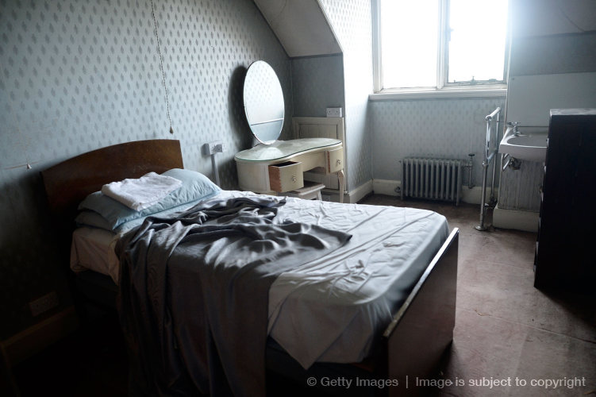
bedroom

Slide 6
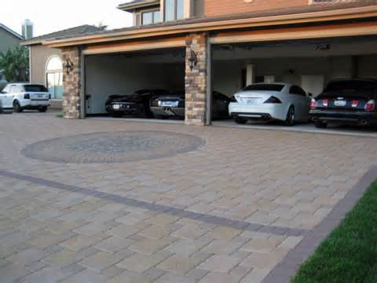
garage

Slide 7
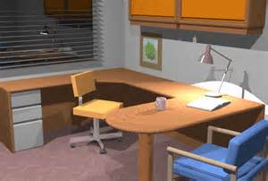
office

Slide 8
garden

Slide 9
WERB

Slide 10
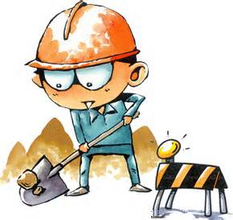
working

Slide 11
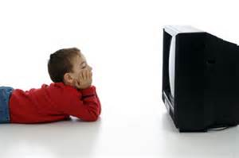
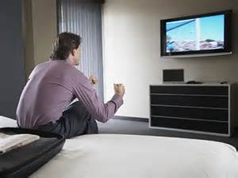
watching TV

Slide 12
reading a book

Slide 13
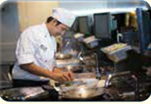
cooking

Slide 14
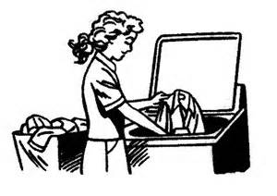
washing

Slide 15
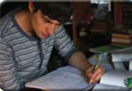
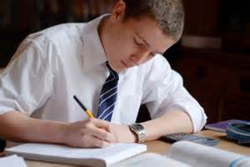
studying

Slide 16
playing football

Slide 17
testing

Slide 18
office - Living room - bedroom
Living room

Slide 19
bedroom- office - Living room -
bedroom

Slide 20
garage- office- garden
garage

Slide 21
garage- office- garden
office

Slide 22
garage - garden - office
garden

Slide 23
WERB

Slide 24
Working-cooking-washing
working

Slide 25
cooking-Working -watching TV
watching TV

Slide 26
reading a book-Working -watching TV
reading a book

Slide 27
Working-cooking-washing
cooking

Slide 28
Working-cooking-washing
washing

Slide 29
reading a book- watching TV-studying
studying

Slide 30
playing football -reading a book- watching TV
playing football

Slide 31
END

