Slide 9

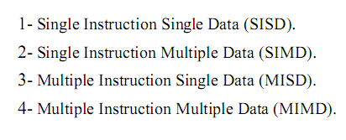


Slide 10
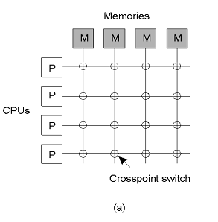

Slide 11
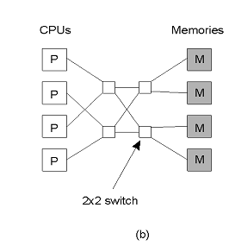


Slide 12

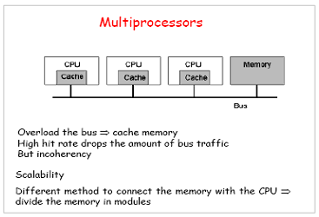

Slide 13
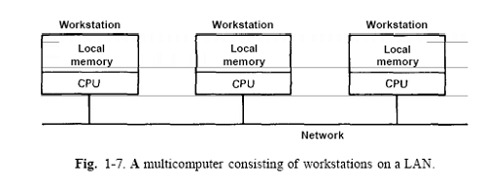

Slide 14
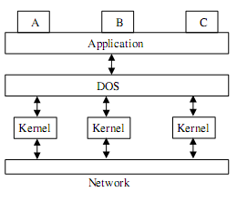

Slide 15

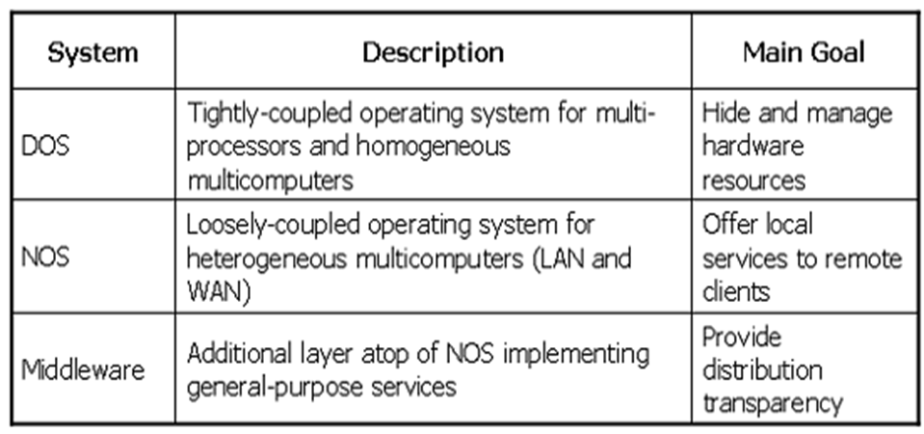

Slide 16
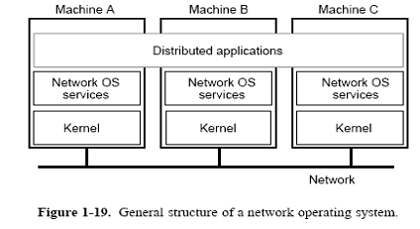

Slide 17
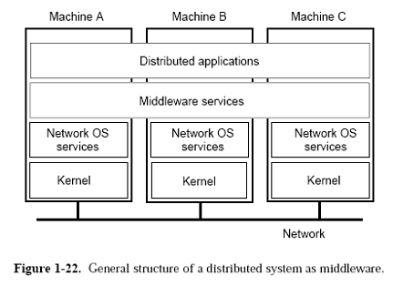

Slide 18

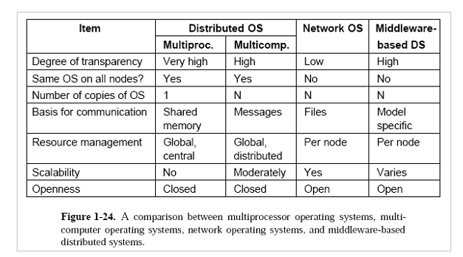

Slide 19

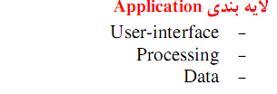

Slide 20
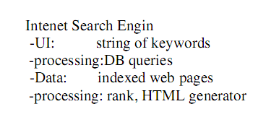

Slide 21
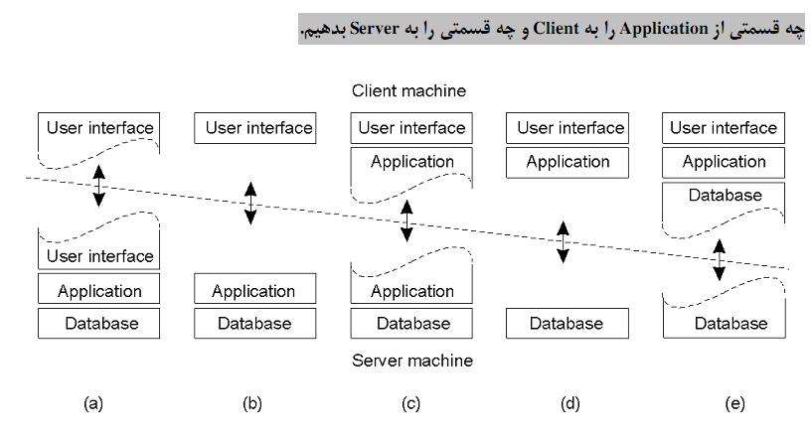

Slide 22
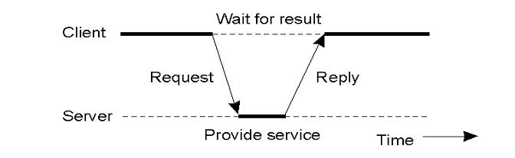

Slide 23
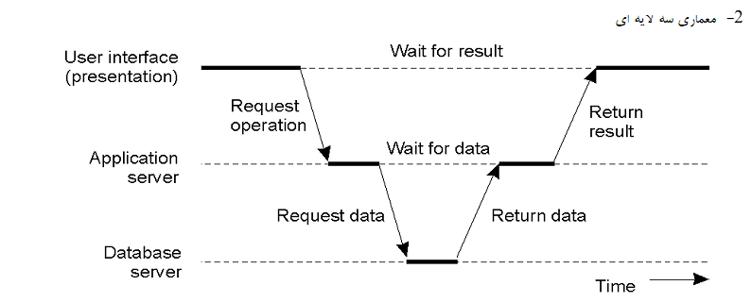

Slide 24
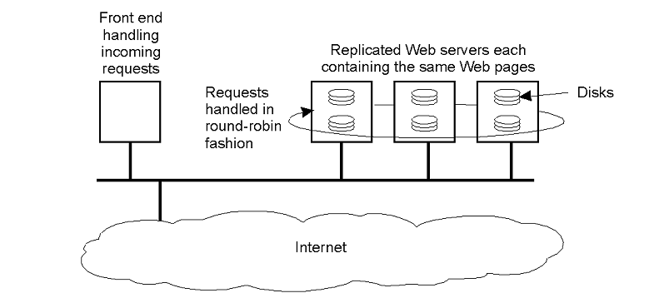

Slide 25
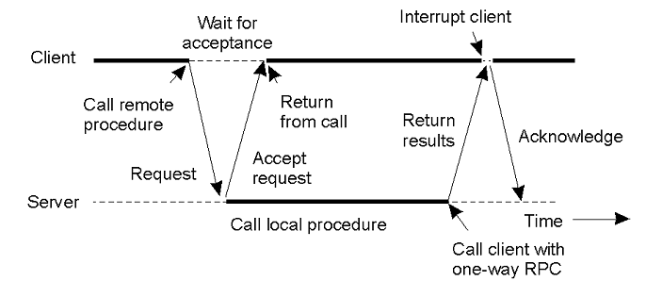

Slide 26

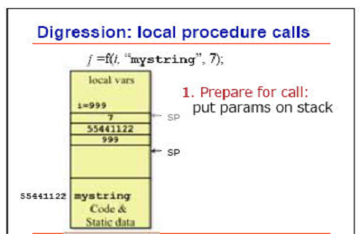

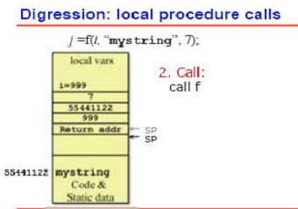

Slide 27
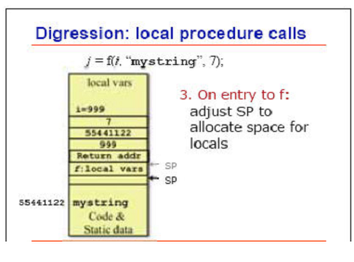

Slide 28

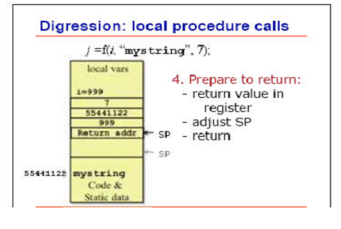

Slide 29

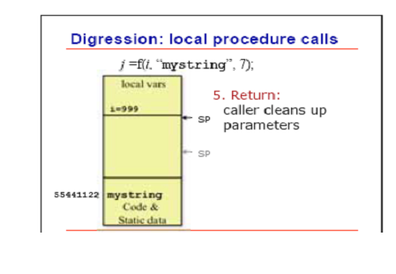

Slide 30


Slide 31
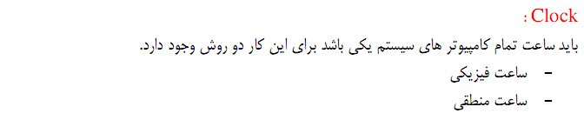
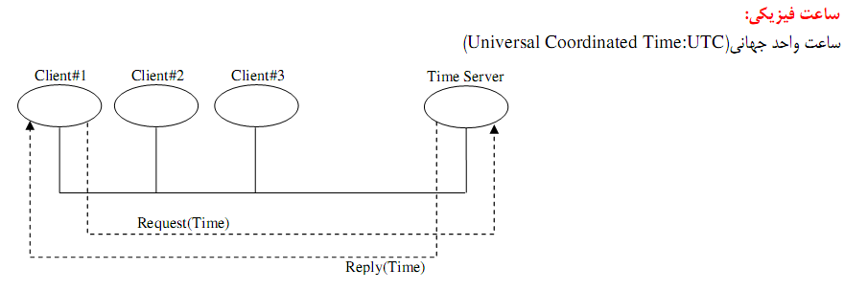

Slide 32



Slide 33
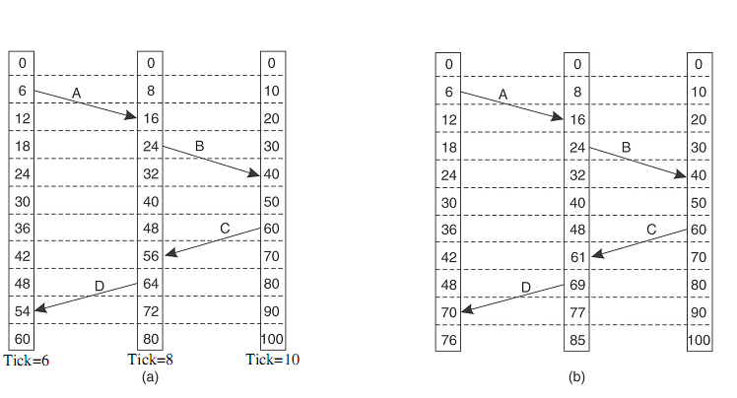

Slide 34
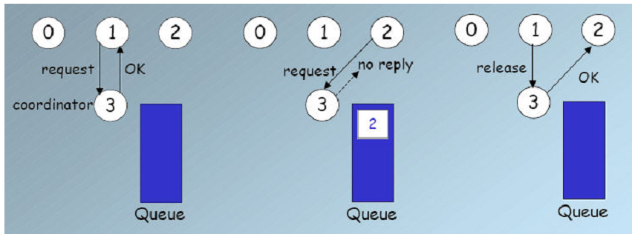

Slide 35
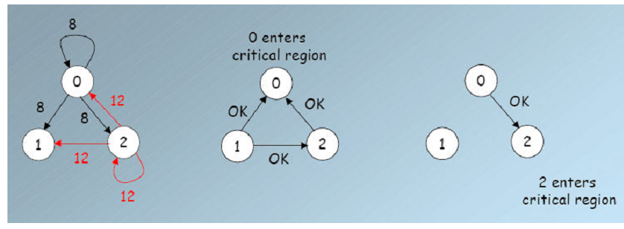

Slide 36

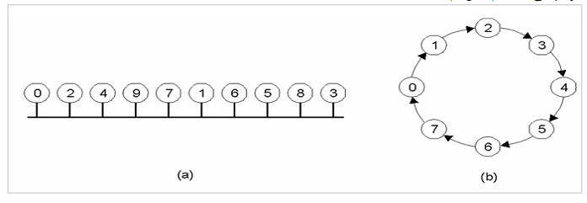

Slide 37
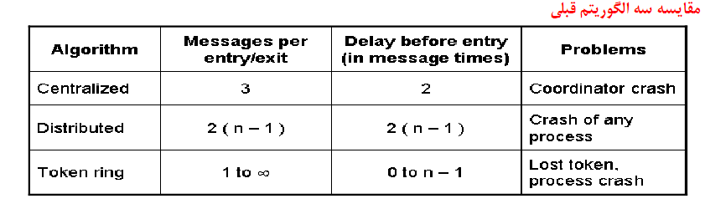

Slide 38




Slide 39



Slide 40


Slide 42

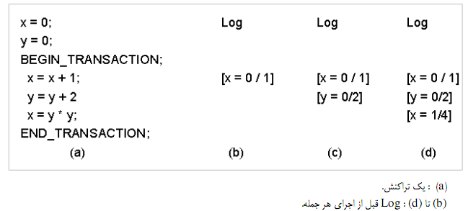

Slide 43
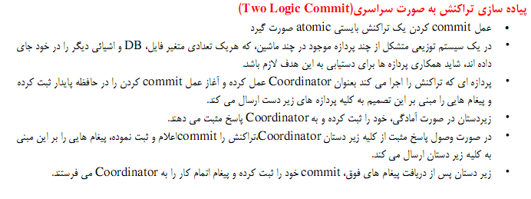

Slide 44
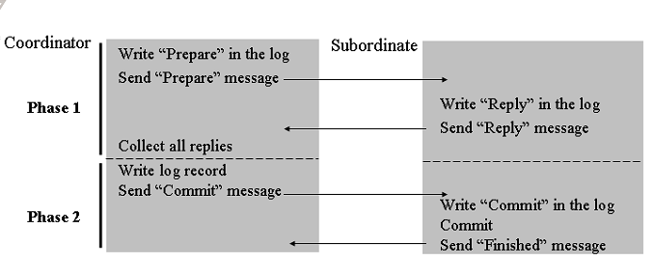

Slide 46
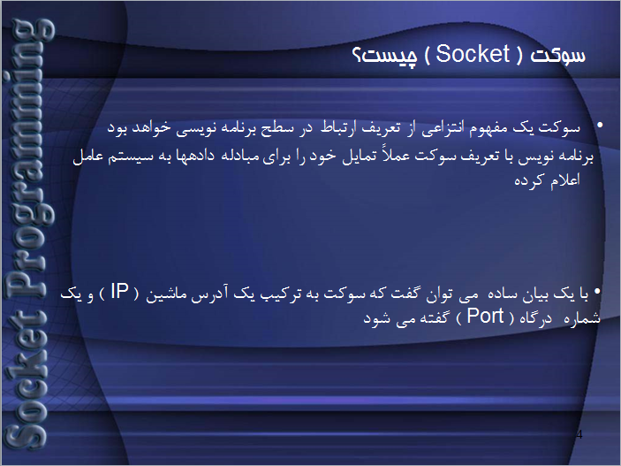

Slide 48
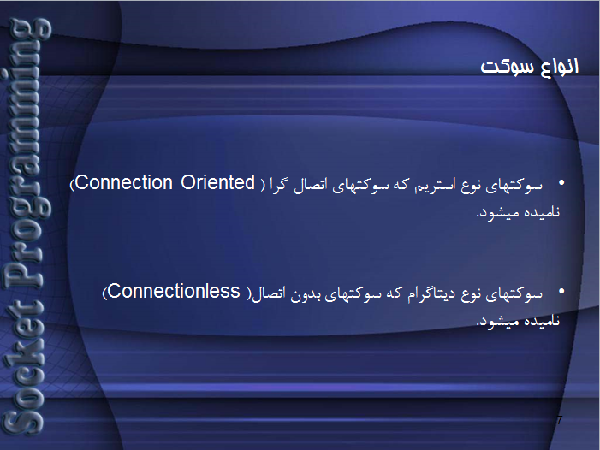

Slide 49
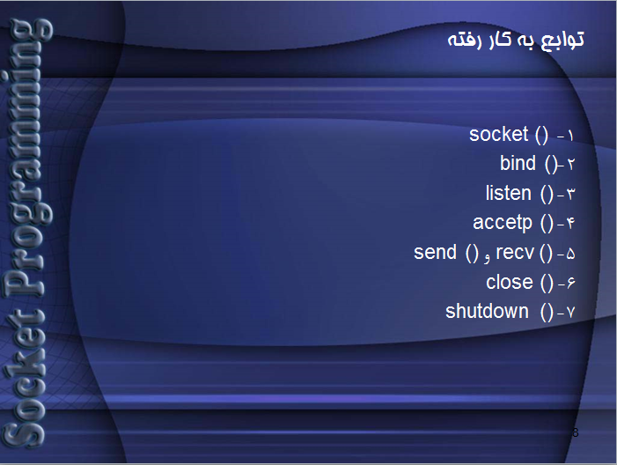

Slide 50
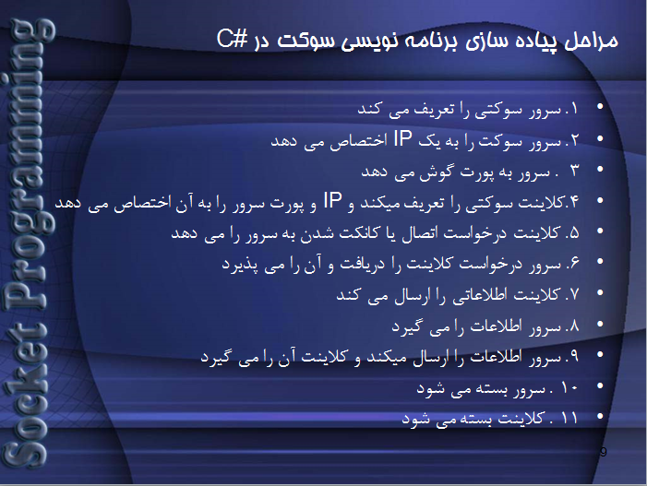

Slide 51
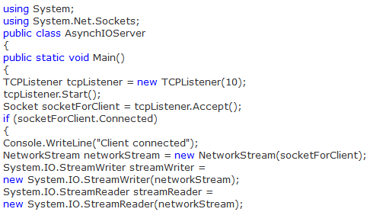
Server Side Code:

Slide 53
Client Code:

Slide 55
TCP vs. UDP
TCP (Transmission Control Protocol) is the most commonly used protocol on the Internet. The reason for this is because TCP offers error correction. When the TCP protocol is used there is a "guaranteed delivery." This is due largely in part to a method called "flow control." Flow control determines when data needs to be re-sent, and stops the flow of data until previous packets are successfully transferred. This works because if a packet of data is sent, a collision may occur. When this happens, the client re-requests the packet from the server until the whole packet is complete and is identical to its original.
UDP (User Datagram Protocol) is anther commonly used protocol on the Internet. However, UDP is never used to send important data such as webpages, database information, etc; UDP is commonly used for streaming audio and video. Streaming media such as Windows Media audio files (.WMA) , Real Player (.RM), and others use UDP because it offers speed! The reason UDP is faster than TCP is because there is no form of flow control or error correction. The data sent over the Internet is affected by collisions, and errors will be present. Remember that UDP is only concerned with speed. This is the main reason why streaming media is not high quality.

Slide 56
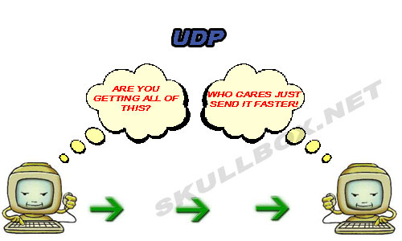

Slide 57
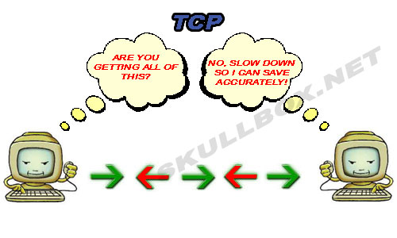

Slide 58
IP Ports
Ports were developed so that computers could accept data from multiple sources over the same IP address. Think if it like this; Your TV service is the Internet, and the ports are you channels. You have many forms of entertainment, news, and information available through many different channels. Think about this, lets say that MTV is channel 35 on your TV. The same is true for web servers that run on port 80. Every port has a special purpose just as each channel serves a different television program. While you only have 1 cable TV subscription, you can still receive multiple channels.
Two main types of ports: TCP and UDP. TCP stands for Transmission Control Protocol. UDP stands for User Data Protocol. Some programs on your computer will use TCP ports to communication and other may use UDP. It is important to know the difference between how the two operation. See TCP vs. UDP for an explanation with pictures!

Slide 59
There are 65,535 TCP and UDP ports available to transmit data with. Ports 0-1023 are reserved for common use. These ports are assigned by the IANA (Internet Assigned Numbering Authority). This means, that every port from 0-1023 will be the same on every system. For example, let's say a server in New York is using port 80, and so is a server Texas. Because port 80 falls in the range of reserved ports, we know both servers are using port 80 for HTTP connections. Viewing a list of known ports can help you determine which type of connections are present on your machine.
Servers, or any machine for that matter "listen" on certain ports. For example, a server running web, FTP, and Telnet services will listen on a port for each. The act of listening simply means the machine is waiting for another device to connect to it. See the illustration below:

Slide 60
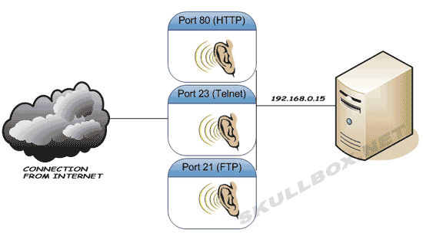
You can see how the server is listening for 3 ports over a single IP address (192.168.0.15). You should also know that it is possible for multiple devices to connect to a single port. Meaning, a telnet server may accept over 100 simultaneous connections to port 23.

