Slide 1
Power & Authority
Political sociology is
…. the study of political processes and structures of power
G.A. Kourvetaris

Slide 2
Consensus & Conflict Model
Consensus - Functional Model
… power as capacity of a social system to get things done in the interests of collective goals
… equal power
Conflict - a form of domination and coercion of one by another

Slide 3
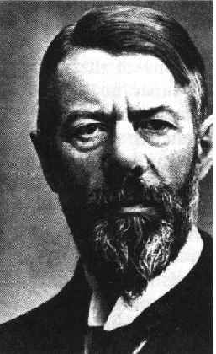
Max Weber ….. on power
Power is the probability that one actor within a social relationship will be in a position to carry out his own will despite resistance …….
Politics is striving to share / get power
So, who holds power, with which basis and for what purpose?

Slide 4
… types of power
Political power
Tung Chee-hwa
Martin Lee ?
Economic power
Li Ka-shing & Richard Li
Ideological power
Rev Kwong-.kit Kwong
…examples in Asia or around the world?

Slide 5
Steven Lukes … 3 dimensions of power
Decisionalism - observable / overt
A get B to do something he would not otherwise do
Non-decisionalism
issues not being discussed within the political arena
Radical
absence of conflict reveals the most thoroughgoing use of power in which potential grievances are prevented through the shaping of perceptions / wants

Slide 6
Authority
Legitimate power

Slide 7
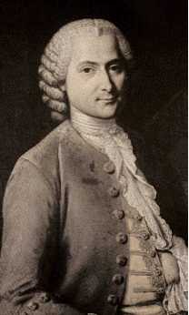
Rousseau
… the strongest man is never strong enough to be always master unless he transform into right and obedience into duty.

Slide 8
Weber… 3 types of legitimacy
Traditional - conferred by custom and accepted practice (King Bhumibol, King Sihanouk)
Charismatic - charisma (gift of grace) and extraordinary personal qualities of an individual (Li Kuan-yew,)
Rational-legal - power authorised by certain legal and bureaucratic procedures (Kim Tae-chun)

Slide 9
John Day
Accepting authority - obey voluntarily the laws of government
Coercion - obey through fear of punishment

Slide 10
Summary
Power - probability that A will act as B wishes (structural perspective)
Power -/- Authority (with legitimacy)
Authority = Coercion
…. when authority loses its legitimacy
Authority = most secure and stable form of power

Slide 11
Radical ……. hegemony
Antonio Gramsci
the bourgeoisie dominated society less by force and more by eliciting consent through using cultural institutions to ensure that its view of the world prevailed

Slide 12
Nicos Poulantzas
... power as ‘the capacity of a social class to
realise its specifc objective interests’
Louis Althusser
… ideoligical domination to the state through
‘ideological state apparatuses’

