Slide 1
My
This lesson

Slide 2
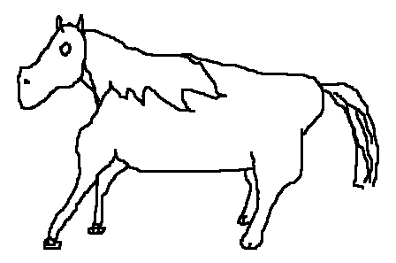
Is he/she good at drawing?

Slide 3
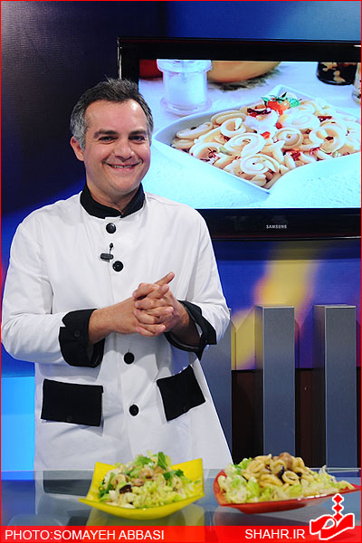
Is he/she good at cooking?

Slide 4
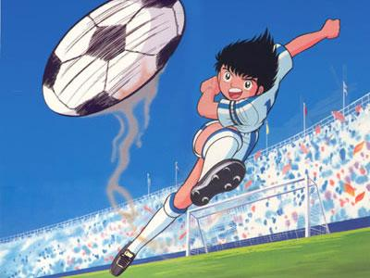
Is he good at playing football?

Slide 5
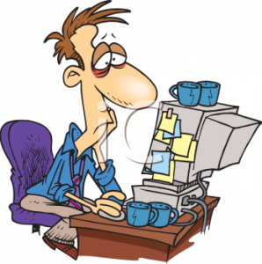
Is he/she good at searching web?

Slide 6
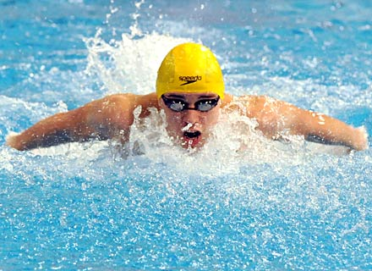
Is he/she good at swimming?

Slide 7
What about you?
Are you good at…..?

Slide 8
Can you …?
make a cake
ride a bicycle
search the web
Play basketball
do a puzzle

Slide 9
Let’s Play Guess what?
He is good at ………. .

Slide 10
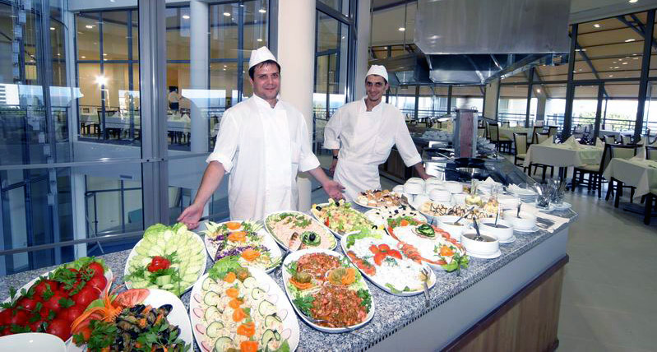
Let’s Play Guess what?
He is good at ………. .

Slide 11
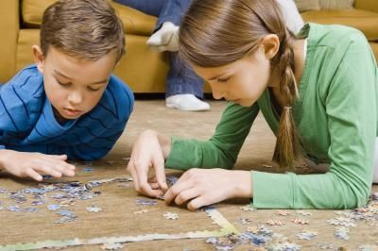
Let’s Play Guess what?
He is good at ………. .

Slide 12
Let’s Play Guess what?
He is good at ………. .

Slide 13
finish
تهیه کننده:امیرحسین فوزی

