Slide 1
Lesson one Grade 8
By Kuchakzadeh
More at t.me/kuchakzadeh
1398

Slide 2
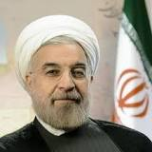
Is he from Iran?
Yes, he is.
What is his nationality?
He’s Iranian.
Is he from Iran?
No, he isn’t.
Where is he from?
He is from America, he’s American.

Slide 3
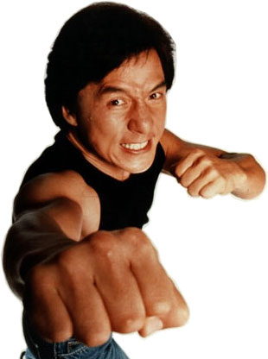
Is he from China?
Yes, he is.
What is his nationality?
He’s Chinese.
Is he from China?
No, he isn’t.
Where is he from?
He is from England, he’s British.

Slide 4
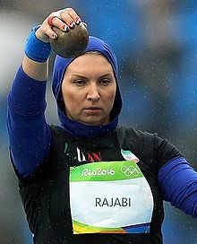
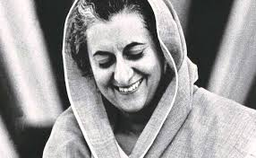
Is she from Iran?
Yes, she is.
What is her nationality?
She’s originally Belarussian.
Is she from Iran?
No, she isn’t.
Where is she from?
She is from India, she’s Indian.

Slide 5
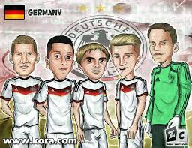
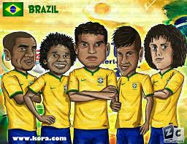
Are they German?
Yes, they are.
Where are they from?
They are from Germany.
Are they German?
No, they aren’t.
What is their nationality?
They are Brazilian.

Slide 6
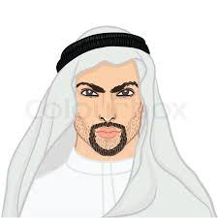
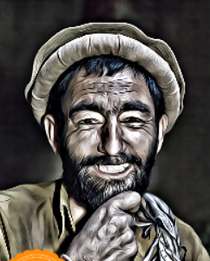
No, I’m not.
Are you Afghan?
I’m from Iraq, I’m Iraqi.
Where are you from?

Slide 7
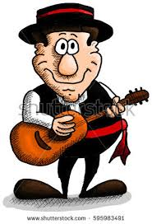
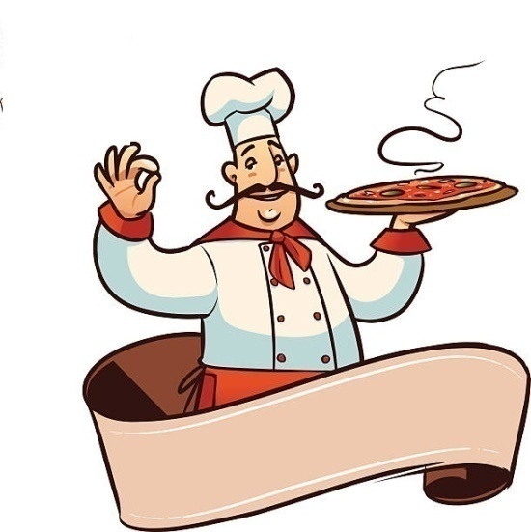
Are you Italian?
No, I’m not.
I’m from Spain, I’m Spanish.
Where are you from?

Slide 8
Role Plays

Slide 9
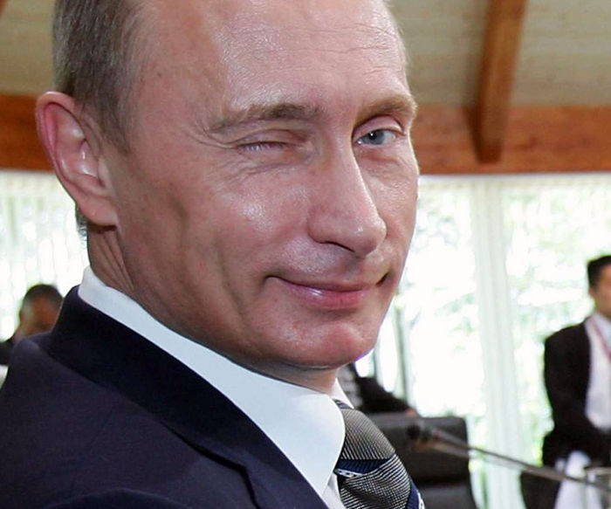
Name: Vladmir Putin
Country: Russia
Nationality: Russian
Job: president

Slide 10
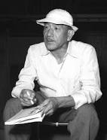
Name: yasujiro ozu
Country: Japan
Nationality: Japanese
Job: Film director

Slide 11
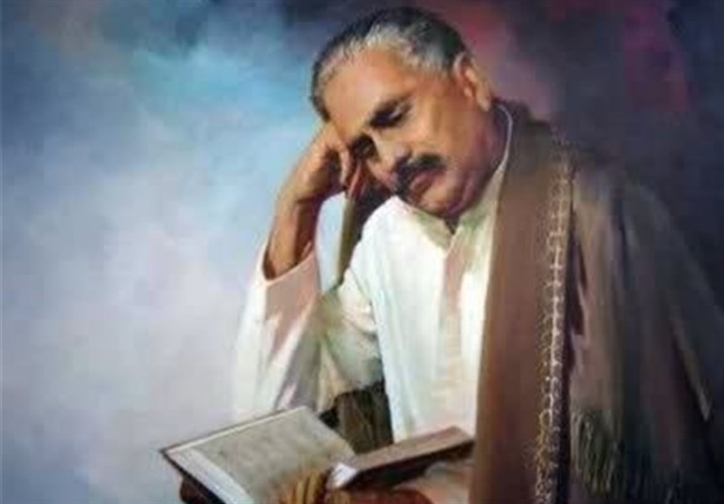
Name: Iqbal Lahori
Country: Pakistan
Nationality: Pakistani
Job: poet

Slide 12
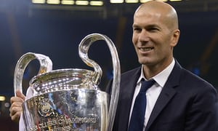
Name: Zinedine Zidane
Country: France
Nationality: French
Job: Football head coach

Slide 13
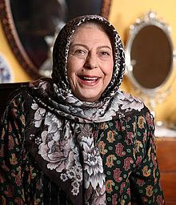
Name: Sorayya Qasemi
Country: Iran
Nationality: Iranian
Job: cinema actress

Slide 14
Monolog

Slide 15
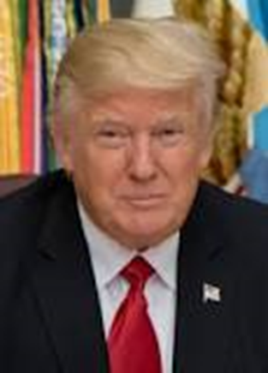
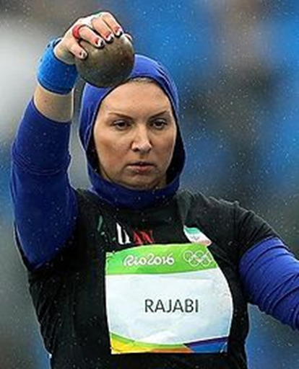
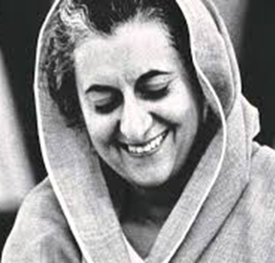
Talk about these people (name/country/nationality)

Slide 16
Hello, my name is Vladimir Putin. I’m from Russia. I’m Russian. I’m the president of Russia. It is in Europe and Asia. I live in Moscow. I am sixty five years old. My birthday is in October. I wear black suit and white shirt. My favorite food is hamburger. My favorite drink is tea. I have two daughters. I love my country.
Hello, my name is Donald Trump. ……………………………………………………………………………………………………………………………………………………………………………………………………………………………………………………………………………………………………………………………………………………………………………………………………………………………………………………………………………………………………………………………………………………………………………………………………………………………………..

Slide 17
Now write about yourself.
(name, country, continent, nationality, job, age, date of birth, your clothes,
your family members, your favorite food & drinks)
………………………………………………………………………………………………………………………………
....................................................................................................................................
……………………………………………………………………………………………………………………….........
……………………………………………………………………………………………………………………………....
……………………………………………………………………………………………………………………………....

