Slide 1
Kidney
Disorders
By Amir Ashkan Ashrafian M.D

Slide 2
Chronic Kidney Disease Introduction
A spectrum of different pathophysiologic processes associated with abnormal kidney function and a progressive decline in glomerular filtration rate (GFR).

Slide 3
Pathophysiology of Chronic Kidney Disease
Underlying etiology
Progressive mechanisms, involving hyperfiltration and hypertrophy of the remaining viable nephrons

Slide 4
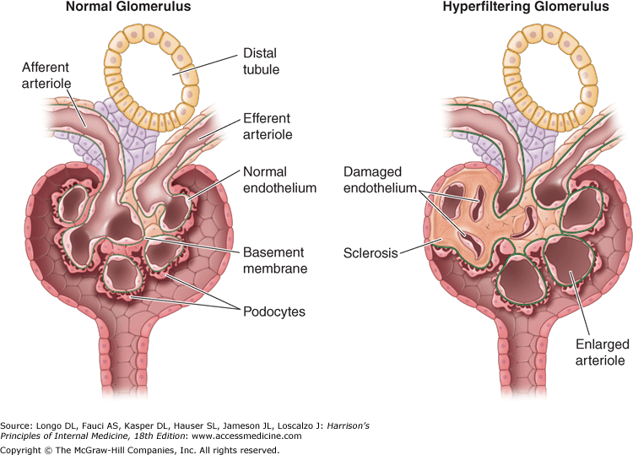

Slide 5
Risk FactORS of CKD
Hypertension
Diabetes mellitus
Autoimmune disease
Older age
African ancestry
Family history of renal disease
Previous episode of acute kidney injury
Presence of proteinuria, abnormal urinary sediment
Structural abnormalities of the urinary tract

Slide 6
Etiology and Epidemiology
6% of the adult population
Majority of such patients with early stages of CKD will succumb to the cardiovascular and cerebrovascular consequences of the vascular disease before they can progress to the most advanced stages of CKD.
A minor decrement in GFR or the presence of albuminuria is now recognized as a major risk factor for cardiovascular disease

Slide 7
Leading Categories of ckd Etiologies
Diabetic glomerular disease
Glomerulonephritis
Hypertensive nephropathy
Primary glomerulopathy with hypertension
Vascular and ischemic renal disease
Autosomal dominant polycystic kidney disease
Other cystic and tubulointerstitial nephropathy

Slide 8
Pathophysiology & Biochemistry of Uremia
those consequent to the accumulation of toxins that normally undergo renal excretion, including products of protein metabolism
(2) those consequent to the loss of other renal functions, such as fluid and electrolyte homeostasis and hormone regulation; and
(3) progressive systemic inflammation and its vascular and nutritional consequences.

Slide 9
Pathophysiology & Biochemistry of Uremia
Serum urea and Creatinine concentrations are used to measure the excretory capacity of the kidneys
Hundreds of toxins that accumulate in renal failure have been implicated in the uremia
A host of metabolic and endocrine functions impaired⇨ anemia, malnutrition, and abnormal metabolism of carbohydrates, fats,& proteins
Plasma levels of many hormones

Slide 10
Clinical Abnormalities in Uremia
Fluid and electrolyte disturbances
Volume expansion (I)
Hyponatremia (I)
Hyperkalemia (I)
Hyperphosphatemia (I)
Gastrointestinal disturbances
Dermatologic disturbances
Cardiovascular and pulmonary
Hematologic and immunologic
Endocrine-metabolic
Neuromuscular disturbances
Fatigue (I)^{b}
Sleep disorders (P)
Headache (P)
Impaired mentation (I)^{b}
Lethargy (I)^{b}
Asterixis (I)
Muscular irritability
Peripheral neuropathy (I or P)
Restless legs syndrome (I or P)
Myoclonus (I)
Seizures (I or P)
Coma (I)
Muscle cramps

Slide 11
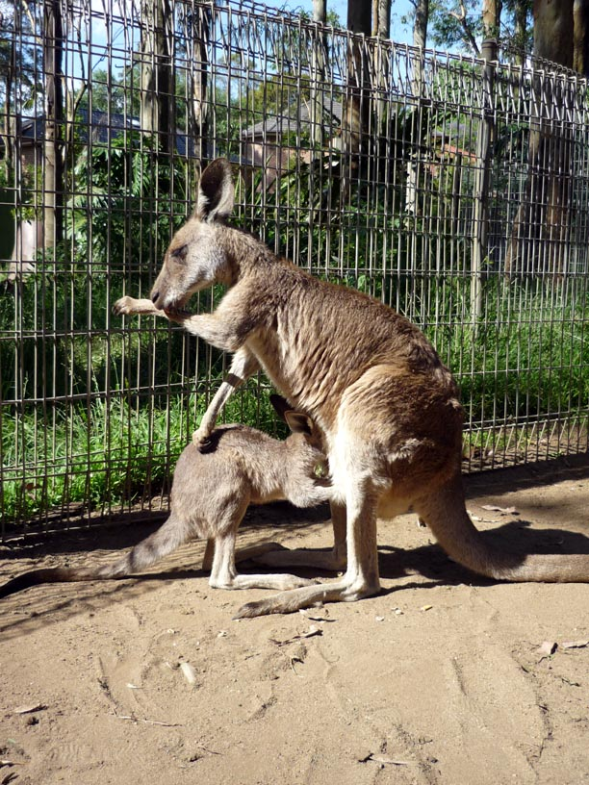
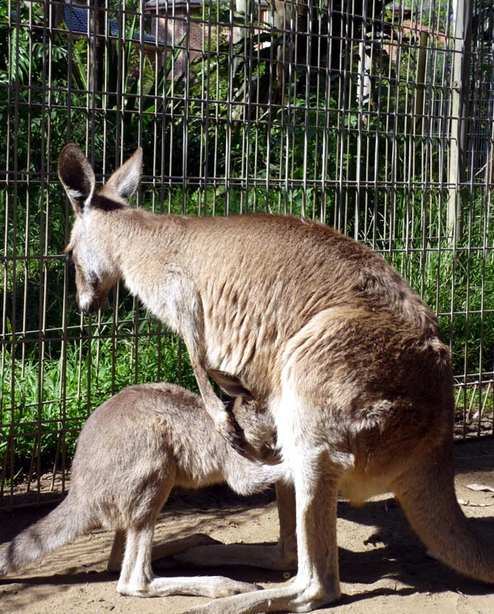
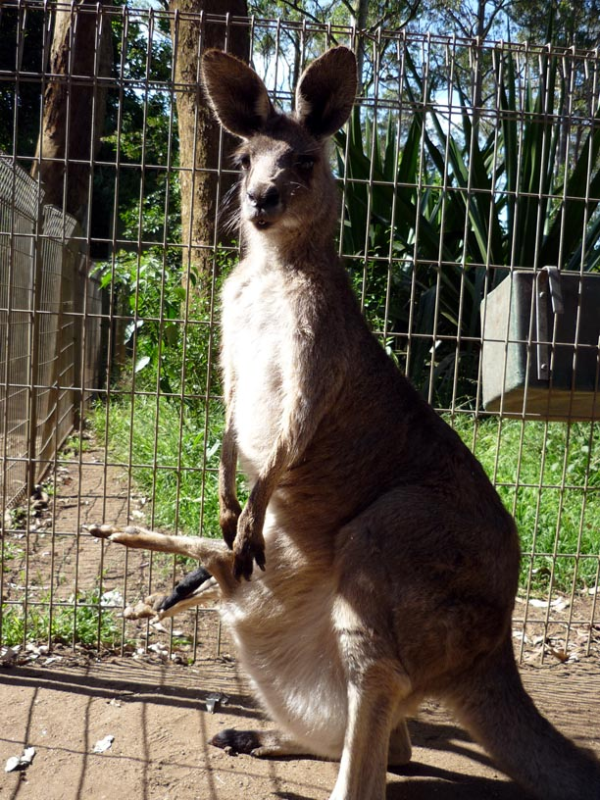
The End
Good Luck

