Slide 1


Image Watermarking For Tampering Protection and Self-Recovery
Iranian Cryptography Society
Dr. Mohammad Ali Akhaee
4Khordad 1393

Slide 2
Outline
Introduction
Problem Definition and Proposed Framework
The Proposed Source-Channel Coding Scheme
  Proposed Method
  Applied Source and Channel Coding
  A Sample Parameter Selection and System Design
  Results
Main References

Slide 3
Outline (2)
New Project topics in Data Hiding
  Data Hiding in the compressed domain
    H.264, H.265
    G.72x
  Steganalysis platform
    Audio, Image, and Video signals
  Network Forensics
    Behavioral Analysis
Demo

Slide 4
Introduction

Slide 5
Introduction
Widespread use of digital multimedia over the Internet
Information hiding Applications
Recent trend: Finding novel IH applications
  IH in PCB design or dll files to ensure the integrity
  Communicating the secret key in cryptography
  Mono transmission of the stereo music
  Communicating the flight information
Authentication: one of the very first applications

Slide 6
Introduction
A very recent IH application: Image tempering protection and self-recovery
Initial IH schemes were capable to detect image integrity, and later, to locate tampering
Recent methods, not only detect and locate the tampering, but also recover the lost content to some extent
A digest of image and authentication information are embedded into image
Tampered area is found using authentication Information, while its content is retrieved using the available digest information as much as possible

Slide 7
Introduction
Self-restoration is a “Forensics” application
The improvement in authentication is necessary due to simple access to image modification software
Self-restoration helps to not only claim the tampering, but also recovers the manipulated truth
In this study, a general source-channel coding framework is proposed
Hash information are used for local authentication
Source coding generates the digest, which is protected against tampering using appropriate channel code

Slide 8
Problem Definition and
Proposed Framework

Slide 9
Problem Definition and Proposed Framework
A watermark is embedded into the original image
Watermark is extracted at the receiver to help retrieving the lost image content
Watermark embedding and image restoration must satisfy the best compromise of three main parameters:
  The quality of the watermarked image (PSNR)
  The quality of restored image in tampered area (PSNR)
  Tolerable tampering rate (percent)

Slide 10
Problem Definition and Proposed Framework
Proposed solution: Source-channel coding modeling of the problem:
  Reference bit or digest generation is an image compression using proper source coding
  Check bits determines the tampered blocks
  Having the tampered blocks known, tampering can be modeled as an erasure channel, and can be dealt with proper channel coding
Using a systematic code, watermark includes three bit groups:
  Source code bits or reference bits
  Channel code parity bits
  Check bits generated using hash function

Slide 11
Problem Definition and Proposed Framework
General Encoder:
General Decoder:

Slide 12
Problem Definition and Proposed Framework
Reference for check bits must remain unchanged
LSB replacement
Unaltered parts might be used as restored image
How to exploit the unaltered information?!
Source coding let us most efficiently represent the image information, but makes it hard to use unaltered content

Slide 13
The Proposed Source-Channel
Coding Based Method

Slide 14
The Proposed S-C Coding Based Method
General Description:
  Transmitter:
    n_{m} MSB unchanged, n_{w} LSB watermarked out of 8
    For each block, check bits are generated from unchanged part, to locate the tampered blocks at the receiver
    Image is compressed at n_{s} bpp
    Compressed bitstream is protected using a channel code from rate of R=n_{s}/n_{c}, with n_{p}=n_{c}-n_{s} bpp parity bits
    n_{s} compressed bitstream, n_{p} channel code parity and n_{h} check bits per pixel form the watermark which is embedded in n_{w} LSB: n_{w}=n_{s}+n_{p}+n_{h}

Slide 15
The Proposed S-C Coding Based Method
  Receiver:
    Tampered blocks are located using check bits
    Channel code bits of healthy blocks along with the list of tampered block as the erasure locations are passed to the channel erasure decoder
    If the tampering does not exceed the limits of the channel code, channel decoder retrieves the compressed bitstream
    Source decoder is applied to deliver an estimation of the original image
    Healthy blocks may or may not replace their equivalents in the restored image

Slide 16
The Proposed S-C Coding Based Method
Source coded bits are permuted using k₁, channel code bits using k₂, both derived from K, the secret key of communication which provides security
A hash algorithm (MD5) is used to generate the hash bits using n_{m} MSB
Hash bits are XORed with a random bitstream to generate check bits, blocks with different check bits at the receiver are marked as tampered
Probability of collision for n_{h}=0.5 bpp=32 bpb=2⁻³² ≈ 0
n_{w} can be non-integer as well, for example n_{w}=2.5 means using 2 and 3 LSB of blocks alternatively

Slide 17
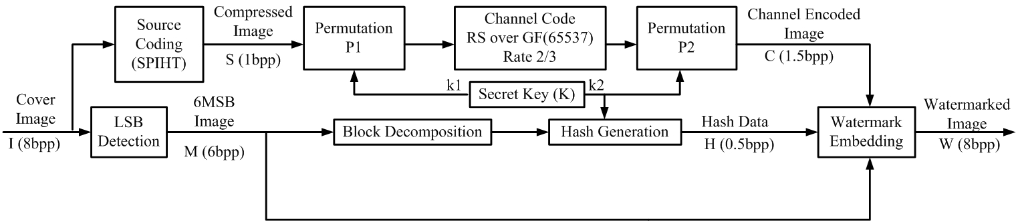
Proposed Encoder
n_{w}=2, n_{s}=1, n_{p}=0.5, n_{h}=0.5 bpp:

Slide 18
Proposed Decoder
n_{w}=2, n_{s}=1, n_{p}=0.5, n_{h}=0.5 bpp:

Slide 19
Source Coding (SPIHT)
Set Partitioning In Hierarchical Trees (SPIHT) is applied as the source coding scheme
SPIHT is an embedded compression method, means that output bitstream can be truncated in desired rate
DWT coefficients are sorted by magnitude
Higher bit-planes in DWT domain are sent earlier
Sorting pass must be available in the receiver too
Self-similarities on the spatial orientation trees, from root downward to the leaves, are used to offer a sophisticated sorting method with least required bit budget

Slide 20
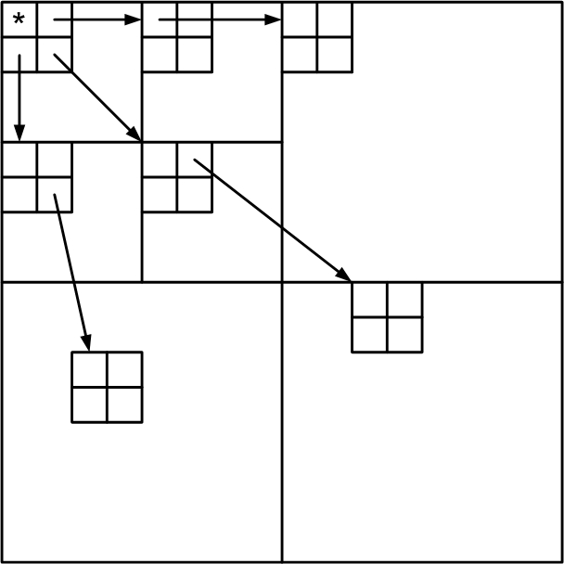
Source Coding (SPIHT)
For an insignificant root, leaves on lower levels are highly likely insignificant too
Low complexity of implementation
Flexible output rate fits our scheme
Quality of compression offered by SPIHT at n_{s} bpp determines the constant restoration performance of proposed method below TTR

Slide 21
Channel Coding (RS)
Reed-Solomon codes: Classical solution of erasures
Codes over large field are desired because:
  All lost bits of a tampered block can be integrated to few erased symbols
  All the compressed bitstream can be channel coded using few coding iteration to gain its best performance
Limitation: Large enough to keep code practical
Symbol bit length divides block watermark bit length

Slide 22
Channel Coding (RS)
Codes over GF(2^{t}):
  t-bit symbols
  Up to 2^{t}-1 symbol can be generated in one iteration
Feature of RS codes fits our generally designed framework: every input and output size is feasible by puncturing and proper base element
RS codes can be also implemented over prime 2^{t}+1:
  No need to lookup table and generator polynomials
  Integer mod(2^{t}+1) calculations instead of polynomials
  Simpler implementation using FFT of length 2^{t}

Slide 23
Channel Coding (RS)
For N=number of pixels, RS(N×n_{c},N×n_{s}) is used if N×n_{c}<2^{t} and:
TTR(n_{c},n_{s})=(n_{c}-n_{s})/n_{c}=1-n_{s}/n_{c}

Slide 24
Sample System Design
Protecting 512×512 cameraman image, 8×8 blocks
Using 2 and 3 LSB results in PSNR of 44.2 and 37.9
Despite most of methods that use 3 LSB and impose near-visible distortions, we propose a 2 LSB scheme
n_{s}=1 for cameraman results in SPIHT compression with quality of 44.9 dB
n_{h}=0.5 results in collision probability of 2⁻³²≈0
n_{c}=1.5 helps to set up channel code over GF(2¹⁶+1)
Every block hosts (1.5×64)/16=6 symbols

Slide 25
Sample System Design
TTR=(1.5-1)/1.5 = 33%
Input length of channel coder: 512×512×1/16=16384
Output length of channel coder: 1.5×16384=24576<2¹⁶
RS(24576,16384) over GF(65537) is used by puncturing RS(32768,16384) made by α=9 from order of 32768
All of the image is coded using one block
The resulting performance is constant restoration quality of 44.9 dB before tampering rate of 33%

Slide 26
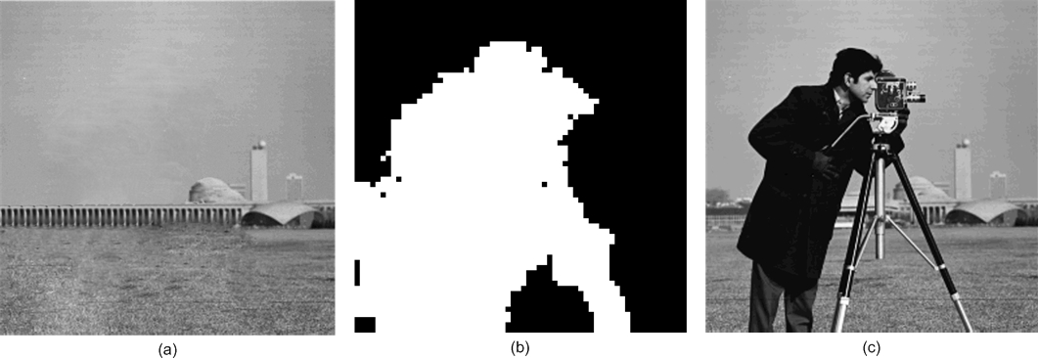
Results
2-LSB:
3-LSB:

Slide 27
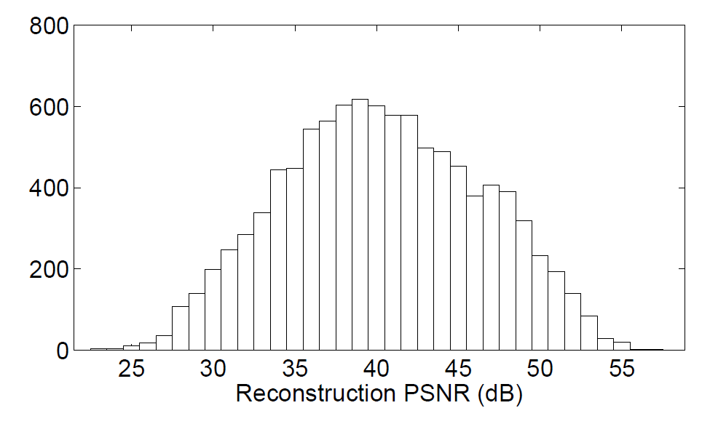
Results
3 LSB in Korus and Zhang methods, resulting in maximum recovery of 40.7dB
Our PSNR is limited to 1bpp SPIHT compression
Applying our and Korus’s to 10000 images, average recovery are 40.3 and 36.3 dB
4 dB recovery gain comparing to Korus’s λ=1
Korus: Proposed:

Slide 28
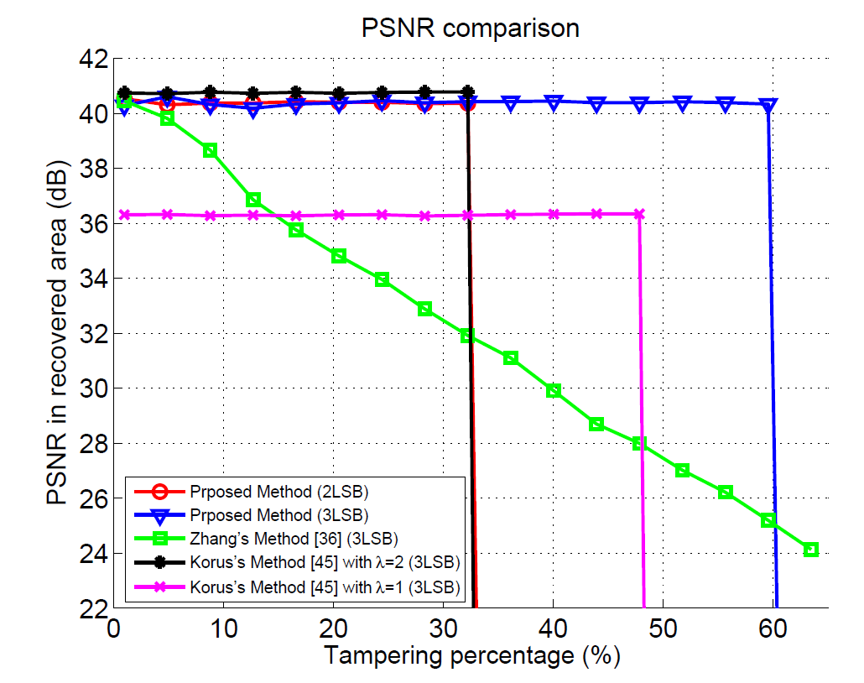
Results
Our 3-LSB version outperforms Korus’s in recovery PSNR and TTR
In our 3-LSB version n_{s}=1 and n_{c}=2.5, resulting in TTR=60%
Constant performance of our 3-LSB version totally outperformance the decaying one of Zhang by up to 14 dB in high tampering rates
A sample image with restoration around both mean values is chosen
Performance of our 2-LSB is similar to Korus’s 3-LSB λ=2, with 6 dB gain in quality of watermarked image

Slide 29
Main References

Slide 30
Main References
S. Sarreshtedari, M. A. Akhaee, "Source-Channel Coding Approach to Generate Tamper-Proof Images," IEEE International Conference on Acoustics, Speech and Signal Processing (ICASSP), May 2014
S. Sarreshtedari, M. A. Akhaee, “On Source Channel Coding for Image Tampering Detection and Self-Recovery,” IEEE Trans. on Image Proc., vol. 25, no. 3, June, 2015.
S. Sarreshtedari, M. A. Akhaee, A. A. Abbasfar, “A Joint Source Channel Coding Framework for Digital Image Self-Embedding,” Accepted to be published, IEEE Trans. on Image Proc.

Slide 31
Main References
P. Korus and A. Dziech, “Efficient method for content reconstruction with self-embedding,” Image Processing, IEEE Transactions on, vol. 22, no. 3, pp. 1134–1147, 2013.
X. Zhang, Z. Qian, Y. Ren, and G. Feng, “Watermarking with flexible self-recovery quality based on compressive sensing and compositive reconstruction,” Information Forensics and Security, IEEE Transactions on, vol. 6, no. 4, pp. 1223–1232, 2011.
A. Said and W. Pearlman, “A new, fast, and efficient image codec based on set partitioning in hierarchical trees,” Circuits and Systems for Video Technology, IEEE Transactions on, vol. 6, no. 3, pp. 243–250, 1996.

Slide 32
Thank You!

