Slide 1
تاریخچه‌‌ای از نظریه احتمال
گرداورنده: سهند حشمتی افشار
اردیبهشت 1392

Slide 2
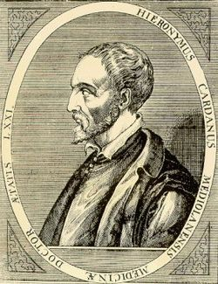
Gerolamo Cardano(1501-1576)
ax^3 +bx+c=0
Notes:
کاردان حدود سالهای 1524-1550 در دانشگاه تحصیل می‌کرد که ”کتاب بازیهای شانس“ را نوشت. که واقعاً کتابی است برای قماربازها. با این حال اولین کتاب درباره احتمال است. این کتاب شامل توصیف بازی‌ها قمار، که مهم‌ترین منبع درآمد برایش بود، است. کاردان به درستی تعداد راه‌های انداخته شدن دو تاس(و حتی سه تا) را فهرست کرد. او اولین کسی است که از امید ریاضی استفاده کرد. او همچنین روز مرگش را پیشبینی کرد ولی وقتی آن روز فرا رسید او هنوز زنده بود. برای اینکه اعتبار حرفه‌اییش حفظ شود، خودکشی کرد.

Slide 3
Galileo(1564-1642)
Galileo(1564-1642)
Galileo Paradox: which shows that there are as many perfect squares as there are whole numbers, even though most numbers are not perfect squares.
Notes:
گالیله مسئله انداختن سه تا تاس را بررسی کرد و نشان داد اعداد 9 و 10 را به شش حالت می‌توان تولید کرد. او تمام حالت‌ها را با دقت بررسی کرد و نشان داد از 216 راه که سه تاس تولید می‌کنند 27 راه برای ده، ولی 25 راه برای به دست آوردن 9 وجود دارد. بنابراین نتایج نظریه احتمال بوسیله روش‌ها آزمایشی بدست می‌آمد.

Slide 4
Simplicio: Here a difficulty presents itself which appears to me insoluble. Since it is clear that we may have one line greater than another, each containing an infinite number of points, we are forced to admit that, within one and the same class, we may have something greater than infinity, because the infinity of points in the long line is greater than the infinity of points in the short line. This assigning to an infinite quantity a value greater than infinity is quite beyond my comprehension.
Salviati: This is one of the difficulties which arise when we attempt, with our finite minds, to discuss the infinite, assigning to it those properties which we give to the finite and limited; but this I think is wrong, for we cannot speak of infinite quantities as being the one greater or less than or equal to another. To prove this I have in mind an argument which, for the sake of clearness, I shall put in the form of questions to Simplicio who raised this difficulty. I take it for granted that you know which of the numbers are squares and which are not.
Simplicio: I am quite aware that a squared number is one which results from the multiplication of another number by itself; thus 4, 9, etc., are squared numbers which come from multiplying 2, 3, etc., by themselves.
Salviati: Very well; and you also know that just as the products are called squares so the factors are called sides or roots; while on the other hand those numbers which do not consist of two equal factors are not squares. Therefore if I assert that all numbers, including both squares and non-squares, are more than the squares alone, I shall speak the truth, shall I not?
Simplicio: Most certainly.
Salviati: If I should ask further how many squares there are one might reply truly that there are as many as the corresponding number of roots, since every square has its own root and every root its own square, while no square has more than one root and no root more than one square.
Simplicio: Precisely so.
Salviati: But if I inquire how many roots there are, it cannot be denied that there are as many as the numbers because every number is the root of some square. This being granted, we must say that there are as many squares as there are numbers because they are just as numerous as their roots, and all the numbers are roots. Yet at the outset we said that there are many more numbers than squares, since the larger portion of them are not squares. Not only so, but the proportionate number of squares diminishes as we pass to larger numbers, Thus up to 100 we have 10 squares, that is, the squares constitute 1/10 part of all the numbers; up to 10000, we find only 1/100 part to be squares; and up to a million only 1/1000 part; on the other hand in an infinite number, if one could conceive of such a thing, he would be forced to admit that there are as many squares as there are numbers taken all together.
Sagredo: What then must one conclude under these circumstances?
Salviati: So far as I see we can only infer that the totality of all numbers is infinite, that the number of squares is infinite, and that the number of their roots is infinite; neither is the number of squares less than the totality of all the numbers, nor the latter greater than the former; and finally the attributes "equal," "greater," and "less," are not applicable to infinite, but only to finite, quantities. When therefore Simplicio introduces several lines of different lengths and asks me how it is possible that the longer ones do not contain more points than the shorter, I answer him that one line does not contain more or less or just as many points as another, but that each line contains an infinite number.— Galileo, Two New Sciences

Slide 5
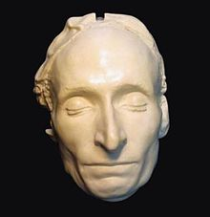
Pascal (1623-1662)
Notes:
به نظر چندی از تاریخ‌نویسان، پاسکال ”می‌توانست“ بزرگترین ریاضی‌دان تاریخ باشد. وقتی او 12 ساله بود از معلم خود پرسید که هندسه چیست. مطابق گفته‌ها خواهرش او 34 قضیه اقلیدس را یاد گرفت که بسیار شک برانگیز است. در سن 14 پدرش او را به بحث‌ها هفتگی علمی می‌برد. ”مثلث پاسکال“ 3 قرن پیش از او شناخته شده بود. با این حال به اسم او گذاشتند چون در آن روابط زیادی کشف کرد. از جمله آنها محاسبه تعداد شیر یا خط آمدن سکه است. مثلاً کمک می‌کند احتمال آمدن دو شیر و یک خط ذر پرتاب کردن همزمانِ 3 سکه را مشخص می‌کند. البته مثلث پاسکال قسمتی کوچک از توسعه نظریه احتمال بود که توسط او توسعه یافت.

Slide 6
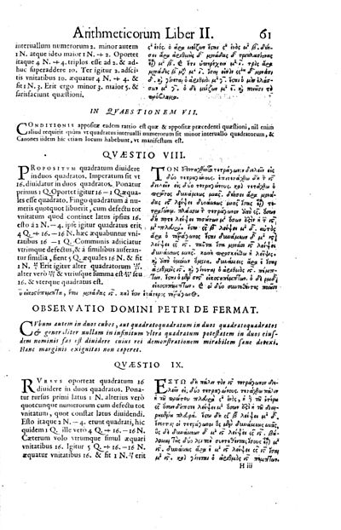
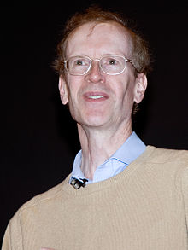
Fermat (1601 or 1607-1665)
“I have found for this truly wonderful proof, but the margin is too small to hold it.”
a^{n} + b^{n} = c^{n}
Notes:
فرما همان اعتبار گذاشتن نظریه احتمال را بر پایه‌ها علمی دارد که پاسکال دارد. خوش‌گذرانی او ریاضیات بوده است. زیباترین کشفیات او در ریاضی مربوط به نظریه اعداد می‌باشد. بیشتر کارهای او در حاشیه‌ها کتاب‌هایی است که می‌خوانده پیدا می‌شود.

Slide 7
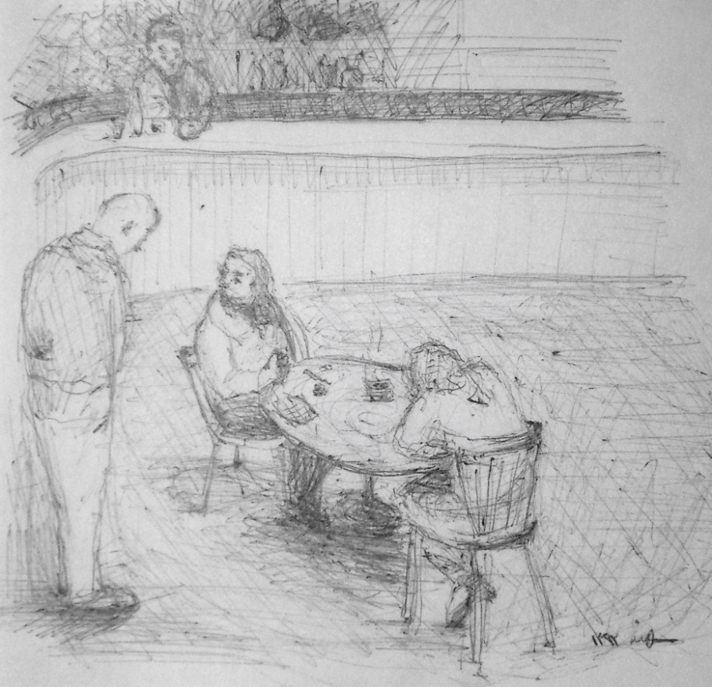
Probabality Becomes Science: Correspondence between Fermat and Pascal
Problem of Points: Two equally skilled players are interrupted while playing a game of chance for a certain amount of money. Given the score of the game at that point, how should the stakes be divided?
Notes:
De Mere posed this question to Pascal and Fermat are sitting in a cafe in Paris and decide, after many arduous hours discussing more difficult scenarios, to play the simplest of all games, flipping a coin. If the coin comes up heads, Fermat gets a point. If it comes up tails, Pascal gets a point. The first to get 10 points wins. Knowing that they'll just end up taking each other out to dinner anyway, they each ante up a generous 50 Francs, making the total pot worth 100. They are, of course, playing 'winner takes all'. But then a strange thing happens. Fermat is winning, 8 points to 7, when he receives an urgent message that a friend is sick, and he must rush to his home town of Toulouse. The carriage man who has delivered the message offers to take him, but only if they leave immediately. Of course Pascal understands, but later, in correspondence, the problem arises: how should the 100 Francs be divided?
In a letter to Pascal, Fermat proposes this solution:
Dearest Blaise,
As to the problem of how to divide the 100 Francs, I think I have found a solution that you will find to be fair. Seeing as I needed only two points to win the game, and you needed 3, I think we can establish that after four more tosses of the coin, the game would have been over. For, in those four tosses, if you did not get the necessary 3 points for your victory, this would imply that I had in fact gained the necessary 2 points for my victory. In a similar manner, if I had not achieved the necessary 2 points for my victory, this would imply that you had in fact achieved at least 3 points and had therefore won the game. Thus, I believe the following list of possible endings to the game is exhaustive. I have denoted 'heads' by an 'h', and tails by a 't.' I have starred the outcomes that indicate a win for myself.
h h h h * h h h t * h h t h * h h t t *h t h h * h t h t * h t t h * h t t tt h h h * t h h t * t h t h * t h t tt t h h * t t h t t t t h t t t tI think you will agree that all of these outcomes are equally likely. Thus I believe that we should divide the stakes by the ration 11:5 in my favor, that is, I should receive (11/16)*100 = 68.75 Francs, while you should receive 31.25 Francs.

Slide 8
Huygens(1629 – 1695)
Probability in Print
Notes:
هیوگنز از مکاتبات پاسکال و فرما با خبر بود و در سال 1657 رساله‌ای دربره احتمال منتشر کرد. این اولین چیزی بود که در مورد بازی‌ها شانس منتشر می‌شد. در حالی که کتاب کاردان تا نود سال بعد از مرگش یعنی 1663 به چاپ نرسید. اعتبار مفهوم امید ریاضی به هیوگنز داده شده است.

Slide 9
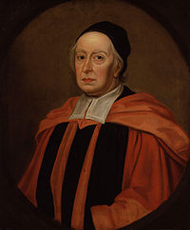
Leibniz(1646–1716German)
John Wallis(1616–1703)
Dissertatio de Arte Combinatoria:
He is credited with introducin the symbol for infinity.
Leibniz was the first to use the term analysis situs(ناحیه)

Slide 10
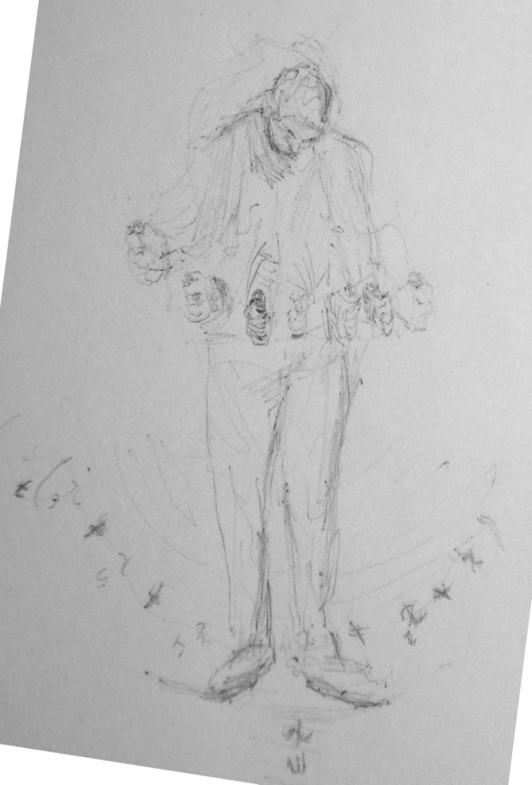
Jacob Benoulli (1655 -1705, Switzerland)
The number of ways in which a total of m points can be obtained by throwing n dice at once is equal to the coefficient of in:
Bernoulli discovered the constant e:

Slide 11
Daniel Bernoulli(1700–1782)
A casino offers a game of chance for a single player in which a fair coin is tossed at each stage. The pot starts at 1 dollar and is doubled every time a head appears. The first time a tail appears, the game ends and the player wins whatever is in the pot. Thus the player wins 1 dollar if a tail appears on the first toss, 2 dollars if a head appears on the first toss and a tail on the second, 4 dollars if a head appears on the first two tosses and a tail on the third, 8 dollars if a head appears on the first three tosses and a tail on the fourth, and so on. In short, the player wins 2^{k−1} dollars if the coin is tossed k times until the first tail appears.
What would be a fair price to pay the casino for entering the game? To answer this we need to consider what would be the average payout: With probability 1/2, the player wins 1 dollar; with probability 1/4 the player wins 2 dollars; with probability 1/8 the player wins 4 dollars, and so on. The expected value is thus
Assuming the game can continue as long as the coin toss results in heads, in particular that the casino has unlimited resources, this sum grows without bound, and so the expected win for the player, at least in this idealized form, is an infinite amount of money. Considering nothing but the expectation value of the net change in one's monetary wealth, one should therefore play the game at any price if offered the opportunity. Yet, in published descriptions of the game, many people expressed disbelief in the result. Martin quotes Ian Hacking as saying "few of us would pay even $25 to enter such a game" and says most commentators would agree. The paradox is the discrepancy between what people seem willing to pay to enter the game and the infinite expected value.

Slide 12
De Moivre(1667-1754)
If p is the probability of the success of an event, the probabilty of exactly r successes followed by n-r failures is:

Slide 14
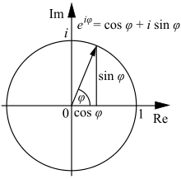
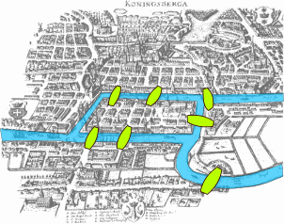
Leonhard Euler(1707–1783, German)
Notes:
اویلر بیشتر از دستاوردهای احتمال در مسال کاربردی استفاده می‌کرد: سود بانکی، بیمه و... .

Slide 15
Buffon (1707–1788)
Introduced differential and integral calculus to probability
Notes:
بوفُن رویکرد آزمایشی را دوست داشت. او سکه‌ای را 4040 بار پرتاب کرد که 2048 بار آن شیر آمد. و بنابراین احتمال شیر آمدن را 0.507 محاسبه کرد. آیا این یک تناقض است؟ اگر هر چقدر تعداد پرتاب‌ها بیشتر شود به 0.5 نزدیک‌تر می‌شود؟

Slide 16
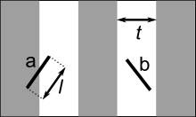
Buffon’s Needle
The problem in more mathematical terms is: Given a needle of length dropped on a plane ruled with parallel lines t units apart, what is the probability that the needle will cross a line?
Let x be the distance from the center of the needle to the closest line, let θ be the acute angle between the needle and the lines.
The uniform probability density function of x between 0 and t /2 is
The uniform probability density function of θ between 0 and π/2 is
The two random variables, x and θ, are independent, so the joint probability density function is the product
The needle crosses a line if
This GIF image describes the solution of Buffon's Needle Problem for the "short needle" case
Suppose .
Integrating the joint probability density function gives the probability that the needle will cross a line:
A particularly nice argument for this result can alternatively be given using "Buffon's noodle".

Slide 17
Estimating π
In the first, simpler case above, the formula obtained for the probability can be rearranged to:
Thus, if we conduct an experiment to estimate P, we will also have an estimate for π.
Suppose we drop n needles and find that h of those needles are crossing lines, so is approximated by the fraction . This leads to the formula:
In 1901, Italian mathematician Mario Lazzarini performed the Buffon's needle experiment. Tossing a needle 3408 times, he obtained the well-known estimate 355/113 for π, which is a very accurate value, differing from π by no more than 3×10⁻⁷

Slide 18
Thomas Bayes(1702-1761)
Notes:
In the first decades of the eighteenth century, many problems concerning the probability of certain events, given specified conditions, were solved. For example, given a specified number of white and black balls in an urn, what is the probability of drawing a black ball? Attention soon turned to the converse of such a problem: given that one or more balls has been drawn, what can be said about the number of white and black balls in the urn?

Slide 19
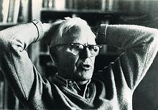
- Bertrand’s Box Paradox -Monty Hall Problem(Steve Selvin) -Three Prisoner Problem(Martin Gardner)

Slide 20
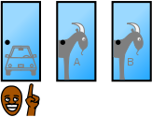
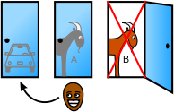
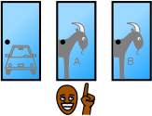
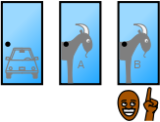
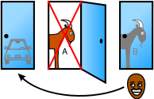

Slide 21
Laplace (1749–1827)
Classic definition of probability:
1. Probability is the ratio of the "favored events" to the total possible events.
2. The first principle assumes equal probabilities for all events. When this is not true, we must first determine the probabilities of each event. Then, the probability is the sum of the probabilities of all possible favored events.
3. For independent events, the probability of the occurrence of all is the probability of each multiplied together.
4. For events not independent, the probability of event B following event A (or event A causing B) is the probability of A multiplied by the probability that A and B both occur.
5. The probability that A will occur, given that B has occurred, is the probability of A and B occurring divided by the probability of B.
6. Three corollaries are given for the sixth principle, which amount to Bayesian probability. Where event A_{i} ∈ {A₁, A₂, ...A_{n}} exhausts the list of possible causes for event B, Pr(B) = Pr(A₁, A₂, ...A_{n}). Then
“I had no need of such a hypothesis.”
Notes:
لاپلاس به عنوان پدر نظریه احتمال مدرن شناخته می‌شود. همچنین او این نظریه را در مکانیک آسمان بکار برد. در یک رساله‌اش از صد ستاره‌ دنباله‌دار، حتی یکی از آنها روی هذلولی حرکت نمی‌کنند. او بوسیله نظریه احتمال نشان داد که چنین نتیجه‌ای قابل انتظار است. احتمال اینکه ستاره دنباله‌دار روی بیضی خیلی زیاد است. او همچنین قضیه حد مرکزی را اثبات کرد.

Slide 22
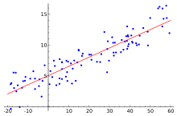
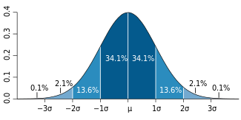
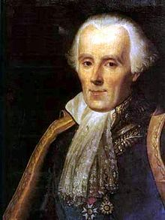
Gauss(1777 –1855)
Notes:
گاوس به نظر بسیاری از تاریخ‌نویسان جزو سه نفر برتر تاریخ ریاضی بوده است؛ که دوتا دیگر آن نیوتن و ارشمیدس هستند. تز دکترای او به“قضیه اساسی جبر“ معروف است. که می‌گوید هر چندجمله‌ای از درجه یک یا بیشتر ریشه دارد. او 1809 روش کوچک‌ترین مربعات را ابداع کرد که دستاوردش منجربه کشف منحنی نرمال شد. و لاپلاس در سال 1810 قضیه حد مرکزی را اثبات کرد.

Slide 23
Charles Peirce
In 1860 he suggested a cardinal arithmetic for infinite numbers, years before any work by Georg Cantor (who completed his dissertation in 1867) and without access to Bernard Bolzano's 1851 (posthumous) Paradoxien des Unendlichen.
In 1881 he set out the axiomatization of natural number arithmetic, a few years before Richard Dedekind and Giuseppe Peano.
In 1885 he distinguished between first-order and second-order quantification. In the same paper he set out what can be read as the first (primitive) axiomatic set theory, anticipating Zermelo by about two decades (Brady 2000, pp. 132–3).
In 1886 he saw that Boolean calculations could be carried out via electrical switches, the same idea that was used decades later to produce digital computers.
Pragmatism

Slide 24
Notes:
در رساله ”قرمز و سیاه“ گفته است نظریه احتمال علم منطق است.هر چیز درست یا غلط است، و اینها می‌توانند با اعداد 1 و 0 جایگزین شوند. پس هر مساله نظریه احتمال، یک مساله کلی در منطق است.

Slide 25
Keynes (1883–1946)
Notes:
هیچ گزاره به خودی خود محتمل یا نامحتمل نیست، مثل اینکه هیچ مکانی ذاتاً دور نیست، و احتمال همان گزاره با شواهد جدید، که همان منباء رجوع است، تغییر می‌کند. به عنوان مثال احتمال بدنیا آمدن دختر 0.5 است چون بچه بدنیا آمده یا پسره یا دختر. ولی اگر اطلاعات مربوط به DNA داشته باشیم محاسبه این احتمال پیچیده‌تر می‌شود. بنایراین کینز و ون مایسز بر این عقیده بودند هر احتمالی، شرطی است.[Gillies,1973]

Slide 26
Richard von Mises(1883-1953)
The law of stability of statistical frequencies:
The law of excluded gambling system:
Notes:
قانون اول: وقتی تعداد مشاهدات بیشتر می‌شود، نسبت تعداد پیشامد‌ها مطلوب به کل پایدارتر می‌شود. این یعنی حد بالا وجود دارد. و آنرا احتمال A می‌نامیم. قانون دوم: غیر ممکن است که زیر دنباله‌ای از دنباله تصادفی از مشاهدات را انتخاب کرد که نسبت m(a)/a(n) (که a(n) زیردنباله اعداد طبیعی است) به احتمال A میل نکند. مایسز به تعریف کلموگروف از دو پیشامد مستقل ایراد گرفت(1941)، کلموگروف دو پیشامد را مستقل می‌دانست اگرB)=P(A)P(B)∩P(A. او مثال زیر را معرفی کرد: Ω={1،2،3،4} و P(1)=P(2)=P(3)=P(4)=1/4 و A=(1,2) , B=(2,3) آنگاه ایندو مستقلند ولی نه در شهود.[Gillies,1973]

Slide 27
Andrey Kolmogorov (1903–1987)
First axiom
The probability of an event is a non-negative real number:
where is the event space and is any event in . In particular, is always finite, in contrast with more general measure theory. Theories which assign negative probability relax the first axiom.
Second axiom
This is the assumption of unit measure: that the probability that some elementary event in the entire sample space will occur is 1. More specifically, there are no elementary events outside the sample space.
This is often overlooked in some mistaken probability calculations; if you cannot precisely define the whole sample space, then the probability of any subset cannot be defined either.
Third axiom This is the assumption of σ-additivity:
Any countable sequence of disjoint (synonymous with mutually exclusive) l events satisfies
Some authors consider merely finitely additive probability spaces, in which case one just needs an algebra of sets, rather than a σ-algebra.Quasiprobability distributions in general relax the third axiom

Slide 28
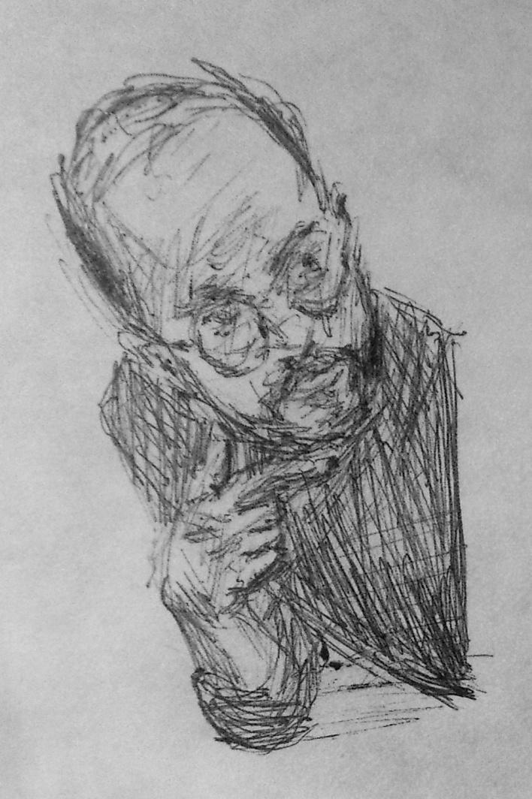
Birthday Problem
Pigeonhole theorem vs. Probability Theory

Slide 29
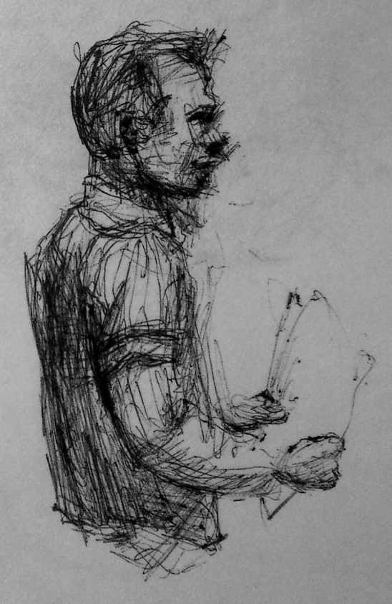
n | P(n)
20 | 41.1%
23 | 50.7%
30 | 70.6%
50 | 97%
57 | 99%
100 | 99.99997%
200 | 99. 9999999999999999999999999998%

Slide 30
Refrences
Pathways to Probability, Amy C. King/Cecil Read, 1963.
An Objective Theory of Probability, Gillies, 1973.
wikipedia.com

