Slide 2
Diabetes Mellitus: Introduction
Diabetes mellitus (DM) a group of common metabolic disorders that share the phenotype of hyperglycemia.
All types caused by interaction of genetics & environment
Depending on the etiology of the DM:
reduced insulin secretion
decreased glucose utilization, and
increased glucose production.

Slide 3
The metabolic dysregulation associated with DM causes secondary pathophysiologic changes in multiple organ systems
In the United States, DM is the leading cause of end-stage renal disease (ESRD), nontraumatic lower extremity amputations, and adult blindness. It also predisposes to cardiovascular diseases. With an increasing incidence worldwide, DM will be a leading cause of morbidity and mortality for the foreseeable future

Slide 4
Classification
DM is classified on the basis of the pathogenic process that leads to hyperglycemia, as opposed to earlier criteria such as age of onset or type of therapy . The two broad categories of DM are designated type 1 and type 2

Slide 5
Type 1 DM is the result of complete or near-total insulin deficiency.
Type 2 DM is a heterogeneous group of disorders characterized by variable degrees of insulin resistance, impaired insulin secretion, and increased glucose production. Type 2 DM is preceded by a period of abnormal glucose homeostasis classified as impaired fasting glucose (IFG) or impaired glucose tolerance (IGT).

Slide 6
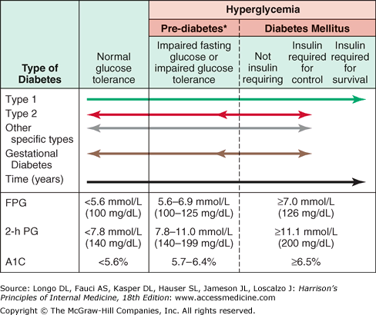

Slide 7
Etiologic Classification of Diabetes Mellitus
I. Type 1 diabetes (beta cell destruction, usually leading to absolute insulin deficiency)
A. Immune-mediated
B. Idiopathic
II. Type 2 diabetes (may range from predominantly insulin resistance with relative insulin deficiency to a predominantly insulin secretory defect with insulin resistance)

Slide 8
Etiologic Classification of Diabetes Mellitus
III. Other specific types of diabetes
A. Genetic defects of βcell function by mutation: Proinsulin or insulin
B. Genetic defects in insulin action : Lipodystrophy syndromes
C. Diseases of the exocrine pancreas : pancreatitis, neoplasia, cystic fibrosis, hemochromatosis
D. Endocrinopathies : acromegaly, glucagonoma, pheochromocytoma, hyperthyroidism, aldosteronoma
E. Drug- or chemical-induced : glucocorticoids, vacor , pentamidine, nicotinic acid, diazoxide, thiazides, hydantoins, asparaginase, interferon, antipsychotics, epinephrin
F. Infections—congenital rubella, cytomegalovirus, coxsackievirus
G. Uncommon forms of immune-mediated diabetes : anti-insulin receptor antibodies
H. Other genetic syndromes : Down's syndrome, Klinefelter's syndrome, Turner's syndrome, Huntington's chorea, myotonic dystrophy, porphyria, Prader-Willi syndrome
IV. Gestational diabetes mellitus (GDM)

Slide 9
Gestational Diabetes Mellitus (GDM)
Glucose intolerance developing during pregnancy is classified as gestational diabetes. Insulin resistance is related to the metabolic changes of late pregnancy, and the increased insulin requirements may lead to IGT or diabetes. GDM occurs in 7% of pregnancies ; most women revert to normal but have risk of developing DM in the next 10–20 years. The International Diabetes and Pregnancy Study Groups now recommends that diabetes diagnosed at the initial prenatal visit should be classified as "overt" diabetes rather than gestational diabetes.

Slide 10
Epidemiology
The worldwide prevalence of DM has risen dramatically over the past two decades. Although the prevalence of both type 1 and type 2 DM is increasing worldwide, the prevalence of type 2 DM is rising much more rapidly, presumably because of increasing obesity, reduced activity levels as countries become more industrialized, and the aging of the population.
DM increases with aging.
The prevalence is similar in men and women throughout most age ranges.
Worldwide estimates project that in 2030 the greatest number of individuals with diabetes will be aged 45–64 years.

Slide 11
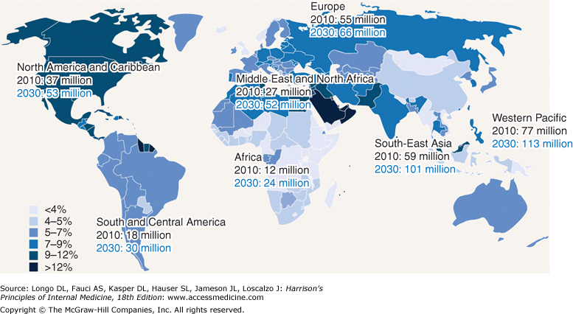

Slide 13
Criteria for the Diagnosis of Diabetes Mellitus
Symptoms of diabetes plus random blood glucose concentration 11.1 mmol/L (200 mg/dL) or
Fasting plasma glucose 7.0 mmol/L (126 mg/dL) or
A1C > 6.5%
Two-hour plasma glucose 11.1 mmol/L (200 mg/dL) during an oral glucose tolerance test

Slide 14
Risk Factors for Type 2 Diabetes Mellitus
Family history of diabetes (i.e., parent or sibling with type 2 diabetes)
Obesity (BMI >25 kg/m2)
Physical inactivity
Race/ethnicity (e.g., African American, Latino, Native American, Asian American, Pacific Islander)
Previously identified with IFG, IGT, or an A1C of 5.7–6.4%
History of GDM or delivery of baby >4 kg (9 lb)
Hypertension (blood pressure 140/90 mmHg)
HDL cholesterol level <35 mg/dL (0.90 mmol/L) and/or a triglyceride level >250 mg/dL (2.82 mmol/L)
Polycystic ovary syndrome or acanthosis nigricans
History of cardiovascular diseases

Slide 15
Biosynthesis
. It is initially synthesized as a single-chain 86-amino-acid precursor polypeptide, preproinsulin. Subsequent proteolytic processing removes the amino-terminal signal peptide, giving rise to proinsulin. WHICH is structurally related to insulin-like growth factors I & II

Slide 16
Secretion
Glucose is the key regulator of insulin secretion by the pancreatic beta cell, although amino acids, ketones, various nutrients, gastrointestinal peptides, and neurotransmitters also influence insulin secretion. Glucose levels >3.9 mmol/L (70 mg/dL) stimulate insulin synthesis, primarily by enhancing protein translation and processing. Glucose stimulation of insulin secretion begins with its transport into the beta cell by a facilitative glucose transporter

Slide 17
Action

Slide 18
Pathogenesis Type 1 DM
Normal beta cell mass at birth but begin to lose cells secondary to autoimmune destruction that occurs over months to years.
Triggered by an infectious or environmental stimulus. In the majority, immunologic markers appear after the triggering event but before diabetes becomes clinically overt.
Beta cell mass decrease, although normal glucose tolerance. The rate of decline varies widely. Not evident until a majority of beta cells are destroyed (70–80%)

Slide 19
Pathogenesis Type 1 DM
Trigger event: transition from glucose intolerance to frank diabetes are often increased insulin requirements, i.e infections or puberty.
A “Honeymoon" phase : glycemic control by modest doses of insulin or, rarely, insulin is not needed. However, residual beta cells disappear as the autoimmune process destroys remaining beta cells, and the individual becomes insulin deficient.
Some produce a small amount of insulin (as reflected by C-peptide production) and some individuals have insulin-positive cells in the pancreas at autopsy.

Slide 20
Genetic Considerations
Susceptibility to type 1 DM involves multiple genes. The concordance of type 1 DM in identical twins 50%, indicating additional modifying factors .
The major susceptibility gene for type 1 DM is located in the HLA region on chromosome 6

Slide 21
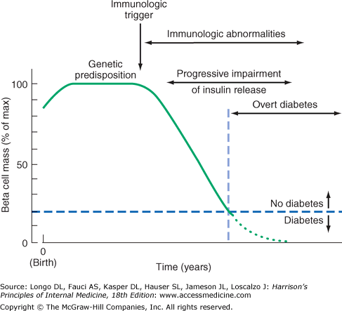

Slide 22
Pathophysiology
Although other islet cell types [alpha cells (glucagon-producing), delta cells (somatostatin-producing), or PP cells (pancreatic polypeptide-producing)] are functionally and embryologically similar to beta cells and express most of the same proteins as beta cells, they are spared from the autoimmune destruction. Pathologically, the pancreatic islets are infiltrated with lymphocytes (insulitis).
After all beta cells destruction, the inflammatory process abates, the islets become atrophic, and most immunologic markers disappear.
environmental triggers include viruses (coxsackie, rubella, enteroviruses most prominently), bovine milk proteins, and nitrosourea compounds.

Slide 23
Type 2 DM
Insulin resistance and abnormal insulin secretion are central to the development of type 2 DM

Slide 24
Strong Genetic Component
Type 2 DM has a The concordance of type 2 DM in identical twins is between 70 and 90%
If both parents have type 2 DM, the risk approaches 40%
The disease is polygenic and multifactorial, since in addition to genetic susceptibility, environmental factors (such as obesity, nutrition, and physical activity) modulate the phenotype

Slide 25
Pathophysiology
Characterized by impaired insulin secretion, insulin resistance, excessive hepatic glucose production, and abnormal fat metabolism. Obesity, particularly visceral or central (as evidenced by the hip-waist ratio), is very common in type 2 DM (80% or more are obese). In the early stages of the disorder, glucose tolerance remains near-normal, despite insulin resistance, because of compensatory hyperinsulinemia.

Slide 26
Metabolic Abnormalities
Abnormal Muscle and Fat Metabolism
Impaired Insulin Secretion
Increased Hepatic Glucose and Lipid Production

Slide 27
Prevention
Type 2 DM is preceded by a period of IGT or IFG, and a number of lifestyle modifications and pharmacologic agents prevent or delay the onset of DM. The Diabetes Prevention Program (DPP) demonstrated that intensive changes in lifestyle (diet and exercise for 30 min/d five times/week) in individuals with IGT prevented or delayed
Individuals with a strong family history of type 2 DM and individuals with IFG or IGT should be strongly encouraged to maintain a normal BMI and engage in regular physical activity.

Slide 28
Acute Complications of DM
Diabetic Ketoacidosis
Hyperglycemic Hyperosmolar State

Slide 29
Diabetic Ketoacidosis
DKA results from relative or absolute insulin deficiency combined with counterregulatory hormone excess (glucagon, catecholamines, cortisol, and growth hormone) in 24 hrs.
After initiating IV fluid replacement and insulin therapy, the agent or event that precipitated the episode of DKA should be sought and aggressively treated

Slide 30
Manifestations of Diabetic Ketoacidosis
Precipitating events
Inadequate insulin administration
Infection (pneumonia/UTI/gastroenteritis/sepsis)
Infarction (cerebral, coronary, mesenteric, peripheral)
Drugs (cocaine)
Pregnancy

Slide 31
Symptoms
Nausea/vomiting
Thirst/polyuria
Abdominal pain
Shortness of breath
Physical Findings
Tachycardia
Dehydration/hypotension
Tachypnea/Kussmaul respirations/respiratory distress
Abdominal tenderness (acute pancreatitis or surgical abdomen)
Lethargy/possibly coma

Slide 32
Hyperglycemic Hyperosmolar State Pathophysiology
The prototypical patient with HHS is an elderly individual with type 2 DM, with a several-week history of polyuria, weight loss, and diminished oral intake that culminates in mental confusion, lethargy, or coma
Relative insulin deficiency and inadequate fluid intake

Slide 33
Chronic Complications Microvascular
Eye disease
Retinopathy (nonproliferative/proliferative)
Macular edema
Neuropathy
Sensory & motor (mono & polyneuropathy)
Autonomic
Nephropathy

Slide 34
Chronic Complications Macrovascular
Coronary heart disease
Peripheral arterial disease
Cerebrovascular disease
Other
Gastrointestinal (gastroparesis, diarrhea)
Genitourinary (uropathy/sexual dysfunction)
Dermatologic
Infectious
Cataracts
Glaucoma
Periodontal disease
Hearing loss

Slide 35
Patient Education
The patient with type 1 or type 2 DM should receive education about nutrition, exercise, care of diabetes during illness, and medications to lower the plasma glucose. Along with improved compliance, patient education allows individuals with DM to assume greater responsibility for their care.
Diabetes self-management education (DSME). More frequent contact between the patient and the diabetes management team (electronic, telephone, etc.) improves glycemic control

Slide 36
Diabetes Education
The diabetes educator is a health care professional (nurse, dietician, or pharmacist) with specialized patient education skills who is certified in diabetes education (e.g., ADA Educators).
Education topics important for optimal diabetes care include self-monitoring of blood glucose; urine ketone monitoring (type 1 DM); insulin administration; guidelines for diabetes management during illnesses; prevention and management of hypoglycemia; foot and skin care; diabetes management before, during, and after exercise; and risk factor–modifying activities

Slide 37
Nutritional Recommendations
Weight loss diet (in prediabetes and type 2 DM)
Hypocaloric diet that is low-fat or low-carbohydrate
Fat in diet
Minimal trans fat consumption
Carbohydrate in diet
Monitor carbohydrate intake in regards to calories
Sucrose-containing foods may be consumed with adjustments in insulin dose
Amount of carbohydrate determined by estimating grams of carbohydrate in diet for (type 1 DM)
Glycemic index reflects how consumption of a particular food affects the blood glucose
Protein in diet: as part of an optimal diet
Other components
Nonnutrient sweeteners
Routine supplements of vitamins, antioxidants, or trace elements not advised

Slide 38
Exercise
Exercise has multiple positive benefits : cardiovascular risk reduction, reduced BP, maintenance of muscle mass, reduction in body fat, and weight loss.
For DM, exercise is also useful for lowering plasma glucose (during and following exercise) and increasing insulin sensitivity.
ADA recommends 150 min/week (distributed over at least 3 days) of moderate aerobic physical activity

Slide 39
Treatment Establishment of Target Level of Glycemic Control
Type 1 DM
Type 2 DM
Intensive Management
Insulin Regimens
(Short & Long acting)
Other Agents that Improve Glucose Control ( Amylin ! )
Glucose-Lowering Agents
Bile acid–binding resins
Insulin Therapy

Slide 40
Special Considerations
Total parenteral nutrition (TPN) greatly increases insulin requirements. In addition, individuals not previously known to have DM may become hyperglycemic during TPN and require insulin treatment
Glucocorticoids increase insulin resistance, decrease glucose utilization, increase hepatic glucose production, and impair insulin secretion
Reproductive capacity in either men or women with DM appears to be normal. Menstrual cycles may be associated with alterations in glycemic control in women with DM. Pregnancy is associated with marked insulin resistance; the increased insulin requirements often precipitate DM and lead to the diagnosis of GDM
Emotional stress may provoke a change in behavior so that individuals no longer adhere to a dietary, exercise, or therapeutic regimen

