Slide 2
How do we know that something is alive?
The answer generally comes down to a series of conditions:
Movement: Living things have an ability to detect and respond to stimuli (both internal and external) and are capable of moving as a response to a stimulus.
Reproduction and heredity: All cells come from existing cells and must have some way of reproducing. Living things use a molecule called DNA (deoxyribonucleic acid). This information is passed from one generation to the next and controls a large number of different characteristics. These instructions must be unchanging most of the time, but provide for the rare change in instructions. Changes in the hereditary instructions that can lead to evolution are called mutations.

Slide 3
How do we know that something is alive?
Growth and development: Even single-celled organisms which reproduce by dividing themselves in half, grow. DNA contains the instructions for growth and development. When first formed by cell division, cells are small, and must grow and develop into mature cells. Animals and plants that are composed of large numbers of cells pass through a more complicated process of growth and development. Cells increase in number and also change themselves into different kinds of cells to form the various tissues and organs that make up the individual.
Organization: Living things exhibit a high level of organization. Organisms are made up of cells. Cells contain organelles. Organelles are made up of molecules.

Slide 4
How do we know that something is alive?
Metabolism: Living things acquire energy (from sunlight, inorganic chemicals, or another organism), and by chemical processes use it to keep themselves alive. The chemical processes in the living cell are collectively called metabolism. a molecule called ATP (adenosine triphosphate).
Homeostasis: essentially means remaining the same. Our bodies strive to maintain a constant yet dynamic internal environment. This includes such things as temperature, pH, and water concentrations.

Slide 5
7 Theories on the Origin of Life:
Panspermia
Perhaps life did not begin on Earth at all, but was brought here from elsewhere in space, a notion known as panspermia. For instance, rocks regularly get blasted off Mars by cosmic impacts, and a number of Martian meteorites have been found on Earth that some researchers have controversially suggested brought microbes over here, potentially making us all Martians originally. Other scientists have even suggested that life might have hitchhiked on comets from other star systems. However, even if this concept were true, the question of how life began on Earth would then only change to how life began elsewhere in space.

Slide 6
7 Theories on the Origin of Life:
2) Simple Beginnings
Instead of developing from complex molecules such as RNA, life might have begun with smaller molecules interacting with each other in cycles of reactions. These might have been contained in simple capsules akin to cell membranes, and over time more complex molecules that performed these reactions better than the smaller ones could have evolved, scenarios dubbed "metabolism-first" models, as opposed to the "gene-first" model of the "RNA world" hypothesis.

Slide 7
7 Theories on the Origin of Life:
3) RNA World
Nowadays DNA needs proteins in order to form, and proteins require DNA to form, so how could these have formed without each other? The answer may be RNA, which can store information like DNA, serve as an enzyme like proteins, and help create both DNA and proteins. Later DNA and proteins succeeded this "RNA world," because they are more efficient. RNA still exists and performs several functions in organisms, including acting as an on-off switch for some genes. The question still remains how RNA got here in the first place. And while some scientists think the molecule could have spontaneously arisen on Earth, others say that was very unlikely to have happened.

Slide 8
7 Theories on the Origin of Life:
4) Chilly Start
Ice might have covered the oceans 3 billion years ago, as the sun was about a third less luminous than it is now. This layer of ice, possibly hundreds of feet thick, might have protected fragile organic compounds in the water below from ultraviolet light and destruction from cosmic impacts. The cold might have also helped these molecules to survive longer, allowing key reactions to happen.

Slide 9
7 Theories on the Origin of Life:
5) Deep-Sea Vents
The deep-sea vent theory suggests that life may have begun at submarine hydrothermal vents, spewing key hydrogen-rich molecules. Their rocky nooks could then have concentrated these molecules together and provided mineral catalysts for critical reactions. Even now, these vents, rich in chemical and thermal energy, sustain vibrant ecosystems.

Slide 10
7 Theories on the Origin of Life:
6) Community Clay
The first molecules of life might have met on clay, according to an idea elaborated by organic chemist Alexander Graham Cairns-Smith at the University of Glasgow in Scotland. These surfaces might not only have concentrated these organic compounds together, but also helped organize them into patterns much like our genes do now.
The main role of DNA is to store information on how other molecules should be arranged. Genetic sequences in DNA are essentially instructions on how amino acids should be arranged in proteins. Cairns-Smith suggests that mineral crystals in clay could have arranged organic molecules into organized patterns. After a while, organic molecules took over this job and organized themselves.

Slide 11
7 Theories on the Origin of Life:
7) Electric Spark
Electric sparks can generate amino acids and sugars from an atmosphere loaded with water, methane, ammonia and hydrogen, as was shown in the famous Miller-Urey experiment reported in 1953, suggesting that lightning might have helped create the key building blocks of life on Earth in its early days. Over millions of years, larger and more complex molecules could form. Although research since then has revealed the early atmosphere of Earth was actually hydrogen-poor, scientists have suggested that volcanic clouds in the early atmosphere might have held methane, ammonia and hydrogen and been filled with lightning as well.

Slide 12
Primordial soup
Life on Earth began more than 3 billion years ago, evolving from the most basic of microbes into a dazzling array of complexity over time. But how did the first organisms on the only known home to life in the universe develop from the primordial soup?

Slide 13
Animal Classification
In order for us to understand how all living organisms are related, they are arranged into different groups. The more features that a group of animals share, the more specific the group is. Animals are given scientific names so that people all around the world can communicate about animals, no matter what language they speak (these names are traditionally Latin words). Animals belong to a number of different groups, starting with the animal kingdom.

Slide 14
Kingdom
All living organisms are first placed into different kingdoms. There are five different kingdoms to classify life on Earth, which are Animals, Plants, Fungi, Bacteria, and Protists (single-celled organisms).

Slide 15
Phylum
The animal kingdom is divided into 40 smaller groups, known as phylum. Here, animals are grouped by their main features. Animals usually fall into one of five different phylum which are Cnidaria (invertebrates), Chordata (vertebrates), Arthropods, Molluscs and Echinoderms.

Slide 16
Class
The phylum group is then divided into even smaller groups, known as classes. The Chordata (vertebrates) phylum splits up into Mammalia (Mammals), Actinopterygii (Bony Fish), Chondrichthyes (Cartilaginous Fish) , Aves (Birds), Amphibia (Amphibians) and Reptilia (Reptiles).

Slide 17
Order
Each class is divided into small groups again, known as orders. The class Mammalia (Mammals), splits into different groups including Carnivora, Primate, Artiodactyla and Rodentia.

Slide 18
Family
In every order, there are different families of animals which all have very similar features. The Carnivora order breaks into families that include Felidae (Cats), Canidae (Dogs), Ursidae (Bears), and Mustelidae (Weasels).

Slide 19
Genus
Every animal family is then divided into small groups known as genus. Each genus contains animals that have very similar features and are closely related. For example, the Felidae (Cat) family contains genus including Felis (small Cats and domestic Cats), Panthera (Tigers, Leopards, Jaguars and Lions) and Puma (Panthers and Cougars).

Slide 20
Species
Each individual species within the genus is named after it's individual features and characteristics. The names of animals are in Latin so that they can be understood worldwide, and consist of two words. The first word in the name of an animal will be the genus, and the second name indicates the specific species.

Slide 21
Example - Tiger
Kingdom: Animalia (Animal)
Phylum: Chordata (Vertebrate)
Class: Mammalia (Mammal)
Order: Carnivora (Carnivore)
Family: Felidae (Cat)
Genus: Panthera
Species: Panthera tigris (Tiger)

Slide 22
There are many different types of animals in the world. Many animals are quite similar to each other. Others are quite different. Animals can be classified based on their similarities. Continue on, and learn more about your fellow Earth inhabitants.

Slide 23
Vertebrates:
Vertebrate animals have their unique backbone with the spinal cord. The backbone is a column of vertebrae, which are parts of their internal skeleton. The skeleton could be either bony or cartilaginous. Among members of the Chordates, they are the largest group including Birds, Mammals, Fish, Amphibians, and Reptiles. Their spinal cord runs along the body between cranial and caudal regions with a hollow tube of nervous tissue called spinal cord. Vertebrates have a bilaterally symmetrical bodies. The most important feature of the vertebrates is the well-developed brain covered by the bony structure called skull. Their respiratory systems function with either lungs or gills for gas exchange between the animal and the environment. Sometimes, there are other gas exchanging surfaces viz. oral cavities and skins have been important, especially in amphibians. The vertebrate digestive system is a complete one starting at the mouth and ends after rectum. This gastro intestinal tract lies ventrally to the spinal cord. Additionally, the mouth opens anterior, and the anus opens from the posterior end of the body. The circulatory system is a closed one with a ventrally located heart. Those are the major characteristics of vertebrates.

Slide 24
Invertebrates:
Invertebrates are simply the animals without a backbone. Invertebrates are a large group of animals that consist of more than 97% of all the animal species with a broad collection of animals including many Phylas and Subphylas. Sponges, coelenterates, echinoderms, Annelids, Molluscs (Squid, Octopus, Snails, Bivalves), and Arthropods are all belong to invertebrates. Some invertebrates such as Insects and many Molluscs (mollusks) have external skeletons, while others do not. Because of the lack of a supportive system, most of the invertebrates are smaller. The nervous system is extremely diverse among invertebrates ranging from loosely organized hydra nerve net up to sophisticated cephalopod brains. Feeding in invertebrates is mostly parasitic as well as other heterotrophic habits, and their systems are very simple. Sometimes there is only one opening for both feeding and defecation. Circulatory systems are open in many instances, and the heart is dorsal. Their respiratory systems are extremely diverse that starts from simple diffusion. Invertebrates demonstrate both radial and bilateral symmetry in their body organization. All those discussed characteristics of invertebrates have great diversification among them.

Slide 25
What is the difference between Vertebrates and Invertebrates?
• Vertebrates have a backbone with a spinal cord, whereas invertebrates do not.
• The diversity is exceptionally high among the invertebrates compared to vertebrates.
• Vertebrates are always bilaterally symmetrical, while invertebrates could show either bilateral or radial symmetry.
• Vertebrates are usually large-bodied and move fast compared to invertebrates.
• Vertebrates have a closed blood system, a well-developed brain, either gills or lungs for respiration, and a complex and sophisticated nervous system, whereas those are primitive in invertebrates. Therefore, it concerns that vertebrates have many specializations to extract the best out of the environment compared to invertebrates.

Slide 26
Despite all these changes, someone could draw a point that invertebrates are more adaptive due to their simplicity, whereas vertebrates do not have a good adaptability in comparison because of the specialization. However, I would like to quote a popular quote to finish that in evolution specialization paralyses and ultra specialization kills the viability of taxons.

Slide 27
Invertebrates: classification by cell namber
Protozoa
Metazoa

Slide 28
What is the Difference between Protozoans and Metazoans?
In order to study the difference between protozoans and Metazoans, we should have a clear picture of what are protozoans and what are metazoans. So, the word Protozoans came from the Greek words “proto” meaning, “First” and “zoa” meaning “animals”. Protozoa are a diverse group of single cell eukaryotic organisms. A eukaryote is an organism whose cells contain complex structures enclosed within membranes. Historically, Protozoa were defined as a single-cell with anima-like behavior, although plant-like unicellular organisms are classified as algae. The Metazoa or Animalia are a major group or kingdom of multi-cellular eukaryotic organisms. In general, they are capable of locomotion, responsive to their environment, and feed by consuming other organisms. Early on, Metazoa developed body layers, organs, a nervous system and finally a head, advanced sensory organs and a brain, leading to the development of intelligence. Both protozoans and metazoans have fuzzy ends.

Slide 29
What is Protozoa?
They are single celled organisms that are not an animal, plant, bacteria or fungi.
A single cell performs all functions; therefore there is no division of You do not have access to view this node.
They have a cellular grade of organization, e.g. Amoeba paramecium.
Protozoans range bigger from 10-50 microns (millionth of meter), just a few species are as large as 1mm.

Slide 30
What is Protozoa?
Protozoans are always motile, as there are no protozoans that can survive by stationary filter-feeding, in contrast to the numerous animals such as sponges, corals etc. Motility is a biological term which refers to the ability to move spontaneously and actively, consuming energy in the process. Filter feeding is a method of feeding where small food particles are filtered from the surrounding water by various mechanisms.
Many unicellular organisms also arrange themselves into a thread like or spherical colonies such as cyanobacteria (often referred as “blue-green algae) or cholorphyte volvox.

Slide 31
What is Metazoa?
They are multi-cellular organisms.
They show division as different cells or organs perform different functions.
They have cellular You do not have access to view this node, organ and system grade of organization, e.g. Sponges to chordates.

Slide 32
What is Metazoa?
Metazoans include about 50 microns, like the blue whale (34m or 111ft), lions mane jelly fish (36.5 m or 120 feet), and Bootlac worm (55m or 180ft). The extinct dinosaur “Amphicoelias fragillimus” might have been 60m (197 ft) or longer. So we see, the largest metazoans may be as much as a million times larger than a typical protozoan, though most metazoans are smaller in size, less than an ‘mm’ in length. Macroscopic metazoans such as humans are in minority.

Slide 33
What is Metazoa?
It is though that metazoans evolved from protozoans approximately 600 million years ago, though molecular systematic evidence suggest even earlier. When the initial metazoan animals must have been really small, and derived from soft You do not have access to view this node, they would not have fossilized too well. Though one of the earliest known metazoan fossils, a small spherical animal called “Vermanimalcula guizhouena’, was a soft creature just 0.1 to 0.2 mm in size, barely large enough to see and about the width of a human hair.

Slide 34
Classification of Protozoa
A) Phylum Sarcomastigophora (Flagellata)
B) Phylum Apicomplexa
C) Phylum Microspora
D) Pphylum Ciliophora

Slide 35
A) Sarcomastigophora
A subphylum of Protozoa, including those forms that possess flagella or pseudopodia or both. Organisms have a single type of nucleus, except the developmental stages of some Foraminiferida. Sexuality, if present, is syngamy, the fusion of two gametes. Spores typically are not formed. Flagella may be permanent or transient or confined to a certain stage in the life history; this is true also of pseudopodia. Both flagella and pseudopodia may be present at the same time.

Slide 36
Three superclasses of Sarcomastigophora are included:
(A1) Subphylum Mastigophora (Flagellata)
(A2) Subphylum Opalinata
(A3) Subphylum Sarcodina

Slide 37
A1. Flagellata (Brusca & Brusca)
Euglenids
Euglenids (sometimes referred to as “euglenoids”) are a prominent group of free-living, aquatic flagellates with diverse modes of nutrition, including bacterivory (generally consumers of small prey cells like bacteria), eukaryovory (generally consumers of large prey cells like other microeukaryotes), osmotrophy (absorbers of organic molecules) and photoautotrophy (referred to as "euglenophytes"). The presence of both phagotrophic and photautotrophic species within the same group has led to redundant classification schemes under the International Code of Botanical Nomenclature and the International Code of Zoological Nomenclature (so-called “ambiregnal taxa”). Euglenids are neither plant nor animal, so the group does not fall neatly within the archaic plant-animal dichotomy that still pervades biological thinking.

Slide 40
2) Kinetoplastida
Kinetoplastids (Kinetoplastea) are a widespread and very important group of obligatory parasitic protists. At least one stage in the life cycle of all members of this group is represented by a slender and highly flexible cell equipped with one or two flagella, arising from a prominent flagellar pocket. Another hallmark is the presence of extensive mitochondrial DNA, termed kinetoplast DNA and trans-splicing. Usually a centrally located nucleus can be seen in Giemsa-stained smeared cells. The size of the kinetoplastid cell varies from about 10 to 100 microns in length, and never exceeds 20 microns in width. When present in the life cycle, the intracellular stage is usually round and lacks the flagellum.

Slide 41
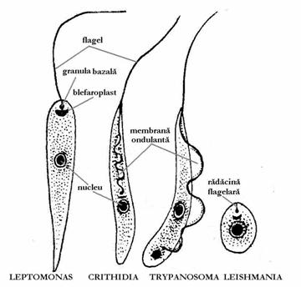

Slide 42
3) diplomonad
Excavate flagellates, small (less than 30µm), free-living or parasitic in animals; anaerobic or microaerophilic; no mitochondria; although there may be Golgi function there is no Golgi apparatus (dictyosome); with one or two karyomastigonts formed of 4 basal bodies and flagella closely associated with a nucleus; in each karyomastigont one flagellum is always directed backward and is generally associated with a ventral cytostome; mitosis is semi-open, the nuclear envelope persists and the two hemi-spindles are extranuclear with kinetochore microtubules penetrating in the nucleus by pores; form resistant cysts which ensure the transmission in parasitic species; free-living species found in water sites rich in organic matter and deficient in oxygen such as sediments, stagnant reservoirs, marshes, water treatment plants and also in brackish or salt water; feed on bacteria and also on dead cells of other protists, plants and animals which are engulfed by the cytostomal apparatus.

Slide 44
4) Parabasalida
The parabasalids are a group of flagellated protists within the supergroup Excavata. Most of these organisms form a symbiotic relationship in animals; these include a variety of forms found in the intestines of termites and cockroaches, many of which have symbiotic bacteria that help them digest cellulose in woody plants. Other species within this supergroup are known parasites, and include human pathogens.

Slide 46
5) Choanoflagellata
Choanoflagellates are small single-celled protists that live in freshwater and marine environments. They have one flagellum, which enables them to eat and move. Around this flagellum is a collar-like ring of microvilli (slender fingerlike projections) and it is from this structure that the name "choanoflagellate" (collar-flagellate) is derived. The flagellum beats water through the microvilli, which filters out bacteria and tiny food particles. Under everything but the most powerful microscope the microvilli look like a single unit. Choanoflagellates either use the flagellum for locomotion or are rooted to the substrate by a thin stalk. While the choanoflagellates' history is not completely known, morphological evidence has shown that they may be the closest living relatives of the sponges, the most primitive animals. Choanoflagellates are nearly identical to the collar cells (choanocytes) of sponges, which also act as filters of bacteria and food particles. One colonial species of Choanoflagellata in particular, Proterospongia, demonstrates some characteristics which may have been shared by some of the sponge's ancestors. The link between choanoflagellates and sponges has long been a subject of debate among taxonomists and other scientists, and raises questions whose answers greatly impact our understanding of evolution.

Slide 47
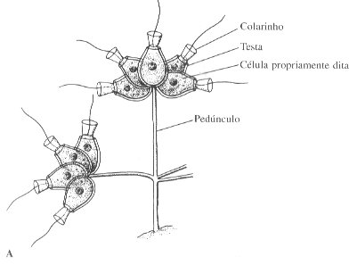

Slide 48
6) Opalinida
Opalinida (ō´pəlĬn´Ĭdə), phylum of unicellular heterotrophic organisms of the kingdom Protista. The opalinids are all intestinal parasites of small vertebrates, such as frogs, toads, and fish. Opalinid cells are covered with either short, hairlike structures called cilia or with longer flagella. Each organism has at least two nuclei. Their evolutionary lineage is unknown.

Slide 50
A3) Subphylum Sarcodina
..Superclass Rhizopoda
Class Lobosea, Class Eumycetozoea, Class Filosea
..Superclass Actinopoda
Class Acantharea, Class Polycystinea, Class Phaeodarea, Class Heliozoea
..Granuloreticulosa (Foraminifera)

Slide 51
Rhizopoda (Amoebas)
Members of the phylum Rhizopoda, the amoebas and their relatives, are all unicellular. Some of them have shells. No stages in their life histories are flagellated. Instead, amoebas use cellular extension called pseudopodia to move and to feed. You have probably observed this mode of motility in Amoeba proteus in the laboratory. Pseudopodia may bulge from virtually anywhere on the cell surface. When an amoeba moves, it extends a pseudopodium and anchors its tip, and then more cytoplasm streams into the pseudopodium (rhizopoda means "rootlike feet"). The cytoskeleton, consisting of microtubules and microfilaments, functions in amoeboid movement. Pseudopodial activity may appear chaotic but in fact amoebas show taxis as they creep slowly toward a food surface.

Slide 52
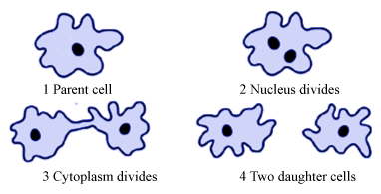

Slide 53
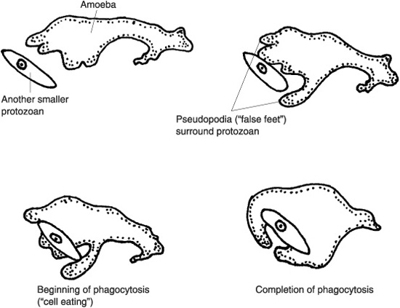

Slide 56
Actinopoda
Actinopoda means "ray feet," a reference to the slender pseudopodia called axopodia that radiate from the beautiful protists that compose the phylum. Each axopodium is reinforced by a bundle of microtubules, covered by a thin layer of cytoplasm. The projections place an extensive area of cellular surface in contact with the surrounding water, help the organisms float, and function in feeding. Smaller protists and other microorganisms stick to the axopodia and are phagocytized by the thin layer of cytoplasm. Cytoplasmic streaming then carries the engulfed prey down to the main part of the cell.

Slide 58
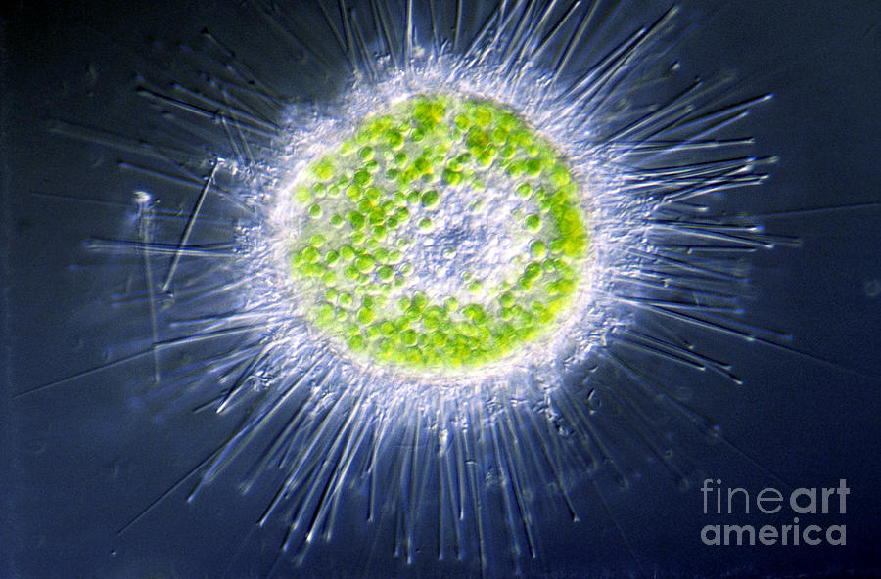
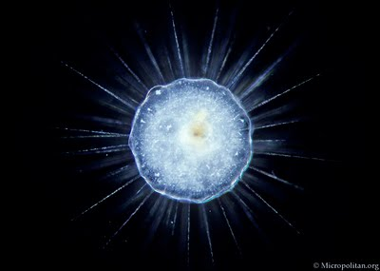

Slide 59
B. Apicomplexa (Sporozoans)
The Apicomplexa are common parasites of insects, vertebrates, and almost everything else. They are characterized by a particularly fiendish parasitic tool-kit called the apical complex (hence, of course, the name). Added to this, apicomplexans have a thick, triple outer layer which is very flexible, but nearly impervious to biological, and even to most chemical, agents. In some cases it is possible to clean out the entire cytoplasm with detergents and still recover -- more or less intact -- the reinforced membrane structure.
The outer layer of the apicomplexan cell is an ordinary(?) plasma membrane. However, this membrane is buttressed by an inner, double membrane made up of flattened alveoli sutured together. Finally, the whole business is reinforced with the cellular equivalent of rebar -- longitudinal bundles of microtubules running from the apical complex back towards the posterior end of the cell. These are cross-linked in some fashion.

Slide 60
The membrane is broken only by a simple cytostome consisting of an invagination of the plasma membrane. It is very similar in structure to the flagellar grooves that are occur in many other protist groups.
The components of the apical complex (rhoptries, micronemes, polar rings, the conoid, and subpellicular microtubules) are described in the appropriate glossary entries. We defer further discussion to a time when we can go beyond brief summaries. Apicomplexans have life cycles which are complex. In fact they would seem almost comical were it not for the fact that they are so efficient, and so often deadly to the host species. The basic life cycle may be said to start when an infective stage, or sporozoite, enters a host cell, and then divides repeatedly to form numerous merozonts. Some of the merozonts transform into reproductive cells, or gamonts. Gamonts join together in pairs and form a gamontocyst. Within the gamontocyst, the gamonts divide to form numerous gametes. Pairs of gametes then fuse to form zygotes, which give rise by meiosis to new sporozoites.

Slide 63
c) Phylum Microspora
Microsporidia are eukaryotic, unicellular organisms belonging to the phylum Microspora. All microspoidia are obligate, spore-forming, intracellular parasites that invade vertebrates and invertebrates. A characteristic feature of microsporidia is the polar tube or polar filament found in the spore used to infiltrate host cells. They are widely distributed in nature with over 1200 species characterized. However, microsporidia have only recently been documented to parasite humans, and more research is needed to understand this emerging infectious disease. Infection in humans, Microsporidiosis, is primarily found in patients with compromised immune systems, especially those infected with Human Immunodeficiency Virus (HIV) or have undergone organ transplants. Some species, however, have also been known to parasite those with health immune systems. Beyond the human realm, Microsporidia are important parasites in fisheries, veterinary medicines and pest management.

Slide 64
D) Ciliophora (Ciliates)
The diverse protists of the phylum Ciliophora are characterized by their use of cilia to move and feed. Most members of Ciliophora, or ciliates, live as solitary cells in fresh water. In contrast to most flagella, cilia are relatively short. They are associated with a submembrane system of microtubules that may coordinate the movement of thousands of cilia.

Slide 65
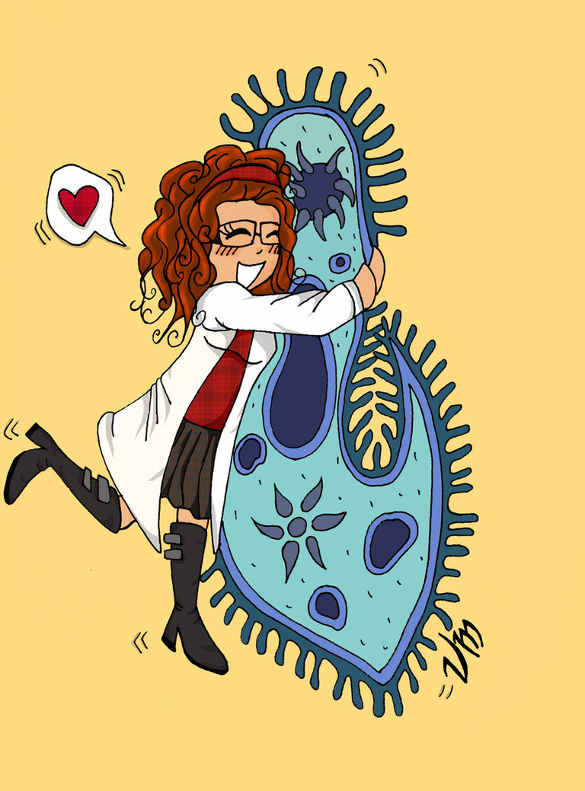

Slide 67
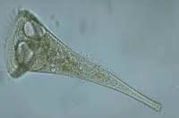

Slide 68
Foraminifera
an order of Protozoa of the subclass Rhizopoda of the class Sarcodina. There are more than 1,500 species of foraminifers. The cytoplasmic body of most species is clad in a limestone shell (an external skeleton). A few species have chitinous shells or shells consisting of foreign particles (grains of sand, sponge spicules) cemented together by secretions of the cytoplasm. The unicameral or polycameral shells are sometimes branching. The variation in arrangement and shape of the chambers (in one or two rows, in a spiral) results in a diversity of skeletal shapes. The shell is usually 0.1–1.0 mm long but occasionally reaches 20 cm. Stomata connect the interior of the shell with the external environment; in many species there also are numerous pores in the wall of the shell. Through the stomata and the pores protrude slender branching and anastomosing pseudopodia, which serve to capture food and for locomotion.

Slide 69
All foraminifers are characterized by the alternation of haploid and diploid generations. The asexual diploid generation—the agamont—develops from the zygotes. The nucleus repeatedly divides as it grows and the organism becomes multinuclear. The two final nuclear divisions involve meiosis, after which the agamont decomposes into numerous (according to the number of nuclei) agametes. The agametes give rise to the haploid sexual generation—the gamont—whose growth and development are completed by the formation of gametes. Some foraminifers have motile flagellate isogametes, which enter the water and copulate, forming diploid zygotes. In plastogamic species the gamonts first join (most often in pairs) in syzygy and then form amoeboid or drop-shaped gametes. The diploid zygote gives rise to an agamont.

Slide 70
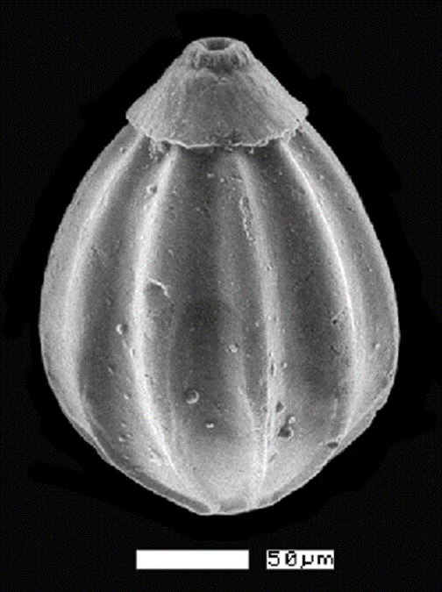

Slide 71
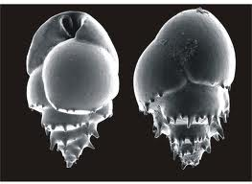
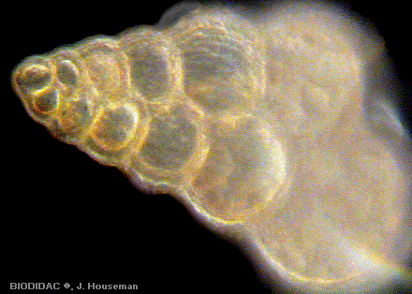

Slide 72
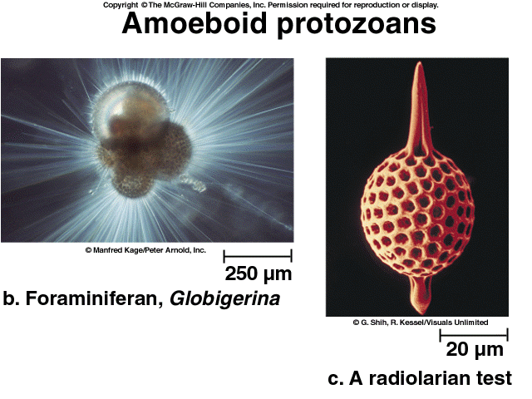

Slide 74
dinoflagellata
Dinoflagellates are unicellular protists which exhibit a great diversity of form. The largest, Noctiluca, may be as large as 2 mm in diameter! Though not large by human standards, these creatures often have a big impact on the environment around them. Many are photosynthetic, manufacturing their own food using the energy from sunlight, and providing a food source for other organisms. Some species are capable of producing their own light through bioluminescence, which also makes fireflies glow. There are some dinoflagellates which are parasites on fish or on other protists.

Slide 75
The most dramatic effect of dinoflagellates on life around them comes from the coastal marine species which "bloom" during the warm months of summer. These species reproduce in such great numbers that the water may appear golden or red, producing a "red tide". When this happens many kinds of marine life suffer, for the dinoflagellates produce a neurotoxin which affects muscle function in susceptible organisms. Humans may also be affected by eating fish or shellfish containing the toxins. The resulting diseases include ciguatera (from eating affected fish) and paralytic shellfish poisoning, or PSP (from eating affected shellfish, such as clams, mussels, and oysters); they can be serious but are not usually fatal.

Slide 77
References
http://www.about.com
http://www.innovateus.net
http://micro.magnet.fsu.edu
http://what-when-how.com
http://www.cladocera.de
http://www.microbeworld.org
https://www.cbd.int
http://www.snipview.com
http://www.perkepi.com
https://pt.slideshare.net
http://www.microscope-microscope.org
https://en.wikipedia.org
http://www.encyclopedia.com
https://www.yandex.ru
https://smartsite.ucdavis.edu
https://www.enotes.com
http://www.tutorvista.com
http://www.slideshare.net
http://www.livescience.com
http://www.ncbi.nlm.nih.gov
http://biodidac.bio.uottawa.ca
http://palaeos.com
http://www.theodora.com
http://www.deviantart.com
https://quizlet.com
http://www.desertbruchid.net
http://www.livescience.com
http://www.majordifferences.com
http://tolweb.org
http://www.ucmp.berkeley.edu
http://www.saralstudy.com
http://a-z-animals.com
http://www.warrenhills.org
http://www.araku.ac.ir
http://www.phsource.us
http://www.differencebetween.com

