Slide 1
Travel Grade 9 Lesson 2
By Kuchakzadeh
T.me/kuchakzadeh
1398

Slide 2
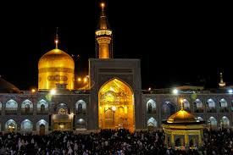
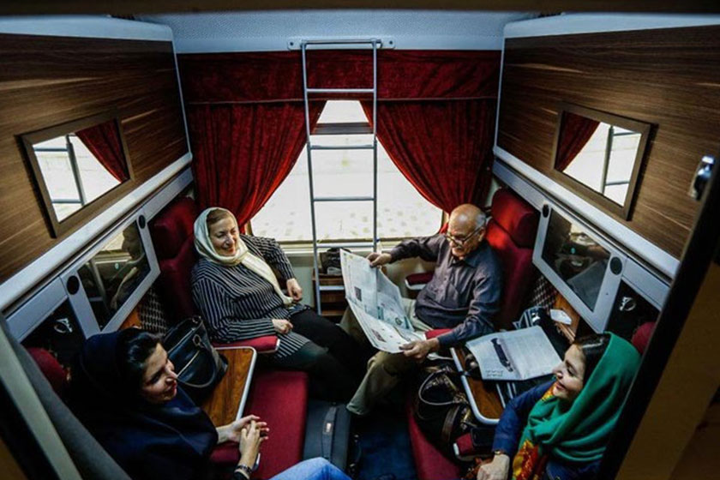
Mr Amini’s family
Who are traveling?
Mr. Amini’s family
Where are they going?
To Mashhad
How are they going?
By Train
Is Mr Amini reading a guide book?
No, he’s reading a newspaper

Slide 3
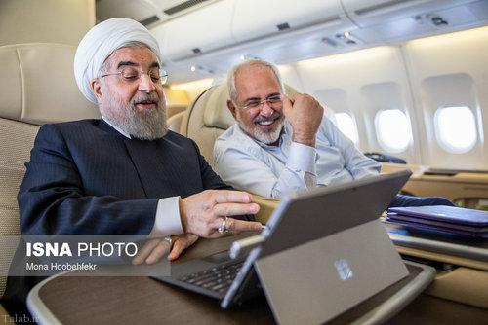
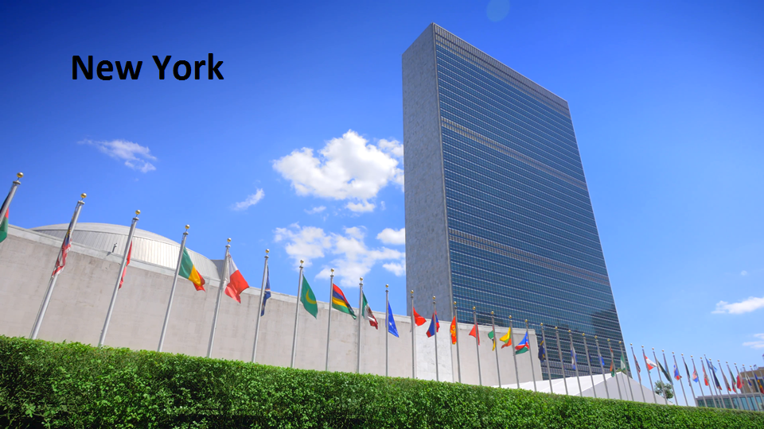
Who are traveling?
Dr Rouhani & Dr Zarif
Where are they going?
To New York
How are they going?
By plane
Are they watching a comedy?
No, they’re checking a timetable

Slide 4
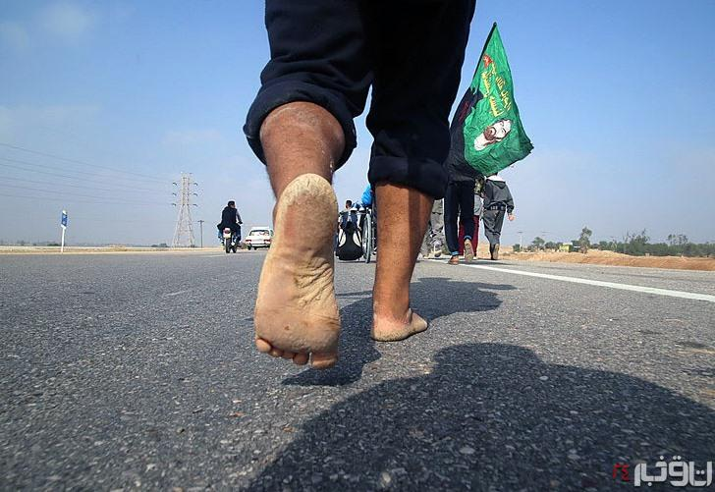
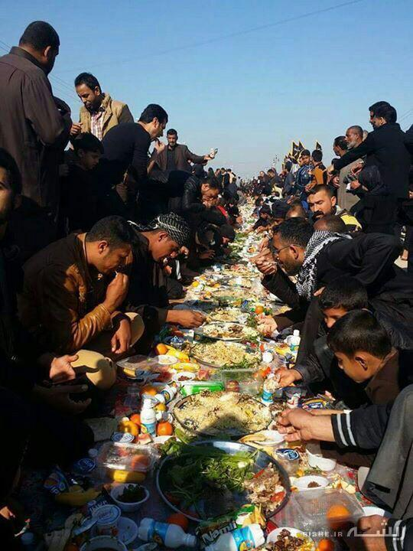
Who are traveling?
A lot of Iranians
Where are they going?
To Karbala
How are they going?
They are walking
Are they sleeping now?
No, they’re eating food.

Slide 5
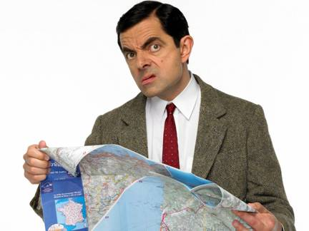
Who is traveling?
Mr. Bean
Where is he going?
To London
How is he going?
By car
Is he reading a book?
No, he’s checking the map.

Slide 6
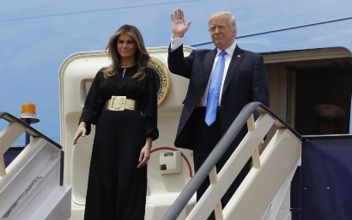
Who are traveling?
Trump and his wife
Where are they going?
To Washington
How are they going?
By plane
Are they in their car?
No, they’re boarding the plane.

Slide 7
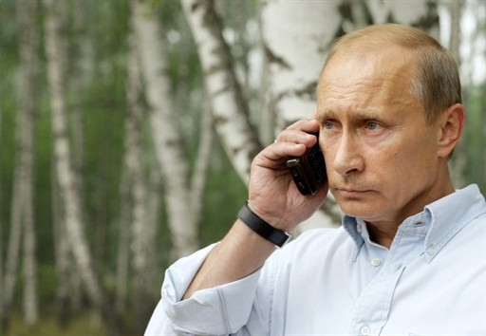
Who is traveling?
Vladmir Putin.
Where is he going?
To Caspian Sea.
How is he going?
Making a voyage by a ship.
Is he reading a book?
No, he’s talking by his phone.

Slide 8
before traveling

Slide 9
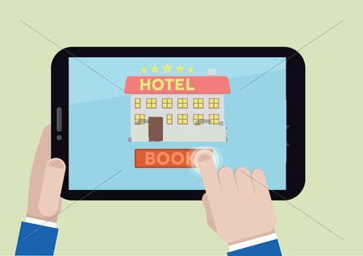
What are they doing?
She’s packing for a trip
He’s booking a room online

Slide 10
in a terminal

Slide 11
Is he/she …………?
Are they …………..?
What is he/she doing?
What are they doing?

Slide 12
ging
1. Taking baggage
7. Filling out a form
2. Boarding the plane
8. Landing
4. Buying tickets
10. Taking off
5. Checking the timetable
11. Talking to a receptionist
6. Exchanging money
12. Weighing baggage

Slide 13
at a hotel

Slide 14
Is he/she ………….…?
What is he/she doing?

Slide 15
15. Checking passports
13. Checking in
14. Checking out

Slide 16
role plays

Slide 17
Name: Mr. Bean
Personality: …………………….
Destination: ………………………
Vehicle: …………………
Action: ……………………………

Slide 18
Name: Donald Trump
Personality: ……………………
Destination: ………………………
Vehicle: ………………………..
Action: …………………………..

Slide 19
Name: Ali Daei
Personality: ………………………….
Destination: ………………………….
Vehicle: …………………………
Action: ………………………….

Slide 20
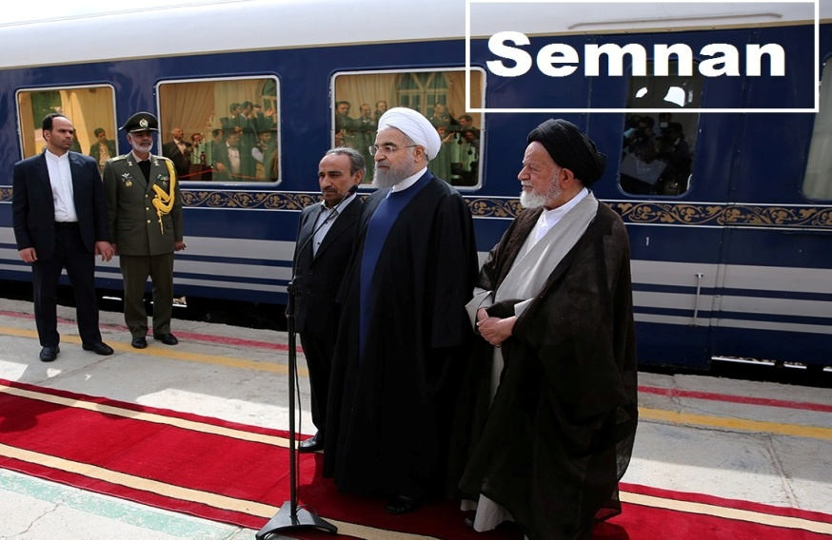
Name: Hassan Rohani
Personality: ……………………….
Destination: …………………………
Vehicle: ………………………..
Action: ……………………………

Slide 21
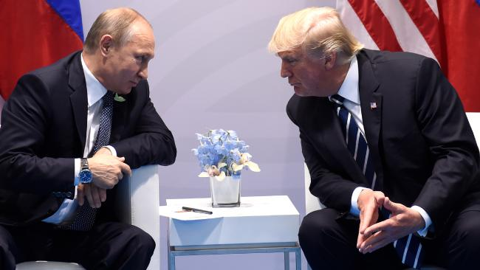
Name: Vladimir Putin
Personality: ………………………….
Destination: ………………………….
Vehicle: …………………………..
Action: …………………………….

Slide 22
Monologue

Slide 23
Talk about these people

Slide 24
Talk about these people

Slide 25
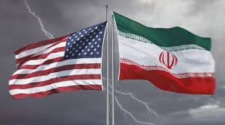
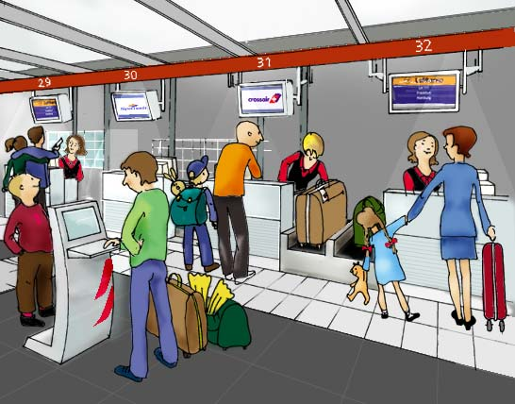
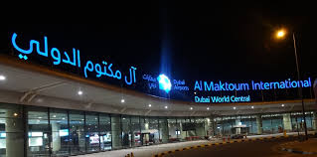
A boy who likes to be Iranian
Hello, My name is Hafez Hamilton . I live in Los Angeles. I am 14 years old. My family and I are traveling to Iran. My mother is Iranian. I think I am Iranian too, but I have not an Iranian passport yet. We are visiting our mother’s family in Iran.
It’s 7 o’clock now. My father is buying tickets. My mother is packing the baggage.
Now it’s 9 o’clock. We are in airport. I am ckecking the timetable. My father is weighing the baggage. My mother is standing by the gift shop. She wants to buy some gifts.
It’s 10 o’clock. We are boarding the plane. Now the plane is taking off. Now it’s midnight and the plane is landing in Dubai air port and then we change our plane to Imam Khomeini air port in Tehran. I am so happy.

Slide 26
A family traveling to IRAQ by plane
Hello, my name is ………………… . I am interested in traveling to Karbala. Now my father is ………………………… . My mother is ……………………… My sister is ……………………. . Now we are going to the airport. I am ………………………. . My brother is ……………………. . An Arab man is buying ………………………… . A Pakistani woman is ………………………… . Now, we are boarding ………… . It is 11 pm and we are ………………………………. …

Slide 27
You are traveling to Istanbul by train
Hello, my name is ……………… . We are traveling to …………...................................................... . ………………………………………………………………………………………………………………………………………………………………………………………………………………………………………………………………………………………………………………………………………………………………………………………………………………………………………………

