Slide 1
In the Name of the Creator of beauty
Proverbs

Slide 2
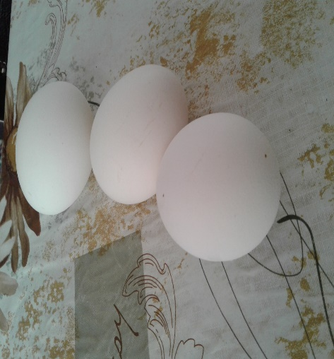
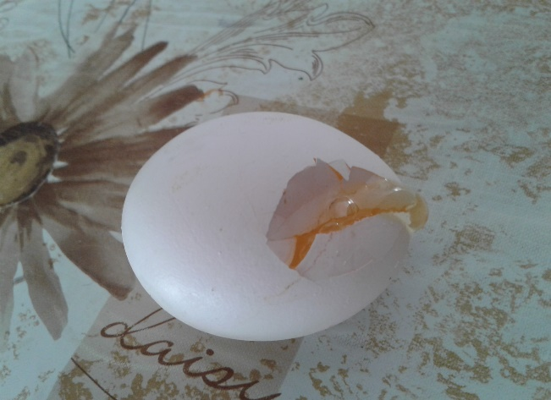
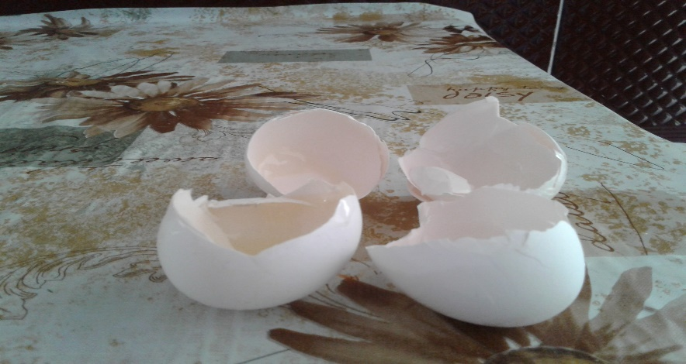
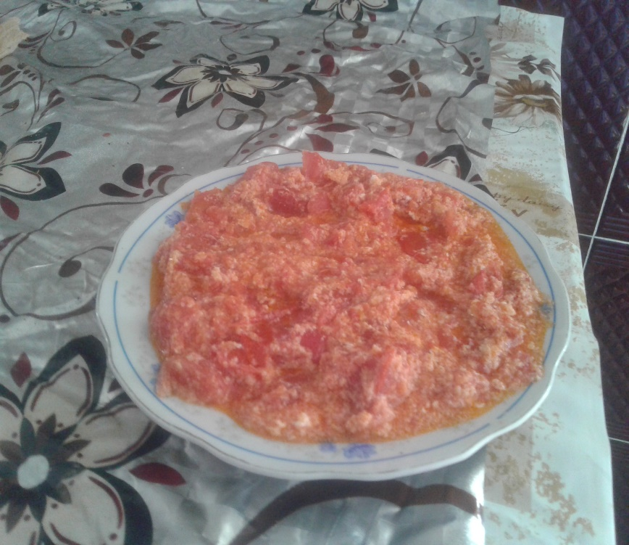
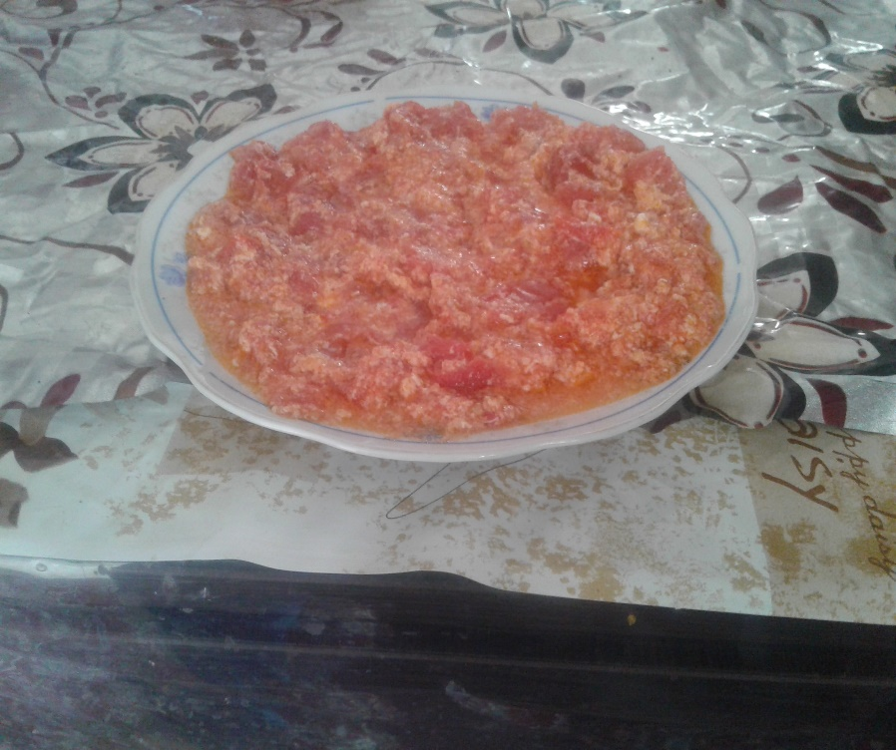

Slide 3
You can't make an omelet without breaking a few eggs. When you try to do something great, you'll probably make a few people annoyed or angry. Don't worry about those people; just focus on the good results.

Slide 5
"There's no time like the present."
If you need to do something, don't wait until later. Do it now.
'When do you think I should phone Mr. Hughes about that job?' 'Well, there's no time like the present.'

Slide 6
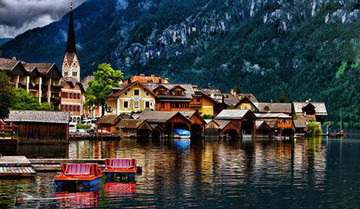
Hallstatt

Slide 7
Beauty is in the eye of the beholder."
Different people have different ideas about what's beautiful.
Personally, I can't understand why she finds him attractive, but they do say beauty is in the eye of the beholder.

Slide 8
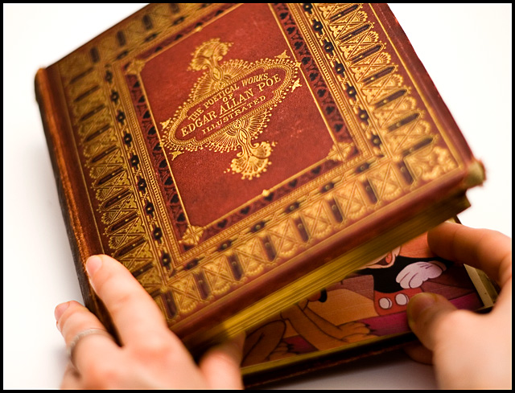

Slide 9
"You can't judge a book by its cover."
Things sometimes look different than they really are.
A restaurant that looks old and small might have amazing food.

Slide 11
Honesty is the best policy."
Don't lie.
Jill: I borrowed Jane's white blouse without asking her, and then I spilled tomato sauce on it. Should I tell her what happened, or should I just put the blouse back in her closet and hope she won't notice? Jane: Honesty is the best policy.

