Slide 1
MODULE 7
Sub Module 7.15
WELDING, BRAZING, SOLDERING AND BONDING

Slide 2
Why Joining Processes?
Some (even simple) products are too large to be made by individual processes
Easier, more economical to manufacture & join individual components
Products to be disassembled for maintenance
Varying functionality of product.
Transportation + assembly is less costly

Slide 3
Product Example
A tubular part fabricated by joining individual components. This product cannot be manufactured in one piece by any of the methods , if it consists of thin-walled, large-diameter, tubular-shaped long arms.
A drill bit with a carbide cutting insert brazed to a steel shank—an example of a part in which two materials need to be joined for performance reasons.
Spot welding of automobile bodies.

Slide 4
JOINING PROCESSES
An all-inclusive term covering processes such as:
Welding
Brazing
Soldering
Adhesive bonding
Mechanical fastening

Slide 5
Overview on Joining Processes

Slide 6
Overview on Joining Processes

Slide 7
FUSION WELDING

Slide 8
SOLID STATE WELDING (SSW)

Slide 9
BRAZING AND SOLDERING

Slide 10
Advantages of welding
• Welding provides a permanent joint.
• Welded joint can be stronger than the parent materials if a proper filler metal is used that has strength properties better than that of parent base material and if defect less welding is done.
• It is the economical way to join components in terms of material usage and fabrication costs. Other methods of assembly require, for example, drilling of holes and usage of rivets or bolts which will produce a heavier structure.

Slide 11
Disadvantages of welding
• Labour costs are more since manual welding is done mostly.
• Dangerous to use because of presence of high heat and pressure.
• Disassembly is not possible as welding produces strong joints.
• Some of the welding defects cannot be identified which will reduce the strength.

Slide 12
Fusion Welding
Any welding process that uses fusion of the base metal to make the weld (AWS A3.0: 2001)

Slide 13
Type Of Fusion Welding
Arc welding
Resistance welding
Oxyfuel gas welding
electron beam welding
laser welding

Slide 14
Arc Welding
A fusion welding process in which coalescence of the metals is achieved by the heat from an electric arc between an electrode and the work
Electric energy from the arc produces temperatures ~ 10,000 F (5500 C), hot enough to melt any metal
Most AW processes add filler metal to increase volume and strength of weld joint
An electric arc is a discharge of electric current across a gap in a circuit
It is sustained by an ionized column of gas (plasma) through which the current flows
To initiate the arc in AW, electrode is brought into contact with work and then quickly separated from it by a short distance

Slide 15
Arc Welding
Arc Shielding
- At high temperatures in AW, metals are chemically
reactive to oxygen, nitrogen, and hydrogen in air
- Mechanical properties of joint can be seriously
degraded by these reactions
-To protect operation, arc must be shielded from
surrounding air in AW processes
Arc shielding is accomplished by:
-Shielding gases, e.g., argon, helium, CO2
-Flux

Slide 16
Arc Welding
Shielding gas:
This covers the arc, electrode tip and weld pool from external atmosphere.
So the shielding is done with a blanket of gas or flux, or both, which inhibit exposure of the weld metal to air.
Common shielding gas: Argon, Helium
Flux:
Used mainly to protect the weld region from formation of oxides and other unwanted contaminants, or to dissolve them and facilitate removal.
During welding, the flux melts and covers the weld region giving protection and it should be removed by brushing as it is hardened.
Additional function:
stabilize the arc, and reduce spattering

Slide 17
Arc Welding
Power Source in Arc Welding
Direct current (DC) vs. Alternating current (AC)
-AC machines less expensive to purchase and
operate, but generally restricted to ferrous
metals
-DC equipment can be used on all metals and is
generally noted for better arc control

Slide 18
Arc Welding -Electrodes
Two Basic Types of AW Electrodes
Consumable
Present in rod or wire form with 200 to 450 mm length and less than 10 mm diameter.
This is the source of filler rod in arc welding.
The electrode is consumed by the arc during the welding process and added to the weld joint as filler metal.
The consumable electrodes will be changed periodically as it is consumed for each welding trials.
This becomes a disadvantage for welder and reduces the production rate.

Slide 19
Arc Welding -Electrodes
Two Basic Types of AW Electrodes
Non Consumable
The electrodes are not consumed during arc welding.
Though this is the case, some depletion occurs because of vaporization.
Filler metal must be supplied by means of a separate wire that is fed into the weld pool.

Slide 20
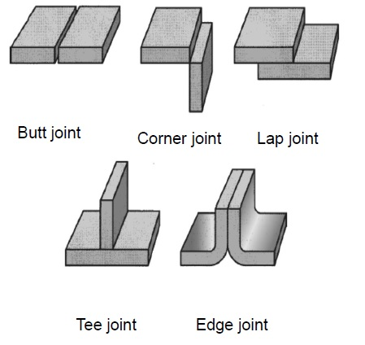
Arc Welding
Weld Joint Configuration

Slide 21
Arc Welding
Type Of Consumable Electrode
Arc Welding
SMAW(Shield Metal Arc Welding)
MIG/MAG(Metal Inert/Active Gas Welding)
SAW(Submerged arc welding)

Slide 22
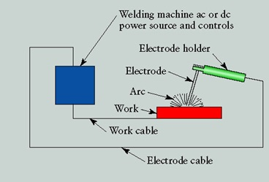
SMAW(Shield Metal Arc Welding)
Older, simple technology
The electrode is also the filler rod
Only for steel
Strong welds if done properly (but often not)
Very high heat input: good for thick parts, bad for grain growth and distortion
SMAW Video

Slide 23
SMAW(Shield Metal Arc Welding)
A pool of molten metal is formed near electrode
tip, and as electrode is moved along joint,
molten weld pool solidifies in its wake

Slide 24
SMAW(Shield Metal Arc Welding)
Welding Currents :
The two types of current used in welding are:
direct current (DC)
alternating current (AC).
Direct Current (DC):
Direct current flows in one direction only and has either a positive or negative value.
The electron theory states current flows from negative to positive.
All SMAW electrodes will function on DC.
most welders will prefer to use DC rather than AC because of superior versatility and arc stability.

Slide 25
SMAW(Shield Metal Arc Welding)
Direct Current Straight Polarity(DCSP) OR
Direct Current Electrode Negative(DCEN).
In a SMAW DC welding circuit, straight polarity occurs when the electrode cable is connected to the negative terminal of the welding machine.
Using straight polarity with SMAW results in the following electrode and arc characteristics.
The electrode melts somewhat slower and allows slower metal deposit.
Approximately two thirds of the arc energy is associated with the base metal (negative terminal).
Penetration is deeper, especially with a short arc length.
Metal flow is generally narrow, unless a longer arc length is used.
Reverse polarity is the preferred choice when welding in deep grooves, when welding in vertical and overhead positions and for multi-pass welds. The E6010, E6011 and E7018 .

Slide 26
SMAW(Shield Metal Arc Welding)

Slide 27
SMAW(Shield Metal Arc Welding)
Direct Current Reverse Polarity (DCRP) OR
Direct Current Electrode Positive(DCEP).
In DC welding circuit, reverse polarity occurs when the electrode cable is connected to the
positive terminal of the welding machine.
The electrode melts somewhat faster, which results in faster metal deposit.
Approximately two thirds of the arc energy is associated with the electrode.
Penetration is shallow.
Metal flow is somewhat wider.

Slide 28
SMAW(Shield Metal Arc Welding)

Slide 29
SMAW(Shield Metal Arc Welding)
Alternating Current (AC)
Alternating current reverses or changes direction of flow according to the number of cycles per second that the current is being produced.
In North America, 60 cycle current is standard. With AC, the welding arc is somewhat less stable due to the changing of current flow across the arc.
Some electrodes will loose the arc when used on AC. With alternating current, there can be no fixed polarity. The arc characteristics and weld results using AC is an average of the weld characteristics between direct current electrode positive and direct current electrode negative.

Slide 30
SMAW(Shield Metal Arc Welding)
Alternative Current (AC)

Slide 31
Electrode Standards For ARC WELDING
Electrode Production
AWS
EN944
BS-639
ISIRI-871(1,2)

Slide 32
GMAW (Gas Metal Arc Welding)
MIG , MAG (Metal-Inert/ACTIVE-Gas)
Complex mechanism but simple to perform and easy to automate
The electrode is also the filler rod, fed continuously from a spool. It melts in the arc.
Application : For steel or aluminum
Skill : Low skill level can achieve good weld
Medium heat input: distortion and grain growth are significant

Slide 33
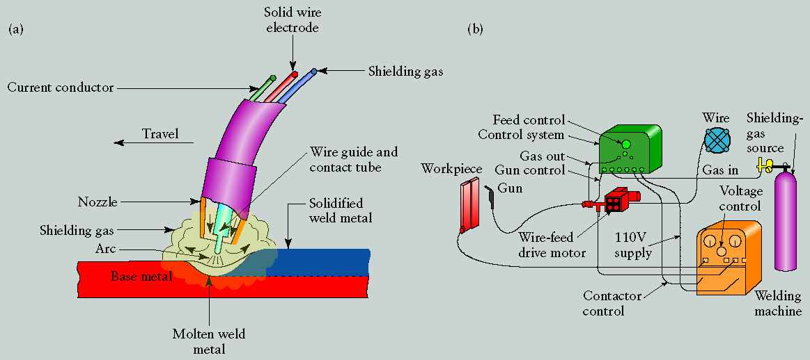
GMAW (Gas Metal Arc Welding)
MIG , MAG (Metal-Inert/ACTIVE-Gas)

Slide 34
GMAW (Gas Metal Arc Welding)
MIG , MAG (Metal-Inert/ACTIVE-Gas)
Flux cored arc welding (FCAW):
arc welding process in which the electrode is a continuous consumable tubing that contains flux.
Self-shielded FCAW: the arc shielding was provided by the flux core. The core also includes ingredients that generate shielding gases for protecting the arc.
Gas shielded FCAW: Shielding is done from externally supplied gases. Since it uses both flux and shielding gas (provided separately), it is considered as a hybrid of SMAW and GMAW.

Slide 35
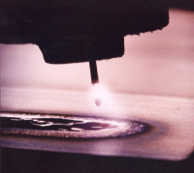
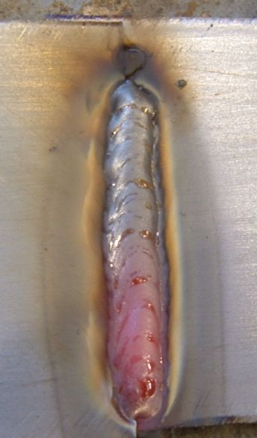
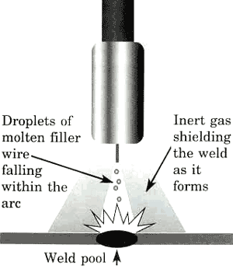
GMAW (Gas Metal Arc Welding)
MIG , MAG (Metal-Inert/ACTIVE-Gas)
A fair/typical quality MIG
weld (still hot!)
MIG VIDEO
1 2

Slide 36
SAW (Submerged Arc Welding )
In this process, a continuous bare electrode wire is used. The shielding is provided by external granular flux through hopper.
Granular flux is provided just before the weld arc.
granular flux completely provides protection from sparks, spatter, and radiation and hence safety glasses, gloves can be avoided.
some part of flux gets melted and forms a glassy layer.
This layer and unfused flux results in slow cooling rate and good weld quality.
The unused flux can be reused.

Slide 37
SAW (Submerged Arc Welding )
application:
longitudinal and circumferential welds for large diameter pipes, tanks, and pressure vessels welded components for heavy machinery.
Steel plates of 25 mm thick are welded.
PLATE
PIPE

Slide 38
Arc Welding
Type Of Non Consumable Electrode Arc Welding
GTAW/TIG(Gas Tungsten Arc Welding)
PAW(Plasma Arc Welding)
RW(Resistance Welding)

Slide 39
GTAW (Gas Tungsten Arc Welding )
TIG (Tungsten-Inert-Gas)
The electrode is tungsten (not consumed)
The filler rod is separate and fed manually
High skill level required to achieve good weld
Difficult to automate
Low heat input and small weld bead: distortion and grain growth are minimized

Slide 40
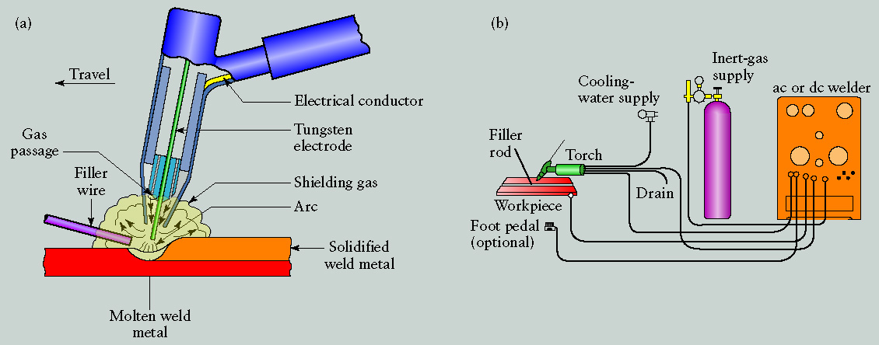
GTAW (Gas Tungsten Arc Welding )
TIG (Tungsten-Inert-Gas)

Slide 41
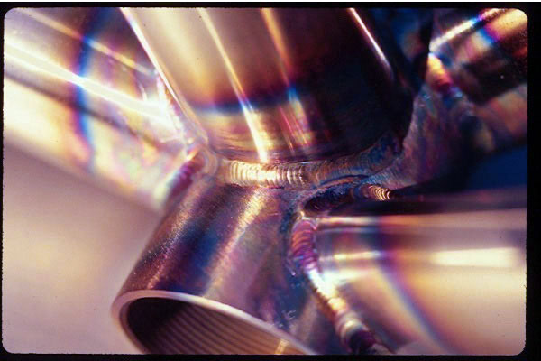
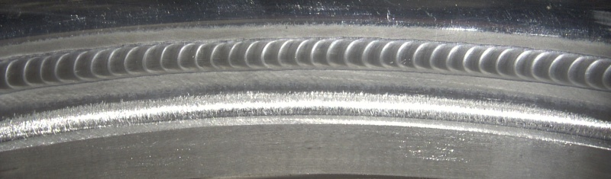
GTAW (Gas Tungsten Arc Welding )
TIG (Tungsten-Inert-Gas)
Typical good quality
TIG welds
TIG VIDEO

Slide 43
Morphology of fusion weld
typical fusion weld has got few zones like
(i) fusion zone
(ii) weld interface
(iii) heat affected zone
(iv) unaffected base material

Slide 44
Morphology of fusion weld
Fusion zone:
-It consists of a mixture of filler metal and base metal that have completely melted.
-A high degree of homogeneity is present among the component metals that have been melted during welding. --the solidification occurs by epitaxial grain growth, in which the atoms in the molten metal solidify at the preexisting lattice sites in the unaffected base material.
-Moreover the grain structure in the fusion zone has got preferred orientation and they are oriented roughly perpendicular to the weld interface.
-This results in coarse columnar grains in fusion zone.

Slide 45
Morphology of fusion weld
Weld interface:
It is a narrow boundary that separates the fusion zone from heat affected zone.
This zone consists of a thin band of base metal that was partially melted during the welding process but immediately solidified without mixing with the metal in the fusion zone.
Its chemical composition is generally same as that of the base metal.

Slide 46
Morphology of fusion weld
Heat affected zone:
This zone is between weld interface and base material.
This experience temperatures below melting point, but sufficient enough to change the microstructure and hence the mechanical properties.
The mechanical properties are such that most of the failures occur in this region.
Base material:
Unaffected because of heat generation and preserve the initial microstructure.

