Slide 1
Basic Cryptographic Concepts

Slide 2
Security Attacks
Any action that compromises the security of information.
Four types of attack:
Interruption
Interception
Modification
Fabrication
Basic model:
S
D
Source
Destination

Slide 3
Interruption:
Attack on availability
Interception:
Attack on confidentiality
S
D
S
D
I

Slide 4
Modification:
Attack on integrity
Fabrication:
Attack on authenticity
S
D
I
S
D
I

Slide 5
Passive and Active Attacks
Passive attacks
Obtain information that is being transmitted (eavesdropping).
Two types:
Release of message contents.
Traffic analysis.
Very difficult to detect.

Slide 6
Active attacks
Involve some modification of the data stream or the creation of a false stream.
Four categories:
Masquerade: One entity pretends to be a difficult entity.
Replay: Passive capture of transaction and subsequent replay.

Slide 7
Modification: Some portion of a message is altered on its way
Denial of service: Prevents access to resources.

Slide 8
Security Services
Confidentiality (privacy)
Authentication (who created and sent the data)
Integrity (has not altered)
Non-repudiation (parties cannot later deny)
Access control (prevent misuse of resources)
Availability (permanence, non-erasure)
Denial of Service Attacks
Virus the deletes files

Slide 9
Network Access Security Model
Internal
Network
GATEWAY
Opponent:
Human
Virus
worm
Computer
Software resources
Databases
ACCESS CHANNEL
Security
Control

Slide 10
Cryptography Terminologies

Slide 11
Introduction
Most important concept behind network security is encryption.
Two forms of encryption:
Private (or Symmetric)
Single key shared by sender and receiver.
Public-key (or Asymmetric)
Separate keys for sender and receiver.

Slide 12
Typical Flow
Trusted Third Party
SENDER
RECEIVER
EA
DA
Channel
Message
Message
Key 1
Key 2
Intruder

Slide 13
Symmetric Key Cryptography
Basic ingredients of the scheme:
Plaintext (P)
Message to be encrypted.
Secret Key(K)
Shared among the two parties
Ciphertext (C)
Message after encryption
Encryption Algorithm (EA)
Used P and K
Decryption Algorithm (DA)
Uses C and K

Slide 14
Security of scheme
Depends on the security of the key.
Does not depend on the secrecy of the algorithm.
Assumption that we make:
Algorithm for encryption/decryption are known to the public.
Keys used are kept secret.

Slide 15
Illustration
Shared Key K
Shared Key K
EA
DA0
Ciphertext
C
Plaintext
P
Plaintext
P

Slide 16
Some Point to Observe
Key distribution problem of secret key system:
Establish key before communication.
Need n(n-1)/2 keys with n different parties.
A
B
E
C
D

Slide 17
Classical Techniques
Broadly falls under two categories:
Substitution ciphers
Each letter or group of letters of the plaintext are replaced by some other letter or group of letters, to obtain the ciphertext
Transposition cipher
Letters of the plaintext are permuted in some form.

Slide 18
A Simple Example
Caesar Cipher ( a substitution cipher):
Earliest know substitution cipher.
Replace each letter of the alphabet with the letter three placed after that alphabet.
Alphabets are assumed to be wrapped around ( Z is followed by A, etc.).
P: H A P P Y N E W Y E A R
C: K D S S B Q H Z BHDU

Slide 19
We can generalize the idea by replacing each letter by the k_{th} following letter.
If we assign a number to each letter (A=1, B=2, etc), then
C = E (P) = (P + k -1) % 26 +1
P = D (C) = (C- k + 25) % 26 + 1
Drawback:
Brute force attack is easy
Try out all the 25 possible keys

Slide 20
Mono-alphabetic Cipher
Allow any arbitrary substitution.
There can be 26! Or 4 *1026 possible keys.
A typical key may be:
(ZAQWSXCDERFVBGTYHNMJUIKLOP)
Drawbacks:
We can make guesses by observing the relative frequency of letters, digrams, and trigrams in the text.
Easy to break in general.

Slide 21
Transposition Ciphers
Many techniques were proposed under this category.
A simple scheme:
Write out plaintext in a rectangle, row by row, and read the message column by column, by permuting the order of the columns.
Order of the column becomes the key.

Slide 22
P: we are attending one conference at IIT Kharagpur
Key: 4 3 1 2 5 6 7
w e a r e a t
t e n d I n g
o n e c o n f
e r e n c e a
t I I T K h a
r a g p u r -
C: aneelg rdcnTp eenrla wtoetr elocKu annehr tgfaa-

Slide 23
Drawbacks:
The ciphertext has the same letter frequency as the original plaintext.
Guessing the number of columns and some probable words in the plaintext holds the key.

Slide 24
Stream Cipher vs. Block Cipher
A stream cipher encrypts the plaintext bit by bit (in stream).
A block cipher encrypt n-bit blocks at a time.
For example, a 256-bit cipher encrypts 256-bit blocks at a time.
Short blocks have to be padded.

Slide 25
Practical Algorithms
Data Encryption Standard (DES)
Block size is 64 bits.
Key is 56 bits.
IDEA
Block size is 64 bits.
Key size is 128 bits.
Advanced Encryption Standard (AES)
Also known as Rijndael cryptosystem.
Block size can be 128, 192, or 256 bits.
Key size can be 128, 192, or 256 bits.

Slide 26
Data Encryption Standard (DES)
The most widely used encryption scheme.
Also known as Data Encryption Algorithm (DEA).
It is a block cipher.
The plaintext is 64-bits in length.
The key is 56-bits in length.
Longer plaintexts are processed in 64-bit blocks.

Slide 27
General Schematic of DES
P (64 bit)
K (56 bit)
K(56 bit)
P (64 bit)
IP
PC 1
K₁
Round 1
PC 2
LCS
K₂
Round 2
PC 2
LCS
K₁₆
Round 16
PC 2
LCS
32-bit swap
PC: permuted choice
LCS: left circular shift
IP: initial permutation
RIP: reverse initial permutation
RIP
C (64 bit)

Slide 28
DES
The overall processing at each iteration:
L_{i} = R_{i-1}
R_{i} = L_{i-1} XOR F(R_{i-1} ,K_{i} )
Concerns about:
The algorithm and the key length (56-bits)
Longer key lengths essential for critical applications
Fiestel Structure

Slide 29
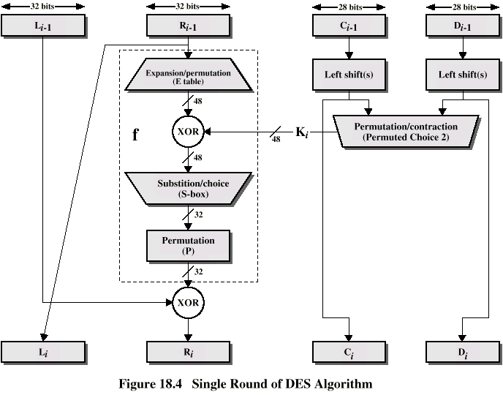
DES Single Iteration

Slide 30
Strength of DES
Declared insecure in 1998
Electronic Frontier Foundation
DES Cracker machine
DES now worthless
Alternatives include TDEA

Slide 31
Need for a new standard
DES had been in use for a long time.
A replacement for DES was needed.
Theoretical attacks that can break it.
Demonstration of exhaustive key search attacks.
US NIST issued call for ciphers in 1997.
15 candidates accepted in June 1998.
5 were short-listed in August 1999.
Rijndael was selected as the Advanced Encryption Standard in October 2000.

Slide 32
The AES Cryptosystem
In the Rijndael proposal, the block length and key length can be independency specified to be 128, 192, or 256 bits.
The AES standard limits the block length to 128 bits.
Key length can be 128, 192, or 256 bits.
Easy to implement, both in hardware and software.
Resistant against all known attacks

