Slide 1
Stat Counter
Web Traffic Analysis Tool

Slide 2
What is it ?!
How do you think you can improve your website?
Do you want to know which part of your site has more viewer?
Do you want to know on which subject you should focus on more?
A true website manager needs to know all that kind of “Statistic” related things to improve his website and that’s exactly what Stat counter does for you.

Slide 3
A little bit more about company
Access to basic services is free and advanced services can cost between 5US$ and 119US$/month.
Stat Counter is used on 3% of all websites ( not that much famous comparing to google analysis )
The company was founded by Aodhan Cullen at the age of 16. He remains the CEO of StatCounter. Cullen received the "Internet Hero" award at the 2008 Eircom Golden Spider Awards
In 2008, the company surpassed two million members globally

Slide 4
More About the features
Free account => 1project == 1 stat counter account
Log-size – 2 level
Invisible Counter option / Configurable

Slide 5
Configurable visible stat counter

Slide 6
Magnify User

Slide 7
Magnify User

Slide 8
Drill Down

Slide 9
Drill and magnify !!!
You can drill down on many stats, including Popular Pages, Referring Links, Entry and Exit pages and so on. For example, you could drill down on a page of particular interest - like a checkout page - and see the visitors who loaded that page, and subsequently magnify them to see how they got there. This kind of information is invaluable for optimising your most important pages and driving traffic to them - a combination of the drill down and magnify tools is the wise webmaster's most potent ally!

Slide 10
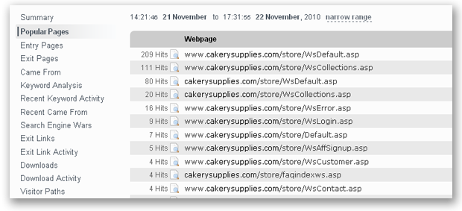
Drill down Panel
Lets Skim through this panel fast

Slide 11
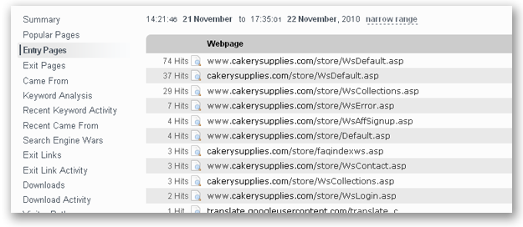
Drill down Panel
Which page have the user entered at first place ?
With how much hits ?

Slide 12
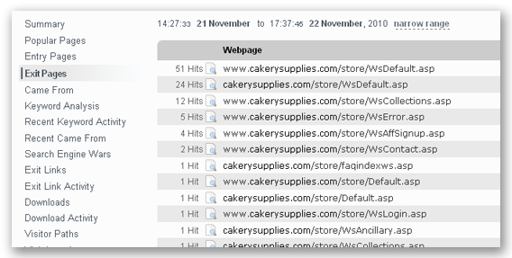
Drill down Panel
Its very useful to be aware of the exit point ! Maybe there is a problem …
Optimising those pages can be helpful to keep the visitor in website.

Slide 13
Drill down Panel

Slide 14
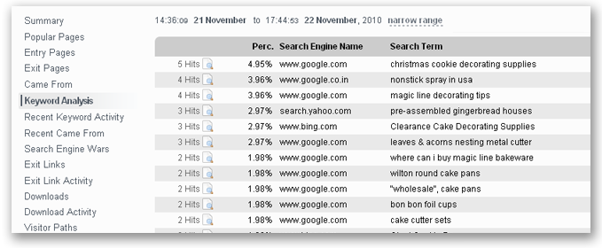
Drill down Panel
Which keywords in your website is useful and related to subject, and which ones are redundant… ? Helpful to generate more traffic and hits

Slide 15
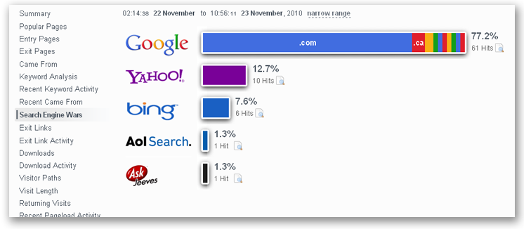
Drill down Panel
Which search engine is creating the most traffic for you… ?

Slide 16
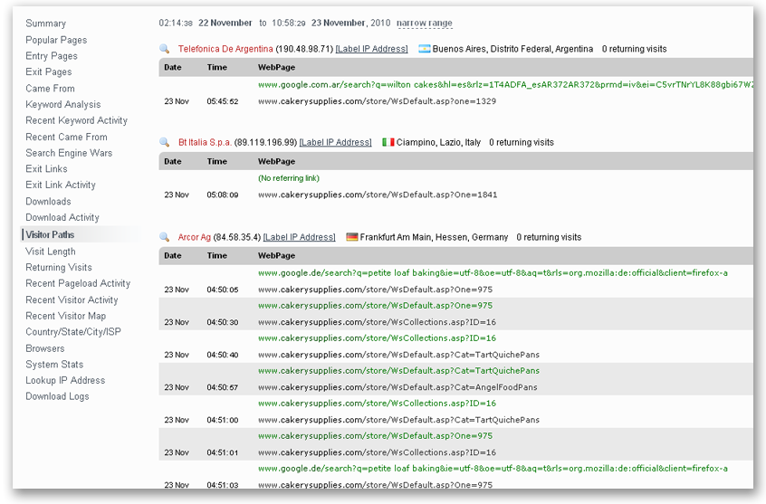
Drill down Panel
You can use this to identify common visitor behaviour, or unusual navigation paths that may indicate a problem with your site.

Slide 17
Drill down panel

Slide 18
Drill down panel
Visit Length ( pull )
Returning Visits ( loyalty )
Recent Visitor Google Map ( position + other detail )
ISP Stats
Browser Stats ( how they look on each…)
O.S. Stats
Resolution Stats
JavaScript Stats
HTTPS Tracking [Upgraded Members Only]

Slide 19
That’s it ! ☺
All of these features, almost 100% free just by adding a few lines of codes into your website ! ^_^

