Slide 1
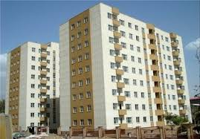
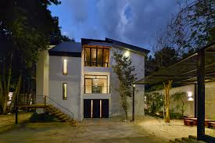
My house
By Kuchakzadeh
Apartment/flat
villa

Slide 2
Where is she?
She is in the kitchen.
What is she doing?
She is cooking.

Slide 3
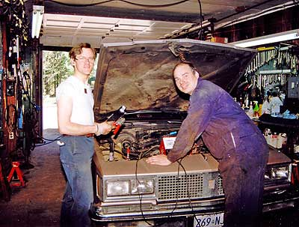
Where are they?
They are in a garage.
What are they doing?
They are fixing the car.

Slide 4
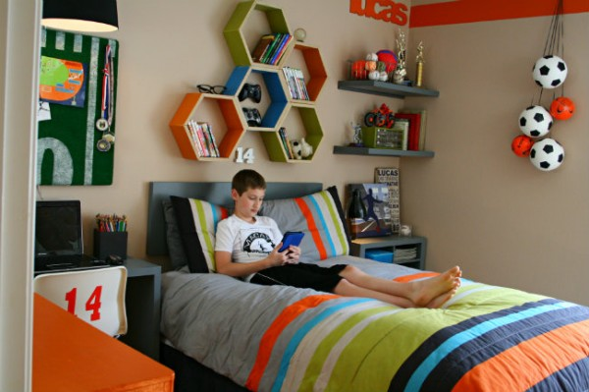
Where is he?
He is in his bedroom.
What is he doing?
He is studying a book.

Slide 5
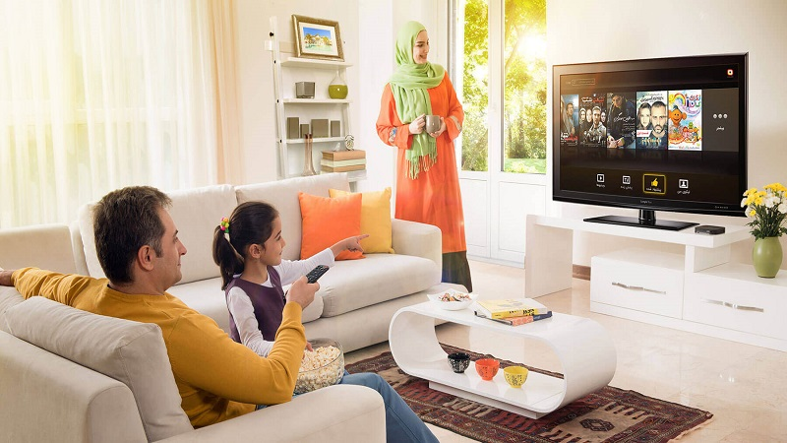
Where are they?
They are in the living room.
What are they doing?
They are watching TV.

Slide 6
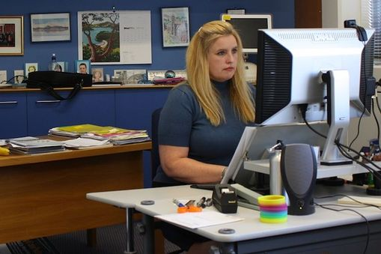
Where is she?
She is in her office.
What is she doing?
She is working with a computer.

Slide 7
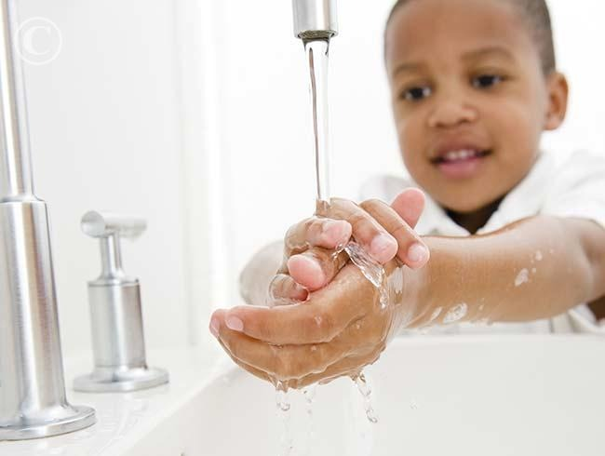
Where is he?
He is in the bathroom.
What is he doing?
He is washing his hands.

Slide 8
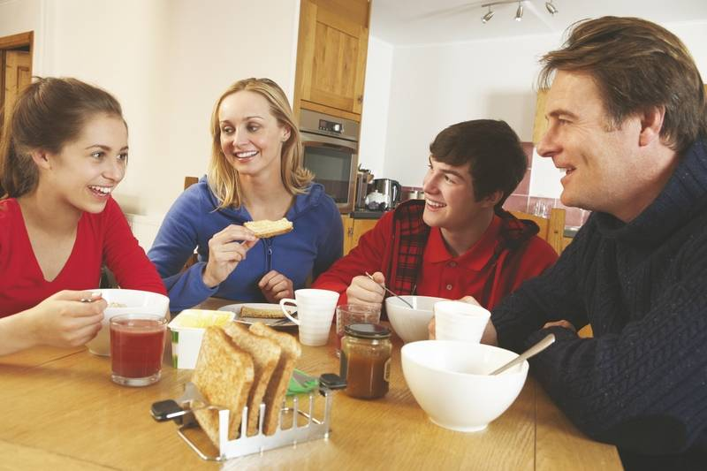
Where are they?
They are in the kitchen.
What are they doing?
They are eating and drinking.

Slide 9
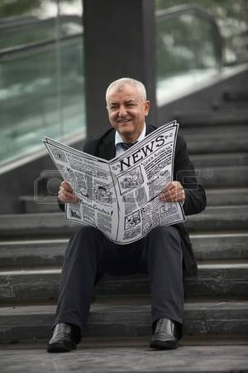
Where is he?
He is on the stairs.
What is he doing?
He is reading a newspaper.

Slide 10
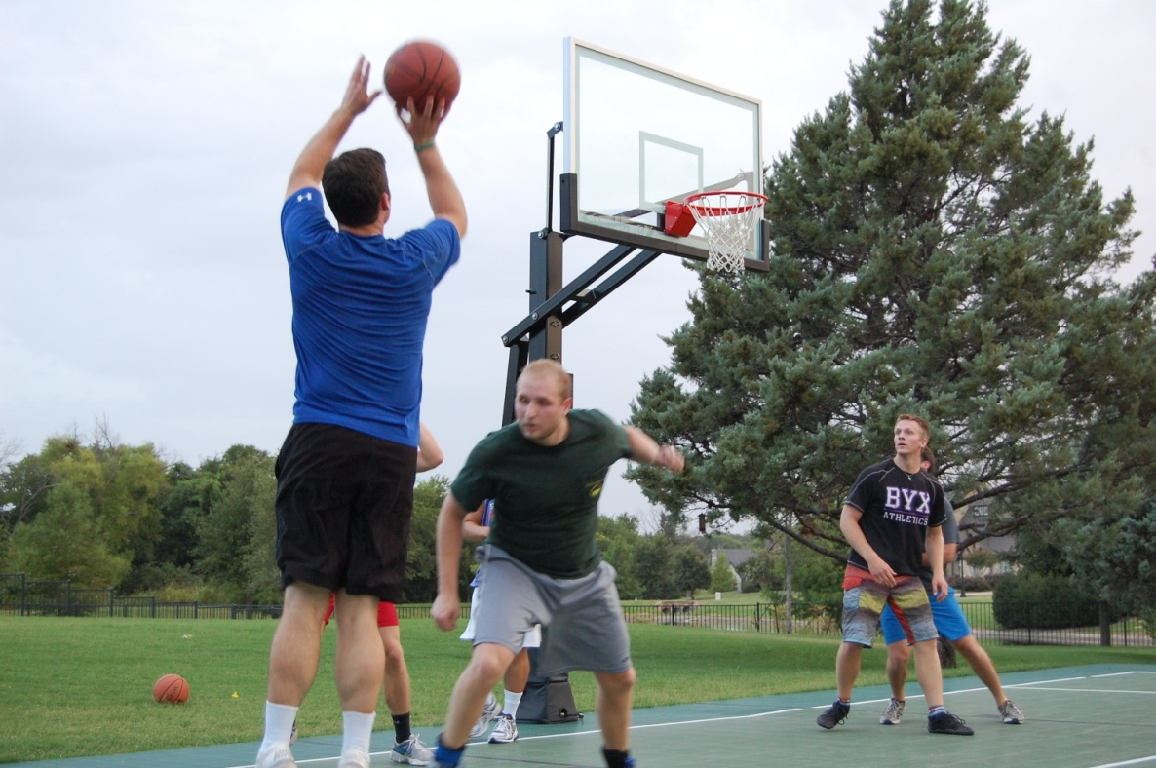
Where are they?
They are in a park.
What are they doing?
They are playing basketball.

