Slide 2
Lesson 5
Media

Slide 3
titles
Conversation
Practice 1
Practice 2
Photo Dictionary
Language Melody
Grammar
Find it
Tell Your Classmates

Slide 4
Conversation
Listen to the conversation between Mina and Mahsa over the phone.
Mina: Did you enjoy your weekend?
Mahsa: Yes, it was wonderful ! I attended Fajr International
Film Festival.
Mina: Really? I am also interested in its events and movies.
Mahsa: Oh, did you watch the reports on TV last night?
Mina: Yes, I did, but I like to read about them.
Mahsa: Well, you can surf its website if you like. There are
many interesting things there.
Mina: That’s great! Could you please give me the website
address?
Mahsa: Why not! Just a moment. Umm… I just texted it.
Mina: Thanks a lot.
Home

Slide 5
Practice 1 Talking about Media (1)
Listen to the examples. Then ask and answer with a friend.
Did the girls listen to the radio?
Did Mina surf the Internet?
Did you watch the cartoon?
Did Amir work with his computer?
Yes, they did.
No, she didn’t.
Yes, we watched it.
No, he worked with his mobile.
Home

Slide 6
Practice 2 Talking about Media (2)
Listen to the examples. Then ask and answer with a friend.
Who watched the movie last night?
What did you do last week?
What did Ali receive?
When did they download the book?
Where did she connect to the Internet?
My sister.
I attended Fajr International Film Festival.
He received an email.
They downloaded it yesterday.
She connected to the Internet at school.
Home

Slide 7
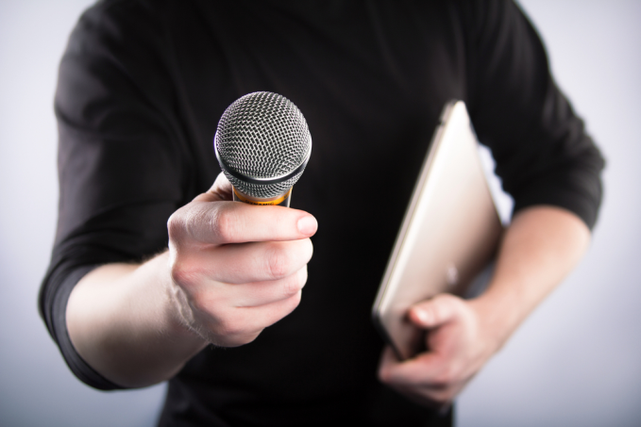
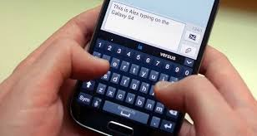
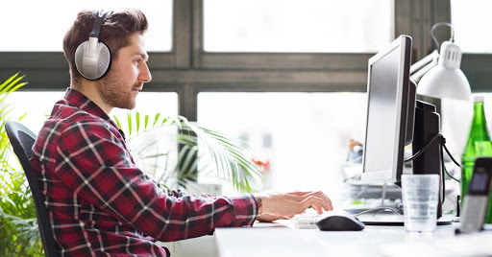
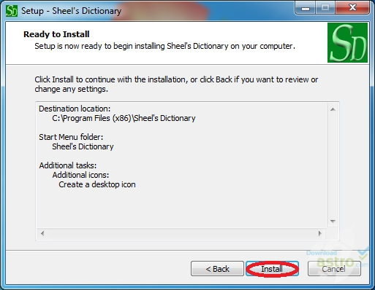
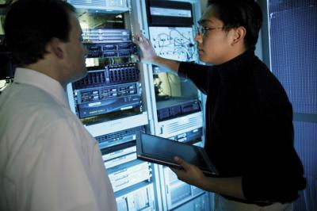
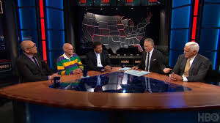
Photo Dictionary
download something from
the Internet
interview somebody
text a message
receive an e-mail
attend a TV program
participate in an online course
update a blog
use Information Technology
connect to the Internet
install a computer dictionary
Home

Slide 8
Language Melody
Listen to the conversation and pay attention to the rising intonation of sentences with surprises.
Mahdi: There is a football match on TV tonight.
Sam: That’s great news! When?
Mahdi: Around 7, I think.
Sam: Really?! I get home at 6. We can watch it together.
Mahdi: It’s excellent! Please buy some fruits.
Sam: Ok. That’ll be all fun!

Slide 9
Language Melody
Listen to these sentences and then practice.
1. How fantastic!
2. That’s great!
3. That’s really nice!
4. It’s brilliant!
5. Well done!
6. It’s amazing!
7. What a wonderful day!
8. What a beautiful flower!
Home

Slide 10
Grammar
Look at the tables below and listen to your teacher’s explanations.
He received an e-mail.
They closed the door yesterday.
Affirmative
I | watched | TV | Yesterday. last night. last week. two days ago.
You We They
He She

Slide 11
Grammar
Negative
I | did not didn’t | download | the book.
You We They
He She

Slide 12
Grammar
Yes/No Question
Did | I | search | the Internet | ?
 | you we they
 | he she

Slide 13
Grammar
Who listened to the poem? What did she do? What did Amir update? When did they connect to the Internet? Where did you watch the movie?

Slide 14
Grammar
Home

Slide 15
Find it
Find and underline “simple past tense” in the passage below.
Last weekend, something happened to our TV. It didn’t work. At first, we were upset. But then we talked about our day. It was really fun! Later, we helped our mother and cleaned the house. In the afternoon, my grandfather showed us how to play an old game. We enjoyed it a lot. All day we were busy doing different things. At night, we all were happy. No one talked about TV!
Home

Slide 16
Tell Your Classmates
Tell your classmates five things you did yesterday.
Example: I watched TV yesterday.
1.
2.
3.
4.
5.
Home

Slide 17
Thanks for watching
Producers:
Mohamad abed masroor
Reza lotfi
Teacher:
Sir zahedi

