Slide 1
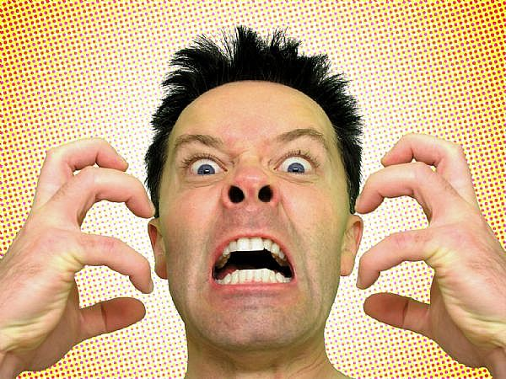
Angry (adjective)
He was angry with himself for making a stupid mistake.

Slide 2
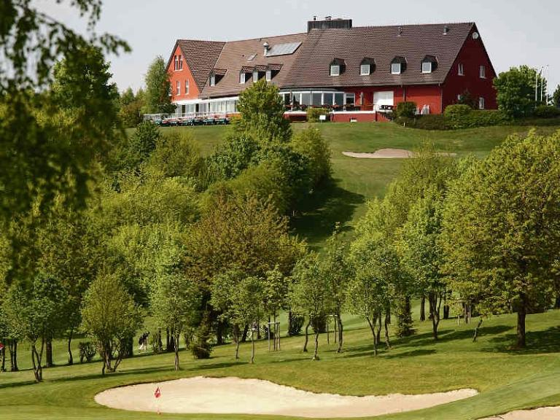
A pleasant place

Slide 3
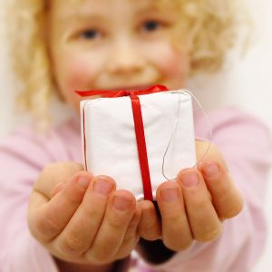
Generous girl

Slide 4
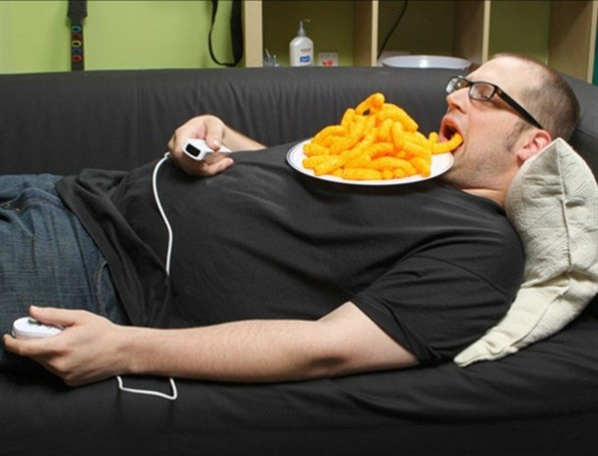
A lazy person

Slide 5
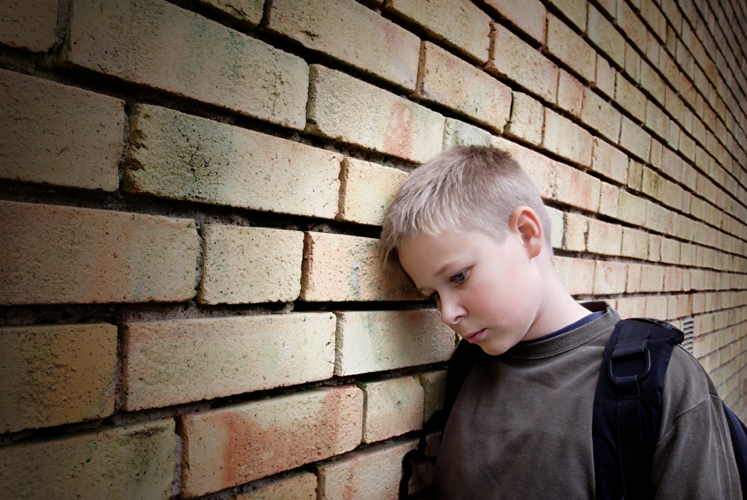
Upset(adj)

Slide 6
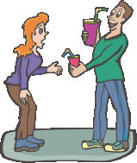
Selfish(adj)

Slide 7
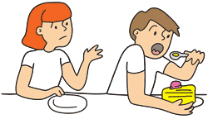
Selfish(adj)

Slide 8
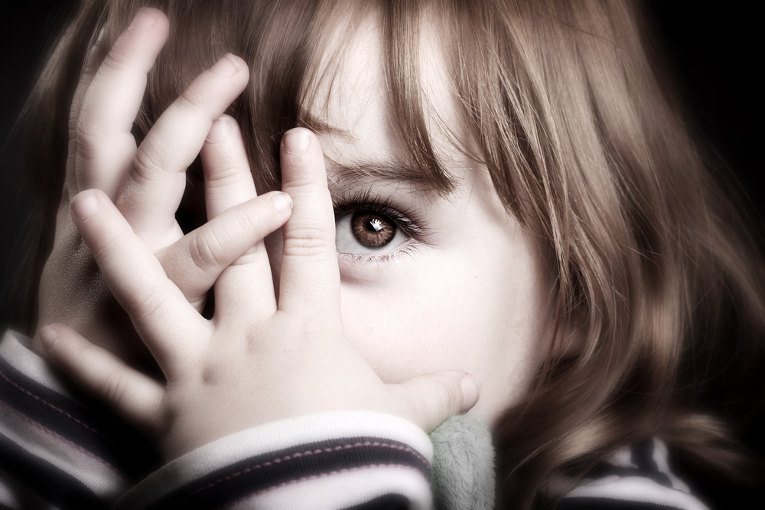
Shy(adj)

Slide 9
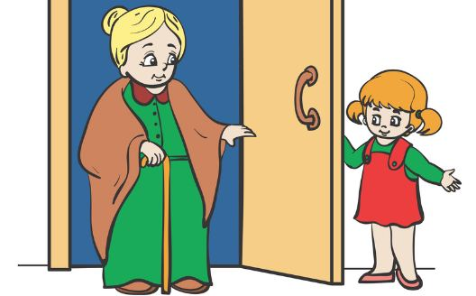
Polite(adj)

Slide 10
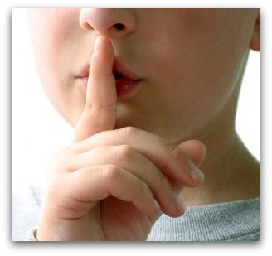
Quiet(adj)

Slide 11
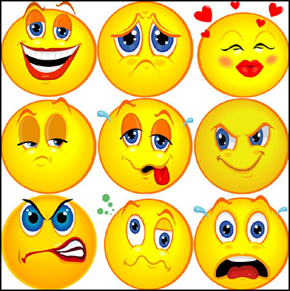
personality

Slide 12
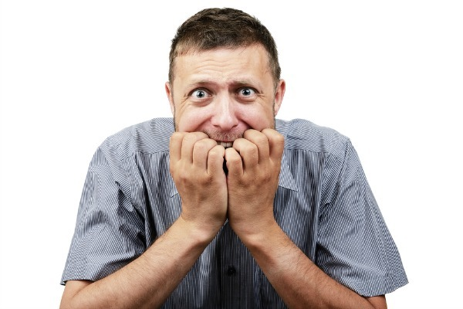
Nervous(adj)

Slide 13
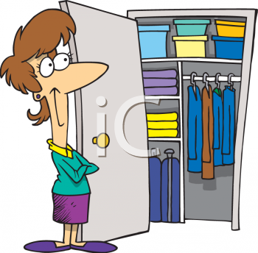
Neat(adj)

Slide 14
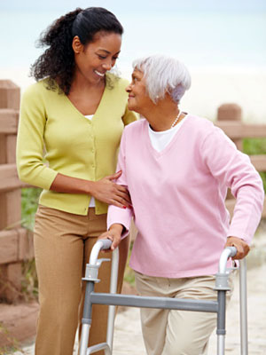
Helpful(adj)

Slide 15

Hard working(adj)

Slide 16
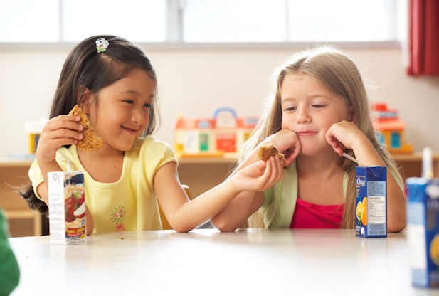
Kind(adj)

Slide 17
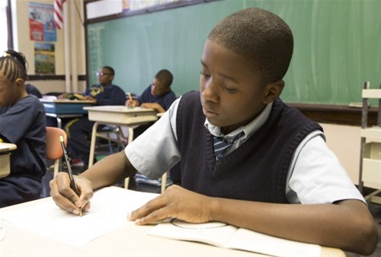
Hard working(adj)

Slide 18
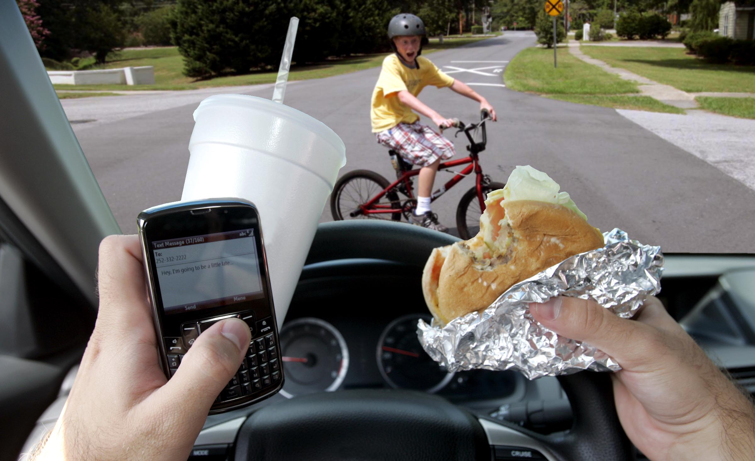
Careless(adjective)
(A careless driver)

Slide 19
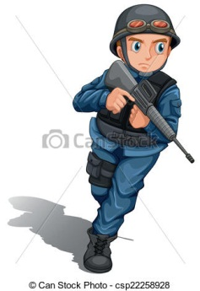
Brave(adjective)
(ready to face danger)

Slide 20
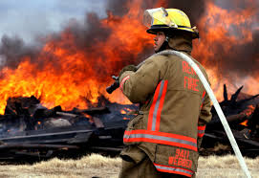
Brave(adj)
(ready to face danger)

Slide 21
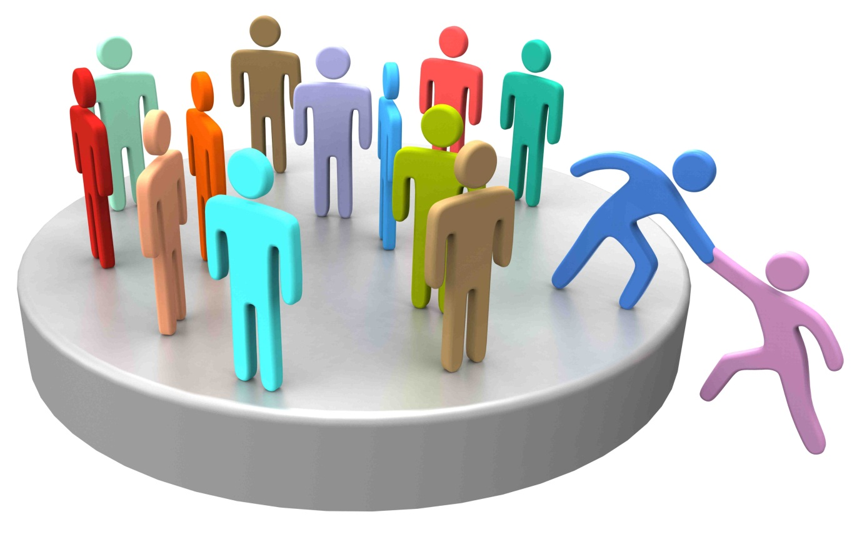
member

Slide 22
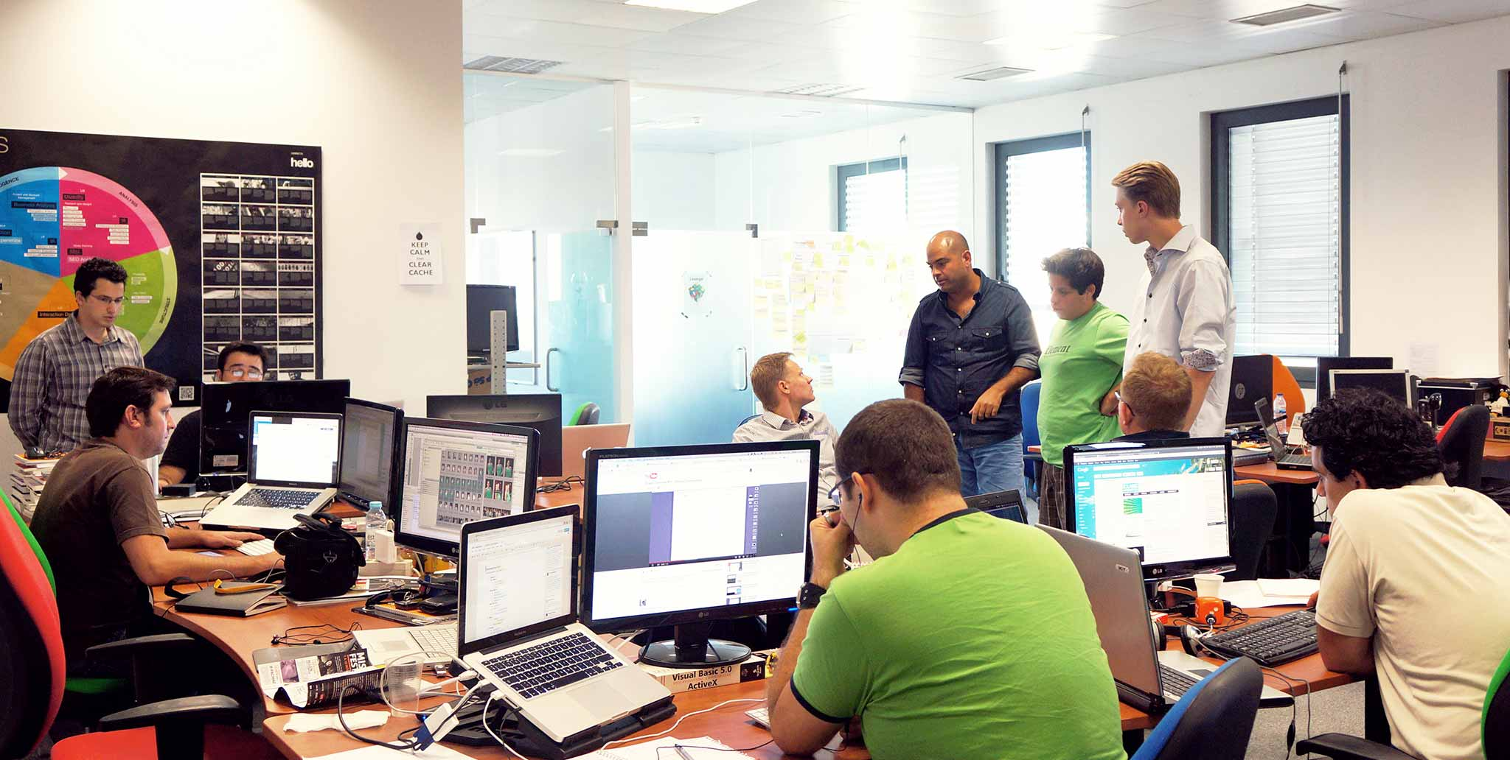
Company
(group of people working together)

Slide 23
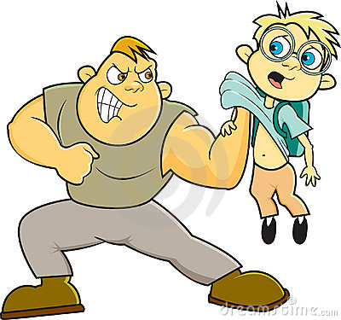
Cruel(adj)
(This man is cruel)

Slide 24
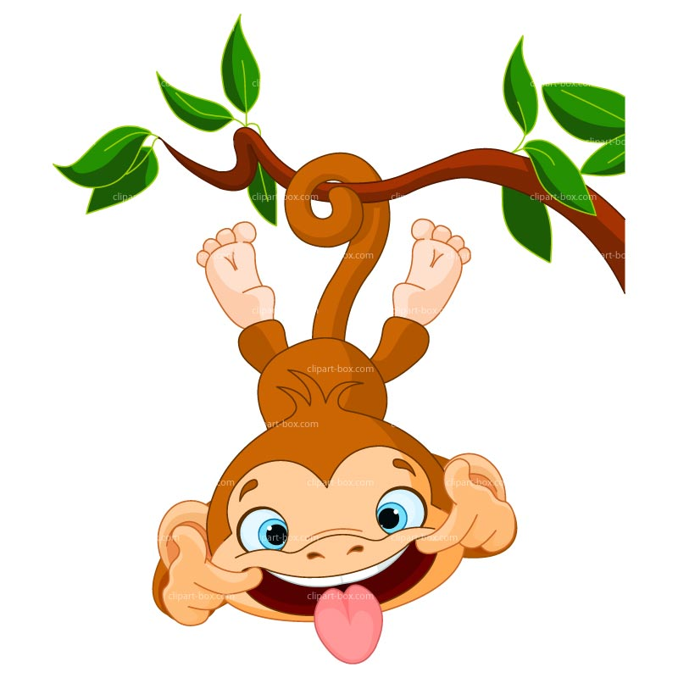
Funny(adj)

Slide 25
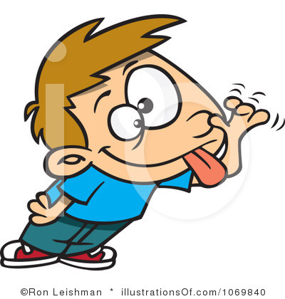
Funny(adj)

