Slide 1
State, Society and Individual

Slide 3
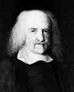
‘Negative’ interpretation of Individual
Thomas Hobbes
Individual as self-sufficient, possessive and self-interested units in a ‘state of nature’ before the formation of the state’
state as a ‘social contract’ between consenting individuals

Slide 4
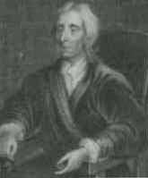
‘Positive’ interpretation of individual
John Locke: individual born ‘free and equal’, governed by reasons and endowed with certain inalienable rights and liberties
J S Mills: capable of self-development, of being educated and civilised, and thus of achieving an autonomy of action and judgement
Direct and participatory democracy on the basis of a collective political / general will

Slide 5
State
Safeguard the interest of the powerful
Represent ‘social contract’
Reflect general will
Promote and protect civil and political liberties

Slide 6
State and society
State shaped by social relations and power
State as an organised power to shape society
Symbiotic

Slide 7
Civil society
As a reaction to possible state control and the lost of society (society colonised by the state as in totalitarian state)
Civil society as all forms of social intercourse or voluntary association, whether economic or not, provided only that they are not funded or controlled directly by the state
Functions: watchdog, monitoring, innovation, maintain the vitality of a culture, represent the alternative and marginal

