Slide 1

e l e v e n t h e d i t i o n
o r g a n i z a t i o n a l b e h a v i o r

Slide 2

Chapter One
What Is Organizational Behavior

Slide 3
What Managers Do
Managers (or administrators)
Individuals who achieve goals through other people.
Managerial Activities
Make decisions
Allocate resources
Direct activities of others to attain goals

Slide 4
Management Functions
Planning
Organizing
Management
Functions
Controlling
Leading

Slide 5
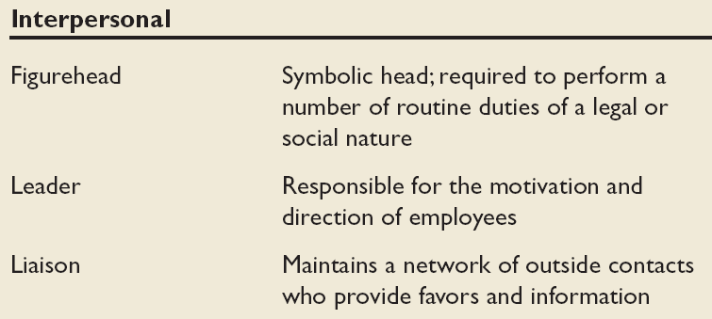
Mintzberg’s Managerial Roles
Source: Adapted from The Nature of Managerial Work by H. Mintzberg. Copyright © 1973 by H. Mintzberg. Reprinted by permission of Pearson Education.
E X H I B I T 1–1

Slide 6
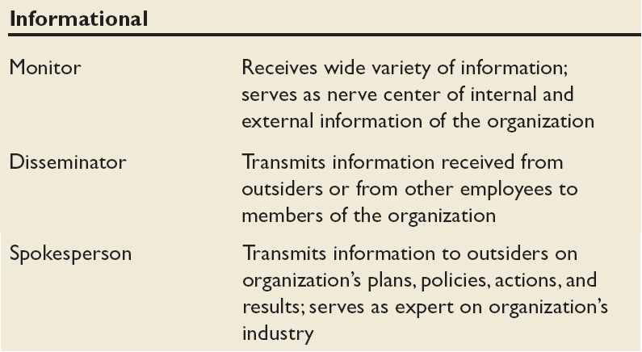
Mintzberg’s Managerial Roles (cont’d)
Source: Adapted from The Nature of Managerial Work by H. Mintzberg. Copyright © 1973 by H. Mintzberg. Reprinted by permission of Pearson Education.
E X H I B I T 1–1 (cont’d)

Slide 7
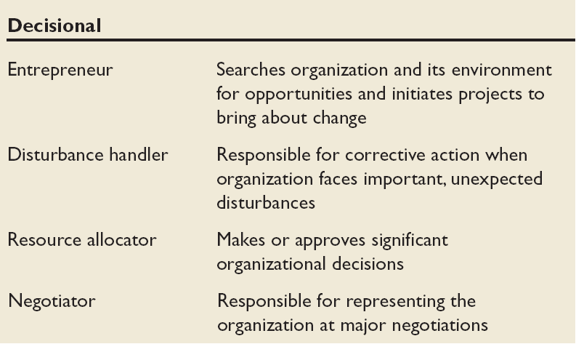
Mintzberg’s Managerial Roles (cont’d)
Source: Adapted from The Nature of Managerial Work by H. Mintzberg. Copyright © 1973 by H. Mintzberg. Reprinted by permission of Pearson Education.
E X H I B I T 1–1 (cont’d)

Slide 8
Management Skills
Technical skills
The ability to apply specialized knowledge or expertise.
Human skills
The ability to work with, understand, and motivate other people, both individually and in groups.
Conceptual Skills
The mental ability to analyze and diagnose complex situations.

Slide 9
Effective Versus Successful Managerial Activities (Luthans)
Traditional management
  Decision making, planning, and controlling
Communication
  Exchanging routine information and processing paperwork
Human resource management
  Motivating, disciplining, managing conflict, staffing, and training
Networking
  Socializing, politicking, and interacting with others

Slide 10
Replacing Intuition with Systematic Study
Intuition
A feeling not necessarily supported by research.
Systematic study
Looking at relationships, attempting to attribute causes and effects, and drawing conclusions based on scientific evidence.
Provides a means to predict behaviors.

Slide 11
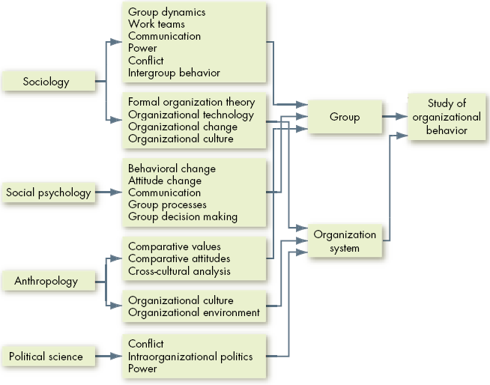

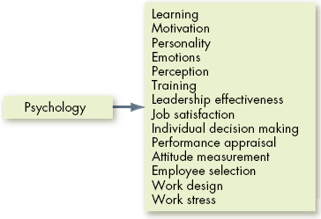
Toward an OB Discipline
E X H I B I T 1–3

Slide 12
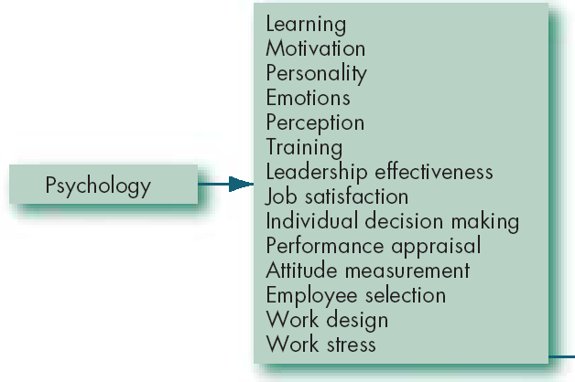
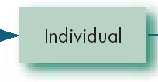
Contributing Disciplines to the OB Field
Psychology
The science that seeks to measure, explain, and sometimes change the behavior of humans and other animals.
E X H I B I T 1–3 (cont’d)

Slide 13
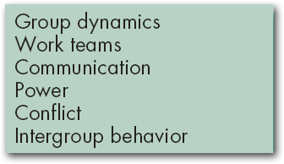


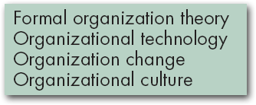

Contributing Disciplines to the OB Field (cont’d)
Sociology
The study of people in relation to their fellow human beings.
E X H I B I T 1–3 (cont’d)

Slide 14
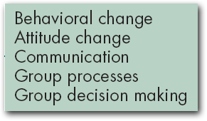

Contributing Disciplines to the OB Field (cont’d)
Social Psychology
An area within psychology that blends concepts from psychology and sociology and that focuses on the influence of people on one another.
E X H I B I T 1–3 (cont’d)

Slide 15
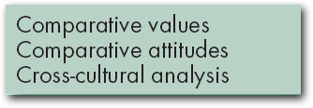


Contributing Disciplines to the OB Field (cont’d)
Anthropology
The study of societies to learn about human beings and their activities.
E X H I B I T 1–3 (cont’d)

Slide 16
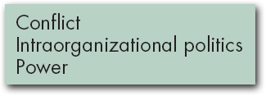

Contributing Disciplines to the OB Field (cont’d)
Political Science
The study of the behavior of individuals and groups within a political environment.
E X H I B I T 1–3 (cont’d)

Slide 17
There Are Few Absolutes in OB
Contingency variables
Situational factors: variables that moderate the relationship between two or more other variables and improve the correlation.
Contingency
Variables
x
y

Slide 18
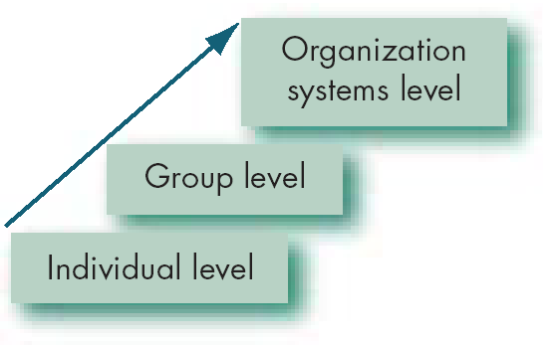
Basic OB Model, Stage I
Model
An abstraction of reality.
A simplified representation of some real-world phenomenon.
E X H I B I T 1–7

Slide 19
The Dependent Variables
Dependent variable
A response that is affected by an independent variable.
y
x

Slide 20
The Dependent Variables (cont’d)
Productivity
A performance measure that includes effectiveness and efficiency.
Effectiveness
Achievement of goals.
Efficiency
The ratio of effective output to the input required to achieve it.

Slide 21
The Dependent Variables (cont’d)
Absenteeism
The failure to report to work.
Turnover
The voluntary and involuntary permanent withdrawal from an organization.

Slide 22
The Dependent Variables (cont’d)
Organizational citizenship behavior (OCB)
Discretionary behavior that is not part of an employee’s formal job requirements, but that nevertheless promotes the effective functioning of the organization.

Slide 23
The Dependent Variables (cont’d)
Job satisfaction
A general attitude toward one’s job, the difference between the amount of reward workers receive and the amount they believe they should receive.

Slide 24
The Independent Variables
Independent variable
The presumed cause of some change in the dependent variable.
Independent
Variables
Individual-Level Variables
Group-Level
Variables
Organization
System-Level
Variables

Slide 25
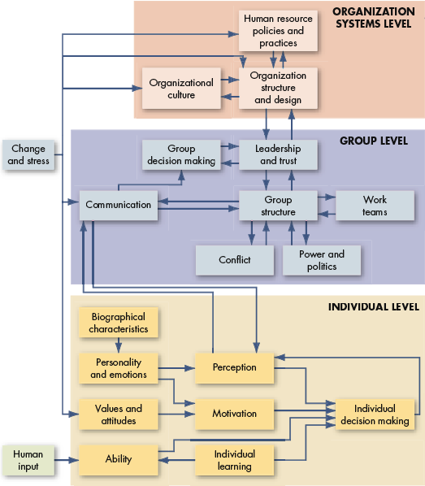
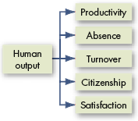
Basic OB Model, Stage II
E X H I B I T 1–8

Slide 26
e l e v e n t h e d i t i o n
o r g a n i z a t i o n a l b e h a v i o r

Slide 27

Chapter 2
Foundations of Individual Behavior

Slide 28
Biographical Characteristics
Biographical Characteristics
Personal characteristics—such as age, gender, and marital status—that are objective and easily obtained from personnel records.

Slide 29
Ability, Intellect, and Intelligence
Ability
An individual’s capacity to perform the various tasks in a job.
Intellectual Ability
The capacity to do mental activities.
Multiple Intelligences
Intelligence contains four subparts: cognitive, social, emotional, and cultural.

Slide 30
Dimensions of
Intellectual Ability
Number aptitude
Verbal comprehension
Perceptual speed
Inductive reasoning
Deductive reasoning
Spatial visualization
Memory
E X H I B I T 2–1

Slide 31
Physical Abilities
Physical Abilities
The capacity to do tasks demanding stamina, dexterity, strength, and similar characteristics.

Slide 32
The Ability-Job Fit
Ability-Job
Fit
Employee’s
Abilities
Job’s Ability
Requirements

Slide 33
Learning
Learning
Any relatively permanent change in behavior that occurs as a result of experience.
Learning
Involves change
Is relatively permanent
Is acquired through experience

Slide 34
Theories of Learning
Classical Conditioning
A type of conditioning in which an individual responds to some stimulus that would not ordinarily produce such a response.
Key Concepts
Unconditioned stimulus
Unconditioned response
Conditioned stimulus
Conditioned response

Slide 35
Theories of Learning (cont’d)
Operant Conditioning
A type of conditioning in which desired voluntary behavior leads to a reward or prevents a punishment.
Key Concepts
Reflexive (unlearned) behavior
Conditioned (learned) behavior
Reinforcement

Slide 36
Theories of Learning (cont’d)
Social-Learning Theory
People can learn through observation and direct experience.
Key Concepts
Attentional processes
Retention processes
Motor reproduction processes
Reinforcement processes

Slide 37
Theories of Learning (cont’d)
Shaping Behavior
Systematically reinforcing each successive step that moves an individual closer to the desired response.
Key Concepts
Reinforcement is required to change behavior.
Some rewards are more effective than others.
The timing of reinforcement affects learning speed and permanence.

Slide 38
Types of Reinforcement
Positive reinforcement
  Providing a reward for a desired behavior.
Negative reinforcement
  Removing an unpleasant consequence when the desired behavior occurs.
Punishment
  Applying an undesirable condition to eliminate an undesirable behavior.
Extinction
  Withholding reinforcement of a behavior to cause its cessation.

Slide 39
Schedules of Reinforcement
Continuous Reinforcement
A desired behavior is reinforced each time it is demonstrated.
Intermittent Reinforcement
A desired behavior is reinforced often enough to make the behavior worth repeating but not every time it is demonstrated.

Slide 40
Schedules of Reinforcement (cont’d)
Fixed-Interval Schedule
Rewards are spaced at uniform time intervals.
Variable-Interval Schedule
Rewards are initiated after a fixed or constant number of responses.

Slide 41
OB MOD Organizational Applications
Well Pay versus Sick Pay
  Reduces absenteeism by rewarding attendance, not absence.
Employee Discipline
  The use of punishment can be counter-productive.
Developing Training Programs
  OB MOD methods improve training effectiveness.
Self-management
  Reduces the need for external management control.

Slide 42
e l e v e n t h e d i t i o n
o r g a n i z a t i o n a l b e h a v i o r

Slide 43

Chapter 3
Values, Attitudes, and Job Satisfaction

Slide 44
Values
Values
Basic convictions that a specific mode of conduct or end-state of existence is personally or socially preferable to an opposite or converse mode of conduct or end-state of existence.
Value System
A hierarchy based on a ranking of an individual’s values in terms of their intensity.

Slide 45
Importance of Values
Provide understanding of the attitudes, motivation, and behaviors of individuals and cultures.
Influence our perception of the world around us.
Represent interpretations of “right” and “wrong.”
Imply that some behaviors or outcomes are preferred over others.

Slide 46
Types of Values –- Rokeach Value Survey
Terminal Values
Desirable end-states of existence; the goals that a person would like to achieve during his or her lifetime.
Instrumental Values
Preferable modes of behavior or means of achieving one’s terminal values.

Slide 47
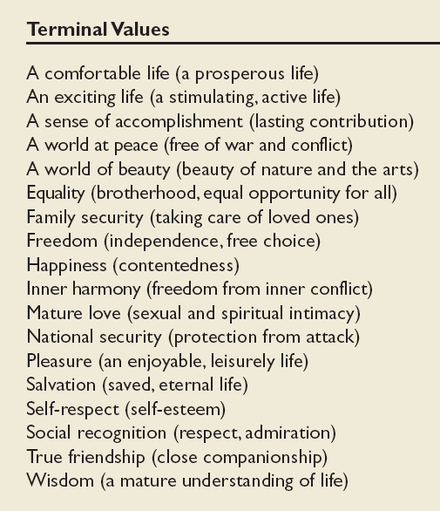
Values in the Rokeach
Survey
Source: M. Rokeach, The Nature of Human Values (New York: The Free Press, 1973).
E X H I B I T 3–1

Slide 48
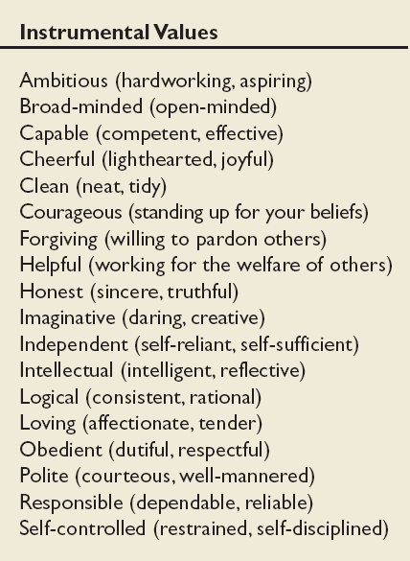
Values in the Rokeach Survey
(cont’d)
Source: M. Rokeach, The Nature of Human Values (New York: The Free Press, 1973).
E X H I B I T 3–1 (cont’d)

Slide 49
Hofstede’s Framework for Assessing Cultures
Power Distance
The extent to which a society accepts that power in institutions and organizations is distributed unequally.
low distance: relatively equal distribution
high distance: extremely unequal distribution

Slide 50
Hofstede’s Framework (cont’d)
Individualism
The degree to which people prefer to act as individuals rather than a member of groups.
Collectivism
A tight social framework in which people expect others in groups of which they are a part to look after them and protect them.

Slide 51
Hofstede’s Framework (cont’d)
Achievement
The extent to which societal values are characterized by assertiveness, materialism and competition.
Nurturing
The extent to which societal values emphasize relationships and concern for others.

Slide 52
Hofstede’s Framework (cont’d)
Uncertainty Avoidance
The extent to which a society feels threatened by uncertain and ambiguous situations and tries to avoid them.

Slide 53
Hofstede’s Framework (cont’d)
Long-term Orientation
A national culture attribute that emphasizes the future, thrift, and persistence.
Short-term Orientation
A national culture attribute that emphasizes the past and present, respect for tradition, and fulfilling social obligations.

Slide 54
The GLOBE
Framework for
Assessing
Cultures
Assertiveness
Future Orientation
Gender differentiation
Uncertainty avoidance
Power distance
Individual/collectivism
In-group collectivism
Performance orientation
Humane orientation
Source: M. Javidan and R. J. House, “Cultural Acumen for the Global Manager: Lessons from Project GLOBE,” Organizational Dynamics, Spring 2001, pp. 289–305.
E X H I B I T 3–4

Slide 55
Attitudes
Attitudes
Evaluative statements or judgments concerning objects, people, or events.
Cognitive component
The opinion or belief segment of an attitude.
Affective Component
The emotional or feeling segment of an attitude.
Behavioral Component
An intention to behave in a certain way toward someone or something.

Slide 56
Types of Attitudes
Job Satisfaction
A collection of positive and/or negative feelings that an individual holds toward his or her job.
Job Involvement
Identifying with the job, actively participating in it, and considering performance important to self-worth.
Organizational Commitment
Identifying with a particular organization and its goals, and wishing to maintain membership in the organization.

Slide 57
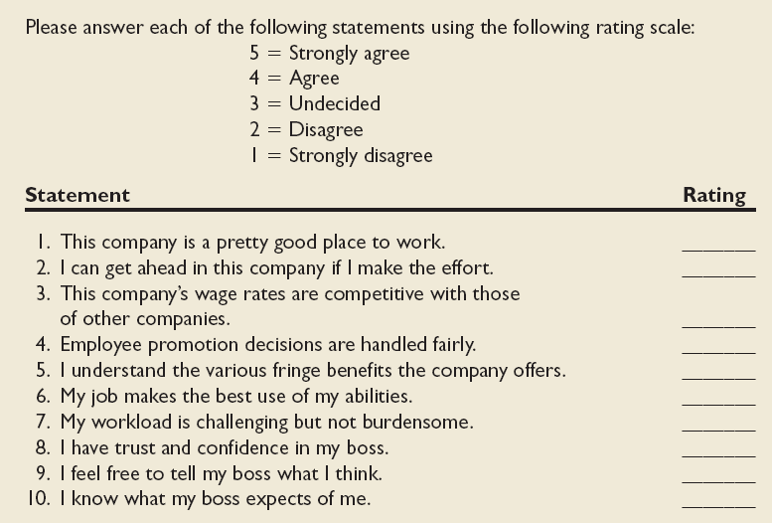
Sample Attitude Survey

Slide 58
How Employees Can Express Dissatisfaction
Exit
Behavior directed toward leaving the organization.
Voice
Active and constructive attempts to improve conditions.
Loyalty
Passively waiting for conditions to improve.
Neglect
Allowing conditions to worsen.

Slide 59
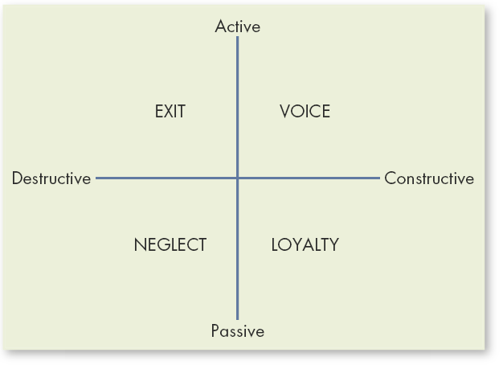
Responses to Job Dissatisfaction
Source: C. Rusbult and D. Lowery, “When Bureaucrats Get the Blues,” Journal of Applied Social Psychology. 15, no. 1, 1985:83. Reprinted with permission.
E X H I B I T 3–5

Slide 60
Job Satisfaction and OCB
Satisfaction and Organizational Citizenship Behavior (OCB)
  Satisfied employees who feel fairly treated by and are trusting of the organization are more willing to engage in behaviors that go beyond the normal expectations of their job.

Slide 61
Job Satisfaction and Customer Satisfaction
Satisfied employees increase customer satisfaction because:
  They are more friendly, upbeat, and responsive.
  They are less likely to turnover which helps build long-term customer relationships.
  They are experienced.
Dissatisfied customers increase employee job dissatisfaction.

Slide 62
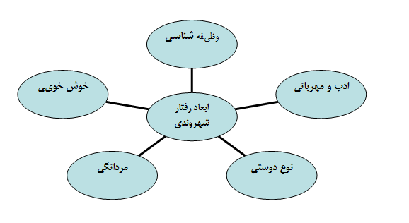

Slide 63
e l e v e n t h e d i t i o n
o r g a n i z a t i o n a l b e h a v i o r

Slide 64

Chapter 4
Personality and Emotions

Slide 65
What is Personality?
Personality
The sum total of ways in which an individual reacts and interacts with others.
Personality Traits
Enduring characteristics that describe an individual’s behavior.
Personality
Determinants
Heredity
Environment
Situation

Slide 66
The Myers-Briggs Type Indicator
Myers-Briggs Type Indicator (MBTI)
A personality test that taps four characteristics and classifies people into 1 of 16 personality types.
Personality Types
Extroverted vs. Introverted (E or I)
Sensing vs. Intuitive (S or N)
Thinking vs. Feeling (T or F)
Judging vs. Perceiving (P or J)
انواع شخصيت :
برون گرا در مقابل درون گرا (برون گرا : معاشرتي، اجتماعي، و مثبت هستند .درون گرا : در خود ، ترسو ، ساكت ، معاشرتي نيستند ، اجتماعي نيستند .
حسي در مقابل شهودي
متفكر در مقابل احساسي
ادراكي در مقابل قضاوتي

Slide 67
MBTI Preferences
Notes:
18
18

Slide 68
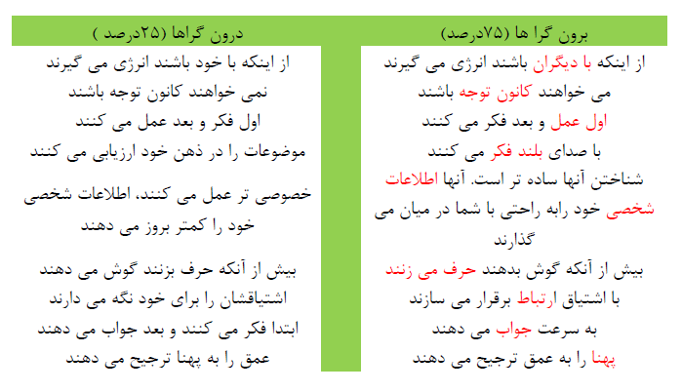

Slide 69
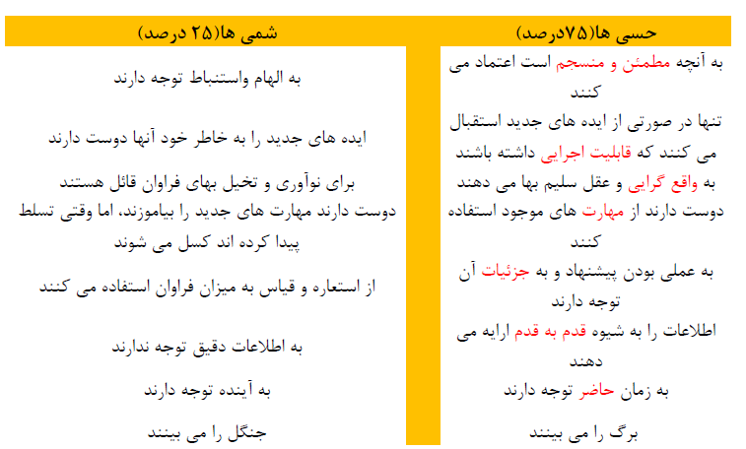

Slide 70
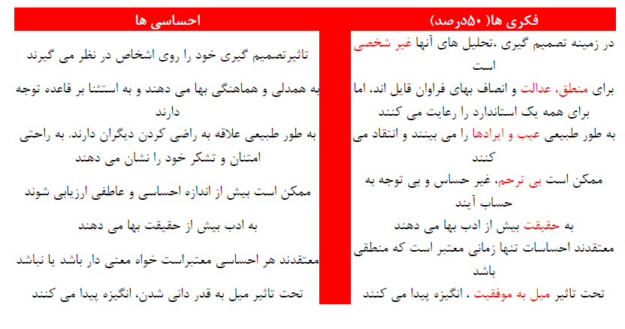

Slide 71
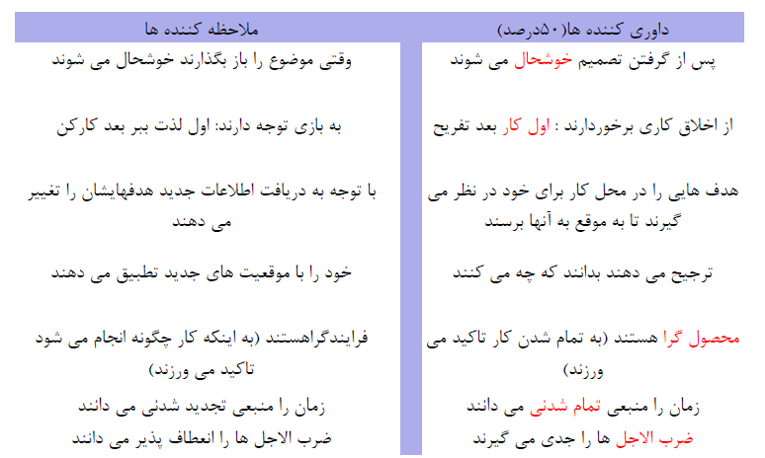

Slide 72
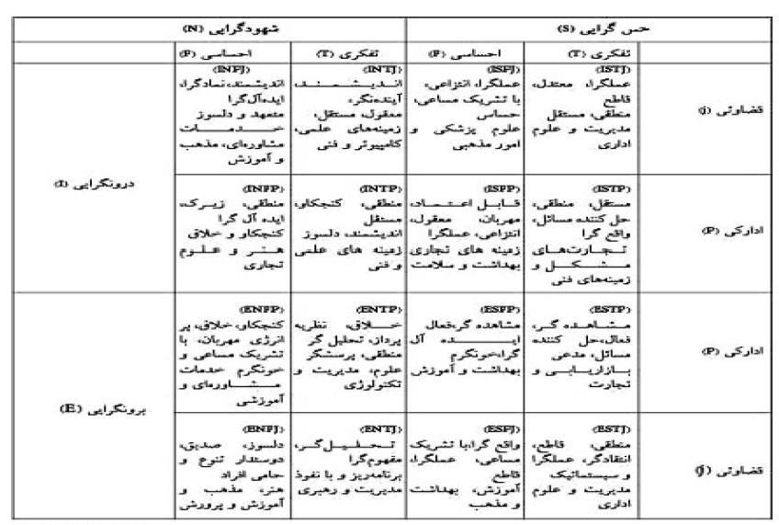

Slide 73
تيپ | نام | اشاره خيلي مختصرنقاط قوت و ضعف بالقوه هر تيپ
INTJ | درونگراي شهودي متفکر قضاوتي | مستقل- خلاق - منتقد
ISTJ | درون گراي حسي متفکر قضاوتي | منظم - وفادار- بدبين
ISFJ | درونگراي حسي احساسي قضاوتي | محطاط- فروتن - نگران
ESTP | برونگراي حسي متفکر ادراکي | پر انرژي- مستقل - بي نظم
ESFP | برونگراي حسي احساسي ادراکي | اجتماعي- پر شور و هيجان - غير قابل پيش بيني
INFJ | درونگراي شهودي احساسي قضاوتي | کمال گرا- صبور - تاييد طلب
ENTP | برونگراي شهودي متفکر ادراکي | خلاق - پرتلاش- تنوع طلب
INFP | درونگراي شهودي احساسي ادراکي | آرام - ملاحظه کار - متوقع
ISTP | درونگراي حسي متفکر ادراکي | کنجکاو - اهل ريسک - کم تحمل
INTP | درونگراي شهودي متفکر ادراکي | مستقل - دقيق - خودبين
ESTJ | برونگراي حسي متفکر قضاوتي | متعهد - صادق - کم تحمل
ENTJ | برونگراي شهودي متفکر قضاوتي | مسئوليت پذير- دور انديش - سلطه جو
ISFP | درونگراي حسي احساسي ادراکي | صميمي- سخاوتمند- عدم قاطعيت
ENFP | برونگراي شهودي احساسي ادراکي | خلاق - خوشبين - بي نظم
ESFJ | برونگراي حسي احساسي قضاوتي | خون گرم - سنتي- سلطه جو
ENFJ | برونگراي شهودي احساسي قضاوتي | پرتلاش- خوشبين- عجول

Slide 74
16 صفت اصلي
خوددار | رک
کم هوش | با هوش
متأثر از احساسات | ثبات عاطفي
سلطه پذير | سلطه گر
جدي | الله بختي-لاقيد-آسان گير
مصلحت آميز | باوجدان-وظيفه شناس
ترسو | متهور
خشن | حساس
خوش گمان | بدگمان
عمل گرا | تخيل گرا
بي محابا | زيرک
مطمئن به نفس | بيمناک
محافظه کار | اهل تجربه کردن
وابسته به گروه | خود اتکاء
مهار نشده | مهار شده
آرام | تنيده

Slide 75
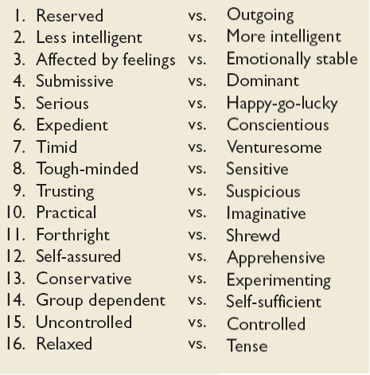
Myers-Briggs Sixteen Primary Traits

Slide 76
MBTI در موارد زير بخوبي عمل مي‌كند:
- شناخت بهتر خود (خودشناسي)
- شناخت بهتر ديگران و تفاوت‌هاي فردي
- بررسي و توسعه شغلي
- توسعه سازماني
- آموزش رهبران و مديران
- مشاوره در ارتباطات
- توسعه برنامه‌هاي آموزشي و پرورشي
- مشاوره آموزشي ـ تحصيلي
- حل مسئله
- آموزش‌هاي متنوع و چندفرهنگه
- ايجاد تيم و تشکيل گروه
از سوي ديگر، اين ابزار در موارد زير به‌صورت خاص توسعه‌يافته و راهكارهايي خاص را پيشنهاد مي‌دهد:
- توسعه رهبري
- شناخت سبك‌هاي رهبري
- مربيگري
- توسعه فردي
- توسعه هوش هيجاني
- تصميم‌گيري
- برقراري ارتباط اثر بخش
- حفظ و نگهداري كاركنان
- مديريت پروژه
- تحقيق و توسعه
- فروش و ارتباط با مشتريان

Slide 77
The Big Five Model of Personality Dimensions
Extroversion
Sociable, gregarious, and assertive
Agreeableness
Good-natured, cooperative, and trusting.
Conscientiousness
Responsible, dependable, persistent, and organized.
Emotional Stability
Calm, self-confident, secure (positive) versus nervous, depressed, and insecure (negative).
Openness to Experience
Imaginativeness, artistic, sensitivity, and intellectualism.

Slide 78
Major Personality Attributes Influencing OB
Locus of control
Machiavellianism
Self-esteem
Self-monitoring
Risk taking
Type A personality

Slide 79
Locus of Control
Locus of Control
The degree to which people believe they are masters of their own fate.
Internals
Individuals who believe that they control what happens to them.
Externals
Individuals who believe that what happens to them is controlled by outside forces such as luck or chance.

Slide 80
Machiavellianism
Machiavellianism (Mach)
Degree to which an individual is pragmatic, maintains emotional distance, and believes that ends can justify means.
Conditions Favoring High Machs
Direct interaction
Minimal rules and regulations
Emotions distract for others

Slide 81
Self-Esteem and Self-Monitoring
Self-Esteem (SE)
Individuals’ degree of liking or disliking themselves.
Self-Monitoring
A personality trait that measures an individuals ability to adjust his or her behavior to external, situational factors.

Slide 82
Risk-Taking
High Risk-taking Managers
  Make quicker decisions
  Use less information to make decisions
  Operate in smaller and more entrepreneurial organizations
Low Risk-taking Managers
  Are slower to make decisions
  Require more information before making decisions
  Exist in larger organizations with stable environments
Risk Propensity
  Aligning managers’ risk-taking propensity to job requirements should be beneficial to organizations.

Slide 83
Personality Types
Type A’s
are always moving, walking, and eating rapidly;
feel impatient with the rate at which most events take place;
strive to think or do two or more things at once;
cannot cope with leisure time;
are obsessed with numbers, measuring their success in terms of how many or how much of everything they acquire.
Type B’s
never suffer from a sense of time urgency with its accompanying impatience;
feel no need to display or discuss either their achievements or accomplishments;
play for fun and relaxation, rather than to exhibit their superiority at any cost;
can relax without guilt.

Slide 84
ويژگي ها | تيپ A | تيپ B
مکالمه | تند | کند
لحن کلام | شديد | ملايم
کيفيت کلام | زمخت، محکم، کوتاه | يکنواخت
زمان پاسخ به سوال | پاسخ آني | مکث پيش ازپاسخگويي
آه کشيدن | فراوان | کم
حرکات چهره | کشيده، خصمانه، ابروها درهم | آرام ودوست داشتني
تبسم | درگوشه لب | گسترده
خنده | خشک | نرم ولطيف وخوش آيند
فشاردادن انگشتان | زياد | کم
قطع کردن حرف ديگران | اغلب | کم
تلاش براي تسلط به طرف مقابل | اغلب | کم
پرخاشگري | اغلب | هرگز
رضايت ازکار | خير | بلي
تلاش براي طي کردن درجات | بلي | بلي
احساس فوريت | بلي | خير
شايستگي | تلاش براي برنده شدن حتي به هنگام بازي با کودکان | بي اهميت بودن

Slide 85
Personality Types
Proactive Personality
Identifies opportunities, shows initiative, takes action, and perseveres until meaningful change occurs.
Creates positive change in the environment, regardless or even in spite of constraints or obstacles.

Slide 86
Achieving Person-Job Fit
Personality-Job Fit Theory (Holland)
Identifies six personality types and proposes that the fit between personality type and occupational environment determines satisfaction and turnover.
Personality Types
Realistic
Investigative
Social
Conventional
Enterprising
Artistic

Slide 87
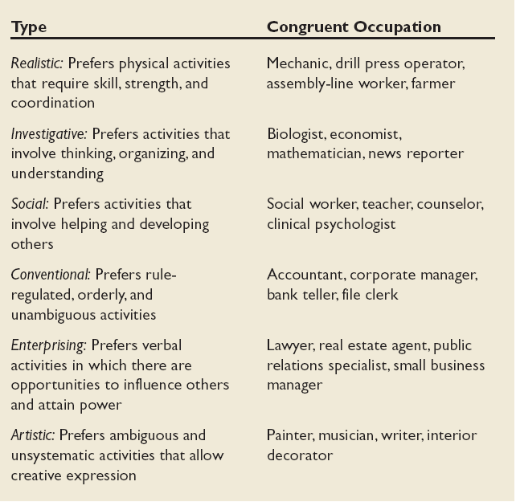
Holland’s Typology of Personality and
Congruent Occupations
E X H I B I T 4–2

Slide 88
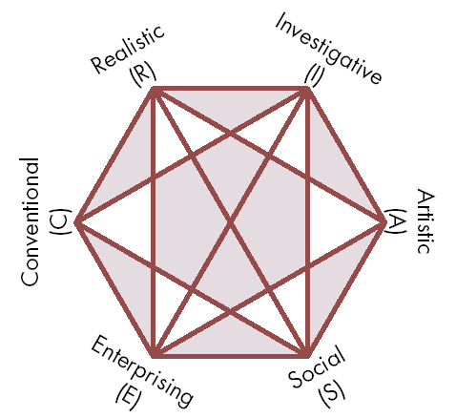
Relationships among Occupational Personality Types
Source: Reprinted by special permission of the publisher, Psychological Assessment Resources, Inc., from Making Vocational Choices, copyright 1973, 1985, 1992 by Psychological Assessment Resources, Inc. All rights reserved.
E X H I B I T 4–3

Slide 89
Emotions- Why Emotions Were Ignored in OB
The “myth of rationality”
  Organizations are not emotion-free.
Emotions of any kind are disruptive to organizations.
  Original OB focus was solely on the effects of strong negative emotions that interfered with individual and organizational efficiency.

Slide 90
What Are Emotions?
Affect
A broad range of emotions that people experience.
Emotions
Intense feelings that are directed at someone or something.
Moods
Feelings that tend to be less intense than emotions and that lack a contextual stimulus.

Slide 91
What Are Emotions? (cont’d)
Emotional Labor
A situation in which an employee expresses organizationally desired emotions during interpersonal transactions.
Emotional Dissonance
A situation in which an employee
must project one emotion while simultaneously feeling another.

Slide 92
Felt versus Displayed Emotions
Felt Emotions
An individual’s actual emotions.
Displayed Emotions
Emotions that are organizationally required and considered appropriate in a given job.

Slide 93
Emotion Continuum
The closer any two emotions are to each other on the continuum, the more likely people are to confuse them.
E X H I B I T 4–4
Source: Based on R.D. Woodworth, Experimental Psychology (New York: Holt, 1938).

Slide 94
Emotion Dimensions
Variety of emotions
  Positive
  Negative
Intensity of emotions
  Personality
  Job Requirements
Frequency and duration of emotions
  How often emotions are exhibited.
  How long emotions are displayed.

Slide 95
Gender and Emotions
Women
  Can show greater emotional expression.
  Experience emotions more intensely.
  Display emotions more frequently.
  Are more comfortable in expressing emotions.
  Are better at reading others’ emotions.
Men
  Believe that displaying emotions is inconsistent with the male image.
  Are innately less able to read and to identify with others’ emotions.
  Have less need to seek social approval by showing positive emotions.

Slide 96
External Constraints on Emotions
Organizational
Influences
Cultural
Influences
Individual
Emotions

Slide 97
Affective Events Theory (AET)
Emotions are negative or positive responses to a work environment event.
  Personality and mood determine the intensity of the emotional response.
  Emotions can influence a broad range of work performance and job satisfaction variables.
Implications of the theory:
  Individual response reflects emotions and mood cycles.
  Current and past emotions affect job satisfaction.
  Emotional fluctuations create variations in job satisfaction.
  Emotions have only short-term effects on job performance.
  Both negative and positive emotions can distract workers and reduce job performance.

Slide 98
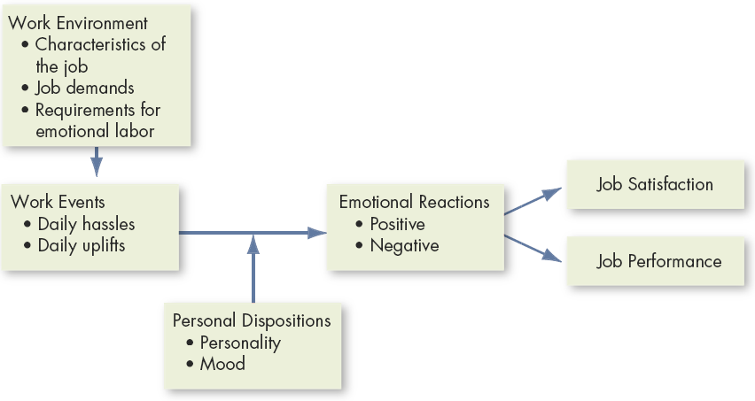
Affective Events Theory (AET)
Source: Based on N.M. Ashkanasy and C.S. Daus, “Emotion in the Workplace: The New Challenge for Managers,” Academy of Management Executive, February 2002, p. 77.
E X H I B I T 4–5

Slide 99
OB Applications of Understanding Emotions
Ability and Selection
  Emotions affect employee effectiveness.
Decision Making
  Emotions are an important part of the decision-making process in organizations.
Motivation
  Emotional commitment to work and high motivation are strongly linked.
Leadership
  Emotions are important to acceptance of messages from organizational leaders.

Slide 100
OB Applications… (cont’d)
Interpersonal Conflict
  Conflict in the workplace and individual emotions are strongly intertwined.
Customer Services
  Emotions affect service quality delivered to customers which, in turn, affects customer relationships.
Deviant Workplace Behaviors
  Negative emotions lead to employee deviance (actions that violate norms and threaten the organization).
    Productivity failures
    Property theft and destruction
    Political actions
    Personal aggression

Slide 101
Ability and Selection
Emotional Intelligence
An assortment of noncognitive skills, capabilities, and competencies that influence a person’s ability to succeed in coping with environmental demands and pressures.
Emotional Intelligence (EI)
  Self-awareness
  Self-management
  Self-motivation
  Empathy
  Social skills
Research Findings
  High EI scores, not high IQ scores, characterize high performers.

Slide 102
e l e v e n t h e d i t i o n
o r g a n i z a t i o n a l b e h a v i o r

Slide 103

Chapter 5
Perception and
Individual Decision Making

Slide 104
After studying this chapter, you should be able to:
Explain how two people can see the same thing and interpret it differently.
List three determinants of attribution.
Describe how shortcuts can assist in or distort our judgment of others.
Explain how perception affects the decision-making process.
Outline the six steps in the rational decision-making model.
L E A R N I N G O B J E C T I V E S

Slide 105
After studying this chapter, you should be able to:
Describe the actions of a boundedly rational decision maker.
Identify the conditions in which individuals are most likely to use intuition in decision making.
Describe four styles of decision making.
Define heuristics and explain how they bias decisions.
Contrast the three ethical decision criteria.
L E A R N I N G O B J E C T I V E S (cont’d)

Slide 106
What Is Perception, and Why Is It Important?
Perception
A process by which individuals organize and interpret their sensory impressions in order to give meaning to their environment.
People’s behavior is based on their perception of what reality is, not on reality itself.
The world as it is perceived is the world that is behaviorally important.

Slide 107
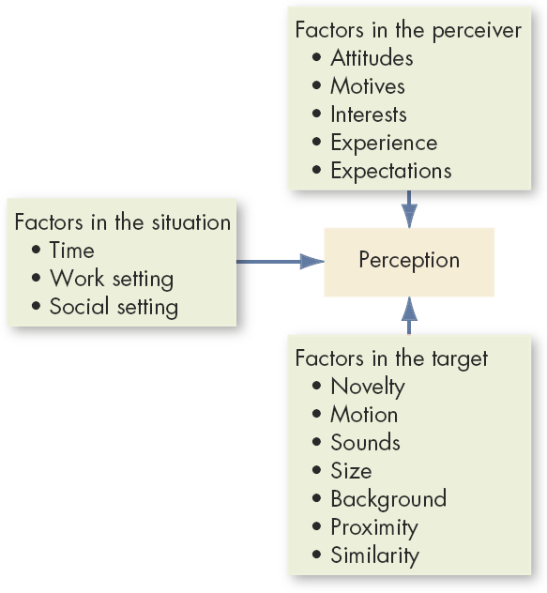
Factors That
Influence Perception
E X H I B I T 5–1

Slide 108
Person Perception: Making Judgments About Others
Attribution Theory
When individuals observe behavior, they attempt to determine whether it is internally or externally caused.
Distinctiveness: shows different behaviors in different situations.
Consensus: response is the same as others to same situation.
Consistency: responds in the same way over time.

Slide 109
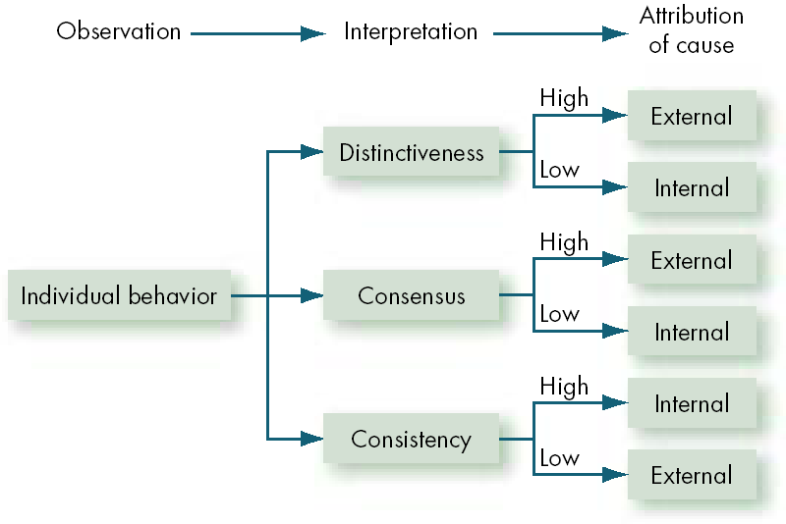
Attribution Theory
E X H I B I T 5–2

Slide 110
Errors and Biases in Attributions
Fundamental Attribution Error
The tendency to underestimate the influence of external factors and overestimate the influence of internal factors when making judgments about the behavior of others.

Slide 111
Errors and Biases in Attributions (cont’d)
Self-Serving Bias
The tendency for individuals to attribute their own successes to internal factors while putting the blame for failures on external factors.

Slide 112
Frequently Used Shortcuts in Judging Others
Selective Perception
People selectively interpret what they see on the basis of their interests, background, experience, and attitudes.

Slide 113
Frequently Used Shortcuts in Judging Others
Halo Effect
Drawing a general impression about an individual on the basis of a single characteristic
Contrast Effects
Evaluation of a person’s characteristics that are affected by comparisons with other people recently encountered who rank higher or lower on the same characteristics.

Slide 114
Frequently Used Shortcuts in Judging Others
Projection
Attributing one’s own characteristics to other people.
Stereotyping
Judging someone on the basis of one’s perception of the group to which that person belongs.

Slide 115
Specific Applications in Organizations
Employment Interview
  Perceptual biases of raters affect the accuracy of interviewers’ judgments of applicants.
Performance Expectations
  Self-fulfilling prophecy (pygmalion effect): The lower or higher performance of employees reflects preconceived leader expectations about employee capabilities.
Ethnic Profiling
  A form of stereotyping in which a group of individuals is singled out—typically on the basis of race or ethnicity—for intensive inquiry, scrutinizing, or investigation.

Slide 116
Specific Applications in Organizations (cont’d)
Performance Evaluations
  Appraisals are often the subjective (judgmental) perceptions of appraisers of another employee’s job performance.
Employee Effort
  Assessment of individual effort is a subjective judgment subject to perceptual distortion and bias.

Slide 117
The Link Between Perceptions and Individual Decision Making
Problem
A perceived discrepancy between the current state of affairs and a desired state.
Perception of the decision maker
Decisions
Choices made from among alternatives developed from data perceived as relevant.
Outcomes

Slide 118
Assumptions of the Rational Decision-Making Model
Rational Decision-
Making Model
Describes how individuals should behave in order to maximize some outcome.
Model Assumptions
Problem clarity
Known options
Clear preferences
Constant preferences
No time or cost constraints
Maximum payoff

Slide 119
Steps in the Rational Decision-Making Model
Define the problem.
Identify the decision criteria.
Allocate weights to the criteria.
Develop the alternatives.
Evaluate the alternatives.
Select the best alternative.
E X H I B I T 5–3

Slide 120
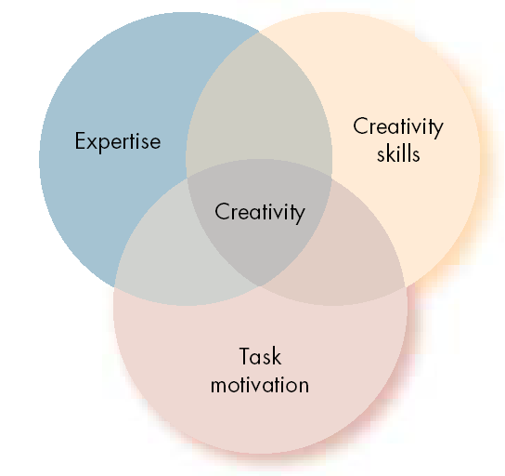
The Three Components of Creativity
Creativity
The ability to produce novel and useful ideas.
Three-Component
Model of Creativity
Proposition that individual creativity requires expertise, creative-thinking skills, and intrinsic task motivation.
E X H I B I T 5–4
Source: T.M. Amabile, “Motivating Creativity in Organizations,” California Management Review, Fall 1997, p. 43.

Slide 121
How Are Decisions Actually Made in Organizations
Bounded Rationality
Individuals make decisions by constructing simplified models that extract the essential features from problems without capturing all their complexity.

Slide 122
How Are Decisions Actually Made in Organizations (cont’d)
How/Why problems are identified
  Visibility over importance of problem
    Attention-catching, high profile problems
    Desire to “solve problems”
  Self-interest (if problem concerns decision maker)
Alternative Development
  Satisficing: seeking the first alternative that solves problem.
  Engaging in incremental rather than unique problem solving through successive limited comparison of alternatives to the current alternative in effect.

Slide 123
Common Biases and Errors
Overconfidence Bias
  Believing too much in our own decision competencies.
Anchoring Bias
  Fixating on early, first received information.
Confirmation Bias
  Using only the facts that support our decision.
Availability Bias
  Using information that is most readily at hand.
Representative Bias
  Assessing the likelihood of an occurrence by trying to match it with a preexisting category.

Slide 124
Common Biases and Errors
Escalation of Commitment
  Increasing commitment to a previous decision in spite of negative information.
Randomness Error
  Trying to create meaning out of random events by falling prey to a false sense of control or superstitions.
Hindsight Bias
  Falsely believing to have accurately predicted the outcome of an event, after that outcome is actually known.

Slide 125
Intuition
Intuitive Decision Making
  An unconscious process created out of distilled experience.
Conditions Favoring Intuitive Decision Making
  A high level of uncertainty exists
  There is little precedent to draw on
  Variables are less scientifically predictable
  “Facts” are limited
  Facts don’t clearly point the way
  Analytical data are of little use
  Several plausible alternative solutions exist
  Time is limited and pressing for the right decision

Slide 126
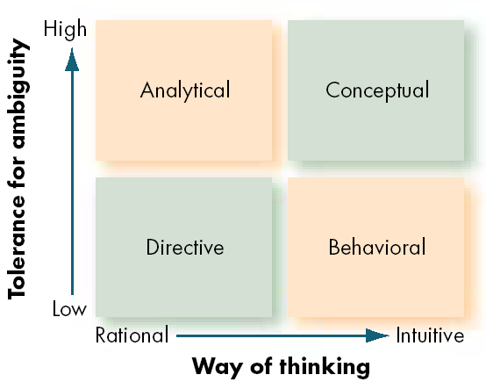
Decision-Style Model
Source: A.J. Rowe and J.D. Boulgarides, Managerial Decision Making, (Upper Saddle River, NJ: Prentice Hall, 1992), p. 29.
E X H I B I T 5–5

Slide 127
Organizational Constraints on Decision Makers
Performance Evaluation
  Evaluation criteria influence the choice of actions.
Reward Systems
  Decision makers make action choices that are favored by the organization.
Formal Regulations
  Organizational rules and policies limit the alternative choices of decision makers.
System-imposed Time Constraints
  Organizations require decisions by specific deadlines.
Historical Precedents
  Past decisions influence current decisions.

Slide 128
Cultural Differences in Decision Making
Problems selected
Time orientation
Importance of logic and rationality
Belief in the ability of people to solve problems
Preference for collect decision making

Slide 129
Ethics in Decision Making
Ethical Decision Criteria
  Utilitarianism
    Seeking the greatest good for the greatest number.
  Rights
    Respecting and protecting basic rights of individuals such as whistleblowers.
  Justice
    Imposing and enforcing rules fairly and impartially.

Slide 130
Ethics in Decision Making
Ethics and National Culture
  There are no global ethical standards.
  The ethical principles of global organizations that reflect and respect local cultural norms are necessary for high standards and consistent practices.

Slide 131
Ways to Improve Decision Making
Analyze the situation and adjust your decision making style to fit the situation.
Be aware of biases and try to limit their impact.
Combine rational analysis with intuition to increase decision-making effectiveness.
Don’t assume that your specific decision style is appropriate to every situation.
Enhance personal creativity by looking for novel solutions or seeing problems in new ways, and using analogies.

Slide 132
Toward Reducing Bias and Errors
Focus on goals.
  Clear goals make decision making easier and help to eliminate options inconsistent with your interests.
Look for information that disconfirms beliefs.
  Overtly considering ways we could be wrong challenges our tendencies to think we’re smarter than we actually are.
Don’t try to create meaning out of random events.
  Don’t attempt to create meaning out of coincidence.
Increase your options.
  The number and diversity of alternatives generated increases the chance of finding an outstanding one.
Source: S.P. Robbins, Decide & Conquer: Making Winning Decisions and Taking Control of Your Life (Upper Saddle River, NJ: Financial Times/Prentice Hall, 2004), pp. 164–68.
E X H I B I T 5–6

Slide 133
e l e v e n t h e d i t i o n
o r g a n i z a t i o n a l b e h a v i o r

Slide 134

Chapter 6
Basic Motivation Concepts

Slide 135
After studying this chapter, you should be able to:
Outline the motivation process.
Describe Maslow’s need hierarchy.
Contrast Theory X and Theory Y.
Differentiate motivators from hygiene factors.
List the characteristics that high achievers prefer in a job.
Summarize the types of goals that increase performance.
L E A R N I N G O B J E C T I V E S

Slide 136
After studying this chapter, you should be able to:
Explain the job characteristics model.
State the impact of underrewarding employees.
Clarify key relationships in expectancy theory.
Explain how the contemporary theories of motivation complement each other.
L E A R N I N G O B J E C T I V E S (cont’d)

Slide 137
Defining Motivation
Motivation
The processes that account for an individual’s intensity, direction, and persistence of effort toward attaining a goal.
Key Elements
Intensity: how hard a person tries
Direction: toward beneficial goal
Persistence: how long a person tries

Slide 138
Hierarchy of Needs Theory (Maslow)
Hierarchy of Needs Theory
There is a hierarchy of five needs—physiological, safety, social, esteem, and self-actualization; as each need is substantially satisfied, the next need becomes dominant.
Self-Actualization
The drive to become what one is capable of becoming.

Slide 139
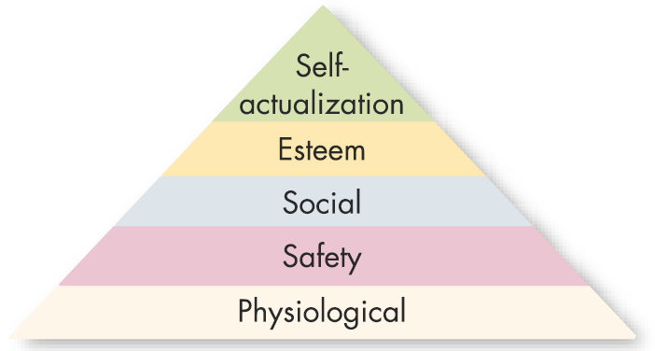
Maslow’s Hierarchy of Needs
Lower-Order Needs
Needs that are satisfied externally; physiological
and safety needs.
Higher-Order Needs
Needs that are satisfied
internally; social, esteem,
and self-actualization
needs.
Source: Motivation and Personality , 2nd ed,, by A.H. Maslow, 1970. Reprinted by permission of Prentice Hall, Inc., Upper Saddle River, NJ.
E X H I B I T 6–1

Slide 140
Theory X and Theory Y (Douglas McGregor)
Theory X
Assumes that employees dislike work, lack ambition, avoid responsibility, and must be directed and coerced to perform.
Theory Y
Assumes that employees like work, seek responsibility, are capable of making decisions, and exercise self-direction and self-control when committed to a goal.

Slide 141
Two-Factor Theory (Frederick Herzberg)
Two-Factor (Motivation-Hygiene) Theory
Intrinsic factors are related to job satisfaction, while extrinsic factors are associated with dissatisfaction.
Hygiene Factors
Factors—such as company policy and administration, supervision, and salary—that, when adequate in a job, placate workers. When factors are adequate, people will not be dissatisfied.

Slide 142
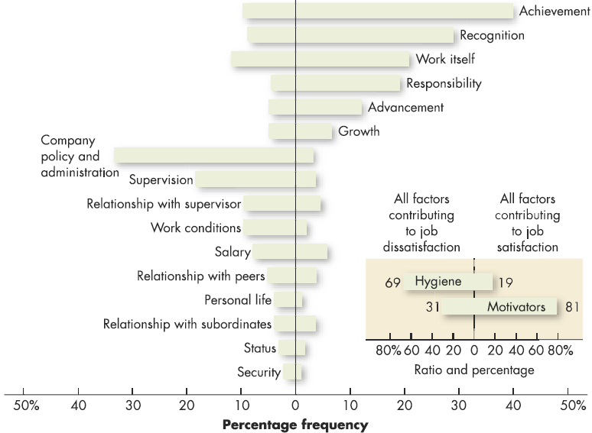
Comparison of Satisfiers and Dissatisfiers
Factors characterizing events on the job that led to extreme job dissatisfaction
Factors characterizing events on the job that led to extreme job satisfaction
Source: Reprinted by permission of Harvard Business Review. An exhibit from One More Time: How Do You Motivate Employees? by Frederick Herzberg, September–October 1987. Copyright © 1987 by the President and Fellows of Harvard College: All rights reserved.
E X H I B I T 6–2

Slide 143
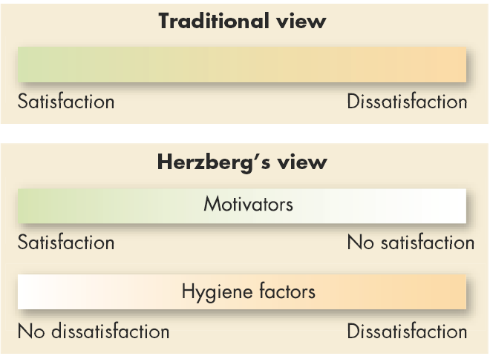
Contrasting Views of Satisfaction and Dissatisfaction
E X H I B I T 6–3

Slide 144
ERG Theory (Clayton Alderfer)
ERG Theory
There are three groups of core needs: existence, relatedness, and growth.
Core Needs
Existence: provision of basic material requirements.
Relatedness: desire for relationships.
Growth: desire for personal development.
Concepts:
More than one need can be operative at the same time.
If a higher-level need cannot be fulfilled, the desire to satisfy a lower-level need increases.

Slide 145
David McClelland’s Theory of Needs
Need for Achievement
The drive to excel, to achieve in relation to a set of standards, to strive to succeed.
Need for Affiliation
The desire for friendly and close personal relationships.
Need for Power
The need to make others behave in a way that they would not have behaved otherwise.
nPow
nAch
nAff

Slide 146
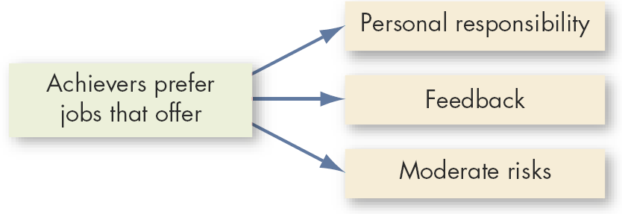
Matching High Achievers and Jobs
E X H I B I T 6–4

Slide 147
Cognitive Evaluation Theory
Cognitive Evaluation Theory
Providing an extrinsic reward for behavior that had been previously only intrinsically rewarding tends to decrease the overall level of motivation.
The theory may only be relevant to
jobs that are neither extremely
dull nor extremely interesting.

Slide 148
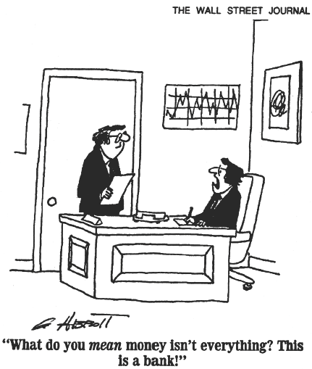
E X H I B I T 6–5

Slide 149
Goal-Setting Theory (Edwin Locke)
Goal-Setting Theory
The theory that specific and difficult goals, with feedback, lead to higher performance.
Factors influencing the goals–performance relationship:
Goal commitment, adequate self-efficacy, task characteristics, and national culture.
Self-Efficacy
The individual’s belief that he or she is capable of performing a task.

Slide 150
Reinforcement Theory
The assumption that behavior is a function of its consequences.
Concepts:
Behavior is environmentally caused.
Behavior can be modified (reinforced) by providing (controlling) consequences.
Reinforced behavior tends to be repeated.

Slide 151
Job Design Theory
Job Characteristics Model
Identifies five job characteristics and their relationship to personal and work outcomes.
Characteristics:
Skill variety
Task identity
Task significance
Autonomy
Feedback

Slide 152
Job Design Theory (cont’d)
Job Characteristics Model
  Jobs with skill variety, task identity, task significance, autonomy, and for which feedback of results is given, directly affect three psychological states of employees:
    Knowledge of results
    Meaningfulness of work
    Personal feelings of responsibility for results
  Increases in these psychological states result in increased motivation, performance, and job satisfaction.

Slide 153
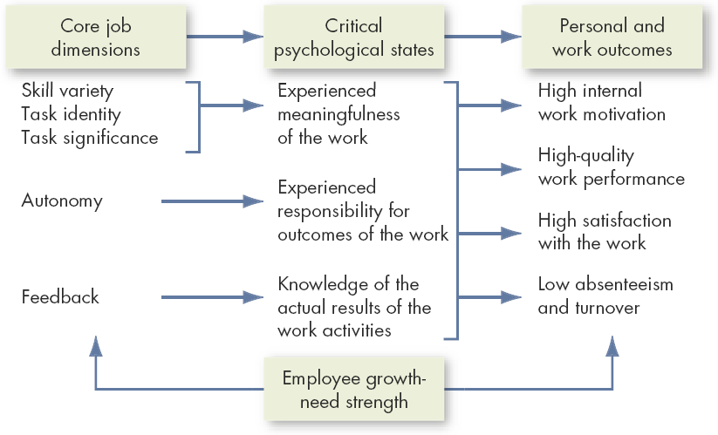
The Job Characteristics Model
Source: J.R. Hackman and G.R. Oldham, Work Design (excerpted from pp. 78–80). © 1980 by Addison-Wesley Publishing Co., Inc. Reprinted by permission of Addison-Wesley Longman, Inc.
E X H I B I T 6–6

Slide 154
Job Design Theory (cont’d)
Skill Variety
The degree to which a job requires a variety of different activities.
Task Identity
The degree to which the job requires completion of a whole and identifiable piece of work.
Task Significance
The degree to which the job has a substantial impact on the lives or work of other people.

Slide 155
Job Design Theory (cont’d)
Autonomy
The degree to which the job provides substantial freedom and discretion to the individual in scheduling the work and in determining the procedures to be used in carrying it out.

Slide 156
Job Design Theory (cont’d)
Feedback
The degree to which carrying out the work activities required by a job results in the individual obtaining direct and clear information about the effectiveness of his or her performance.

Slide 157
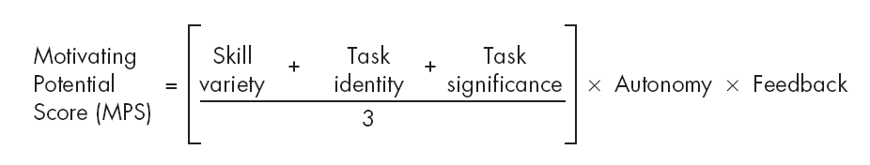
Computing a Motivating Potential Score
People who work on jobs with high core dimensions are generally more motivated, satisfied, and productive.
Job dimensions operate through the psychological states in influencing personal and work outcome variables rather than influencing them directly.

Slide 158
Job Design Theory (cont’d)
Social Information Processing (SIP) Model
The fact that people respond to their jobs as they perceive them rather than to the objective jobs themselves.
Concept:
Employee attitudes and behaviors are responses to social cues by others.

Slide 159
Social Information Processing Model (SIP)
Concepts of the SIP Model
  Employees adopt attitudes and behaviors in response to the social cues provided by others (e.g., coworkers) with whom they have contact.
  Employees’ perception of the characteristics of their jobs is as important as the actual characteristics of their jobs.

Slide 160
Equity Theory
Equity Theory
Individuals compare their job inputs and outcomes with those of others and then respond to eliminate any inequities.
Referent Comparisons:
Self-inside
Self-outside
Other-inside
Other-outside

Slide 161
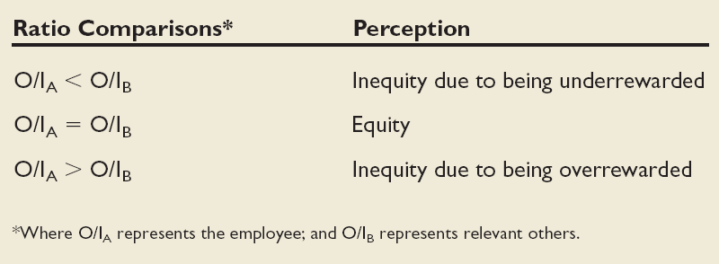
Equity Theory (cont’d)
E X H I B I T 6–7

Slide 162
Equity Theory (cont’d)
Choices for dealing with inequity:
Change inputs (slack off)
Change outcomes (increase output)
Distort/change perceptions of self
Distort/change perceptions of others
Choose a different referent person
Leave the field (quit the job)

Slide 163
Equity Theory (cont’d)
Propositions relating to inequitable pay:
Overrewarded hourly employees produce more than equitably rewarded employees.
Overrewarded piece-work employees produce less, but do higher quality piece work.
Underrewarded hourly employees produce lower quality work.
Underrewarded employees produce larger quantities of lower-quality piece work than equitably rewarded employees

Slide 164
Equity Theory (cont’d)
Distributive Justice
Perceived fairness of the amount and allocation of rewards among individuals.
Procedural Justice
The perceived fairness of the process to determine the distribution of rewards.

Slide 165
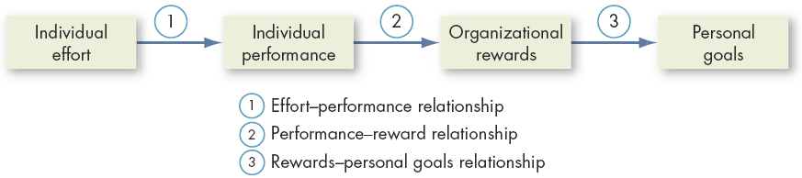
Expectancy Theory
Expectancy Theory (Victor Vroom)
The strength of a tendency to act in a certain way depends on the strength of an expectation that the act will be followed by a given outcome and on the attractiveness of that outcome to the individual.
E X H I B I T 6–8

Slide 166
Expectancy Theory Relationships
Effort–Performance Relationship
  The probability that exerting a given amount of effort will lead to performance.
Performance–Reward Relationship
  The belief that performing at a particular level will lead to the attainment of a desired outcome.
Rewards–Personal Goals Relationship
  The degree to which organizational rewards satisfy an individual’s goals or needs and the attractiveness of potential rewards for the individual.

Slide 167
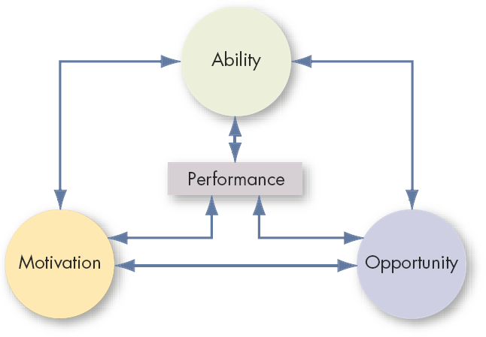
Performance Dimensions
Source: Adapted from M. Blumberg and C.D. Pringle, “The Missing Opportunity in Organizational Research: Some Implications for a Theory of Work Performance,” Academy of Management Review, October 1982, p. 565.
E X H I B I T 6–9

Slide 168
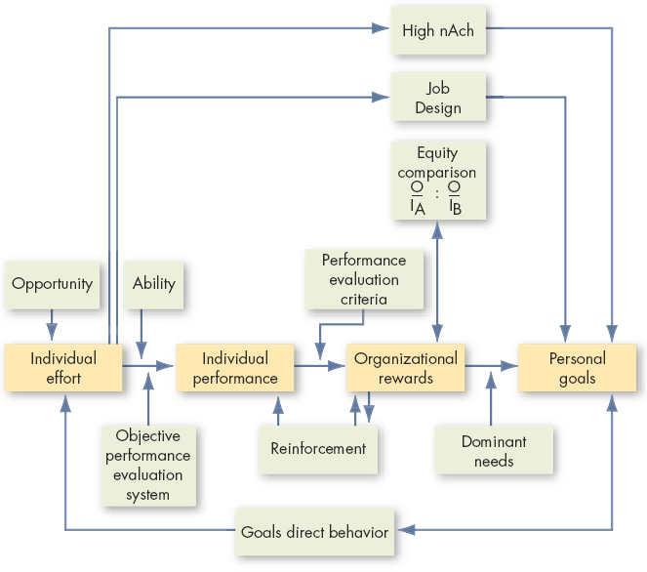
Integrating Contemporary Theories of Motivation
E X H I B I T 6–10

Slide 169
e l e v e n t h e d i t i o n
o r g a n i z a t i o n a l b e h a v i o r

Slide 170

Chapter 7
Motivation:
From Concept to
Applications

Slide 171
After studying this chapter, you should be able to:
Identify the four ingredients common to MBO programs.
Explain why managers might want to use employee involvement programs.
Contrast participative management with employee involvement.
Explain how ESOPs can increase employee motivation.
Describe how a job can be enriched.
L E A R N I N G O B J E C T I V E S

Slide 172
After studying this chapter, you should be able to:
Compare the benefits and drawbacks to telecommuting from the employee’s point of view.
Contrast gainsharing and profit sharing.
Describe the link between skill-based pay plans and motivation theories.
Explain how flexible benefits turn benefits into motivators.
L E A R N I N G O B J E C T I V E S (cont’d)

Slide 173
What is MBO?
Management by Objectives (MBO)
A program that encompasses specific goals, participatively set, for an explicit time period, with feedback on goal progress.
Key Elements
Goal specificity
Participative decision making
An explicit time period
Performance feedback

Slide 174
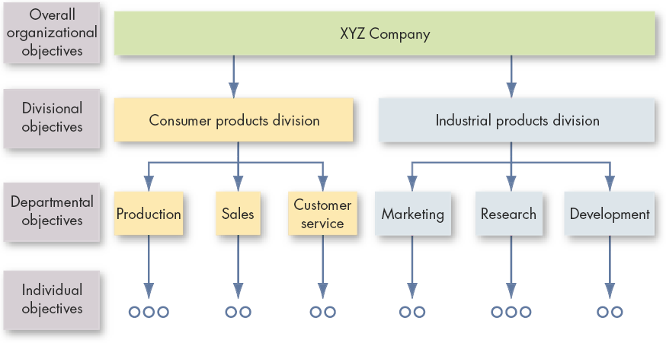
Cascading of Objectives
E X H I B I T 7–1

Slide 175
Linking MBO and Goal-Setting Theory
MBO Goal-Setting Theory
Goal Specificity Yes Yes
Goal Difficulty Yes Yes
Feedback Yes Yes
Participation Yes No
(qualified)

Slide 176
Why MBO’s Fail
Unrealistic expectations about MBO results
Lack of commitment by top management
Failure to allocate reward properly
Cultural incompatibilities

Slide 177
Employee Recognition Programs
Types of programs
  Personal attention
  Expressing interest
  Approval
  Appreciation for a job well done
Benefits of programs
  Fulfill employees’ desire for recognition.
  Encourages repetition of desired behaviors.
  Enhance group/team cohesiveness and motivation.
  Encourages employee suggestions for improving processes and cutting costs.

Slide 178
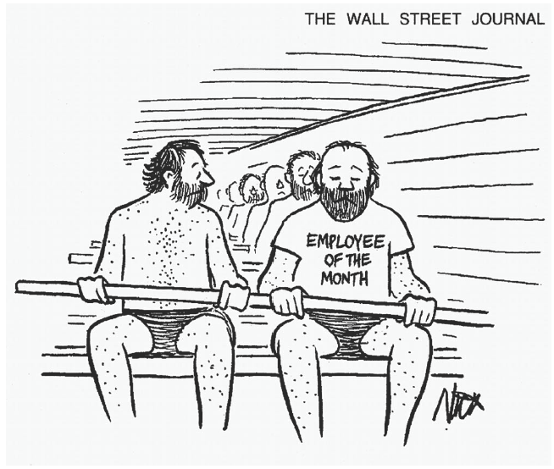
E X H I B I T 7–2
From the Wall Street Journal, October 21, 1997. Reprinted by permission of Cartoon Features Syndicate.

Slide 179
What is Employee Involvement?
Employee Involvement Program
A participative process that uses the entire capacity of employees and is designed to encourage increased commitment to the organization’s success.

Slide 180

E X H I B I T 7–3
Source: Courtesy of Phoenix Inn Suites.

Slide 181
Examples of Employee Involvement Programs
Participative Management
A process in which subordinates share a significant degree of decision-making power with their immediate superiors.

Slide 182
Examples of Employee Involvement Programs (cont’d)
Representative Participation
Workers participate in organizational decision making through a small group of representative employees.
Works Councils
Groups of nominated or elected employees who must be consulted when management makes decisions involving personnel.
Board Representative
A form of representative participation; employees sit on a company’s board of directors and represent the interests of the firm’s employees.

Slide 183
Examples of Employee Involvement Programs (cont’d)
Quality Circle
A work group of employees who meet regularly to discuss their quality problems, investigate causes, recommend solutions, and take corrective actions.

Slide 184
Examples of Employee Involvement Programs (cont’d)
Employee Stock Ownership Plans (ESOPs)
Company-established benefit plans in which employees acquire stock as part of their benefits.

Slide 185
Linking EI Programs and Motivation Theories
Theory Y
Participative Management
Employee Involvement Programs
Two-Factor Theory
Intrinsic Motivation
ERG Theory
Employee
Needs

Slide 186
Job Design and Scheduling
Job Rotation
The periodic shifting of a worker from one task to another.
Job Enlargement
The horizontal expansion of jobs.
Job Enrichment
The vertical expansion of jobs.

Slide 187
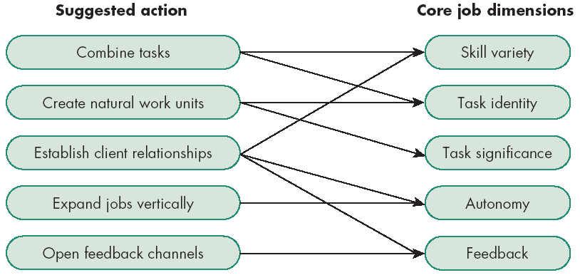
Guidelines for Enriching a Job
E X H I B I T 7–4
Source: J.R. Hackman and J.L. Suttle, eds., Improving Life at Work (Glenview, IL: Scott Foresman, 1977), p. 138.

Slide 188
Work Schedule Options
Flextime
Employees work during a common core time period each day but have discretion in forming their total workday from a flexible set of hours outside the core.
Job Sharing
The practice of having two or more people split a 40-hour-a-week job.

Slide 189
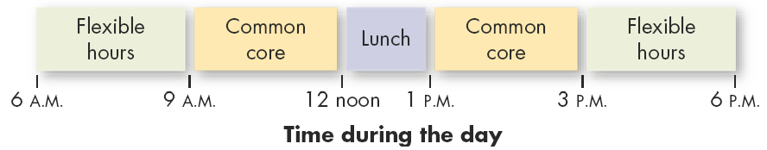
Example of a Flextime Schedule
E X H I B I T 7–5

Slide 190
Work Schedule Options
Telecommuting
Employees do their work at home on a computer that is linked to their office.
Categories of telecommuting jobs:
Routine information handling tasks
Mobile activities
Professional and other knowledge-related tasks

Slide 191
Telecommuting
Advantages
  Larger labor pool
  Higher productivity
  Less turnover
  Improved morale
  Reduced office-space costs
Disadvantages (Employer)
  Less direct supervision of employees
  Difficult to coordinate teamwork
  Difficult to evaluate non-quantitative performance

Slide 192
Variable Pay Programs
Variable Pay Programs
A portion of an employee’s pay is based on some individual and/or organization measure of performance.
  Piece rate pay plans
  Profit sharing plans
  Gain sharing plans

Slide 193
Variable Pay Programs (cont’d)
Piece-rate Pay Plans
Workers are paid a fixed sum for each unit of production completed.
Profit-Sharing Plans
Organizationwide programs that distribute compensation based on some established formula designed around a company’s profitability.
Gain Sharing
An incentive plan in which improvements in group productivity determine the total amount of money that is allocated.

Slide 194
Skill-Based Pay Plans
Pay levels are based on how many skills employees have or how many jobs they can do.
Benefits of Skill-based Pay Plans:
Provides staffing flexibility.
Facilitates communication across the organization.
Lessens “protection of territory” behaviors.
Meets the needs of employees for advancement (without promotion).
Leads to performance improvements.

Slide 195
Skill-Based Pay Plans (cont’d)
Drawbacks of Skill-based Pay Plans:
Lack of additional learning opportunities that will increase employee pay.
Continuing to pay employees for skills that have become obsolete.
Paying for skills which are of no immediate use to the organization.
Paying for a skill, not for the level of employee performance for the particular skill.

Slide 196
Flexible Benefits
Employees tailor their benefit program to meet their personal need by picking and choosing from a menu of benefit options.
Core-Plus Plans:
a core of essential benefits and a menu-like selection of other benefit options.
Modular Plans: predesigned benefits packages for specific groups of employees.
Flexible Spending Plans: allow employees to use their tax-free benefit dollars purchase benefits and pay service premiums.

Slide 197
Implications for Managers
Motivating Employees in Organizations
  Recognize individual differences.
  Use goals and feedback.
  Allow employees to participate in decisions that affect them.
  Link rewards to performance.
  Check the system for equity.

Slide 198
e l e v e n t h e d i t i o n
o r g a n i z a t i o n a l b e h a v i o r

Slide 199

Chapter 8
Foundations of Group Behavior

Slide 200
After studying this chapter, you should be able to:
Differentiate between formal and informal groups.
Compare two models of group development.
Explain how role requirements change in different situations.
Describe how norms exert influence on an individual’s behavior.
Explain what determines status
Define social loafing and its effect on group performance.
L E A R N I N G O B J E C T I V E S

Slide 201
After studying this chapter, you should be able to:
Identify the benefits and disadvantages of cohesive groups.
List the strengths and weaknesses of group decision making.
Contrast the effectiveness of interacting, brainstorming, nominal and electronic meeting groups.
L E A R N I N G O B J E C T I V E S (cont’d)

Slide 202
Defining and Classifying Groups
Group(s)
Two or more individuals interacting and interdependent, who have come together to achieve particular objectives.
Formal Group
A designated work group defined by the organization’s structure.
Informal Group
A group that is neither formally structured now organizationally determined; appears in response to the need for social contact.

Slide 203
Defining and Classifying Groups (cont’d)
Command Group
A group composed of the individuals who report directly to a given manager.
Task Group
Those working together to complete a job or task.
Interest Group
Those working together to attain a specific objective with which each is concerned.
Friendship Group
Those brought together because they share one or more common characteristics.

Slide 204
Why People Join Groups
Security
Status
Self-esteem
Affiliation
Power
Goal Achievement
E X H I B I T 8–1

Slide 205
The Five-Stage Model of Group Development
Forming Stage
The first stage in group development, characterized by much uncertainty.
Storming Stage
The second stage in group development, characterized by intragroup conflict.
Norming Stage
The third stage in group development, characterized by close relationships and cohesiveness.

Slide 206
…Group Development (cont’d)
Performing Stage
The fourth stage in group development, when the group is fully functional.
Adjourning Stage
The final stage in group development for temporary groups, characterized by concern with wrapping up activities rather than performance.

Slide 207
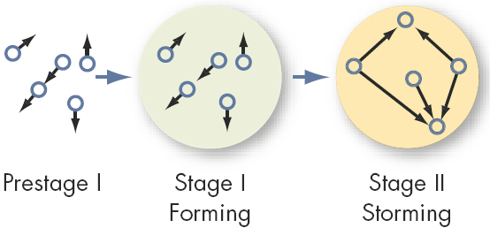
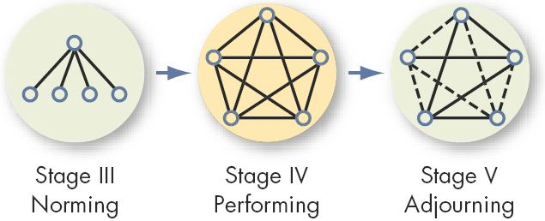
Stages of Group Development
E X H I B I T 8–2

Slide 208
An Alternative Model: Temporary Groups with Deadlines
Punctuated-Equilibrium Model
Temporary groups go through transitions between inertia and activity.
Sequence of actions:
Setting group direction
First phase of inertia
Half-way point transition
Major changes
Second phase of inertia
Accelerated activity

Slide 209

The Punctuated-Equilibrium Model
E X H I B I T 8–3

Slide 210
Group Structure - Roles (cont’d)
Role(s)
A set of expected behavior patterns attributed to someone occupying a given position in a social unit.
Role Identity
Certain attitudes and behaviors consistent with a role.
Role Perception
An individual’s view of how he or she is supposed to act in a given situation.

Slide 211
Group Structure - Roles (cont’d)
Role Expectations
How others believe a person should act in a given situation.
Psychological Contract
An unwritten agreement that sets out what management expects from the employee and vice versa.
Role Conflict
A situation in which an individual is confronted by divergent role expectations.

Slide 212
Group Structure - Norms
Norms
Acceptable standards of behavior within a group that are shared by the group’s members.
Classes of Norms:
Performance norms
Appearance norms
Social arrangement norms
Allocation of resources norms

Slide 213
The Hawthorne Studies
A series of studies undertaken by Elton Mayo at Western Electric Company’s Hawthorne Works in Chicago between 1924 and 1932.
Research Conclusions:
  Worker behavior and sentiments were closely related.
  Group influences (norms) were significant in affecting individual behavior.
  Group standards (norms) were highly effective in establishing individual worker output.
  Money was less a factor in determining worker output than were group standards, sentiments, and security.

Slide 214
Group Structure - Norms (cont’d)
Conformity
Adjusting one’s behavior to align with the norms of the group.
Reference Groups
Important groups to which individuals belong or hope to belong and with whose norms individuals are likely to conform.

Slide 215

Examples of Cards Used in Asch’s Study
E X H I B I T 8–4

Slide 216
Group Structure - Norms (cont’d)
Deviant Workplace Behavior
Antisocial actions by organizational members that intentionally violate established norms and result in negative consequences for the organization, its members, or both.

Slide 217
Typology of Deviant Workplace Behavior
Category Examples
Production Leaving early
Intentionally working slowly
Wasting resources
Property Sabotage
Lying about hours worked
Stealing from the organization
Political Showing favoritism
Gossiping and spreading rumors
Blaming coworkers
Personal Aggression Sexual harassment
Verbal abuse
Stealing from coworkers
Source: Adapted from S.L. Robinson, and R.J. Bennett. “A Typology of Deviant Workplace Behaviors: A Multidimensional Scaling Study,” Academy of Management Journal, April 1995, p. 565.
E X H I B I T 8–5

Slide 218
Group Structure - Status
Status
A socially defined position or rank given to groups or group members by others.
Group Norms
Status Equity
Group Member
Status
Culture

Slide 219
Group Structure - Size
Social Loafing
The tendency for individuals to expend less effort when working collectively than when working individually.
Performance
Other conclusions:
Odd number groups do better than even.
Groups of 7 or 9 perform better overall than larger or smaller groups.
Expected
Actual (due to loafing)
Group Size

Slide 220
Group Structure - Composition
Group Demography
The degree to which members of a group share a common demographic attribute, such as age, sex, race, educational level, or length of service in the organization, and the impact of this attribute on turnover.
Cohorts
Individuals who, as part of a group, hold a common attribute.

Slide 221
Group Structure - Cohesiveness
Cohesiveness
Degree to which group members are attracted to each other and are motivated to stay in the group.
Increasing group cohesiveness:
Make the group smaller.
Encourage agreement with group goals.
Increase time members spend together.
Increase group status and admission difficultly.
Stimulate competition with other groups.
Give rewards to the group, not individuals.
Physically isolate the group.

Slide 222

Relationship Between Group Cohesiveness, Performance Norms, and Productivity
E X H I B I T 8–6

Slide 223

S. Adams, Build a Better Life by Stealing Office Supplies (Kansas City MO: Andrews & McMeal, 1991), p. 31. Dilbert reprinted with permission of United Features Syndicate, Inc.
E X H I B I T 8–7

Slide 224
Group Tasks
Decision-making
  Large groups facilitate the pooling of information about complex tasks.
  Smaller groups are better suited to coordinating and facilitating the implementation of complex tasks.
  Simple, routine standardized tasks reduce the requirement that group processes be effective in order for the group to perform well.

Slide 225
Group Decision Making
Strengths
  More complete information
  Increased diversity of views
  Higher quality of decisions (more accuracy)
  Increased acceptance of solutions
Weaknesses
  More time consuming (slower)
  Increased pressure to conform
  Domination by one or a few members
  Ambiguous responsibility

Slide 226
Group Decision Making (cont’d)
Groupthink
Phenomenon in which the norm for consensus overrides the realistic appraisal of alternative course of action.
Groupshift
A change in decision risk between the group’s decision and the individual decision that member within the group would make; can be either toward conservatism or greater risk.

Slide 227
Symptoms Of The Groupthink Phenomenon
Group members rationalize any resistance to the assumptions they have made.
Members apply direct pressures on those who express doubts about shared views or who question the alternative favored by the majority.
Members who have doubts or differing points of view keep silent about misgivings.
There appears to be an illusion of unanimity.

Slide 228
Group Decision-Making Techniques
Interacting Groups
Typical groups, in which the members interact with each other face-to-face.
Nominal Group Technique
A group decision-making method in which individual members meet face-to-face to pool their judgments in a systematic but independent fashion.

Slide 229
Group Decision-Making Techniques
Brainstorming
An idea-generation process that specifically encourages any and all alternatives, while withholding any criticism of those alternatives.
Electronic Meeting
A meeting in which members interact on computers, allowing for anonymity of comments and aggregation of votes.

Slide 230
Evaluating Group Effectiveness
TYPE OF GROUP
Effectiveness Criteria Interacting Brainstorming Nominal Electronic
Number and quality of ideas Low Moderate High High
Social pressure High Low Moderate Low
Money costs Low Low Low High
Speed Moderate Moderate Moderate Moderate
Task orientation Low High High High
Potential for interpersonal conflict High Low Moderate Low
Commitment to solution High Not applicable Moderate Moderate
Development of High High Moderate Low
group cohesiveness
E X H I B I T 8–8

Slide 231
e l e v e n t h e d i t i o n
o r g a n i z a t i o n a l b e h a v i o r

Slide 232

Chapter 9
Understanding Work Teams

Slide 233
After studying this chapter, you should be able to:
Explain the growing popularity of teams in organizations.
Contrast teams with groups.
Identify four types of teams.
Specify the characteristics of effective teams.
Explain how organizations can create team players.
Describe conditions under which teams are preferred over individuals.
L E A R N I N G O B J E C T I V E S

Slide 234
Why Have Teams Become So Popular
Teams typically outperform individuals.
Teams use employee talents better.
Teams are more flexible and responsive to changes in the environment.
Teams facilitate employee involvement.
Teams are an effective way to democratize and organization and increase motivation.

Slide 235
Team Versus Group: What’s the Difference
Work Group
A group that interacts primarily to share information and to make decisions to help each group member perform within his or her area of responsibility.
Work Team
A group whose individual efforts result in a performance that is greater than the sum of the individual inputs.

Slide 236

Comparing Work Groups and Work Teams
E X H I B I T 9–1

Slide 237


Types of Teams
Problem-Solving Teams
Groups of 5 to 12 employees from the same department who meet for a few hours each week to discuss ways of improving quality, efficiency, and the work environment.
Self-Managed Work Teams
Groups of 10 to 15 people who take on the responsibilities of their former supervisors.

Slide 238

Types of Teams (cont’d)
Cross-Functional Teams
Employees from about the same hierarchical level, but from different work areas, who come together to accomplish a task.
Task forces
Committees

Slide 239

Types of Teams (cont’d)
Virtual Teams
Teams that use computer technology to tie together physically dispersed members in order to achieve a common goal.
Team Characteristics
The absence of paraverbal and nonverbal cues
A limited social context
The ability to overcome time and space constraints

Slide 240


A Team-Effectiveness Model
E X H I B I T 9–3

Slide 241

Creating Effective Teams

Slide 242

Creating Effective Teams (cont’d)

Slide 243

Key Roles of Teams
E X H I B I T 9–4

Slide 244

Creating Effective Teams (cont’d)

Slide 245

Creating Effective Teams (cont’d)

Slide 246




Effects of Group Processes
+
–
=
E X H I B I T 9–4

Slide 247
Creating Effective Teams: Diversity
Group Demography
The degree to which members of a group share a common demographic attribute, such as age, sex, race, educational level, or length of service in the organization, and the impact of this attribute on turnover.
Cohorts
Individuals who, as part of a group, hold a common attribute.

Slide 248
Turning Individuals Into Team Players
The Challenges
  Overcoming individual resistance to team membership.
  Countering the influence of individualistic cultures.
  Introducing teams in an organization that has historically valued individual achievement.
Shaping Team Players
  Selecting employees who can fulfill their team roles.
  Training employees to become team players.
  Reworking the reward system to encourage cooperative efforts while continuing to recognize individual contributions.

Slide 249
Teams and Quality Management
Team Effectiveness and Quality Management Requires That Teams:
  Are small enough to be efficient and effective.
  Are properly trained in required skills.
  Allocated enough time to work on problems.
  Are given authority to resolve problems and take corrective action.
  Have a designated “champion” to call on when needed.

Slide 250
Beware: Teams Aren’t Always the Answer
Three tests to see if a team fits the situation:
  Is the work complex and is there a need for different perspectives?
  Does the work create a common purpose or set of goals for the group that is larger than the aggregate of the goals for individuals?
  Are members of the group involved in interdependent tasks?

Slide 251
e l e v e n t h e d i t i o n
o r g a n i z a t i o n a l b e h a v i o r

Slide 252

Chapter 10
Communication

Slide 253
After studying this chapter, you should be able to:
Describe the communication process.
Contrast the advantages and disadvantages of oral versus written communication.
Compare the effectiveness of the chain, wheel, and all-channel networks.
Identify the factors affecting the use of the grapevine.
Discuss how computer-aided technology is changing organizational communication.
L E A R N I N G O B J E C T I V E S

Slide 254
After studying this chapter, you should be able to:
Explain the importance of channel richness to improving communication effectiveness.
Identify common barriers to effective communication.
Describe the potential problems in cross-cultural communication.
L E A R N I N G O B J E C T I V E S (cont’d)

Slide 255
Functions of Communication
Communication
The transference and the understanding of meaning.
Communication Functions
Control member behavior.
Foster motivation for what is to be done.
Provide a release for emotional expression.
Provide information needed to make decisions.

Slide 256
Elements of the Communication Process
The sender
Encoding
The message
The channel
Decoding
The receiver
Noise
Feedback

Slide 257

The Communication Process Model
Communication Process
The steps between a source and a receiver that result in the transference and understanding of meaning.
E X H I B I T 10–1

Slide 258
The Communication Process
Channel
  The medium selected by the sender through which the message travels to the receiver.
Types of Channels
  Formal Channels
    Are established by the organization and transmit messages that are related to the professional activities of members.
  Informal Channels
    Used to transmit personal or social messages in the organization. These informal channels are spontaneous and emerge as a response to individual choices.

Slide 259
Direction of Communication
Downward
Lateral
Upward

Slide 260
Interpersonal Communication
Oral Communication
  Advantages: Speed and feedback.
  Disadvantage: Distortion of the message.
Written Communication
  Advantages: Tangible and verifiable.
  Disadvantages: Time consuming and lacks feedback.
Nonverbal Communication
  Advantages: Supports other communications and provides observable expression of emotions and feelings.
  Disadvantage: Misperception of body language or gestures can influence receiver’s interpretation of message.

Slide 261
Intonations: It’s the Way You Say It!
Change your tone and you change your meaning:
Placement of the emphasis What it means
Why don’t I take you to dinner tonight? I was going to take someone else.
Why don’t I take you to dinner tonight? Instead of the guy you were going with.
Why don’t I take you to dinner tonight? I’m trying to find a reason why I
shouldn’t take you.
Why don’t I take you to dinner tonight? Do you have a problem with me?
Why don’t I take you to dinner tonight? Instead of going on your own.
Why don’t I take you to dinner tonight? Instead of lunch tomorrow.
Why don’t I take you to dinner tonight? Not tomorrow night.
Source: Based on M. Kiely, “When ‘No’ Means ‘Yes,’ ” Marketing, October 1993, pp. 7–9. Reproduced in A. Huczynski and D. Buchanan, Organizational Behaviour, 4th ed. (Essex, England: Pearson Education, 2001), p. 194.
E X H I B I T 10–2

Slide 262



Three Common Formal Small-Group Networks
E X H I B I T 10–3

Slide 263
Small-Group Networks and Effectiveness Criteria
NETWORKS
Criteria Chain Wheel All Channel
Speed Moderate Fast Fast
Accuracy High High Moderate
Emergence of a leader Moderate High None
Member satisfaction Moderate Low High
E X H I B I T 10–4

Slide 264
Grapevine
Grapevine Characteristics
  Informal, not controlled by management.
  Perceived by most employees as being more believable and reliable than formal communications.
  Largely used to serve the self-interests of those who use it.
  Results from:
    Desire for information about important situations
    Ambiguous conditions
    Conditions that cause anxiety

Slide 265
Suggestions for Reducing the Negative Consequences of Rumors
Announce timetables for making important decisions.
Explain decisions and behaviors that may appear inconsistent or secretive.
Emphasize the downside, as well as the upside, of current decisions and future plans.
Openly discuss worst-case possibilities—it is almost never as anxiety-provoking as the unspoken fantasy.
Source: Adapted from L. Hirschhorn, “Managing Rumors,” in L. Hirschhorn (ed.), Cutting Back (San Francisco: Jossey-Bass, 1983), pp. 54–56. With permission.
E X H I B I T 10–5

Slide 266
Computer-Aided Communication
E-mail
  Advantages: quickly written, sent, and stored; low cost for distribution.
  Disadvantages: information overload, lack of emotional content, cold and impersonal.
Instant messaging
  Advantage: “real time” e-mail transmitted straight to the receiver’s desktop.
  Disadvantage: can be intrusive and distracting.

Slide 267

Emoticons: Showing Emotion in E-Mail
Electronic mail needn’t be emotion free. Over the years, a set of symbols (emoticons) has evolved that e-mail users have developed for expressing emotions. For instance, the use of all caps (i.e., THIS PROJECT NEEDS YOUR IMMEDIATE ATTENTION!) is the e-mail equivalent of shouting. The following highlights some emoticons:
E X H I B I T 10–6

Slide 268
Computer-Aided Communication (cont’d)
Intranet
  A private organization-wide information network.
Extranet
  An information network connecting employees with external suppliers, customers, and strategic partners.
Videoconferencing
  An extension of an intranet or extranet that permits face-to-face virtual meetings via video links.

Slide 269
Knowledge Management (KM)
Knowledge Management
A process of organizing and distributing an organization’s collective wisdom so the right information gets to the right people at the right time.
Why KM is important:
Intellectual assets are as important as physical assets.
When individuals leave, their knowledge and experience goes with them.
A KM system reduces redundancy and makes the organization more efficient.

Slide 270
Choice of Communication Channel
Channel Richness
The amount of information that can be transmitted during a communication episode.
Characteristics of Rich Channels
Handle multiple cues simultaneously.
Facilitate rapid feedback.
Are very personal in context.

Slide 271

Information Richness of Communication Channels
Low channel richness
High channel richness
Routine
Nonroutine
Source: Based on R.H. Lengel and D.L. Daft, “The Selection of Communication Media as an Executive Skill,” Academy of Management Executive, August 1988, pp. 225–32; and R.L. Daft and R.H. Lengel, “Organizational Information Requirements, Media Richness, and Structural Design,” Managerial Science, May 1996, pp. 554–72. Reproduced from R.L. Daft and R.A. Noe, Organizational Behavior (Fort Worth, TX: Harcourt, 2001), p. 311.
E X H I B I T 10–7

Slide 272
Barriers to Effective Communication
Filtering
A sender’s manipulation of information so that it will be seen more favorably by the receiver.
Selective Perception
People selectively interpret what they see on the basis of their interests, background, experience, and attitudes.
Information Overload
A condition in which information inflow exceeds an individual’s processing capacity.

Slide 273
Barriers to Effective Communication (cont’d)
Emotions
How a receiver feels at the time a message is received will influence how the message is interpreted.
Language
Words have different meanings to different people.
Communication Apprehension
Undue tension and anxiety about oral communication, written communication, or both.

Slide 274
Communication Barriers Between Men and Women
Men talk to:
  Emphasize status, power, and independence.
  Complain that women talk on and on.
  Offer solutions.
  To boast about their accomplishments.
Women talk to:
  Establish connection and intimacy.
  Criticize men for not listening.
  Speak of problems to promote closeness.
  Express regret and restore balance to a conversation.

Slide 275
“Politically Correct” Communication
Certain words stereotype, intimidate, and insult individuals.
In an increasingly diverse workforce, we must be sensitive to how words might offend others.
  Removed: handicapped, blind, and elderly
  Replaced with: physically challenged, visually impaired, and senior.
Removing certain words from the vocabulary makes it harder to communicate accurately.
  Removed: death, garbage, quotas, and women.
  Replaced with terms: negative patient outcome, postconsumer waste materials, educational equity, and people of gender.

Slide 276

Source: The Far Side by Gary Larson © 1994 Far Works, Inc. All rights reserved. Used with permission.
E X H I B I T 10–8

Slide 277
Cross-Cultural Communication
Cultural Barriers
  Semantics
  Word connotations
  Tone differences
  Differences among perceptions
Cultural Guide
  Assume differences until similarity is proven.
  Emphasize description rather than interpretation or evaluation.
  Practice empathy.
  Treat your interpretations as a working hypothesis.

Slide 278

Hand Gestures Mean Different Things in Different Countries
E X H I B I T 10–9

Slide 279

Hand Gestures Mean Different Things in Different Countries (cont’d)
E X H I B I T 10–9 (cont’d)

Slide 280
Communication Barriers and Cultural Context
High-Context Cultures
Cultures that rely heavily on nonverbal and subtle situational cues to communication.
Low-Context Cultures
Cultures that rely heavily on words to convey meaning in communication.

Slide 281

High- vs.
Low-Context Cultures
E X H I B I T 10–10

Slide 282
e l e v e n t h e d i t i o n
o r g a n i z a t i o n a l b e h a v i o r

Slide 283

Chapter 11
Basic Approaches to Leadership

Slide 284
After studying this chapter, you should be able to:
Contrast leadership and management.
Summarize the conclusions of trait theories.
Identify the limitations of behavioral theories.
Describe Fiedler’s contingency model.
Explain Hersey and Blanchard’s situational theory.
Summarize leader-member exchange theory.
L E A R N I N G O B J E C T I V E S

Slide 285
After studying this chapter, you should be able to:
Describe the path-goal theory.
Identify the situational variables in the leader-participation model.
L E A R N I N G O B J E C T I V E S (cont’d)

Slide 286

What Is Leadership?
Leadership
The ability to influence a group toward the achievement of goals.
Management
Use of authority inherent in designated formal rank to obtain compliance from organizational members.

Slide 287
Trait Theories
Traits Theories of Leadership
Theories that consider personality, social, physical, or intellectual traits to differentiate leaders from nonleaders.
Leadership Traits:
Ambition and energy
The desire to lead
Honest and integrity
Self-confidence
Intelligence
High self-monitoring
Job-relevant knowledge

Slide 288
Trait Theories
Limitations:
No universal traits found that predict leadership in all situations.
Traits predict behavior better in “weak” than “strong” situations.
Unclear evidence of the cause and effect of relationship of leadership and traits.
Better predictor of the appearance of leadership than distinguishing effective and ineffective leaders.

Slide 289
Behavioral Theories
Behavioral Theories of Leadership
Theories proposing that specific behaviors differentiate leaders from nonleaders.
Trait theory:
Leaders are born, not made.
Behavioral theory:
Leadership traits can be taught.

Slide 290
Ohio State Studies
Initiating Structure
The extent to which a leader is likely to define and structure his or her role and those of sub-ordinates in the search for goal attainment.
Consideration
The extent to which a leader is likely to have job relationships characterized by mutual trust, respect for subordinate’s ideas, and regard for their feelings.

Slide 291
University of Michigan Studies
Employee-Oriented Leader
Emphasizing interpersonal relations; taking a personal interest in the needs of employees and accepting individual differences among members.
Production-Oriented Leader
One who emphasizes technical or task aspects of the job.

Slide 292


The Managerial Grid
(Blake and Mouton)
E X H I B I T 11–1

Slide 293

Scandinavian Studies
Development-Oriented Leader
One who values experimentation, seeking new ideas, and generating and implementing change.
Researchers in Finland and Sweden question whether there are only two dimensions (production-orientation and employee-orientation) that capture the essence of leadership behavior. Their premise is that in a changing world, effective leaders would exhibit development-oriented behavior.

Slide 294
Contingency Theories
Fiedler’s Contingency Model
The theory that effective groups depend on a proper match between a leader’s style of interacting with subordinates and the degree to which the situation gives control and influence to the leader.
Least Preferred Co-Worker (LPC) Questionnaire
An instrument that purports to measure whether a person is task- or relationship-oriented.

Slide 295
Fiedler’s Model: Defining the Situation
Leader-Member Relations
The degree of confidence, trust, and respect subordinates have in their leader.
Task Structure
The degree to which the job assignments are procedurized.
Position Power
Influence derived from one’s formal structural position in the organization; includes power to hire, fire, discipline, promote, and give salary increases.

Slide 296

Findings from Fiedler Model
E X H I B I T 11–2

Slide 297
Cognitive Resource Theory
Cognitive Resource Theory
A theory of leadership that states that stress can unfavorably affect a situation and that intelligence and experience can lessen the influence of stress on the leader.
Research Support:
Less intelligent individuals perform better in leadership roles under high stress than do more intelligent individuals.
Less experienced people perform better in leadership roles under low stress than do more experienced people.

Slide 298
Hersey and Blanchard’s Situational Leadership Theory
Situational Leadership Theory (SLT)
A contingency theory that focuses on followers’ readiness.
Unable and
Unwilling
Unable but
Willing
Able and
Unwilling
Able and
Willing
Follower readiness:
ability and willingness
Leader: decreasing need
for support and supervision
Directive
High Task and Relationship Orientations
Supportive Participative
Monitoring

Slide 299
Leadership Styles and Follower Readiness
(Hersey and Blanchard)
Follower Readiness
Unwilling
Willing
Able
Supportive Participative
Monitoring
Leadership
Styles
High Task
and
Relationship
Orientations
Unable
Directive

Slide 300
Leader–Member Exchange Theory
Leader-Member Exchange (LMX) Theory
Leaders create in-groups and out-groups, and subordinates with in-group status will have higher performance ratings, less turnover, and greater job satisfaction.

Slide 301

Leader-Member Exchange Theory
E X H I B I T 11–3

Slide 302
Path-Goal Theory
Path-Goal Theory
The theory that it is the leader’s job to assist followers in attaining their goals and to provide them the necessary direction and/or support to ensure that their goals are compatible with the overall objectives of the group or organization.

Slide 303

The Path-Goal Theory
E X H I B I T 11–4

Slide 304
Leader-Participation Model
Leader-Participation Model (Vroom and Yetton)
A leadership theory that provides a set of rules to determine the form and amount of participative decision making in different situations.

Slide 305
Contingency Variables in the Revised
Leader-Participation Model
Importance of the decision
Importance of obtaining follower commitment to the decision
Whether the leader has sufficient information to make a good decision
How well structured the problem is
Whether an autocratic decision would receive follower commitment
Whether followers “buy into” the organization’s goals
Whether there is likely to be conflict among followers over solution alternatives
Whether followers have the necessary information to make a good decision
Time constraints on the leader that may limit follower involvement
Whether costs to bring geographically dispersed members together is justified
Importance to the leader of minimizing the time it takes to make the decision
Importance of using participation as a tool for developing follower decision skills
E X H I B I T 11–5

Slide 306
e l e v e n t h e d i t i o n
o r g a n i z a t i o n a l b e h a v i o r

Slide 307

Chapter 12
Contemporary Issues in Leadership

Slide 308
After studying this chapter, you should be able to:
Identify the five dimensions of trust.
Define the qualities of a charismatic leader.
Contrast transformational with transactional leadership.
Explain how framing influences leadership effectiveness.
Identify four roles that team leaders perform.
Explain the role of a mentor.
L E A R N I N G O B J E C T I V E S

Slide 309
After studying this chapter, you should be able to:
Describe how on-line leadership differs from face-to-face leadership.
Identify when leadership may not be necessary.
Explain how to find and create effective leaders.
L E A R N I N G O B J E C T I V E S (cont’d)

Slide 310

Trust: The Foundation of Leadership
Trust
A positive expectation that another will not—through words, actions, or decisions—act opportunistically.
Trust is a history-dependent process (familiarity) based on relevant but limited samples of experience (risk).
E X H I B I T 12–1

Slide 311
Dimensions of Trust
Integrity
  honesty and truthfulness.
Competence
  an individual’s technical and interpersonal knowledge and skills.
Consistency
  an individual’s reliability, predictability, and good judgment in handling situations.
Loyalty
  the willingness to protect and save face for another person.
Openness
  reliance on the person to give you the full truth.

Slide 312
Trust and Leadership
Leadership
TRUST
and
INTEGRITY

Slide 313

Employees’ Trust in Their CEOs
Employees who believe in senior management:
E X H I B I T 12–2
Source: Gantz Wiley Research. Reproduced in USA Today, February 12, 2003, p. 7B.

Slide 314
Three Types of Trust
Deterrence-based Trust
Trust based on fear of reprisal if the trust is violated.
Knowledge-based Trust
Trust based on behavioral predictability that comes from a history of interaction.
Identification-based Trust
Trust based on a mutual understanding of each other’s intentions and appreciation of the other’s wants and desires.

Slide 315
Basic Principles of Trust
Mistrust drives out trust.
Trust begets trust.
Growth often masks mistrust.
Decline or downsizing tests the highest levels of trust.
Trust increases cohesion.
Mistrusting groups self-destruct.
Mistrust generally reduces productivity.

Slide 316

Framing: Using Words to Shape Meaning and Inspire Others
Framing
A way to use language to manage meaning.
Leaders use framing (selectively including or excluding facts) to influence how others see and interpret reality.

Slide 317
Inspirational Approaches to Leadership
Charismatic Leadership Theory
Followers make attributions of heroic or extraordinary leadership abilities when they observe certain behaviors.
Charismatics Influence Followers By:
Articulating the vision
Setting high performance expectations
Conveying a new set of values
Making personal sacrifices

Slide 318
Key Characteristics of Charismatic Leaders
Vision and articulation. Has a vision—expressed as an idealized goal—that proposes a future better than the status quo; and is able to clarify the importance of the vision in terms that are understandable to others.
Personal risk. Willing to take on high personal risk, incur high costs and engage in self-sacrifice to achieve the vision.
Environmental sensitivity. Able to make realistic assessments of the environmental constraints and resources needed to bring about change.
Sensitivity to follower needs. Perceptive of others’ abilities and responsive to their needs and feelings.
Unconventional behavior. Engages in behaviors that are perceived as novel and counter to norms.
Source: Based on J. A. Conger and R. N. Kanungo, Charismatic Leadership in Organizations (Thousand Oaks, CA: Sage, 1998), p. 94.
E X H I B I T 12–3

Slide 319
Beyond Charismatic Leadership
Level 5 Leaders
  Possess a fifth dimension—a paradoxical blend of personal humility and professional will—in addition to the four basic leadership qualities of individual capability, team skills, managerial competence, and the ability to stimulate others to high performance.
  Channel their ego needs away from themselves and into the goal of building a great company.

Slide 320
Transactional and Transformational Leadership
Transactional Leaders
Leaders who guide or motivate their followers in the direction of established goals by clarifying role and task requirements.
Contingent Reward
Management by Exception (active)
Management by Exception (passive)
Laissez-Faire
Transformational Leaders
Leaders who provide individualized consideration and intellectual stimulation, and who possess charisma.
Charisma
Inspiration
Intellectual Stimulation
Individual Consideration

Slide 321
Characteristics of Transactional Leaders
Contingent Reward: Contracts exchange of rewards for effort, promises rewards for good performance, recognizes accomplishments.
Management by Exception (active): Watches and searches for deviations from rules and standards, takes corrective action.
Management by Exception (passive): Intervenes only if standards are not met.
Laissez-Faire: Abdicates responsibilities, avoids making decisions.
Source: B. M. Bass, “From Transactional to Transformational Leadership: Learning to Share the Vision,” Organizational Dynamics, Winter 1990, p. 22. Reprinted by permission of the publisher. American Management Association, New York. All rights reserved.
E X H I B I T 12–4

Slide 322
Characteristics of Transformational Leaders
Charisma: Provides vision and sense of mission, instills pride, gains respect and trust.
Inspiration: Communicates high expectations, uses symbols to focus efforts, expresses important purposes in simple ways.
Intellectual Stimulation: Promotes intelligence, rationality, and careful problem solving.
Individualized Consideration: Gives personal attention, treats each employee individually, coaches, advises.
E X H I B I T 12–4 (cont’d)

Slide 323
Emotional Intelligence and Leadership Effectiveness
Elements of Emotional Intelligence:
Self-awareness
Self-management
Self-motivation
Empathy
Social skills

Slide 324
Contemporary Leadership Roles: Providing Team Leadership
Team Leadership Roles:
Act as liaisons with external constituencies.
Serve as troubleshooters.
Managing conflict.
Coaching to improve team member performance

Slide 325

E X H I B I T 12–5
Source: DILBERT reprinted by permission of United Features Syndicate, Inc.

Slide 326
Contemporary Leadership Roles: Mentoring
Mentor
A senior employee who sponsors and supports a less-experienced employee (a protégé).
Mentoring Activities:
Present ideas clearly
Listen well
Empathize
Share experiences
Act as role model
Share contacts
Provide political guidance

Slide 327
Contemporary Leadership Roles:
Self-Leadership
Self-Leadership
A set of processes through which individuals control their own behavior.
Creating self leaders:
Model self-leadership.
Encourage employees to create self-set goals.
Encourage the use of self-rewards.
Create positive thought patterns.
Create a climate of self-leadership.
Encourage self-criticism.

Slide 328
Ethical Leadership
Actions:
Work to positively change the attitudes and behaviors of employees.
Engage in socially constructive behaviors.
Do not abuse power or use improper means to attain goals.

Slide 329
Online Leadership
Leadership at a Distance: Building Trust
  The lack of face-to-face contact in electronic communications removes the nonverbal cues that support verbal interactions.
  There is no supporting context to assist the receiver with interpretation of an electronic communication.
  The structure and tone of electronic messages can strongly affect the response of receivers.
  An individual’s verbal and written communications may not follow the same style.
  Writing skills will likely become an extension of interpersonal skills

Slide 330
Challenges to the Leadership Construct
Attribution Theory of Leadership
The idea that leadership is merely an attribution that people make about other individuals.
Qualities attributed to leaders:
Leaders are intelligent, outgoing, have strong verbal skills, are aggressive, understanding, and industrious.
Effective leaders are perceived as consistent and unwavering in their decisions.
Effective leaders project the appearance of being a leader.

Slide 331
Substitutes and Neutralizers for Leadership
Relationship- Task-
Oriented Oriented
Defining Characteristics Leadership Leadership
Individual
Experience/training No effect on Substitutes for
Professionalism Substitutes for Substitutes for
Indifference to rewards Neutralizes Neutralizes
Job
Highly structured task No effect on Substitutes for
Provides its own feedback No effect on Substitutes for
Intrinsically satisfying Substitutes for No effect on
Organization
Explicit formalized goals No effect on Substitutes for
Rigid rules and procedures No effect on Substitutes for
Cohesive work groups Substitutes for Substitutes for
Source: Based on S. Kerr and J. M. Jermier, “Substitutes for Leadership: Their Meaning and Measurement,” Organizational Behavior and Human Performance, December 1978, p. 378.
E X H I B I T 12–6

Slide 332
Finding and Creating Effective Leaders
Selection
  Review specific requirements for the job.
  Use tests that identify personal traits associated with leadership, measure self-monitoring, and assess emotional intelligence.
  Conduct personal interviews to determine candidate’s fit with the job.
Training
  Recognize the all people are not equally trainable.
  Teach skills that are necessary for employees to become effective leaders.
  Provide behavioral training to increase the development potential of nascent charismatic employees.

Slide 333
e l e v e n t h e d i t i o n
o r g a n i z a t i o n a l b e h a v i o r

Slide 334
Chapter 13
Power and Politics

Slide 335
After studying this chapter, you should be able to:
Contrast leadership and power.
Define the seven bases of power.
Clarify what creates dependency in power relationships.
List nine influence tactics and their contingencies.
Explain how sexual harassment is about the abuse of power.
Describe the importance of a political perspective.
L E A R N I N G O B J E C T I V E S

Slide 336
After studying this chapter, you should be able to:
List the individual and organizational factors that stimulate political behaviors.
Identify seven techniques for managing the impression one makes on others.
Explain how defensive behaviors can protect an individual’s self-interest.
List the three questions that can help determine if a political action is ethical.
L E A R N I N G O B J E C T I V E S (cont’d)

Slide 337
A Definition of Power
Power
A capacity that A has to influence the behavior of B so that B acts in accordance with A’s wishes.
B
A
Dependency
B’s relationship to A when A possesses something that B requires.

Slide 338
Contrasting Leadership and Power
Leadership
  Focuses on goal achievement.
  Requires goal compatibility with followers.
  Focuses influence downward.
Research Focus
  Leadership styles and relationships with followers
Power
  Used as a means for achieving goals.
  Requires follower dependency.
  Used to gain lateral and upward influence.
Research Focus
  Power tactics for gaining compliance

Slide 339
Bases of Power: Formal Power
Formal Power
Is established by an individual’s position in an organization; conveys the ability to coerce or reward, from formal authority, or from control of information.
Coercive Power
A power base dependent on fear.
Reward Power
Compliance achieved based on the ability to distribute rewards that others view as valuable

Slide 340
Bases of Power: Formal Power (cont’d)
Legitimate Power
The power a person receives as a result of his or her position in the formal hierarchy of an organization.
Information Power
Power that comes from access to and control over information.

Slide 341
Bases of Power: Personal Power
Expert Power
Influence based on special skills or knowledge.
Referent Power
Influence based on possession by an individual of desirable resources or personal traits.
Charismatic Power
An extension of referent power stemming from an individual’s personality and interpersonal style.

Slide 342

Source: Drawing by Leo Cullum in The New Yorker, copyright ©1986 The New Yorker Magazine. Reprinted by permission.
E X H I B I T 13–1

Slide 343
Dependency: The Key To Power
The General Dependency Postulate
  The greater B’s dependency on A, the greater the power A has over B.
  Possession/control of scarce organizational resources that others need makes a manager powerful.
  Access to optional resources (e.g., multiple suppliers) reduces the resource holder’s power.
What Creates Dependency
  Importance of the resource to the organization
  Scarcity of the resource
  Nonsubstitutability of the resource

Slide 344
Power Tactics
Power Tactics
Ways in which individuals translate power bases into specific actions.
Influence Tactics:
Legitimacy
Rational persuasion
Inspirational appeals
Consultation
Exchange
Personal appeals
Ingratiation
Pressure
Coalitions

Slide 345
Preferred Power Tactics by Influence Direction
Upward Influence Downward Influence Lateral Influence
Rational persuasion Rational persuasion Rational persuasion
Inspirational appeals Consultation
Pressure Ingratiation
Consultation Exchange
Ingratiation Legitimacy
Exchange Personal appeals
Legitimacy Coalitions
E X H I B I T 13–2

Slide 346
Factors Influencing the Choice and Effectiveness of Power Tactics
Sequencing of tactics
  Softer to harder tactics works best.
Skillful use of a tactic
  Experienced users are more successful.
Relative power of the tactic user
  Some tactics work better when applied downward.
The type of request attaching to the tactic
  Is the request legitimate?
How the request is perceived
  Is the request accepted as ethical?
The culture of the organization
  Culture affects user’s choice of tactic
Country-specific cultural factors
  Local values favor certain tactics over others.

Slide 347
Power in Groups: Coalitions
Coalitions
Clusters of individuals who temporarily come together to a achieve a specific purpose.
Seek to maximize their size to attain influence.
Seek a broad and diverse constituency for support of their objectives.
Occur more frequently in organizations with high task and resource interdependencies.
Occur more frequently if tasks are standardized and routine.

Slide 348
Sexual Harassment: Unequal Power in the Workplace
Sexual Harassment
  Unwelcome advances, requests for sexual favors, and other verbal or physical conduct of a sexual nature.
The U.S. Supreme Court test for determining if sexual harassment has occurred:
  whether comments or behavior
  in a work environment
  “would reasonably be
  perceived, and is
  perceived, as hostile
  or abusive.”

Slide 349
Politics: Power in Action
Political Behavior
Activities that are not required as part of one’s formal role in the organization, but that influence, or attempt to influence, the distribution of advantages or disadvantages within the organization.
Legitimate Political Behavior
Normal everyday politics.
Illegitimate Political Behavior
Extreme political behavior that violates the implied rules of the game.

Slide 350
Politics Is in the Eye of the Beholder
“Political” Label “Effective Management” Label
1. Blaming others vs. Fixing responsibility
2. “Kissing up” vs. Developing working relationships
3. Apple polishing vs. Demonstrating loyalty
4. Passing the buck vs. Delegating authority
5. Covering your rear vs. Documenting decisions
6. Creating conflict vs. Encouraging change and innovation
7. Forming coalitions vs. Facilitating teamwork
8. Whistleblowing vs. Improving efficiency
9. Scheming vs. Planning ahead
10. Overachieving vs. Competent and capable
11. Ambitious vs. Career-minded
12. Opportunistic vs. Astute
13. Cunning vs. Practical-minded
14. Arrogant vs. Confident
15. Perfectionist vs. Attentive to detail
Source: Based on T. C. Krell, M. E. Mendenhall, and J. Sendry, “Doing Research in the Conceptual Morass of Organizational Politics,” paper presented at the Western Academy of Management Conference, Hollywood, CA, April 1987.
E X H I B I T 13–3

Slide 351

Factors That Influence Political Behaviors
E X H I B I T 13–4

Slide 352

Employee Responses to Organizational Politics
E X H I B I T 13–5

Slide 353
Defensive Behaviors
Avoiding Action:
Overconforming
Buck passing
Playing dumb
Stretching
Stalling
Avoiding Blame:
Buffing
Playing safe
Justifying
Scapegoating
Misrepresenting
Avoiding Change:
Prevention
Self-protection
E X H I B I T 13–6

Slide 354
Impression Management (IM)
Impression Management
The process by which individuals attempt to control the impression others form of them.
IM Techniques:
Conformity
Excuses
Apologies
Self-Promotion
Flattery
Favors
Association
Source: Based on B. R. Schlenker, Impression Management (Monterey, CA: Brooks/Cole, 1980); W. L. Gardner and M. J. Martinko, “Impression Management in Organizations,” Journal of Management, June 1988, p. 332; and R. B. Cialdini, “Indirect Tactics of Image Management Beyond Basking,” in R. A. Giacalone and P. Rosenfeld (eds.), Impression Management in the Organization (Hillsdale, NJ: Lawrence Erlbaum Associates, 1989), pp. 45–71.
E X H I B I T 13–6

Slide 355

Is A Political Action Ethical?
Utilitarianism
Rights
Justice
Source: Adapted from G.F. Cavanagh, D. Moberg, and M. Valasquez, “The Ethics of Organizational Politic,” Academy of Management Review, July 1981, p. 368. Reprinted with permission.
E X H I B I T 13–8

Slide 356
e l e v e n t h e d i t i o n
o r g a n i z a t i o n a l b e h a v i o r

Slide 357
Chapter 14
Conflict and Negotiation

Slide 358
After studying this chapter, you should be able to:
Define conflict.
Differentiate between the traditional, human relations, and interactionist views of conflict.
Contrast task, relationship, and process conflict.
Outline the conflict process.
Describe the five conflict-handling intentions.
Contrast distributive and integrative bargaining.
L E A R N I N G O B J E C T I V E S

Slide 359
After studying this chapter, you should be able to:
Identify the five steps in the negotiating process.
Describe cultural differences in negotiations.
L E A R N I N G O B J E C T I V E S (cont’d)

Slide 360
Conflict
Conflict Defined
  Is a process that begins when one party perceives that another party has negatively affected, or is about to negatively affect, something that the first party cares about.
    Is that point in an ongoing activity when an interaction “crosses over” to become an interparty conflict.
  Encompasses a wide range of conflicts that people experience in organizations
    Incompatibility of goals
    Differences over interpretations of facts
    Disagreements based on behavioral expectations

Slide 361
Transitions in Conflict Thought
Traditional View of Conflict
The belief that all conflict is harmful and must be avoided.
Causes:
Poor communication
Lack of openness
Failure to respond to employee needs

Slide 362
Transitions in Conflict Thought (cont’d)
Human Relations View of Conflict
The belief that conflict is a natural and inevitable outcome in any group.
Interactionist View of Conflict
The belief that conflict is not only a positive force in a group but that it is absolutely necessary for a group to perform effectively.

Slide 363
Functional versus Dysfunctional Conflict
Functional Conflict
Conflict that supports the goals of the group and improves its performance.
Dysfunctional Conflict
Conflict that hinders group performance.

Slide 364
Types of Conflict
Task Conflict
Conflicts over content and goals of the work.
Relationship Conflict
Conflict based on interpersonal relationships.
Process Conflict
Conflict over how work gets done.

Slide 365

The Conflict Process
E X H I B I T 14–1

Slide 366
Stage I: Potential Opposition or Incompatibility
Communication
  Semantic difficulties, misunderstandings, and “noise”
Structure
  Size and specialization of jobs
  Jurisdictional clarity/ambiguity
  Member/goal incompatibility
  Leadership styles (close or participative)
  Reward systems (win-lose)
  Dependence/interdependence of groups
Personal Variables
  Differing individual value systems
  Personality types

Slide 367
Stage II: Cognition and Personalization
Perceived Conflict
Awareness by one or more parties of the existence of conditions that create opportunities for conflict to arise.
Felt Conflict
Emotional involvement in a conflict creating anxiety, tenseness, frustration, or hostility.
Conflict Definition
Negative Emotions
Positive Feelings

Slide 368
Stage III: Intentions
Intentions
Decisions to act in a given way.
Cooperativeness:
Attempting to satisfy the other party’s concerns.
Assertiveness:
Attempting to satisfy one’s own concerns.

Slide 369

Dimensions of Conflict-Handling Intentions
Source: K. Thomas, “Conflict and Negotiation Processes in Organizations,” in M.D. Dunnette and L.M. Hough (eds.), Handbook of Industrial and Organizational Psychology, 2nd ed., vol. 3 (Palo Alto, CA: Consulting Psychologists Press, 1992), p. 668. With permission.
E X H I B I T 14–2

Slide 370
Stage III: Intentions (cont’d)
Competing
A desire to satisfy one’s interests, regardless of the impact on the other party to the conflict.
Collaborating
A situation in which the parties to a conflict each desire to satisfy fully the concerns of all parties.
Avoiding
The desire to withdraw from or suppress a conflict.

Slide 371
Stage III: Intentions (cont’d)
Accommodating
The willingness of one party in a conflict to place the opponent’s interests above his or her own.
Compromising
A situation in which each party to a conflict is willing to give up something.

Slide 372
Stage IV: Behavior
Conflict Management
The use of resolution and stimulation techniques to achieve the desired level of conflict.

Slide 373

Conflict-Intensity Continuum
Source: Based on S.P. Robbins, Managing Organizational Conflict: A Nontraditional Approach (Upper Saddle River, NJ: Prentice Hall, 1974), pp. 93–97; and F. Glasi, “The Process of Conflict Escalation and the Roles of Third Parties,” in G.B.J. Bomers and R. Peterson (eds.), Conflict Management and Industrial Relations (Boston: Kluwer-Nijhoff, 1982), pp. 119–40.
E X H I B I T 14–3

Slide 374
Conflict Management Techniques
Conflict Resolution Techniques
Problem solving
Superordinate goals
Expansion of resources
Avoidance
Smoothing
Compromise
Authoritative command
Altering the human variable
Altering the structural variables
Source: Based on S. P. Robbins, Managing Organizational Conflict: A Nontraditional Approach (Upper Saddle River, NJ: Prentice Hall, 1974), pp. 59–89
E X H I B I T 14–4

Slide 375
Conflict Management Techniques
Conflict Resolution Techniques
Communication
Bringing in outsiders
Restructuring the organization
Appointing a devil’s advocate
Source: Based on S. P. Robbins, Managing Organizational Conflict: A Nontraditional Approach (Upper Saddle River, NJ: Prentice Hall, 1974), pp. 59–89
E X H I B I T 14–4 (cont’d)

Slide 376
Stage V: Outcomes
Functional Outcomes from Conflict
  Increased group performance
  Improved quality of decisions
  Stimulation of creativity and innovation
  Encouragement of interest and curiosity
  Provision of a medium for problem-solving
  Creation of an environment for self-evaluation and change
Creating Functional Conflict
  Reward dissent and punish conflict avoiders.

Slide 377
Stage V: Outcomes
Dysfunctional Outcomes from Conflict
  Development of discontent
  Reduced group effectiveness
  Retarded communication
  Reduced group cohesiveness
  Infighting among group members overcomes group goals

Slide 378
Negotiation
Negotiation
A process in which two or more parties exchange goods or services and attempt to agree on the exchange rate for them.
BATNA
The Best Alternative To a Negotiated Agreement; the lowest acceptable value (outcome) to an individual for a negotiated agreement.

Slide 379
Bargaining Strategies
Distributive Bargaining
Negotiation that seeks to divide up a fixed amount of resources; a win-lose situation.
Integrative Bargaining
Negotiation that seeks one or more settlements that can create a win-win solution.

Slide 380
Distributive Versus Integrative Bargaining
Bargaining Distributive Integrative
Characteristic Characteristic Characteristic
Available resources Fixed amount of Variable amount of
resources to be divided resources to be divided
Primary motivations I win, you lose I win, you win
Primary interests Opposed to each other Convergent or congruent
with each other
Focus of relationships Short term Long term
E X H I B I T 14–5
Source: Based on R. J. Lewicki and J. A. Litterer, Negotiation (Homewood, IL: Irwin, 1985), p. 280.

Slide 381

Staking Out the Bargaining Zone
E X H I B I T 14–6

Slide 382

The Negotiation Process
E X H I B I T 14–7

Slide 383
Issues in Negotiation
The Role of Personality Traits in Negotiation
  Traits do not appear to have a significantly direct effect on the outcomes of either bargaining or negotiating processes.
Gender Differences in Negotiations
  Women negotiate no differently from men, although men apparently negotiate slightly better outcomes.
  Men and women with similar power bases use the same negotiating styles.
  Women’s attitudes toward negotiation and their success as negotiators are less favorable than men’s.

Slide 384
Why American Managers Might Have Trouble in Cross-Cultural Negotiations
Italians, Germans, and French don’t soften up executives with praise before they criticize. Americans do, and to many Europeans this seems manipulative. Israelis, accustomed to fast-paced meetings, have no patience for American small talk.
British executives often complain that their U.S. counterparts chatter too much. Indian executives are used to interrupting one another. When Americans listen without asking for clarification or posing questions, Indians can feel the Americans aren’t paying attention.
Americans often mix their business and personal lives. They think nothing, for instance, about asking a colleague a question like, “How was your weekend?” In many cultures such a question is seen as intrusive because business and private lives are totally compartmentalized.
E X H I B I T 14–8
Source: Adapted from L. Khosla, “You Say Tomato,” Forbes, May 21, 2001, p. 36.

Slide 385
Third-Party Negotiations
Mediator
A neutral third party who facilitates a negotiated solution by using reasoning, persuasion, and suggestions for alternatives.
Arbitrator
A third party to a negotiation who has the authority to dictate an agreement.

Slide 386
Third-Party Negotiations (cont’d)
Conciliator
A trusted third party who provides an informal communication link between the negotiator and the opponent.
Consultant
An impartial third party, skilled in conflict management, who attempts to facilitate creative problem solving through communication and analysis.

Slide 387

Conflict and Unit Performance
E X H I B I T 14–9

Slide 388
Conflict-Handling Intention: Competition
When quick, decisive action is vital (in emergencies); on important issues.
Where unpopular actions need implementing (in cost cutting, enforcing unpopular rules, discipline).
On issues vital to the organization’s welfare.
When you know you’re right.
Against people who take advantage of noncompetitive behavior.

Slide 389
Conflict-Handling Intention: Collaboration
To find an integrative solution when both sets of concerns are too important to be compromised.
When your objective is to learn.
To merge insights from people with different perspectives.
To gain commitment by incorporating concerns into a consensus.
To work through feelings that have interfered with a relationship.

Slide 390
Conflict-Handling Intention: Avoidance
When an issue is trivial, or more important issues are pressing.
When you perceive no chance of satisfying your concerns.
When potential disruption outweighs the benefits of resolution.
To let people cool down and regain perspective.
When gathering information supersedes immediate decision.
When others can resolve the conflict effectively
When issues seem tangential or symptomatic of other issues.

Slide 391
Conflict-Handling Intention: Accommodation
When you find you’re wrong and to allow a better position to be heard.
To learn, and to show your reasonableness.
When issues are more important to others than to yourself and to satisfy others and maintain cooperation.
To build social credits for later issues.
To minimize loss when outmatched and losing.
When harmony and stability are especially important.
To allow employees to develop by learning from mistakes.

Slide 392
Conflict-Handling Intention: Compromise
When goals are important but not worth the effort of potential disruption of more assertive approaches.
When opponents with equal power are committed to mutually exclusive goals.
To achieve temporary settlements to complex issues.
To arrive at expedient solutions under time pressure.
As a backup when collaboration or competition is unsuccessful.

Slide 393
e l e v e n t h e d i t i o n
o r g a n i z a t i o n a l b e h a v i o r

Slide 394

Chapter 15
Foundations of Organization Structure

Slide 395
After studying this chapter, you should be able to:
Identify the six key elements that define an organization’s structure.
Explain the characteristics of a bureaucracy.
Describe a matrix organization.
Explain the characteristics of a virtual organization.
Summarize why managers want to create boundaryless organizations.
L E A R N I N G O B J E C T I V E S

Slide 396
After studying this chapter, you should be able to:
Contrast mechanistic and organic structural models.
List the factors that favor different organizational structures.
Explain the behavioral implications of different organizational designs.
L E A R N I N G O B J E C T I V E S (cont’d)

Slide 397
What Is Organizational Structure?
Organizational Structure
How job tasks are formally divided, grouped, and coordinated.
Key Elements:
Work specialization
Departmentalization
Chain of command
Span of control
Centralization and decentralization
Formalization

Slide 398
Key Design Questions and Answers for Designing the Proper Organization Structure
The Key Question The Answer Is Provided By
1. To what degree are articles Work specialization
subdivided into separate jobs?
2. On what basis will jobs be grouped Departmentalization
together?
3. To whom do individuals and groups Chain of command
report?
4. How many individuals can a manager Span of control
efficiently and effectively direct?
5. Where does decision-making Centralization
authority lie? and decentralization
6. To what degree will there be rules Formalization
and regulations to direct employees
and managers?
E X H I B I T 15–1

Slide 399
What Is Organizational Structure? (cont’d)
Work Specialization
The degree to which tasks in the organization are subdivided into separate jobs.
Division of labor:
Makes efficient use of employee skills
Increases employee skills through repetition
Less between-job downtime increases productivity
Specialized training is more efficient.
Allows use of specialized equipment.

Slide 400

Economies and Diseconomies of Work Specialization
E X H I B I T 15–2

Slide 401
What Is Organizational Structure? (cont’d)
Departmentalization
The basis by which jobs are grouped together.
Grouping Activities By:
Function
Product
Geography
Process
Customer

Slide 402
What Is Organizational Structure? (cont’d)
Authority
The rights inherent in a managerial position to give orders and to expect the orders to be obeyed.
Chain of Command
The unbroken line of authority that extends from the top of the organization to the lowest echelon and clarifies who reports to whom.
Unity of Command
A subordinate should have only one superior to whom he or she is directly responsible.

Slide 403
What Is Organizational Structure? (cont’d)
Span of Control
The number of subordinates a manager can efficiently and effectively direct.
Concept:
Wider spans of management increase organizational efficiency.
Narrow Span Drawbacks:
Expense of additional layers of management.
Increased complexity of vertical communication.
Encouragement of overly tight supervision and discouragement of employee autonomy.

Slide 404

Contrasting Spans of Control
E X H I B I T 15–3

Slide 405
What Is Organizational Structure? (cont’d)
Centralization
The degree to which decision making is concentrated at a single point in the organization.
Decentralization
The degree to which decision making is spread throughout the organization.
Formalization
The degree to which jobs within the organization are standardized.

Slide 406

Source: S. Adams, Dogbert’s Big Book of Business, DILBERT reprinted by permission of United Features Syndicate, Inc.
E X H I B I T 15–4

Slide 407

Common Organization Designs
Simple Structure
A structure characterized by a low degree of departmentalization, wide spans of control, authority centralized in a single person, and little formalization.
A Simple Structure:
Jack Gold’s Men’s Store
E X H I B I T 15–5

Slide 408
Common Organization Designs (cont’d)
Bureaucracy
A structure of highly operating routine tasks achieved through specialization, very formalized rules and regulations, tasks that are grouped into functional departments, centralized authority, narrow spans of control, and decision making that follows the chain of command.

Slide 409
The Bureaucracy
Strengths
  Functional economies of scale
  Minimum duplication of personnel and equipment
  Enhanced communication
  Centralized decision making
Weaknesses
  Subunit conflicts with organizational goals
  Obsessive concern with rules and regulations
  Lack of employee discretion to deal with problems

Slide 410
Common Organization Designs (cont’d)
Matrix Structure
A structure that creates dual lines of authority and combines functional and product departmentalization.
Key Elements:
Gains the advantages of functional and product departmentalization while avoiding their weaknesses.
Facilitates coordination of complex and interdependent activities.
Breaks down unity-of-command concept.

Slide 411

Matrix Structure (College of Business Administration)
(Director)
(Dean)
Employee
E X H I B I T 15–6

Slide 412
New Design Options
Team Structure
The use of teams as the central device to coordinate work activities.
Characteristics:
Breaks down departmental barriers.
Decentralizes decision making to the team level.
Requires employees to be generalists as well as specialists.
Creates a “flexible bureaucracy.”

Slide 413
New Design Options (cont’d)
Virtual Organization
A small, core organization that outsources its major business functions.
Highly centralized with little or no departmentalization.
Concepts:
Advantage: Provides maximum flexibility while concentrating on what the organization does best.
Disadvantage: Reduced control over key parts of the business.

Slide 414

A Virtual Organization
E X H I B I T 15–7

Slide 415
New Design Options (cont’d)
Boundaryless Organization
An organization that seeks to eliminate the chain of command, have limitless spans of control, and replace departments with empowered teams.
T-form Concepts:
Eliminate vertical (hierarchical) and horizontal (departmental) internal boundaries.
Breakdown external barriers to customers and suppliers.

Slide 416
Why Do Structures Differ?
Mechanistic Model
A structure characterized by extensive departmentalization, high formalization, a limited information network, and centralization.

Slide 417
Why Do Structures Differ?
Organic Model
A structure that is flat, uses cross-hierarchical and cross-functional teams, has low formalization, possesses a comprehensive information network, and relies on participative decision making.

Slide 418

Mechanistic Versus Organic Models
E X H I B I T 15–8

Slide 419
Why Do Structures Differ? – Strategy
Innovation Strategy
A strategy that emphasizes the introduction of major new products and services.
Cost-minimization Strategy
A strategy that emphasizes tight cost controls, avoidance of unnecessary innovation or marketing expenses, and price cutting.
Imitation Strategy
A strategy that seeks to move into new products or new markets only after their viability has already been proven.

Slide 420
The Strategy-Structure Relationship
Strategy Structural Option
Innovation Organic: A loose structure; low specialization, low formalization, decentralized
Cost minimization Mechanistic: Tight control; extensive work specialization, high formalization, high centralization
Imitation Mechanistic and organic: Mix of loose with tight properties; tight controls over current activities and looser controls for new undertakings
E X H I B I T 15–9

Slide 421
Why Do Structures Differ? – Size
Size
How the size of an organization affects its structure. As an organization grows larger, it becomes more mechanistic.
Characteristics of large organizations:
More specialization
More vertical levels
More rules and regulations

Slide 422
Why Do Structures Differ? – Technology
Technology
How an organization transfers its inputs into outputs.
Characteristics of routineness (standardized or customized) in activities:
Routine technologies are associated with tall, departmentalized structures and formalization in organizations.
Routine technologies lead to centralization when formalization is low.
Nonroutine technologies are associated with delegated decision authority.

Slide 423
Why Do Structures Differ? – Environment
Environment
Institutions or forces outside the organization that potentially affect the organization’s performance.
Key Dimensions-
Capacity: the degree to which an environment can support growth.
Volatility: the degree of instability in the environment.
Complexity: the degree of heterogeneity and concentration among environmental elements.

Slide 424

The Three Dimensional Model of the Environment
Volatility
Capacity
Complexity
E X H I B I T 15–10

Slide 425
“Bureaucracy Is Dead”
Why Bureaucracy Survives
  Large size prevails.
  Environmental turbulence can be largely managed.
  Standardization achieved through hiring people who have undergone extensive educational training.
  Technology maintains control.
Characteristics of Bureaucracies
  Specialization
  Formalization
  Departmentalization
  Centralization
  Narrow spans of control
  Adherence to a chain of command.

Slide 426
Organizational Designs and Employee Behavior
Research Findings:
Work specialization contributes to higher employee productivity, but it reduces job satisfaction.
The benefits of specialization have decreased rapidly as employees seek more intrinsically rewarding jobs.
The effect of span of control on employee performance is contingent upon individual differences and abilities, task structures, and other organizational factors.
Participative decision making in decentralized organizations is positively related to job satisfaction.

Slide 427

Organization Structure: Its Determinants and Outcomes
Implicit Models of Organizational Structure
Perceptions that people hold regarding structural variables formed by observing things around them in an unscientific fashion.
E X H I B I T 15–11

Slide 428
e l e v e n t h e d i t i o n
o r g a n i z a t i o n a l b e h a v i o r

Slide 429

Chapter 16
Organizational Culture

Slide 430
After studying this chapter, you should be able to:
Describe institutionalization and its relationship to organizational culture.
Define the common characteristics making up organizational culture.
Contrast strong and weak cultures.
Identify the functional and dysfunctional effects of organizational culture on people and the organization.
Explain the factors determining an organization’s culture.
L E A R N I N G O B J E C T I V E S

Slide 431
After studying this chapter, you should be able to:
List the factors that maintain an organization’s culture.
Clarify how culture is transmitted to employees.
Outline the various socialization alternatives available to management.
Describe a customer-responsive culture.
Identify characteristics of a spiritual culture.
L E A R N I N G O B J E C T I V E S (cont’d)

Slide 432
Institutionalization: A Forerunner of Culture
Institutionalization
When an organization takes on a life of its own, apart from any of its members, becomes valued for itself, and acquires immortality.

Slide 433
What Is Organizational Culture?
Organizational Culture
A common perception held by the organization’s members; a system of shared meaning.
Characteristics:
Innovation and risk taking
Attention to detail
Outcome orientation
People orientation
Team orientation
Aggressiveness
Stability

Slide 434
Contrasting Organizational Cultures
Organization A
This organization is a manufacturing firm. Managers are expected to fully document all decisions; and “good managers” are those who can provide detailed data to support their recommendations. Creative decisions that incur significant change or risk are not encouraged. Because managers of failed projects are openly criticized and penalized, managers try not to implement ideas that deviate much from the status quo. One lower-level manager quoted an often used phrase in the company: “If it ain’t broke, don’t fix it.”
There are extensive rules and regulations in this firm that employees are required to follow. Managers supervise employees closely to ensure there are no deviations. Management is concerned with high productivity, regardless of the impact on employee morale or turnover.
Work activities are designed around individuals. There are distinct departments and lines of authority, and employees are expected to minimize formal contact with other employees outside their functional area or line of command. Performance evaluations and rewards emphasize individual effort, although seniority tends to be the primary factor in the determination of pay raises and promotions.
E X H I B I T 16–1

Slide 435
Contrasting Organizational Cultures (cont’d)
Organization B
This organization is also a manufacturing firm. Here, however, management encourages and rewards risk taking and change. Decisions based on intuition are valued as much as those that are well rationalized. Management prides itself on its history of experimenting with new technologies and its success in regularly introducing innovation products. Managers or employees who have a good idea are encouraged to “run with it.” And failures are treated as “learning experiences.” The company prides itself on being market-driven and rapidly responsive to the changing needs of its customers.
There are few rules and regulations for employees to follow, and supervision is loose because management believes that its employees are hardworking and trustworthy. Management is concerned with high productivity, but believes that this comes through treating its people right. The company is proud of its reputation as being a good place to work.
Job activities are designed around work teams, and team members are encouraged to interact with people across functions and authority levels. Employees talk positively about the competition between teams. Individuals and teams have goals, and bonuses are based on achievement of these outcomes. Employees are given considerable autonomy in choosing the means by which the goals are attained.
E X H I B I T 16–1 (cont’d)

Slide 436
Do Organizations Have Uniform Cultures?
Dominant Culture
Expresses the core values that are shared by a majority of the organization’s members.
Subcultures
Minicultures within an organization, typically defined by department designations and geographical separation.

Slide 437
Do Organizations Have Uniform Cultures? (cont’d)
Core Values
The primary or dominant values that are accepted throughout the organization.
Strong Culture
A culture in which the core values are intensely held and widely shared.

Slide 438
What Is Organizational Culture? (cont’d)
Culture Versus Formalization
  A strong culture increases behavioral consistency and can act as a substitute for formalization.
Organizational Culture Versus National Culture
  National culture has a greater impact on employees than does their organization’s culture.
  Nationals selected to work for foreign companies may be atypical of the local/native population.

Slide 439
What Do Cultures Do?
Culture’s Functions:
Defines the boundary between one organization and others.
Conveys a sense of identity for its members.
Facilitates the generation of commitment to something larger than self-interest.
Enhances the stability of the social system.
Serves as a sense-making and control mechanism for fitting employees in the organization.

Slide 440
What Do Cultures Do?
Culture as a Liability:
Barrier to change.
Barrier to diversity
Barrier to acquisitions and mergers

Slide 441
How Culture Begins
Founders hire and keep only employees who think and feel the same way they do.
Founders indoctrinate and socialize these employees to their way of thinking and feeling.
The founders’ own behavior acts as a role model that encourages employees to identify with them and thereby internalize their beliefs, values, and assumptions.

Slide 442
Keeping Culture Alive
Selection
  Concern with how well the candidates will fit into the organization.
  Provides information to candidates about the organization.
Top Management
  Senior executives help establish behavioral norms that are adopted by the organization.
Socialization
  The process that helps new employees adapt to the organization’s culture.

Slide 443
Stages in the Socialization Process
Prearrival Stage
The period of learning in the socialization process that occurs before a new employee joins the organization.
Encounter Stage
The stage in the socialization process in which a new employee sees what the organization is really like and confronts the possibility that expectations and reality may diverge.
Metamorphosis Stage
The stage in the socialization process in which a new employee changes and adjusts to the work, work group, and organization.

Slide 444

A Socialization Model
E X H I B I T 16–2

Slide 445
Entry Socialization Options
Formal versus Informal
Individual versus Collective
Fixed versus Variable
Serial versus Random
Investiture versus Divestiture
Source: Based on J. Van Maanen, “People Processing: Strategies of Organizational Socialization,” Organizational Dynamics, Summer 1978, pp. 19–36; and E. H. Schein, Organizational Culture,” American Psychologist, February 1990, p. 116.
E X H I B I T 16–3

Slide 446

How Organization Cultures Form
E X H I B I T 16–4

Slide 447
How Employees Learn Culture
Stories
Rituals
Material Symbols
Language

Slide 448
Creating An Ethical Organizational Culture
Characteristics of Organizations that Develop High Ethical Standards
  High tolerance for risk
  Low to moderate in aggressiveness
  Focus on means as well as outcomes
Managerial Practices Promoting an Ethical Culture
  Being a visible role model.
  Communicating ethical expectations.
  Providing ethical training.
  Rewarding ethical acts and punishing unethical ones.
  Providing protective mechanisms.

Slide 449
Creating a Customer-Responsive Culture
Key Variables Shaping Customer-Responsive Cultures
  The types of employees hired by the organization.
  Low formalization: the freedom to meet customer service requirements.
  Empowering employees with decision-making discretion to please the customer.
  Good listening skills to understand customer messages.
  Role clarity that allows service employees to act as “boundary spanners.”
  Employees who engage in organizational citizenship behaviors.

Slide 450
Creating a Customer-Responsive Culture (cont’d)
Managerial Actions :
Select new employees with personality and attitudes consistent with high service orientation.
Train and socialize current employees to be more customer focused.
Change organizational structure to give employees more control.
Empower employees to make decision about their jobs.

Slide 451
Creating a Customer-Responsive Culture (cont’d)
Managerial Actions (cont’d) :
Lead by conveying a customer-focused vision and demonstrating commitment to customers.
Conduct performance appraisals based on customer-focused employee behaviors.
Provide ongoing recognition for employees who make special efforts to please customers.

Slide 452
Spirituality and Organizational Culture
Workplace Spirituality
The recognition that people have an inner life that nourishes and is nourished by meaningful work that takes place in the context of the community.
Characteristics:
Strong sense of purpose
Focus on individual development
Trust and openness
Employee empowerment
Toleration of employee expression

Slide 453
Reasons for the Growing Interest in Spirituality
As a counterbalance to the pressures and stress of a turbulent pace of life and the lack of community many people feel and their increased need for involvement and connection.
Formalized religion hasn’t worked for many people.
Job demands have made the workplace dominant in many people’s lives, yet they continue to question the meaning of work.
The desire to integrate personal life values with one’s professional life.
An increasing number of people are finding that the pursuit of more material acquisitions leaves them unfulfilled.
E X H I B I T 16–5

Slide 454

How Organizational Cultures Have an Impact on Performance and Satisfaction
E X H I B I T 16–6

Slide 455
e l e v e n t h e d i t i o n
o r g a n i z a t i o n a l b e h a v i o r

Slide 456
Chapter 17
Human Resource Policies and Practices

Slide 457
After studying this chapter, you should be able to:
Describe jobs where interviews are effective selection devices.
List the advantages of performance simulation tests over written tests.
Define four general skill categories.
Identify four types of employee training.
Explain the purposes of performance evaluation.
L E A R N I N G O B J E C T I V E S

Slide 458
After studying this chapter, you should be able to:
Explain who, in addition to the boss, can do performance evaluations.
Describe actions that can improve the performance-evaluation process.
Identify the content in a typical diversity-training program.
L E A R N I N G O B J E C T I V E S (cont’d)

Slide 459
Selection Devices
Interviews
  Are the most frequently used selection tool.
  Carry a great deal of weight in the selection process.
  Can be biased toward those who “interview well.”
  Should be structured to ensure against distortion due to interviewers’ biases.
  Are better for assessing applied mental skills, conscientiousness, interpersonal skills, and person-organization fit of the applicant.

Slide 460
Selection Devices (cont’d)
Written Tests
  Renewed employer interest in testing applicants for:
    Intelligence: trainable to do the job?
    Aptitude: could do job?
    Ability: can do the job?
    Interest (attitude): would/will do the job?
    Integrity: trust to do the job?
  Tests must show a valid connection to job-related performance requirements.

Slide 461
Selection Devices (cont’d)
Performance-Simulation Tests
  Based on job-related performance requirements
  Yield validities (correlation with job performance) superior to written aptitude and personality tests.
Work Sample Tests
Creating a miniature replica of a job to evaluate the performance abilities of job candidates.
Assessment Centers
A set of performance-simulation tests designed to evaluate a candidate’s managerial potential.

Slide 462
Training and Development Programs
Basic Literacy
Skills
Technical
Skills
Types of
Training
Problem Solving
Skills
Interpersonal
Skills

Slide 463
What About Ethics Training?
Argument against ethics training
  Personal values and value systems are fixed at an early age.
Arguments for ethics training
  Values can be learned and changed after early childhood.
  Training helps employees recognize ethical dilemmas and become aware of ethical issues related to their actions.
  Training reaffirms the organization’s expectation that members will act ethically.

Slide 464
Training Methods
E-training
Formal Training
Individual and Group Training
Methods
Off-the-Job Training
Informal Training
On-the-Job Training

Slide 465
Individualizing Formal Training to Fit the Employee’s Learning Style
Readings
Lectures
Learning
Styles
Participation and
Experiential
Exercises
Visual Aids

Slide 466
Career Development Responsibilities
Employees
  Know yourself.
  Manage your reputation.
  Build and maintain network contacts.
  Keep current.
  Balance your generalist and specialist competencies.
  Document your achievement.
  Keep your options open.
Organization
  Clearly communicate organization’s goals and future strategies.
  Create growth opportunities.
  Offer financial assistance.
  Provide time for employees to learn.

Slide 467
Performance Evaluation
Purposes of Performance Evaluation
  Making general human resource decisions.
    Promotions, transfers, and terminations
  Identifying training and development needs.
    Employee skills and competencies
  Validating selection and development programs.
    Employee performance compared to selection evaluation and anticipated performance results of participation in training.
  Providing feedback to employees.
    The organization’s view of their current performance
  Supplying the basis for rewards allocation decisions.
    Merit pay increases and other rewards

Slide 468
Performance Evaluation (cont’d)
Performance Evaluation and Motivation
  If employees are to be motivated to perform, then:
    Performance objectives must be clear.
    Performance criteria must be related to the job.
    Performance must be accurately evaluated.
    Performance must be properly rewarded.

Slide 469
Performance Evaluation (cont’d)
What Do We Evaluate?
Individual Task
Outcomes
Behaviors
Performance Evaluation
Traits

Slide 470
Performance Evaluation (cont’d)
Who Should Do the Evaluating?
Immediate
Supervisor
Peers
Self-Evaluation
Immediate
Subordinates

Slide 471

360-Degree Evaluations
The primary objective of the 360-degree performance evaluation is to pool feedback from all of the employee’s customers.
E X H I B I T 17–1
Source: Adapted from Personnel Journal, November 1994, p. 100.

Slide 472
Methods of Performance Evaluation
Written Essay
A narrative describing an employee’s strengths, weaknesses, past performances, potential, and suggestions for improvement.
Critical Incidents
Evaluating the behaviors that are key in making the difference between executing a job effectively and executing it ineffectively.

Slide 473
Methods of Performance Evaluation (cont’d)
Graphic Rating Scales
An evaluation method in which the evaluator rates performance factors on an incremental scale.
Keeps up with current
policies and regulations.
1
2
3
4
5
Completely
Unaware
Fully
Informed

Slide 474
Methods of Performance Evaluation (cont’d)
Behaviorally Anchored Rating Scales (BARS)
Scales that combine major elements from the critical incident and graphic rating scale approaches: The appraiser rates the employees based on items along a continuum, but the points are examples of actual behavior on a given job rather than general descriptions or traits.
Passes next examination
and graduates on time.
Pays close attention and regularly takes notes.
Alert and takes occasional notes.
Stays awake in class but is inattentive.
Get to class on time,
but nods off immediately.
Oversleeps for class.

Slide 475
Methods of Performance Evaluation (cont’d)
Forced Comparisons
  Evaluating one individual’s performance relative to the performance of another individual or others.
Group Order Ranking
An evaluation method that places employees into a particular classification, such as quartiles.
Individual Ranking
An evaluation method that rank-orders employees from best to worse.

Slide 476
Methods of Performance Evaluation (cont’d)
Forced Comparisons (cont’d)
Paired Comparison
An evaluation method that compares each employee with every other employee and assigns a summary ranking based on the number of superior scores that the employee achieves.

Slide 477
Suggestions for Improving Performance Evaluations
Emphasize behaviors rather than traits.
Document performance behaviors in a journal.
Use multiple evaluators to overcome rater biases.
Evaluate selectively based on evaluator competence.
Train evaluators to improve rater accuracy.
Provide employees with due process.

Slide 478
Providing Performance Feedback
Why Managers Are Reluctance to Give Feedback
  Uncomfortable discussing performance weaknesses directly with employees.
  Employees tend to become defensive when their weaknesses are discussed.
  Employees tend to have an inflated assessment of their own performance.
Solutions to Improving Feedback
  Train managers in giving effective feedback.
  Use performance review as counseling activity than as a judgment process.

Slide 479
Providing Performance Feedback (cont’d)
Why Feedback Is Important?
  Provides employees with information about their current performance
  Affects employee motivation to continue performing.
What About Team Performance Evaluations?
  Tie the team’s results to the organization’s goals.
  Begin with the team’s customers and the work process the team follows to satisfy customer needs.
  Measure both team and individual performance.
  Train the team to create its own measures.

Slide 480
International HR Practices: Selected Issues
Selection
  Few common procedures, differ by nation.
Performance Evaluation
  Not emphasized or considered appropriate in many cultures due to differences in:
    Individualism versus collectivism.
    A person’s relationship to the environment.
    Time orientation (long- or short-term).
    Focus of responsibility.

Slide 481
Managing Diversity in Organizations
Work - Life Conflicts
Work
Integration or
Segmentation
Personal
Life

Slide 482
Work/Life Initiatives
Strategy Program or Policy
Time-based Flextime
strategies Job sharing
Part-time work
Leave for new parents
Telecommuting
Closing plants/offices for special occasions
Information-based Intranet work/life Web site
strategies Relocation assistance
Eldercare resources
Money-based Vouchers for child care
strategies Flexible benefits
Adoption assistance
Discounts for child care tuition
Leave with pay
Source: Based on C. A. Thompson, “Managing the Work-Life Balancing Act: An Introductory Exercise,” Journal of Management Education, April 2002, p. 210; and R. Levering and M. Moskowitz, “The Best in the Worst of Times,” Fortune, February 4, 2002, pp. 60–90.
E X H I B I T 17–2

Slide 483
Work/Life Initiatives
Strategy Program or Policy
Direct services On-site child care
Emergency back-up care
On-site health/beauty services
Concierge services
Take-out dinners
Culture-change Training for managers to help employees
strategies deal with work/life conflicts
Tie manager pay to employee satisfaction
Focus on employees’ actual performance,
not “face time”
Source: Based on C. A. Thompson, “Managing the Work-Life Balancing Act: An Introductory Exercise,” Journal of Management Education, April 2002, p. 210; and R. Levering and M. Moskowitz, “The Best in the Worst of Times,” Fortune, February 4, 2002, pp. 60–90.
E X H I B I T 17–2 (cont’d)

Slide 484
Managing Diversity in Organizations (cont’)
Diversity Training
  Participants learn to value individual differences, increase cross-cultural understanding, and confront stereotypes.
  A typical diversity training program:
    Lasts for half a day to three days.
    Includes role-playing exercises, lectures, discussions, and sharing experiences.

Slide 485
e l e v e n t h e d i t i o n
o r g a n i z a t i o n a l b e h a v i o r

Slide 486

Chapter 18
Organizational Change and Stress Management

Slide 487
After studying this chapter, you should be able to:
Describe forces that act as stimulants to change.
Summarize the sources of individual and organizational resistance to change.
Summarize Lewin’s three-step change model.
Explain the values underlying most OD efforts.
Contrast process reengineering and continuous improvement processes
Identify properties of innovative organizations.
L E A R N I N G O B J E C T I V E S

Slide 488
After studying this chapter, you should be able to:
List characteristics of a learning organization.
Describe potential sources of stress.
Explain individual difference variables that moderate the stress–outcome relationship.
L E A R N I N G O B J E C T I V E S (cont’d)

Slide 489
Forces for Change
Force Examples
Nature of the workforce More cultural diversity
Aging population
Many new entrants with inadequate skills
Technology Faster, cheaper, and more mobile computers
On-line music sharing
Deciphering of the human genetic code
Economic shocks Rise and fall of dot-com stocks
2000–02 stock market collapse
Record low interest rates
Competition Global competitors
Mergers and consolidations
Growth of e-commerce
E X H I B I T 18–1

Slide 490
Forces for Change
Force Examples
Social trends Internet chat rooms
Retirement of Baby Boomers
Rise in discount and “big box” retailers
World politics Iraq–U.S. war
Opening of markets in China
War on terrorism following 9/11/01
E X H I B I T 18–1 (cont’d)

Slide 491
Managing Planned Change
Change
Making things different.
Goals of Planned Change:
Improving the ability of the organization to adapt to changes in its environment.
Changing the behavior of individuals and groups in the organization.
Planned Change
Activities that are intentional and goal oriented.
Change Agents
Persons who act as catalysts and assume the responsibility for managing change activities.

Slide 492
Resistance to Change
Forms of Resistance to Change
  Overt and immediate
    Voicing complaints, engaging in job actions
  Implicit and deferred
    Loss of employee loyalty and motivation, increased errors or mistakes, increased absenteeism

Slide 493

Sources of Individual Resistance to Change
E X H I B I T 18–2

Slide 494

Sources of Organizational Resistance to Change
E X H I B I T 18–2 (cont’d)

Slide 495
Overcoming Resistance to Change
Tactics for dealing with resistance to change:
Education and communication
Participation
Facilitation and support
Negotiation
Manipulation and cooptation
Coercion

Slide 496
The Politics of Change
Impetus for change is likely to come from outside change agents.
Internal change agents are most threatened by their loss of status in the organization.
Long-time power holders tend to implement only incremental change.
The outcomes of power struggles in the organization will determine the speed and quality of change.

Slide 497
Lewin’s Three-Step Change Model
Unfreezing
Change efforts to overcome the pressures of both individual resistance and group conformity.
Refreezing
Stabilizing a change intervention by balancing driving and restraining forces.
Driving Forces
Forces that direct behavior away from the status quo.
Restraining Forces
Forces that hinder movement from the existing equilibrium.

Slide 498

Lewin’s Three-Step Change Model
E X H I B I T 18–3

Slide 499

Unfreezing the Status Quo
E X H I B I T 18–4

Slide 500
Kotter’s Eight-Step Plan for Implementing Change
Establish a sense of urgency by creating a compelling reason for why change is needed.
Form a coalition with enough power to lead the change.
Create a new vision to direct the change and strategies for achieving the vision.
Communicate the vision throughout the organization.
Empower others to act on the vision by removing barriers to change and encouraging risk taking and creative problem solving.
Plan for, create, and reward short-term “wins” that move the organization toward the new vision.
Consolidate improvements, reassess changes, and make necessary adjustments in the new programs.
Reinforce the changes by demonstrating the relationship between new behaviors and organizational success.
E X H I B I T 18–5
Source: Based on J. P. Kotter, Leading Change (Boston: Harvard Business School Press, 1996).

Slide 501
Action Research
Action Research
A change process based on systematic collection of data and then selection of a change action based on what the analyzed data indicate.
Process Steps:
Diagnosis
Analysis
Feedback
Action
Evaluation
Action research benefits:
Problem-focused rather than solution-centered.
Heavy employee involvement reduces resistance to change.

Slide 502
Organizational Development
Organizational Development (OD)
A collection of planned interventions, built on humanistic-democratic values, that seeks to improve organizational effectiveness and employee well-being.
OD Values:
Respect for people
Trust and support
Power equalization
Confrontation
Participation

Slide 503
Organizational Development Techniques
Sensitivity Training
Training groups (T-groups) that seek to change behavior through unstructured group interaction.
Provides increased awareness of others and self.
Increases empathy with others, improves listening skills, greater openess, and increased tolerance for others.

Slide 504
Organizational Development Techniques (cont’d)
Survey Feedback Approach
The use of questionnaires to identify discrepancies among member perceptions; discussion follows and remedies are suggested.

Slide 505
Organizational Development Techniques (cont’d)
Process Consultation (PC)
A consultant gives a client insights into what is going on around the client, within the client, and between the client and other people; identifies processes that need improvement.

Slide 506
Organizational Development Techniques (cont’d)
Team Building
High interaction among team members to increase trust and openness.
Team Building Activities:
Goal and priority setting.
Developing interpersonal relations.
Role analysis to each member’s role and responsibilities.
Team process analysis.

Slide 507
Organizational Development Techniques (cont’d)
Intergroup Development
OD efforts to change the attitudes, stereotypes, and perceptions that groups have of each other.
Intergroup Problem Solving:
Groups independently develop lists of perceptions.
Share and discuss lists.
Look for causes of misperceptions.
Work to develop integrative solutions.

Slide 508
Organizational Development Techniques (cont’d)
Appreciative Inquiry
Seeks to identify the unique qualities and special strengths of an organization, which can then be built on to improve performance.
Appreciative Inquiry (AI):
Discovery: recalling the strengths of the organization.
Dreaming: speculation on the future of the organization.
Design: finding a common vision.
Destiny: deciding how to fulfill the dream.

Slide 509
Contemporary Change Issues For Today’s Managers
How are changes in technology affecting the work lives of employees?
What can managers do to help their organizations become more innovative?
How do managers create organizations that continually learn and adapt?
Is managing change culture-bound?

Slide 510
Technology in the Workplace
Continuous Improvement Processes
  Good isn’t good enough.
  Focus is on constantly reducing the variability in the organizational processes to produce more uniform products and services.
    Lowers costs and raises quality.
    Increases customer satisfaction.
  Organizational impact
    Additional stress on employees to constantly excel.
    Requires constant change in organization.

Slide 511
Technology in the Workplace
Process Reengineering
  “Starting all over”
  Rethinking and redesigning organizational processes to produce more uniform products and services.
    Identifying the organization’s distinctive competencies—what it does best.
    Assessing core processes that add value to the organization’s distinctive competencies.
    Reorganizing horizontally by process using cross-functional and self-managed teams.

Slide 512
Contemporary Change Issues for Today’s Managers: Stimulating Innovation
Innovation
A new idea applied to initiating or improving a product, process, or service.
Sources of Innovation:
Structural variables
  Organic structures
  Long-tenured management
  Slack resources
  Interunit communication
Organization’s culture
Human resources

Slide 513
Contemporary Change Issues for Today’s Managers: Stimulating Innovation (cont’d)
Idea Champions
Individuals who take an innovation and actively and enthusiastically promote the idea, build support, overcome resistance, and ensure that the idea is implemented.

Slide 514
Creating a Learning Organization
Learning Organization
An organization that has developed the continuous capacity to adapt and change.
Characteristics:
Holds a shared vision
Discards old ways of thinking.
Views organization as system of relationships.
Communicates openly.
Works together to achieve shared vision.
E X H I B I T 18–6
Source: Based on P. M. Senge, The Fifth Discipline (New York: Doubleday, 1990).

Slide 515
Creating a Learning Organization
Single-Loop Learning
Errors are corrected using past routines and present policies.
Double-Loop Learning
Errors are corrected by modifying the organization’s objectives, policies, and standard routines.

Slide 516
Creating a Learning Organization
Fundamental Problems in Traditional Organizations:
Fragmentation based on specialization.
Overemphasis on competition.
Reactiveness that misdirects attention to problem-solving rather than creation.

Slide 517
Managing a Learning Organization
Establish
a strategy
Managing Learning
Redesign the
organization’s
structure
Reshape the
organization’s culture

Slide 518
Mastering Change: It’s Culture-Bound
Questions for culture-bound organizations:
Do people believe change is even possible?
How long will it take to bring about change in the organization?
Is resistance to change greater in this organization due to the culture of the society in which it operates?
How will the societal culture affect efforts to implement change?
How will idea champions in this organization go about gathering support for innovation efforts?

Slide 519
Too Much Work, Too Little Time
With companies downsizing workers, those who remain find their jobs are demanding increasing amounts of time and energy. A national sample of U.S. employees finds that they:
Feel overworked 54%
Are overwhelmed by workload 55%
Lack time for reflection 59%
Don’t have time to complete tasks 56%
Must multi-task too much 45%
E X H I B I T 18–7
Source: Business Week, July 16, 2001, p. 12.

Slide 520
Work Stress and Its Management
Stress
A dynamic condition in which an individual is confronted with an opportunity, constraint, or demand related to what he or she desires and for which the outcome is perceived to be both uncertain and important.

Slide 521
Work Stress and Its Management
Constraints
Forces that prevent individuals from doing what they desire.
Demands
The loss of something desired.

Slide 522

Source: The Far Side® by Gary Larsen © 1995 & 1991 Farworks, Inc./Distributed by Universal Press Syndicate. Reprinted with permission. All rights reserved.
E X H I B I T 18–8

Slide 523
Potential Sources of Stress
Environmental Factors
  Economic uncertainties of the business cycle
  Political uncertainties of political systems
  Technological uncertainties of technical innovations
  Terrorism in threats to physical safety and security

Slide 524
Potential Sources of Stress
Organizational Factors
  Task demands related to the job
  Role demands of functioning in an organization
  Interpersonal demands created by other employees
  Organizational structure (rules and regulations)
  Organizational leadership (managerial style)
  Organization’s life stage (growth, stability, or decline)

Slide 525
Potential Sources of Stress (cont’d)
Individual Factors
  Family and personal relationships
  Economic problems from exceeding earning capacity
  Personality problems arising for basic disposition
Individual Differences
  Perceptual variations of how reality will affect the individual’s future.
  Greater job experience moderates stress effects.
  Social support buffers job stress.
  Internal locus of control lowers perceived job stress.
  Strong feelings of self-efficacy reduce reactions to job stress.

Slide 526
Consequences of Stress
High Levels
of Stress
Physiological
Symptoms
Psychological
Symptoms
Behavioral
Symptoms

Slide 527

A Model of Stress
E X H I B I T 18–9

Slide 528

Inverted-U Relationship between Stress and Job Performance
E X H I B I T 18–10

Slide 529
Managing Stress
Individual Approaches
  Implementing time management
  Increasing physical exercise
  Relaxation training
  Expanding social support network

Slide 530
Managing Stress
Organizational Approaches
  Improved personnel selection and job placement
  Training
  Use of realistic goal setting
  Redesigning of jobs
  Increased employee involvement
  Improved organizational communication
  Offering employee sabbaticals
  Establishment of corporate wellness programs

